Slide 1
Telecom Program Funding Request Office Hours
February 14, 2024

Slide 2
DISCLAIMER:
To accommodate all attendees, real-time closed captions will be present during this presentation. We apologize in advance for any transcription errors or distractions. Thank you for your support.

Slide 3
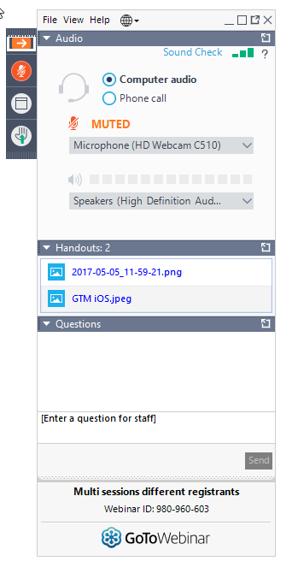
Housekeeping
Use the “Audio” section of your control panel to select an audio source and connect to sound.
Turn on your computer’s speakers, or
Use the call-in instructions in your confirmation email.
All participants are on mute.
Submit questions at any time using the “Questions” box.
Download PDF of Slides here!
Ask questions here!

Slide 4
Meet Our Team
Simone Andrews
Blythe Albert
Senior Communications Specialist| RHC Outreach
Advisor of Program Management | RHC Outreach

Slide 5
Agenda
Introduction – Office Hours
Program Reminders
Program Updates
Submitting the FCC Form 466 in RHC Connect
Best Practices and Resources

Slide 6
Introduction – Office Hours
Subject matter experts are available to answer live questions from program participants.
Today’s presentation will focus on the Telecom Program.
Send FRN or HCP-specific questions to the RHC Customer Service Center at RHC-Assist@usac.org.
Raise your hand or ask your question in the questions box.
Please note, recordings of Office Hours webinars are not posted to the USAC website.
You can download a PDF copy of the slide deck from the handout section on the GoToWebinar dashboard.

Slide 7
Glossary
Acronym | Definition
FCC | Federal Communications Commission
HCF | Healthcare Connect Fund
FY | Funding Year
HCP | Health Care Provider (your site)
HCP Number | Number associated with your site
PAH | Primary Account Holder
FCL | Funding Commitment Letter
NCW | Network Cost Worksheet
BAN | Billing Account Number
SPIN/498 ID | Service Provider Identification Number

Slide 8
Program Reminders
Telecom Program Funding Request Office Hours

Slide 9
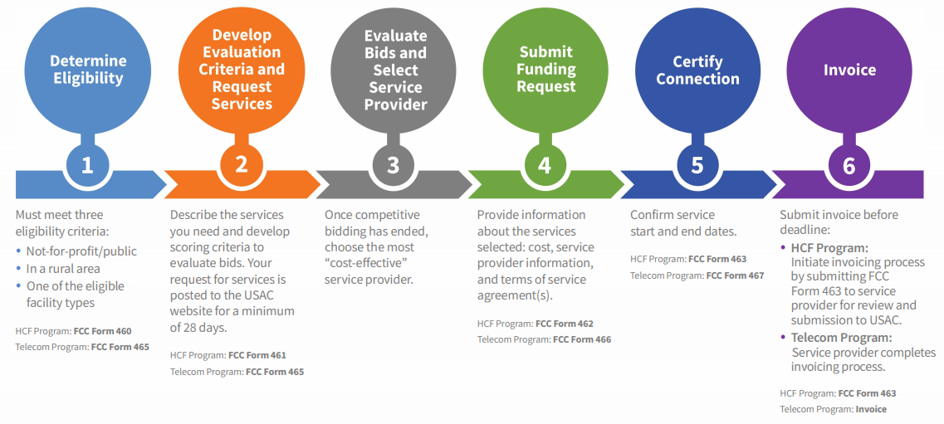
RHC Program Application Process

Slide 10
Submission Checklist
Document(s) confirming the monthly cost for your services (e.g. a copy of your bill dated within the requested funding period) or the most currently available bill as the filing window closes before the funding year opens.
A copy of all bids that were received for your request for service including the winning bid, all bids that were rejected and any bids that were disqualified and why.
A copy of the bidding evaluation matrix.
A list of people who evaluated bids including title, role, and their relationship to the applicant
Internal documents related to the selection of the service provider (if applicable)
Copies of any correspondence with service providers prior to and during the competitive bidding process (if applicable)
A copy of any new contract signed for your services.
The start and end location of your services.
Documentation substantiating the rural and urban rate (Telecom Program only)
* Any information that cannot be located on the submitted supporting documentation will result in an Information Request.

Slide 11
Submission Tips
It is helpful to also submit a cover letter that includes a summary of your submission.
Recommended things to include in your cover letter:
Where to find information about your circuit in the supporting documentation (i.e. Ethernet 20M - $XX.XX – Page 5 of Invoice)
Highlight/label any documentation that is submitted.
Information that isn’t clearly identified via supporting documentation may need to be confirmed by the service provider.
It is the HCPs responsibility to reach out to the service provider to get any missing information. USAC cannot reach out to the service provider on an HCP’s behalf.

Slide 12
Best Practices: Communicating with Your Service Provider
Ensure your service provider is aware of all the necessary documentation needed for future steps in the application process.
Include your service provider when you reply to Information Requests via email.
Program participants are required to retain documentation for a minimum of five years.

Slide 13
Program Updates
Telecom Program Funding Request Office Hours

Slide 14
RHC Connect Updates
Form | Platform | Relevant Funding Years
FCC Forms 460 & 465 | My Portal | Future development
- Letters of Agency (LOA) | My Portal | Future development
- Third Party Authorization (TPA) | My Portal | Future development
FCC Form 461 | RHC Connect | FY2023 and forward
FCC Form 462 | My Portal | FY 2021 and prior – Multi-year commitments
FCC Form 462 | RHC Connect | FY2022 and forward
FCC Form 463 | My Portal | FY 2021 and prior – Multi-year commitments
FCC Form 463 | RHC Connect | FY2022 and forward
Post-commitment Change Requests | RHC Connect | FY2022 and forward
FCC Form 466 | RHC Connect | FY2024 and forward
FCC Form 467 – Telecom Invoice | My Portal | Future development

Slide 15
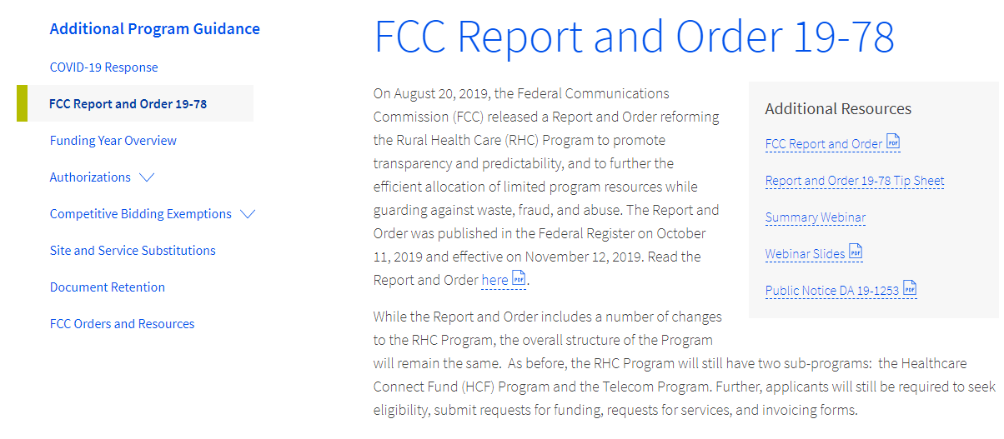
Reminder: FCC Report and Order 19-78
FCC Report and Order 19-78 webpage summarizes the Report and Order’s major changes and includes the following resources:
FCC Report and Order 19-78
Public Notice DA 19-1253
FCC Report and Order 19-78 Tip Sheet
Webinar recording and slides

Slide 16
FCC Report and Order 19-78 (continued)
Consultant Registration – USAC will issue a unique registration number to the consultant or outside expert and that number will be linked to the HCP’s organization.
Telecom Competitive Bidding Exemptions – Telecom Program applicants can use every competitive bidding exemption applicable to the HCF Program, except the $10k or less exemption.
Service Substitutions – Telecom Program applicants will be allowed to submit service substitution requests.
HCPs in both the HCF and Telecom program are required to submit site and service substitutions by the service delivery deadline.

Slide 17
Reminder: FCC Report and Order 19-78 (continued)
SPIN CHANGES
A corrective SPIN change is made when the SPIN associated with a Funding Request Number (FRN) is not correct. This occurs when:
The applicant or USAC made a data entry error,
SPIN has changed due to the merger of companies or the acquisition of one company by another; or
The applicant has not initiated the change (e.g., where the service provider declares bankruptcy).
An operational SPIN change is a request to change the actual service provider associated with an FRN.
The change in service providers is the result of a deliberate decision by the applicant.
The applicant has a legitimate reason to change providers (e.g., breach of contract or the service provider is unable to perform).
Site and Service Substitutions – HCPs in both the HCF and Telecom program are required to submit site and service substitutions by the service delivery deadline.
This date can be found on the Funding Commitment Letter (FCL) for the FRN (FCC Form 466 Application)

Slide 18
FCC Order DA 23-6
On January 26, 2023, the FCC released Order DA 23-6, waiving the requirement that HCPs and service providers participating in the Telecom Program use the Rates Database to calculate urban and rural rates for FY2024 and FY2025.
For FY2024 and FY2025, rules requiring rural rates to be calculated using Methods 1 through 3 and the pre-Rates Database calculation method for urban rates will be reinstated with the following minor changes:
For FY2024 and FY2025, applicants and service providers using Methods 1 and 2 to calculate rural rates are not permitted to use previously approved rates.
For FY2024 and 2025, service providers will be permitted to use previously approved rates for rural rates that would otherwise be calculated under Method 3.
If there are no comparable rural and urban rates within 30 percent of the speed of the requested service, service providers may use the rate for a higher bandwidth service that is otherwise similar to the requested service to justify a rural or urban rate.
Please use the Urban and Rural Rate Information FY2024-2025 tip sheet as a resource.
Notes:
NOTE for Method 3: For all previously approved rural rates, applicants must provide USAC with the previous FRN associated with that approved rate and submit all documentation associated with that rate.

Slide 19
FCC 23-110 Third Report and Order
On December 14, 2023, the FCC released Order FCC 23-110. This order improves RHC Program administration and facilitates participation in the program by allowing health care providers that expect to become eligible during a funding year to complete the processes required to request funding, aligns program deadlines, simplifies rules for calculating urban rates, streamlines administrative processes, and frees up unused funding for other purposes. Changes to RHC Program rules are as follows:
Permits health care providers to be granted conditional eligibility, thus allowing them to initiate competitive bidding and request funding while awaiting a final eligibility determination (Prior to July 1, 2024, for purposes of competitive bidding FY2025).
Provides health care providers more time to complete Service Provider Identification Number (SPIN) changes by moving the SPIN change deadline to align with the invoice filing deadline (Beginning in FY2023).
Simplifies urban rate calculations by eliminating the seldom-used “standard urban distance” component of the rule for determining urban rates in the Telecommunications (Telecom) Program (Beginning in FY2025).
Allows health care providers to request changes to the dates covered by an evergreen contract post-commitment (Beginning in FY2024).
Adopts the FCC Form 460 for eligibility determinations in the Telecom Program, which will eliminate the need for Telecom Program participants to seek an eligibility determine every time they engage in competitive bidding.
Establishes a deadline of July 1, 2024, for health care providers to claim undisbursed funding commitments that do not currently have an applicable invoice filing deadline from FY2019 and prior years.

Slide 20
Reminder: Information Requests
If USAC requires information that cannot be located on the submitted supporting documentation, this will result in an Information Request.
All account holders will receive all Information Requests.
Applicants are given 14 calendar days to provide a response to the Information Request.
11:59 p.m. ET on the 14th day would be the last time to respond to the Information Request.
Information Requests not responded to within 14 calendar days will result in a denial of that form.
An extension request must be received prior to the original 14-day Information Request deadline.

Slide 21
FY2024 Funding Request Reviews
RHC may begin funding request reviews before the funding request window closes.
No final decisions will be made prior to the close of the filing window.
Some changes to submissions must occur prior to the close of the filing window.
This means that you may receive an Information Request before April 1, 2024.
For FY2024 FCC Forms 466, an auto-generated email will be sent with instructions to respond through RHC Connect.
HCPs should respond through RHC Connect only.
The auto-generated email comes from an unattended mailbox so please only respond through RHC Connect.

Slide 22
Reminder: Invoice Filing Deadlines
New invoicing guidelines adopted in FCC Report and Order 19-78 became effective beginning with FY2020 applicants.
The invoice filing deadline will be four months (120 days) from the service delivery deadline in both the HCF and Telecom Programs, October 28 of a given funding year.
Please use the new RHC Invoicing Deadline Tool in the Open Data section of the USAC website to look up your invoicing deadline.
For more information, please see the HCF invoice page and Telecom invoice page.

Slide 23
Supply Chain Order
As a reminder, when service providers login to My Portal they will see two new supply chain certifications included in the FCC Form 463 and Telecom program invoice.
The first certification affirms compliance with the Section 54.9 prohibition on USF for specified transactions with companies deemed to pose a national security threat. The second certification affirms compliance with Section 54.10, which prohibits the use of any Federal subsidies on any communications equipment and services on the Covered List.
FY2023 Applicants: If you requested services or equipment provided or that contain components of products produced by any of the listed covered companies or any of their parents, affiliates and subsidiaries in FY2023, you cannot invoice for these funds. Instead, you should immediately request a service substitution.
FY2024 Applicants: As you proceed with competitive bidding, please ensure you are not requesting funding for services or equipment from listed covered companies or any of their parents, affiliates and subsidiaries.

Slide 24
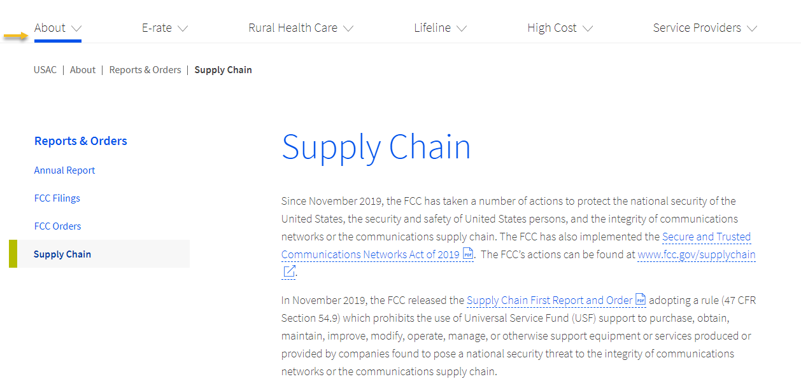
Supply Chain Web Page
Supply Chain webpage

Slide 26
RHC Connect – Submitting the FCC Form 466
Telecom Program Funding Request Office Hours

Slide 27
RHC Connect Updates as of November 2023
Form | Platform | Relevant Funding Years
FCC Forms 460 & 465 | My Portal | Future development
- Letters of Agency (LOA) | My Portal | Future development
- Third Party Authorization (TPA) | My Portal | Future development
FCC Form 461 | RHC Connect | FY2023 and forward
FCC Form 462 | My Portal | FY 2021 and prior – Multi-year commitments
FCC Form 462 | RHC Connect | FY2022 and forward
FCC Form 463 | My Portal | FY 2021 and prior – Multi-year commitments
FCC Form 463 | RHC Connect | FY2022 and forward
Post-commitment Change Requests | RHC Connect | FY2022 and forward
FCC Form 466 | RHC Connect | FY2024 and forward
FCC Form 467 – Telecom Invoice | My Portal | Future development

Slide 28
RHC Connect Updates (continued)
All information from the FCC Forms 465 will be migrated to RHC Connect.
Over time, all FCC forms for the HCF and Telecom programs will move to RHC Connect.
Use the following resources to submit the FCC Form 466 in RHC Connect:
Welcome to RHC Connect – FCC Form 466 webpage
RHC Connect User Guide – FCC Form 466
Information Request tip sheet

Slide 29
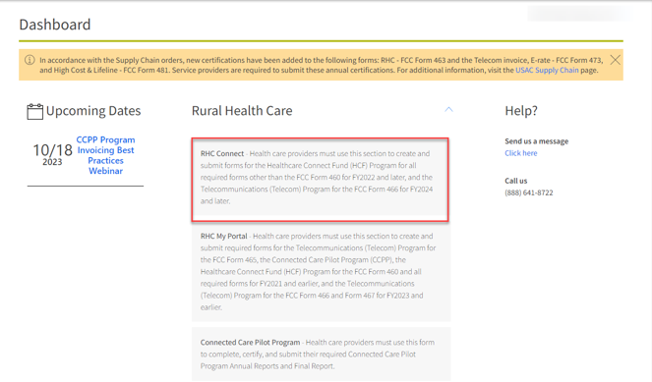
My Portal Landing Page
Log into My Portal and click Rural Health Care then RHC Connect
For all other forms that have not yet moved to RHC Connect, you will use RHC My Portal

Slide 30
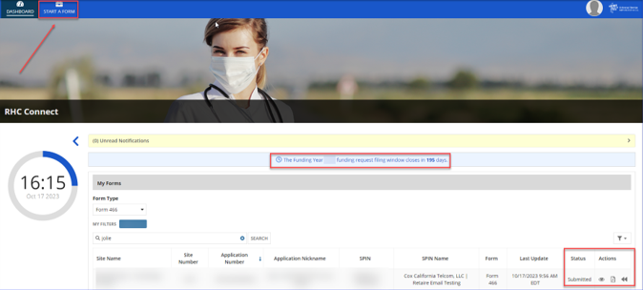
Dashboard
Here you can start a new form, view the status of submitted and processed applications, resume working on a draft or delete a draft FCC Form 466.
If the form is recalled, the bottom screen will appear, and an email will be sent to all account holders.
There’s a countdown banner displaying the days remaining in the filing window.

Slide 31
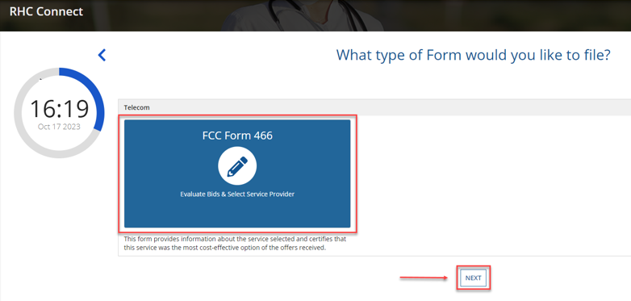
Start Form
Click FCC Form 466 then click Next.

Slide 32
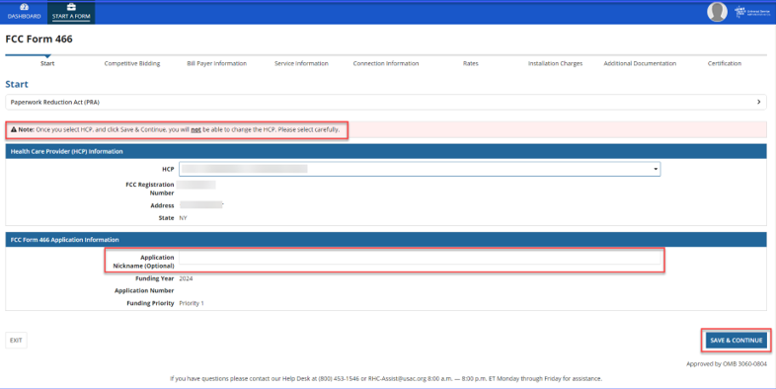
Start Page
Select HCP from the drop-down menu.
Enter an Application Nickname.

Slide 33
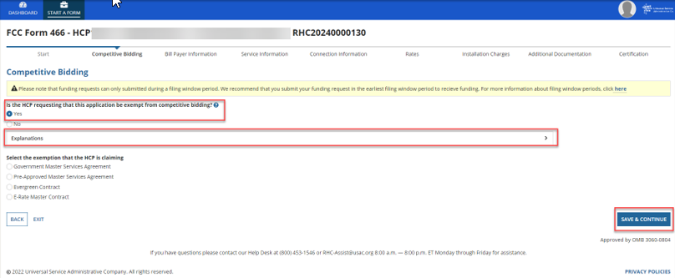
Competitive Bidding Page
Select Yes if you are exempt from competitive bidding and No if you completed your competitive bidding process.

Slide 34
Competitive Bidding Page(continued)
Click the arrow beside Explanations to view a description of each competitive bidding exemption.

Slide 35
Competitive Bidding Exemptions
Purchasing services from a government master service agreement (MSA) negotiated by a federal, state, Tribal, or local governmental entity which was awarded pursuant to applicable competitive bidding requirements;
Requesting support using contracts previously approved by USAC (MSA under the RHC Pilot Program or the HCF Program);
Using an active multi-year contract designated as “evergreen” for the RHC program (exemption applies for the life of the contract); or is
Using a contract approved under the E-rate program.

Slide 36
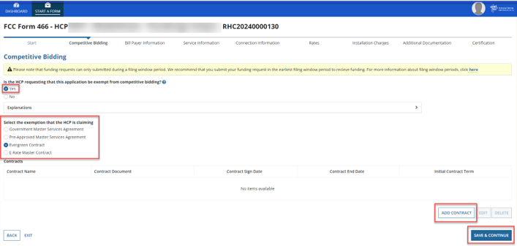
Competitive Bidding Page – Exemptions (continued)
Select the exemption from the list of eligible exemptions.
Click Add Contract at the bottom right on the screen

Slide 37
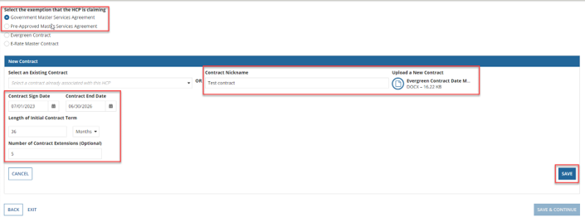
Competitive Bidding Page – Exemptions (continued)
If using an evergreen contract, an existing contract must be selected from the drop-down menu.
For all other exemptions, upload a new contract or choose an existing contract.
Enter the relevant information about the contract in the fields and click Save.

Slide 38
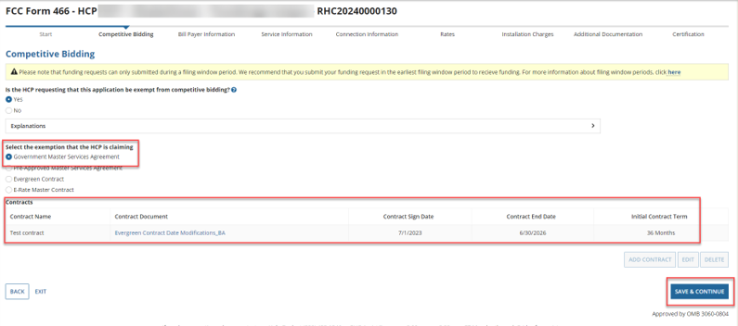
Competitive Bidding Page – Exemptions (continued)
Once the contract is selected, click Save and Continue.

Slide 39
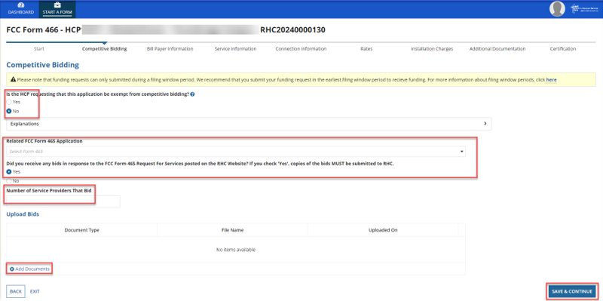
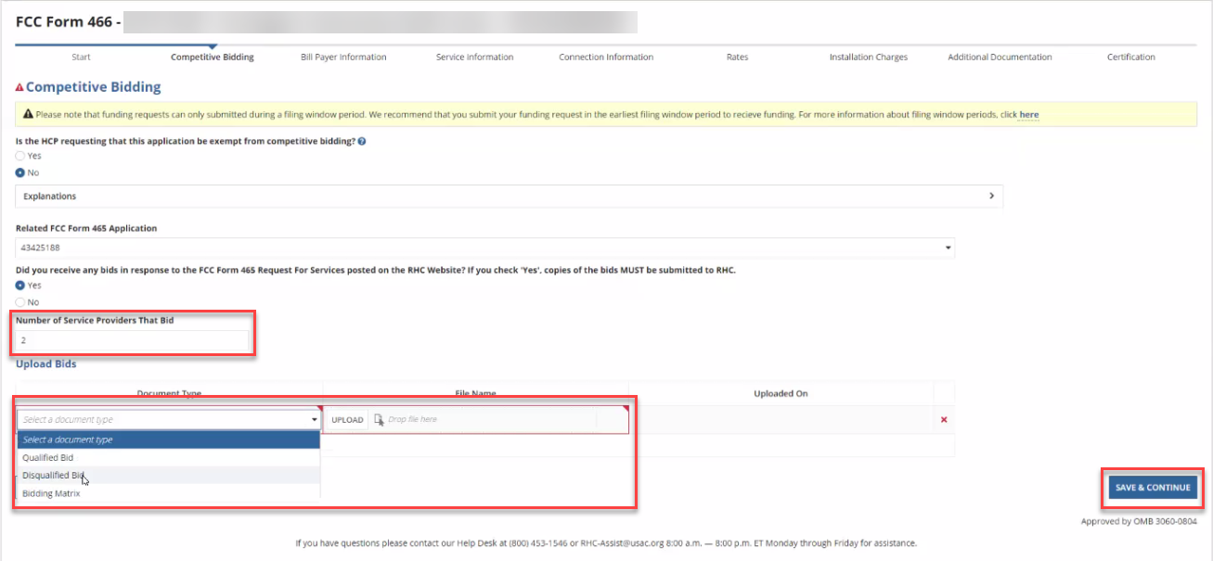
Competitive Bidding Page - Non-Exempt
Click No.
Choose related FCC Form 465 from drop-down menu.
Enter number of bids received.
Upload copies of bids by clicking Add Documents hyperlink.
Select the document type from the drop-down menu, then click Save & Continue.

Slide 40
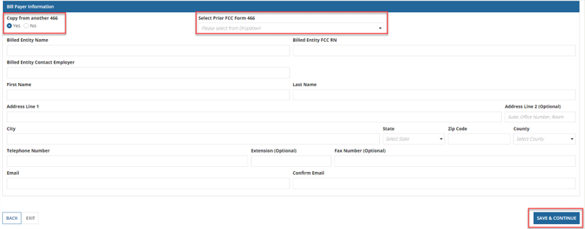
Bill Payer Information Page
Click Yes to copy Bill Payer Information from another FCC Form 466.
Click No to enter required information, then click Save and Continue.

Slide 41
Service Information Page
Select the Service Category and the Service Type from the drop-down menus.
For voice services, enter Number of Lines, then click Save and Continue.

Slide 42
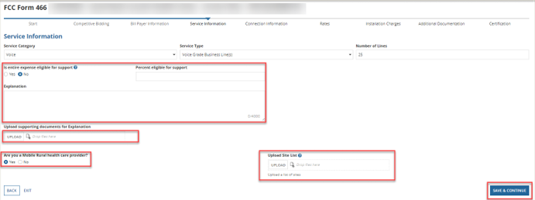
Service Information Page (continued)
Answer Yes or No for the question Is entire expense eligible for support?
If No, enter Percent eligible for support, enter an explanation about the eligible percentage calculation, and upload supporting documentation.
Answer Yes or No for question Are you a Mobile Rural health care provider?
If Yes, upload the required lists of sites the mobile clinic visits, then click Save and Continue.

Slide 43
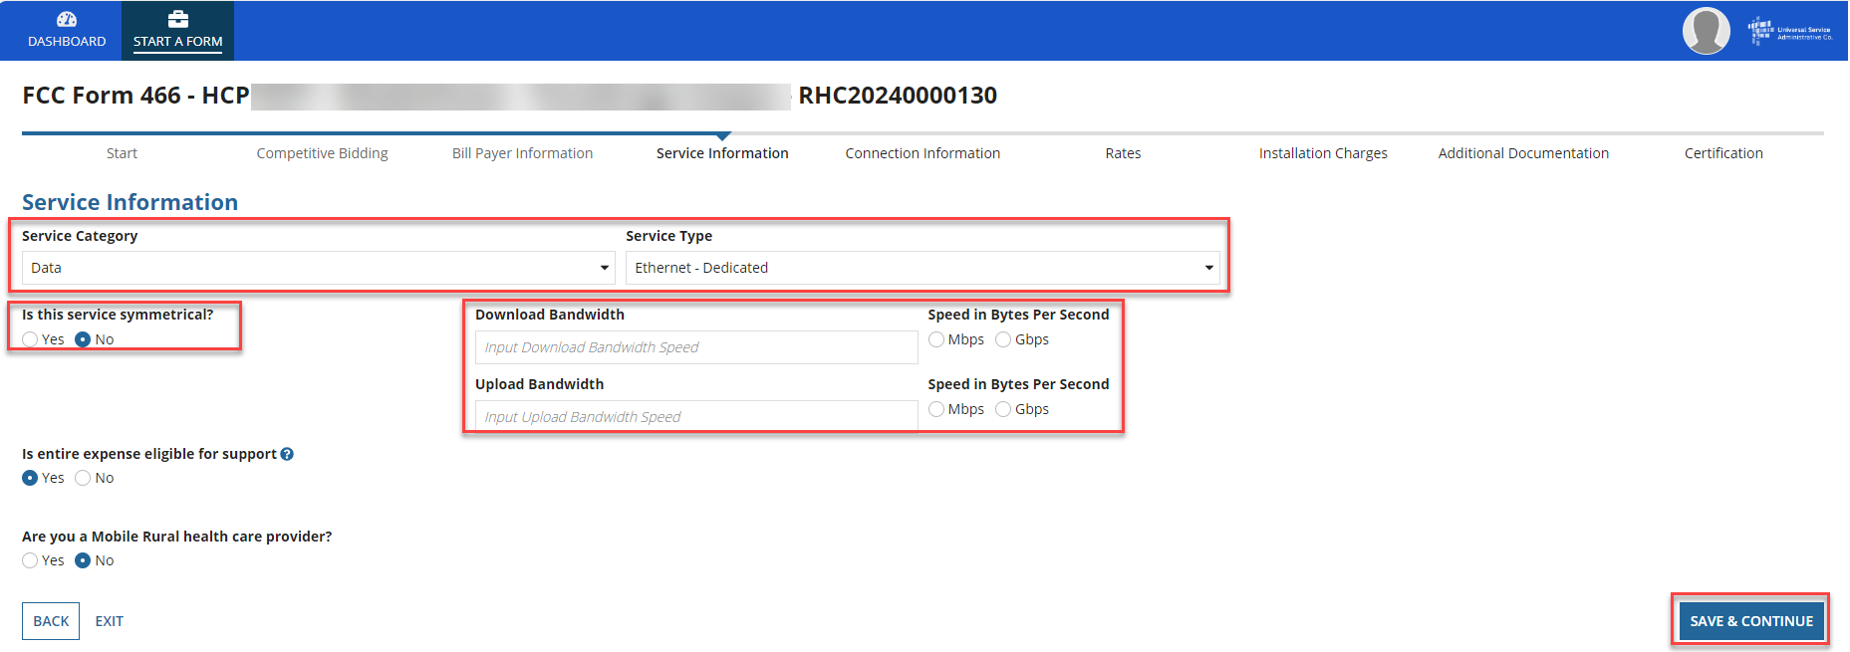
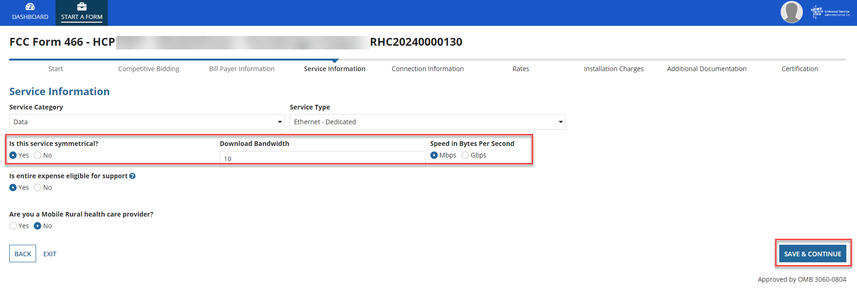
Service Information Page (continued)
For data services, answer the question Is this service symmetrical? and enter bandwidth.
If No is selected, enter Download Bandwidth and Upload Bandwidth.
If Yes is selected, only one bandwidth is required, then click Save & Continue.

Slide 44
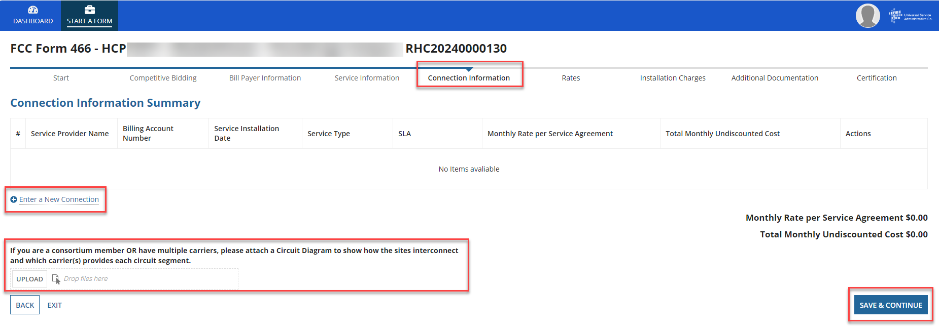
Connection Information Page
On the Connection Information page, click the hyperlink titled Enter a New Connection.
If the service is a multi-carrier connection, each connection should be added using that hyperlink.
If the HCP is a consortium member or the circuit uses more than one carrier, please attach a circuit diagram as indicated on this page, the click Save & Continue.

Slide 45
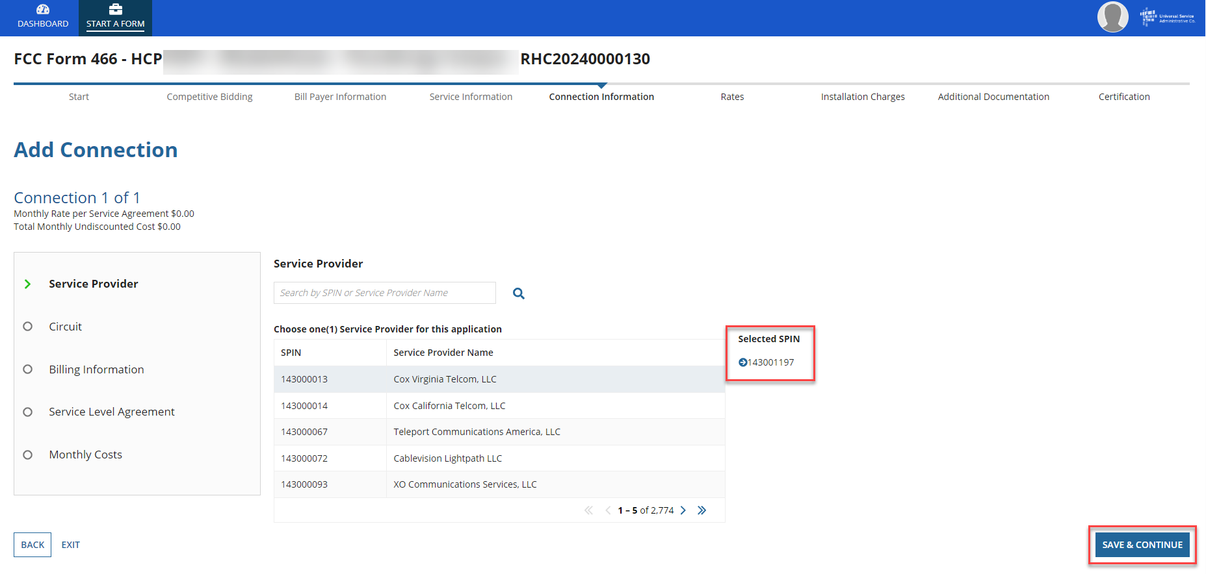
Add Connection Page – Service Provider
Select your service provider’s 498 ID/SPIN.
You can search by service provider name or the 498 ID/SPIN.
Click Save & Continue.

Slide 46
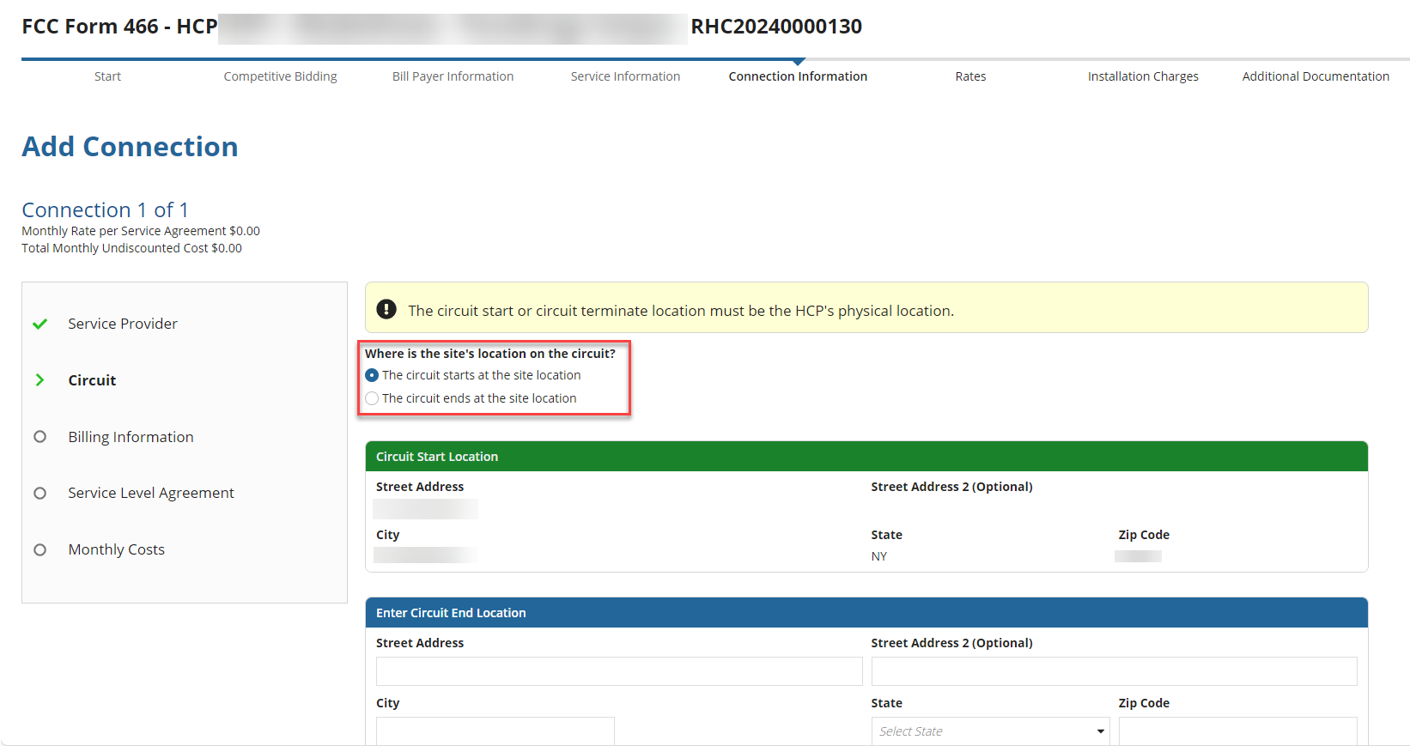
Add Connection Page - Circuit
Select the radio button that describes where the site is located on the requested circuit.
This should align with submitted service provider confirmed documentation.
Information will pre-populate based on information in the FCC Form 465.

Slide 47
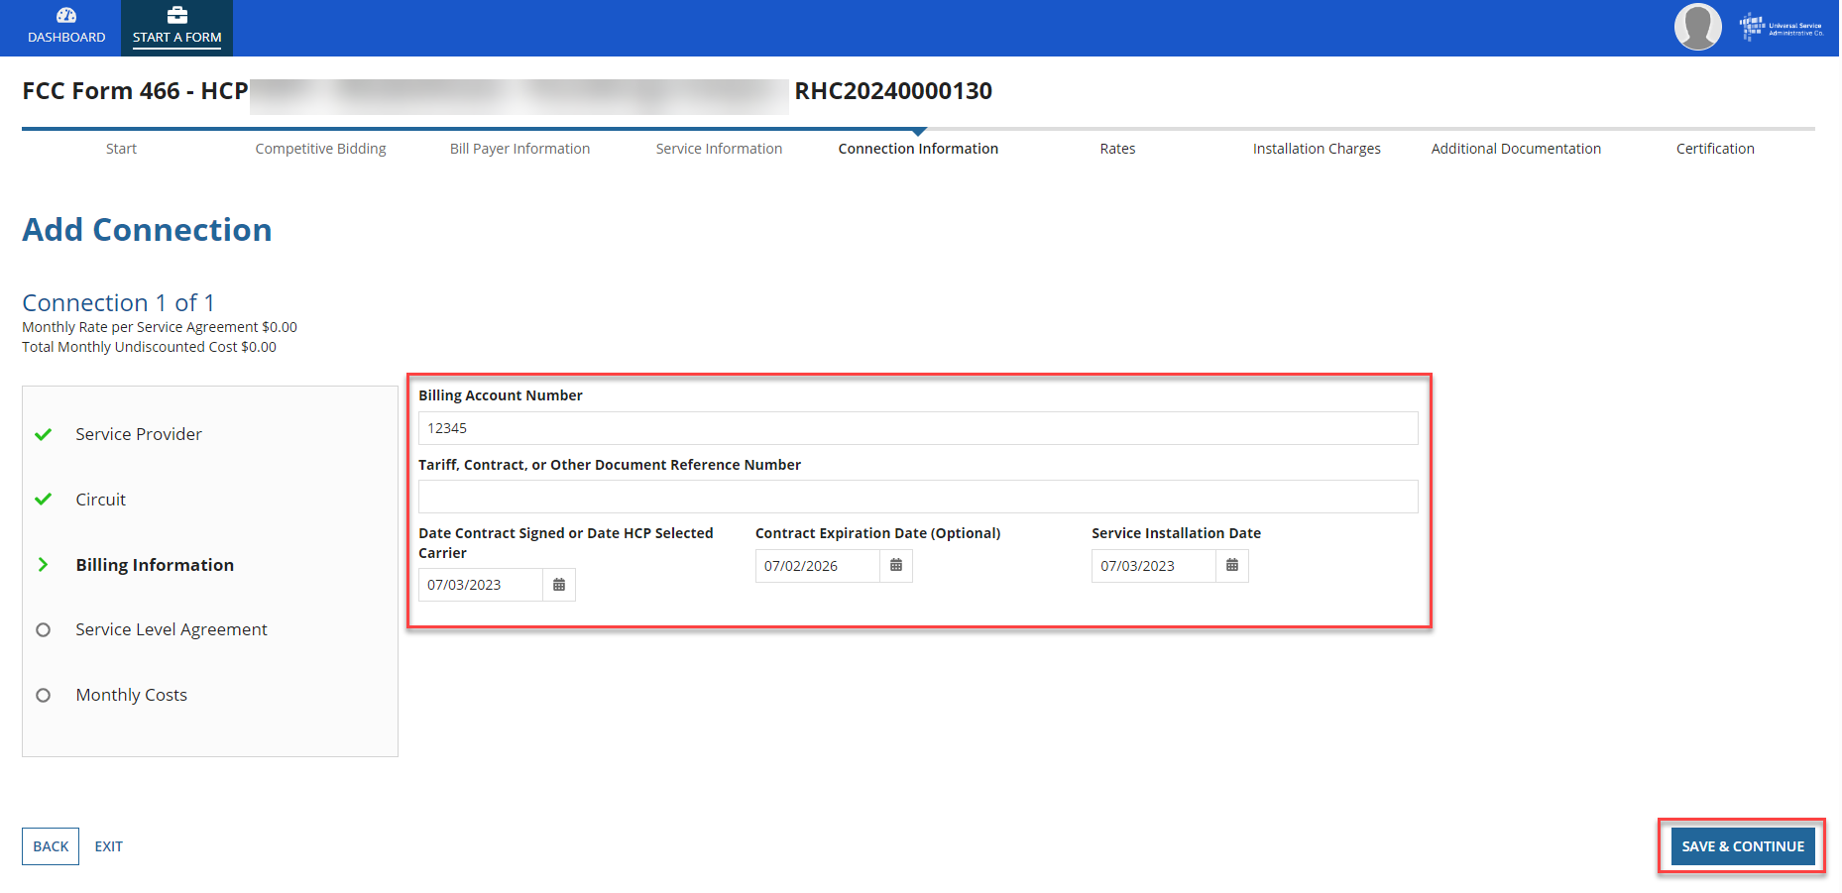
Add Connection Page – Billing Information
Enter Billing Information in fields shown.
Click Save & Continue.

Slide 48
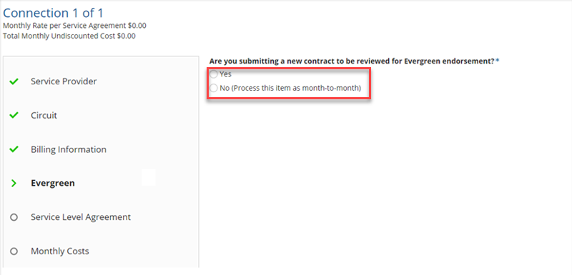
Add Connection Page – Evergreen
Select Yes to the question Are you submitting a new contract to be reviewed for Evergreen endorsement?
Select No if submitting as a month-to-month application.

Slide 49
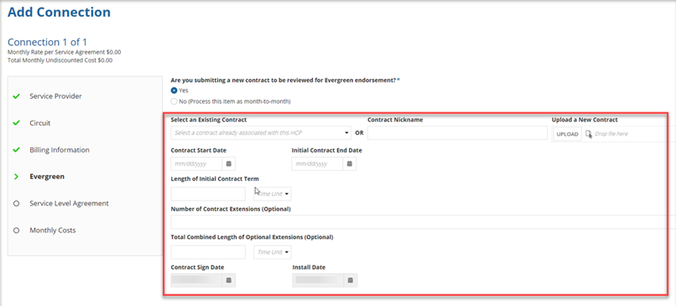
Add Connection Page – Evergreen (continued)
If Yes, enter information about the contract in the fields as shown.
Click Save & Continue.

Slide 50
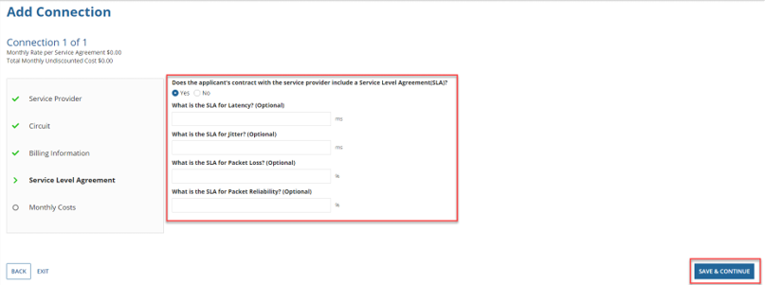
Add Connection Page – Service Level Agreement
Select Yes or No to answer the question about a service level agreement.
If Yes, enter the information shown. Click Save & Continue.

Slide 51
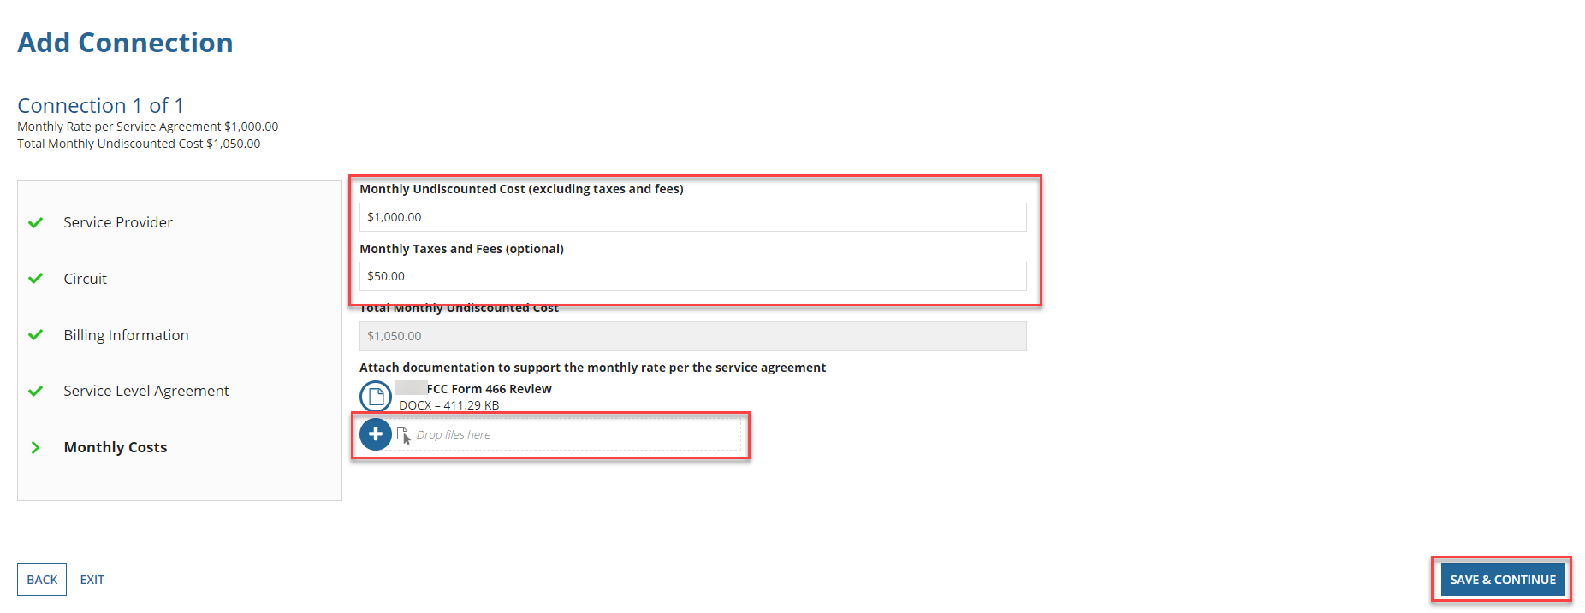
Add Connection Page – Monthly Costs
Enter the Monthly Undiscounted Cost and Monthly Taxes and Fees listed on the bill or invoice.
Upload the documentation that supports these costs.
Click Save & Continue.

Slide 52
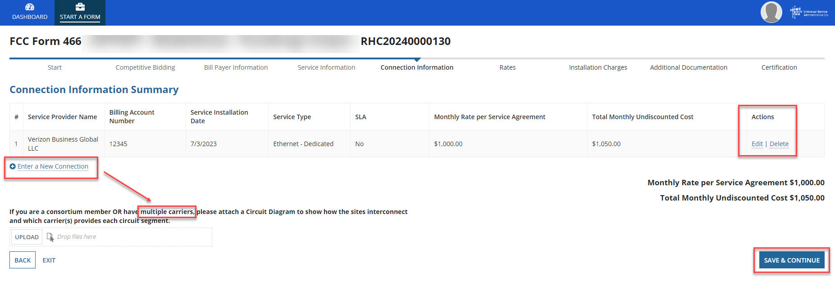
Connection Information Summary Page
Enter each section of the service as a new connection by clicking Enter a New Connection.
Upload a Circuit Diagram to support the data entered.
Connections may be edited or deleted by clicking the hyperlinks under the Actions column.
Click Save & Continue.

Slide 53
FCC Order DA 23-6
On January 26, 2023, the FCC released Order DA 23-6, waiving the requirement that HCPs and service providers participating in the Telecom Program use the Rates Database to calculate urban and rural rates for FY2024 and FY2025.
For FY2024 and FY2025, rules requiring rural rates to be calculated using Methods 1 through 3 and the pre-Rates Database calculation method for urban rates will be reinstated with the following minor changes:
For FY2024 and FY2025, applicants and service providers using Methods 1 and 2 to calculate rural rates are not permitted to use previously approved rates.
For FY2024 and 2025, service providers will be permitted to use previously approved rates for rural rates that would otherwise be calculated under Method 3.
If there are no comparable rural and urban rates within 30 percent of the speed of the requested service, service providers may use the rate for a higher bandwidth service that is otherwise similar to the requested service to justify a rural or urban rate.
Please use the Urban and Rural Rate Information FY2024-2025 tip sheet as a resource.
Notes:
NOTE for Method 3: For all previously approved rural rates, applicants must provide USAC with the previous FRN associated with that approved rate and submit all documentation associated with that rate.

Slide 54
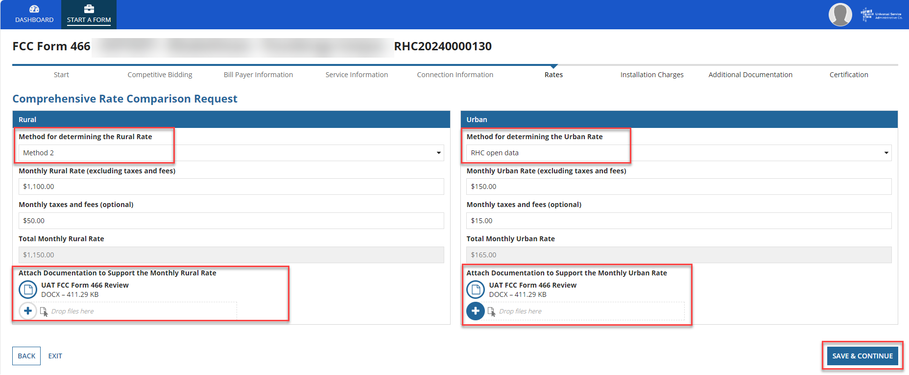
Rates Page
Choose the Method for determining the Rural Rate and the Method for determining the Urban Rate.
Enter the monthly calculated rural and urban rates that comply with the method per Telecom Program rules.
Use the Urban and Rural Rate Information FY2024-2025 tip sheet for information about Telecom Program rules
Upload documentation to support the rural and urban rates below the data fields on this page.
Click Save & Continue.

Slide 55
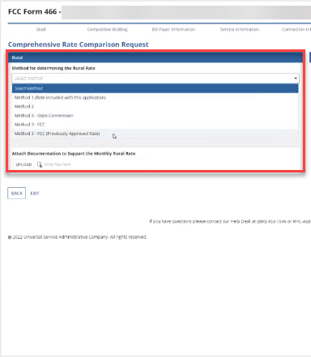
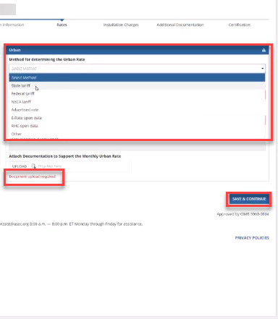
Rates Page (continued)
Select methods for determining the rural and urban rates from the drop-down menus.
Upload the documentation, then click Save & Continue.

Slide 56
Installation Charges Page
Enter One-time Rural Rate Charge and One-time Urban Rate Charge, if applicable.
This is optional and can be skipped if no installation costs were incurred.
Upload supporting documentation.
Click Save & Continue.

Slide 57
Additional Documentation Page
Upload any additional supporting documentation.
Add a description of the document in the required field.
Click Save & Continue.

Slide 58
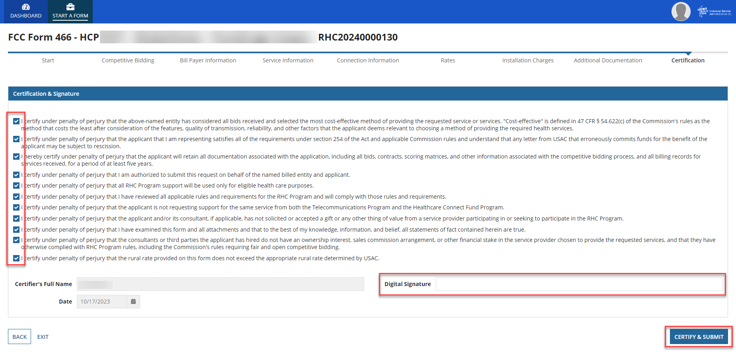
Certifications Page
Each certification must be checked to continue.
Enter your first and last name as it appears in RHC Connect in the Digital Signature field.
Click Certify & Submit.

Slide 59
After Submitting
Once submitted, this screen will appear with a link to the My Forms tab and a link to view the submitted form.
The submitted form with all other FCC Forms 466 will appear on the My Forms tab.

Slide 60
After Submitting
You will receive an email letting you know that your form has been received.
If you do not receive an email, please go back into My Portal and be sure that you actually signed and submitted the form.
The reviewer will reach out if additional information is needed.
No funding decisions will be issued until after the close of the filing window period.
Once your funding request has been approved, you will receive a Funding Commitment Letter (FCL) that will include all corresponding information to your funding request.

Slide 61
Information Requests
Forms with missing or incomplete information cannot be processed.
If an Information Request is sent, it will come from rhcadmin@usac.org.
Respond to the Information Request in RHC Connect.
Email notifications sent from RHC Connect are from an unattended mailbox.
Use the Information Request tip sheet on the USAC website as a resource.

Slide 62
Best Practices: Communicating with Your Service Provider
Ensure your service provider is aware of all the necessary documentation needed for future steps in the application process.
Include your service provider when you reply to Information Requests via email.
HCPs and service providers are required to retain documentation for a period of at least five years.

Slide 64
Best Practices and Resources
Telecom Program Funding Request Office Hours

Slide 65
Upcoming Trainings
Please join the RHC Outreach team for the following webinars:
Consortia Best Practices Webinar:
Wednesday, February 21, 2024, from 2-3 p.m. ET - Register
HCF Office Hours Webinar:
Wednesday, March 13, 2024, from 2-3 p.m. ET - Register
Telecom Office Hours Webinar:
When: Wednesday, March 20, 2024, from 2-3 p.m. ET - Register
For a list of upcoming webinars, check the RHC Upcoming Dates webpage for dates and details.

Slide 66
Online Resources
RHC Learn
Step 4: Submit Funding Requests
Funding Request Summary
Rural and Urban Rate Information for FY2021 and FY2022
Competitive Bidding Exemptions
Blank FCC Form 466
Examples of Eligible Products and Services Telecom Program

Slide 67
RHC Program Customer Service Center
Email: RHC-Assist@usac.org
Include in your email
HCP Number
FRN Number
Phone: (800) 453-1546
Hours are 8 a.m. – 8 p.m. ET
Monday- Friday

Slide 68
RHC Customer Service Center
The RHC Customer Service Center CAN | The RHC Customer Service Center CANNOT
Answer general questions regarding both programs | Determine eligibility of a specific site or service before an official form submission
Provide account holder information for an HCP | Review a form or document for accuracy before an official submission
Provide clarity regarding FCC Report and Order 19-78 and other FCC orders | Contact a service provider or other account holder on someone else’s behalf
Provide helpful resources and best practices for forms | Provide documents that are not already accessible in My Portal and RHC Connect
Assist with My Portal and RHC Connect | Transfer a call to a specific form reviewer

Slide 69
Questions?
69

