Slide 1
Introduction to the E-rate Productivity Center (EPC)
2019 Applicant Training

Slide 2
AGENDA
What is the E-rate Productivity Center (EPC)?
Logging into EPC
New Users: Terms and Conditions
My Landing Page
Navigation Bar
Your EPC Entity Profile

Slide 3
What is the E-rate Productivity Center (EPC)?

Slide 4
Poll the Audience
Who in the audience has logged into EPC?
Who in the audience is an Account Administrator?
Who has no idea?

Slide 5
E-rate Productivity Center (EPC)
What is EPC?
Account and application management portal
Manage program processes, receive notifications, and contact customer service.
What can you do in EPC?
File most program forms
Maintain a list of your related entities
Update entity information
Account Administrators can add users on their organization’s account and assign them rights (permissions) to file program forms.

Slide 6
Logging into EPC

Slide 7
Step 1:
Go to EPC:
https://portal.usac.org/suite/

Slide 8
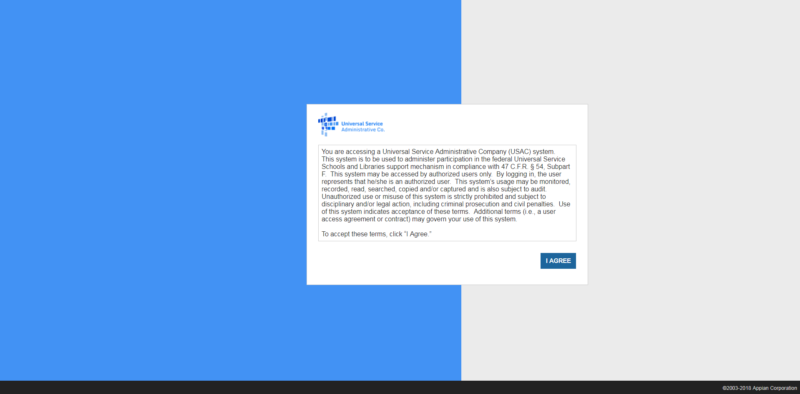
Step 1:

Slide 9
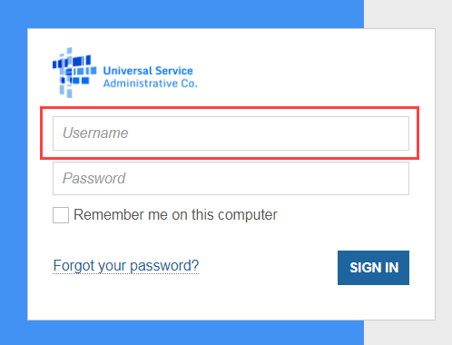
Step 2: Logging In
Tips for Entering your Username
Type in your username instead of copying and pasting.
Enter it in all lowercase.
Make sure there are no spaces or erroneous characters in the username.
Check for typos.

Slide 10
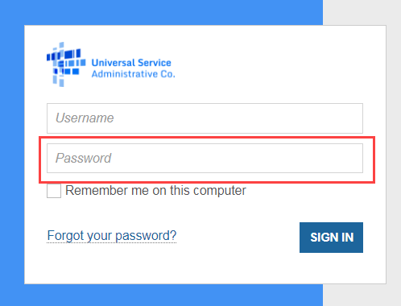
Step 2: Logging In
Tips for Creating your Password
Be at least eight characters
Has not been used in the previous four passwords
Contains at least one numeral (0 through 9)
Contains at least one special character (such as !, $, #, %)
Contains at least one uppercase letter (A through Z)
Contains at least one lowercase letter (a through z)

Slide 11
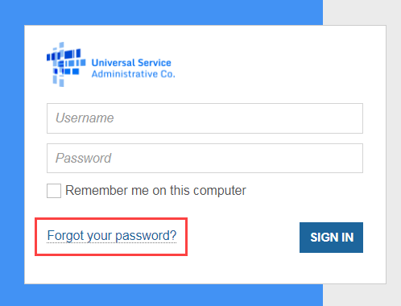
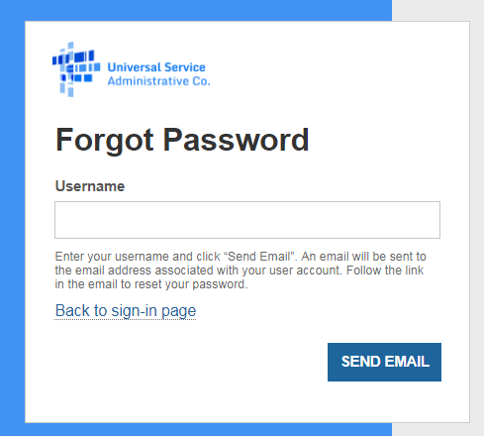
Step 2: Logging In
Forgot your Password?
Enter the email address associated with the account (the EPC username).
Click SEND EMAIL.
You will receive email from portal@usac.org, subject "Universal Service Administrative Company (USAC) Password Reset".

Slide 12
New Users: Terms and Conditions

Slide 13
NEW EPC USERS: Terms and Conditions
In order to access EPC functions, every user must accept Terms & Conditions.
New user accounts are considered inactive and will not have access to anything within EPC until the Terms & Conditions are accepted.
When a new user is created from an organization, the new user will not appear under the organization’s profile until they have accepted the Terms and Conditions.

Slide 14
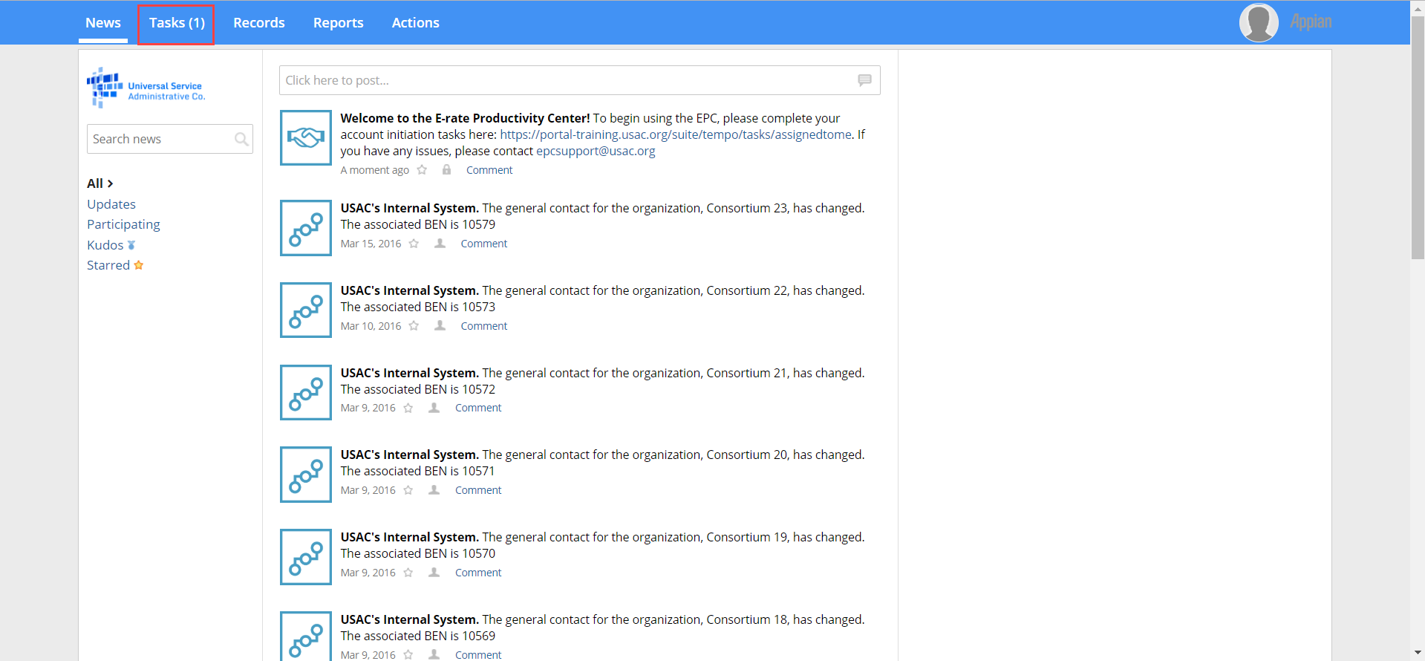
NEW EPC USERS: Terms and Conditions
Once you are created as a new user in EPC:
Log in to EPC
Once you are logged in, you will be routed to your News screen.
Click Tasks (1) on the top left corner

Slide 15
NEW EPC USERS: Terms and Conditions

Slide 16
NEW EPC USERS: Terms and Conditions
Read the Terms of Service
Click the Accept button at the bottom of the screen.
You will now be able to access your EPC user account and your organization's account!

Slide 17
My Landing Page

Slide 18
Ask the Audience -
What functions can be performed from your landing page?

Slide 19
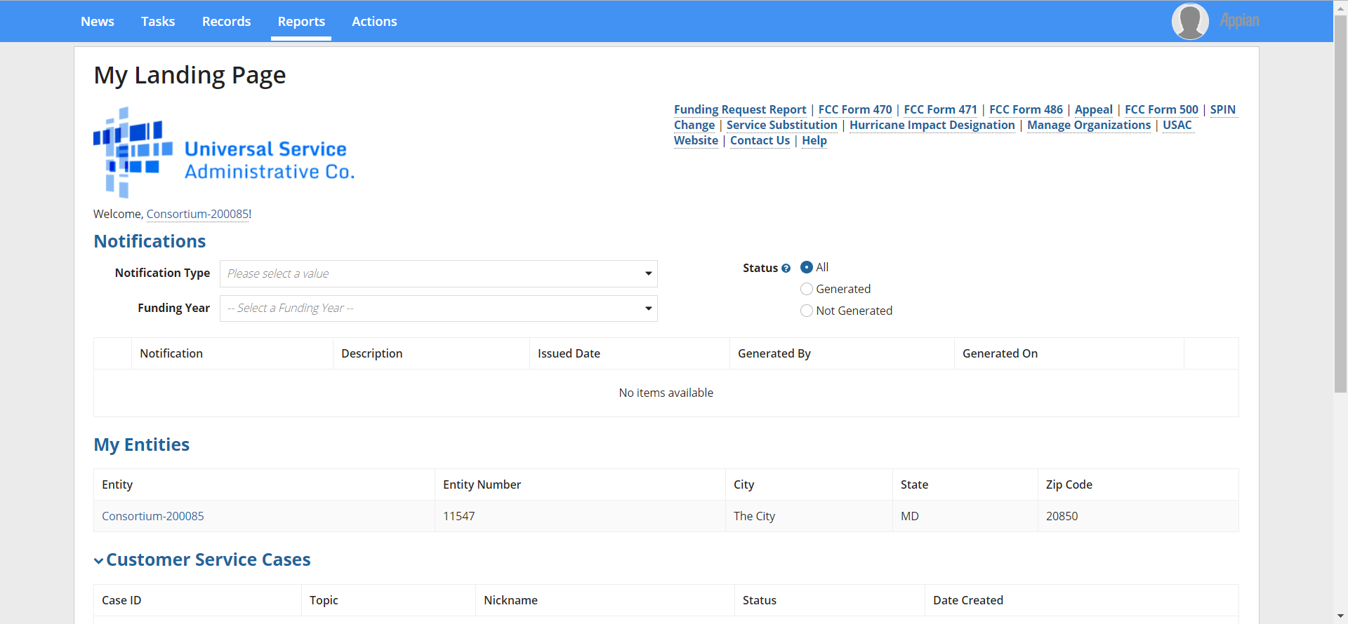
DEMO My Landing Page

Slide 20
DEMO My Landing Page: Notifications
Notifications
Applicants can view their decision letters (FCDL, FCC Form 486 Notification Letters, FCC Form 486 Certification, etc.) by funding year.

Slide 21
DEMO My Landing Page: My Entities
My Entities
For applicants: My Entities will display all entities you have rights to access.
For consultants: My Clients will display all client entities associated with the consulting firm.

Slide 22
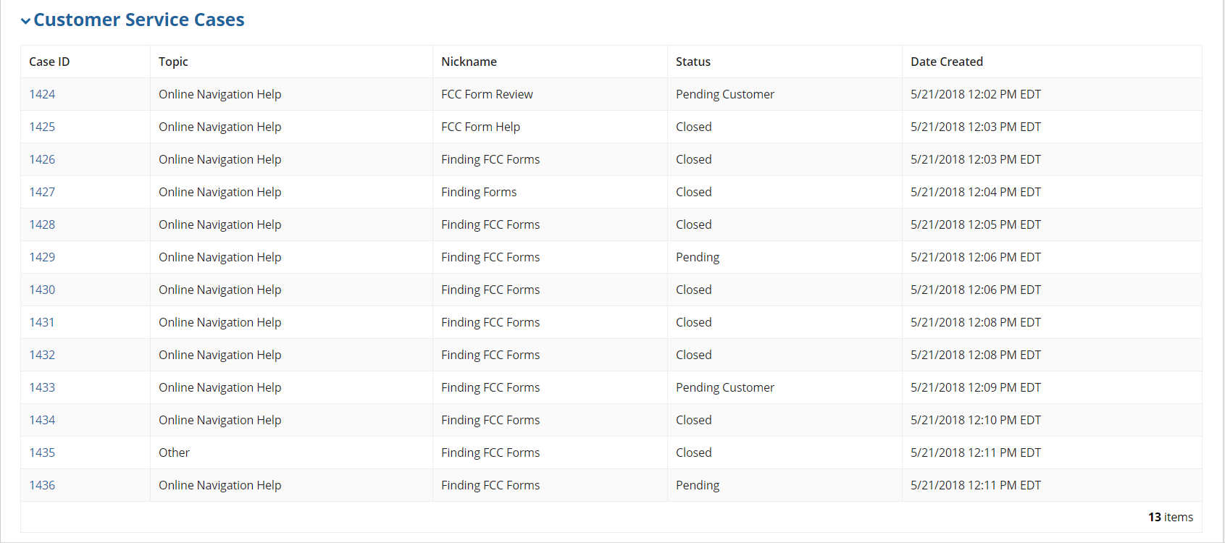
DEMO My Landing Page: Customer Service Cases
Customer Service Cases
You will see all the customer service cases you have opened.

Slide 23
DEMO My Landing Page: FCC Forms and Post-Commitment Requests
FCC Forms and Post Commitment Requests
Users can view all of their FCC Forms by funding year.
FCC Form 470, FCC Form 471, FCC Form 486, FCC Form 500

Slide 24
EPC Navigation Bar

Slide 25
EPC Navigation Bar
Made up of five tabs:
News
Tasks
Records
Reports
Actions

Slide 26
EPC Navigation Bar – News
Populate notifications on actions taken in EPC
Entity Changes
Successful application submissions
All USAC Notifications (e.g., Funding Commitment Decision Letter)

Slide 27
EPC Navigation Bar – Tasks
Tasks populate notifications that require action by the user.
Leaving an incomplete form (whether voluntary or accidental) will populate a task.
Completing data entry on a form will populate a task to certify the form.
PIA inquiries will populate a task.

Slide 28
EPC Navigation Bar – Records
Contains all the records within EPC
All Entities
Applications
Customer service cases

Slide 29
EPC Navigation Bar – Reports
This tab allows users to view various Reports depending on their rights in EPC.
My Submitted Modification Requests (RAL)
My Landing Page

Slide 30
EPC Navigation Bar – Actions
This tab allows users to take various Actions depending on their rights in EPC.
Create a Customer Service Case (Contact Us)
Create a Whistleblower Case
Search and Export Certified FCC Forms 470 and 471

Slide 31
Your EPC Entity Profile

Slide 32
Ask the Audience -
How can you navigate to your EPC profile?

Slide 33
EPC Entity Profile – How do I get there from My Landing Page

Slide 34
EPC Entity Profile – How do I get there from the Records tab?

Slide 35
EPC Entity Profile – Account Administrator

Slide 36
EPC Entity Profile – Full Rights User View

Slide 37
Ask the Audience -
What is the difference between the Account Administrator’s rights and a regular user?

Slide 38
EPC Entity Profile: Parent-Child Relationship (School District or Library System)
To see if other entities are linked to your organization, use the Additional Information Tab.
For Example: A School district would like to know if the correct schools are linked to them in EPC.
Click Additional Information.
Under category selected Related Organizations.
Under Relationship Type select Related Entities.

Slide 39
EPC Entity Profile: Contracts
From your Entity Profile Page.
Click Contracts
All contracts that were completed in EPC will populate.
To enter a contract into EPC select Manage Contracts.

Slide 40
EPC Entity Profile: Contracts
To find information on FCC Forms 470, 471, 486 or 500 by funding year, use the FCC Forms tab on your Entity Profile

Slide 41
EPC Entity Profile: FRN Appeals
To find information on all appeals submitted by the entity use the FRN Appeals tab.

Slide 42
EPC Entity Profile: News
To view recently issued decision letters (Funding Commitment Decision Letters, FCC Forms 486 Notification Letters, etc.) for this entity use the News tab.

Slide 43
Pop Quiz
What are the 3 areas you can locate your Funding Commitment Decision Letter?
Where can you find your Program Integrity Assurance (PIA) inquiries?
Who can manage user permissions?
If all fails who can help you?
Client Service Bureau (CSB)
(888) 203-8100 Monday through Friday,
8:00 a.m. to 8:00 p.m. ET.

