Slide 1
Program Overview
2019 Service Provider Training

Slide 2
AGENDA
Overview and Basic Concepts
FCC Form 498 Demo
Introduction to the E-rate Productivity Center (EPC)
Program Data
Finishing FY2018, Working on FY2019, Starting FY2020
Toolbox
Questions and Answers
©2019 Universal Service Administrative Co.

Slide 3
Schools and Libraries
Mission Statement
© 2019 Universal Service Administrative Co.

Slide 4
Schools & Libraries (E-rate) Program
Mission
Help ensure that schools and libraries can obtain high-speed internet access and telecommunications at affordable rates, and keep students and library patrons connected to broadband by providing a discount on eligible services.
©2019 Universal Service Administrative Co.

Slide 5
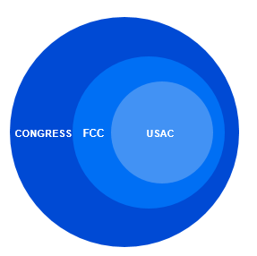
OVERVIEW
Congress wrote the Telecommunications Act of 1996, which directed the Federal Communications Commission (FCC) to establish the E-rate Program and other programs.
The FCC issues orders that set rules and policies for the program and gives direction to the Universal Service Administrative Company (USAC) through orders.
USAC is responsible for the day-to-day administration of the E-rate Program.
WHO MAKES THE RULES?
©2019 Universal Service Administrative Co.

Slide 6
Schools and Libraries Application Process
© 2019 Universal Service Administrative Co.

Slide 7
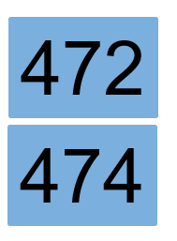
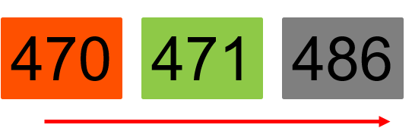
What is the Applicant Process?
Competitive
Bidding
Apply for Discounts
Start
Services
Invoice USAC
©2019 Universal Service Administrative Co.

Slide 8
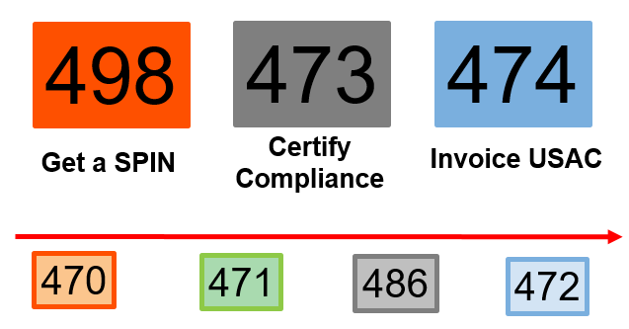
What is the Service Provider Process?
©2019 Universal Service Administrative Co.

Slide 9
Get A SPIN
498
Register with USAC and provide information on contacts and the services you provide.
Information from your FCC Form 498 is used to populate information in your portal (E-rate Productivity Center or EPC).
Keep this information current.
©2019 Universal Service Administrative Co.

Slide 10
Applicant Competitive Bidding
470
Review posted FCC Forms 470, Requests for Proposals (RFPs), and RFP documents on the USAC website and respond to requests for services.
Ask the applicant questions if you need clarification.
Competitive bidding process must be open and fair.
©2019 Universal Service Administrative Co.

Slide 11
Applicants Apply for Discounts
471
Review the Receipt Acknowledgment Letter for accuracy.
Assist applicants with review questions as needed (network diagrams, technical information).
Review USAC’s funding commitment decision.
©2019 Universal Service Administrative Co.

Slide 12
Certify Compliance with Rules
473
File your FCC Form 473 (SPAC Form) to certify that you will follow program rules.
Start the delivery and installation of funded services.
Verify that your customers have filed FCC Form 486.
©2019 Universal Service Administrative Co.

Slide 13
Invoice USAC (SPI Form)
474
Bill your customers for their share of the cost of approved services.
Check the commitment information (services, discount level, costs) before filing a SPI Form.
Answer any USAC review questions.
©2019 Universal Service Administrative Co.

Slide 14
Basic Concepts
© 2019 Universal Service Administrative Co.

Slide 15
BASIC CONCEPTS
Eligibility – Entities, Services, Locations
Funding Year
Filing Window
Identifying Numbers (BEN, SPIN, CRN)
Discounts
Funding Request Numbers (FRNs)
©2019 Universal Service Administrative Co.

Slide 16
Eligibility
Who is Eligible?
© 2019 Universal Service Administrative Co.

Slide 17

ELIGIBILITY - School
Must provide elementary and/or secondary education, as determined under state law
Cannot have an endowment exceeding $50 million.
Cannot operate as a for-profit business.
©2019 Universal Service Administrative Co.

Slide 18
ELIGIBILITY – Libraries
Must be eligible for assistance from their state library agency under LSTA*.
Budget must be separate from any schools.
Cannot operate as a for-profit business.
*LSTA = Library Services Technology Act
©2019 Universal Service Administrative Co.

Slide 19

ELIGIBILITY – Non-instructional Facilities (NIFs)
Non-instructional facilities (NIFs) are eligible for discounts on some services.
NIFs are:
  School buildings that don’t have classrooms.
  Library buildings that don’t have public areas.
©2019 Universal Service Administrative Co.

Slide 20

ELIGIBILITY - Consortia
Schools and libraries can join together to form consortia.
Consortia are not themselves eligible for discounts, but they can run competitive bid processes and/or apply for discounts on behalf of their members.
© 2019 Universal Service Administrative Co.

Slide 21
Eligibility
What Services are Eligible?
© 2019 Universal Service Administrative Co.

Slide 22

ELIGIBILITY- Eligible Services List (ESL)
Each year, the FCC issues a list of services that are eligible for the upcoming funding year.
©2019 Universal Service Administrative Co.

Slide 23
ELIGIBILTY - Services
Category One includes services from the service provider to the schools and/or libraries (demarcation point).
One service type –
Data Transmission and/or Internet Access
Voice services are completely phased out in FY2019.
©2019 Universal Service Administrative Co.

Slide 24
ELIGIBILITY - Services
Examples of Category One (C1) services:
Leased lit or dark fiber
Wireless services (e.g. microwave)
Satellite service
T-1, T-3, etc.
DSL
©2019 Universal Service Administrative Co.

Slide 25
ELIGIBILITY - Services
Category Two includes services and equipment needed for broadband connectivity within schools and libraries.
Three service types –
Internal Connections
Basic Maintenance of Internal Connections
Managed Internal Broadband Services
©2019 Universal Service Administrative Co.

Slide 26
ELIGIBILITY - Services
Examples of Category Two (C2) services:
Routers & switches
Cabling, wireless access points
Basic maintenance of eligible internal connections managed internal broadband services (managed Wi-Fi)
©2019 Universal Service Administrative Co.

Slide 27
ELIGIBILITY - Services
Category One (C1) services are not limited in cost as long as they are cost-effective.
Category Two (C2) services are limited by a pre-discount budget
Budget period is five years
Budget is calculated based on number of students (schools) or square footage (libraries)
©2019 Universal Service Administrative Co.

Slide 28

ELIGIBILITY – Eligible Purposes
Activities related to education that occur on school property.
Activities related to providing library services to individuals that occur on library property.
*Activities that are not on school or library property are generally not considered eligible for discounts.
©2019 Universal Service Administrative Co.

Slide 29
Program Overview
2019 Service Provider Training – Part 2

Slide 30
FUNDING YEAR
© 2019 Universal Service Administrative Co.

Slide 31

FUNDING YEAR
A Funding Year (FY) starts on July 1 and ends the following June 30.
For example, FY2019 starts on July 1, 2019, and ends on June 30, 2020.
©2019 Universal Service Administrative Co.

Slide 32

FUNDING YEAR
Timing of program activities:
Competitive bidding and applying for discounts happen before the funding year starts.
©2019 Universal Service Administrative Co.

Slide 33

FUNDING YEAR
Timing of program activities:
Services generally start at the beginning of the funding year.
©2019 Universal Service Administrative Co.

Slide 34

FUNDING YEAR
Timing of program activities:
Invoicing can occur during the funding year and is generally completed after the funding year ends.
©2019 Universal Service Administrative Co.

Slide 35
FUNDING YEAR – Delivery and installation of services
Recurring services (e.g., monthly internet access) must be delivered during the funding year.
Non-recurring services (e.g., equipment installations) can generally be installed through September 30 following the close of the funding year.
The September 30 deadline can sometimes be extended, either automatically or by request.
Delivery and installation can sometimes start before the funding year.
©2019 Universal Service Administrative Co.

Slide 36
FILING WINDOW
© 2019 Universal Service Administrative Co.

Slide 37
FILING WINDOW
All FCC Forms 471 are filed during a specific period of time – the FCC Form 471 application filing window.
The filing window generally opens in mid-January and closes in mid-March in advance of the start of the funding year.
*Applications (FCC Forms 471) filed outside of the filing window are not considered for funding.
©2019 Universal Service Administrative Co.

Slide 38
IDENTIFYING NUMBERS
© 2019 Universal Service Administrative Co.

Slide 39

IDENTIFYING NUMBERS - SPINs
A Service Provider Identification Number (SPIN) is assigned to providers participating in E-rate.
Service providers may have more than one SPIN due to:
Different business units or service areas.
Mergers and acquisitions.
©2019 Universal Service Administrative Co.

Slide 40
IDENTIFYING NUMBERS - BENs
Each applicant entity is assigned an “entity number” in the system.
Each entity that receives and pays bills is assigned a Billed Entity Number (BEN).
For example: independent schools, school districts, independent libraries, library systems, consortia, educational service agencies.
Schools in a school district, libraries in a library system, and NIFs also have entity numbers.
©2019 Universal Service Administrative Co.

Slide 41

IDENTIFYING NUMBERS - CRNs
Each consulting firm is assigned a Consultant Registration Number (CRN) in the system.
A consultant may be a single individual or a consulting firm with multiple employees.
©2019 Universal Service Administrative Co.

Slide 42
DISCOUNTS
© 2019 Universal Service Administrative Co.

Slide 43
DISCOUNTS – Overview
Discounts depend on two pieces of information:
The level of poverty as defined by the percentage students who qualify for the National School Lunch Program (NSLP) in the school district.
The urban or rural status of the school district or library system.
©2019 Universal Service Administrative Co.

Slide 44
DISCOUNTS –Calculations
School districts use
The percentage of students eligible for NSLP and
Urban/rural status.
Library systems use
The percentage of students eligible for NSLP in the school district where the main branch of the library is located and
Urban/rural status.
Consortia use a simple average of their members’ discounts.
©2019 Universal Service Administrative Co.

Slide 45
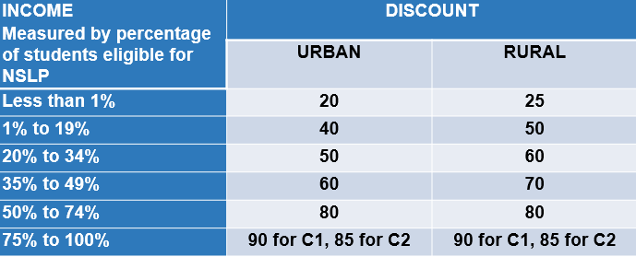
DISCOUNT MATRIX
©2019 Universal Service Administrative Co.

Slide 46
FUNDING REQUEST NUMBER (FRN)
© 2019 Universal Service Administrative Co.

Slide 47
FUNDING REQUEST NUMBER (FRN)
Applying for discounts
Applicants list the services and identify the costs for those services on the FCC Form 471.
Each of these funding requests is assigned a number – an FRN.
There can be one or many FRNs on an FCC Form 471.
©2019 Universal Service Administrative Co.

Slide 48

FUNDING REQUEST NUMBER (FRN)
FRNs are specific to:
A category of service
A service type
An FCC Form 470
A service provider (SPIN)
A contract, if you have one
An FRN can have one or many services, as long as the services have all the above in common.
©2019 Universal Service Administrative Co.

Slide 49
RECAP
Eligibility
Entities
Services
Educational purposes
Funding year
Filing window
©2019 Universal Service Administrative Co.

Slide 50
RECAP
Identifying numbers
Service Provider Identification Numbers (SPINs)
Entity Numbers and Billed Entity Numbers (BENs)
Consultant Registration Numbers (CRNs)
Discounts
Funding Request Numbers (FRNs)
©2019 Universal Service Administrative Co.

Slide 51
Questions?
© 2019 Universal Service Administrative Co.

Slide 52
© 2019 Universal Service Administrative Co.

