Slide 1
Process Overview for Service Providers
2019 Service Provider Training

Slide 2
AGENDA
Process Overview
Basic Concepts
  Funding Year
  Filing Window
  Identifying Numbers – BENs, SPINs, CRNs
  Discounts
  Funding Request Numbers
©2019 Universal Service Administrative Co.

Slide 3
Schools and Libraries Application Process
© 2019 Universal Service Administrative Co.

Slide 4
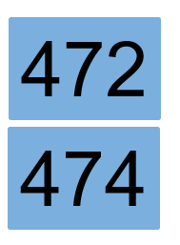
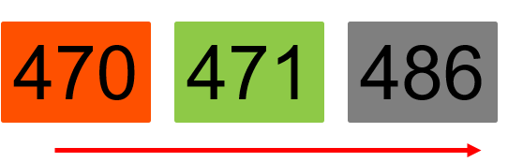
What is the Applicant Process?
Competitive
Bidding
Apply for Discounts
Start
Services
Invoice USAC
©2019 Universal Service Administrative Co.

Slide 5
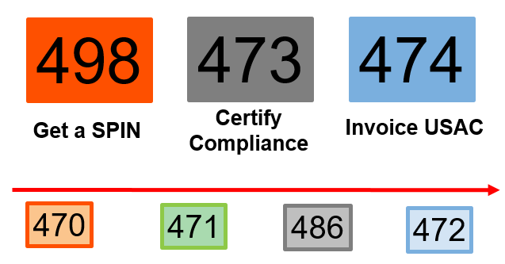
What is the Service Provider Process?
©2019 Universal Service Administrative Co.

Slide 6
Get A SPIN
498
Register with USAC and provide information on contacts and the services you provide.
Information from your FCC Form 498 is used to populate information in your portal (E-rate Productivity Center or EPC).
Keep this information current.
©2019 Universal Service Administrative Co.

Slide 7
Applicant Competitive Bidding
470
Review posted FCC Forms 470, Requests for Proposals (RFPs), and RFP documents on the USAC website and respond to requests for services.
Ask the applicant questions if you need clarification.
Competitive bidding process must be open and fair.
©2019 Universal Service Administrative Co.

Slide 8
Applicants Apply for Discounts
471
Review the Receipt Acknowledgment Letter for accuracy.
Assist applicants with review questions as needed (network diagrams, technical information).
Review USAC’s funding commitment decision.
©2019 Universal Service Administrative Co.

Slide 9
Certify Compliance with Rules
473
File your FCC Form 473 (SPAC Form) to certify that you will follow program rules.
Start the delivery and installation of funded services.
Verify that your customers have filed FCC Form 486.
©2019 Universal Service Administrative Co.

Slide 10
Invoice USAC (SPI Form)
474
Bill your customers for their share of the cost of approved services.
Check the commitment information (services, discount level, costs) before filing a SPI Form.
Answer any USAC review questions.
©2019 Universal Service Administrative Co.

Slide 11
Basic Concepts
© 2019 Universal Service Administrative Co.

Slide 12

FUNDING YEAR
A Funding Year (FY) starts on July 1 and ends the following June 30.
For example, FY2019 starts on July 1, 2019, and ends on June 30, 2020.
©2019 Universal Service Administrative Co.

Slide 13
FILING WINDOW
All FCC Forms 471 are filed during a specific period of time – the FCC Form 471 application filing window.
The filing window generally opens in mid-January and closes in mid-March in advance of the start of the funding year.
*Applications (FCC Forms 471) filed outside of the filing window are not considered for funding.
©2019 Universal Service Administrative Co.

Slide 14

IDENTIFYING NUMBERS - SPINs
A Service Provider Identification Number (SPIN) is assigned to providers participating in E-rate.
Service providers may have more than one SPIN due to:
Different business units or service areas.
Mergers and acquisitions.
©2019 Universal Service Administrative Co.

Slide 15
IDENTIFYING NUMBERS - BENs
Each applicant entity is assigned an “entity number” in the system.
Each entity that receives and pays bills is assigned a Billed Entity Number (BEN).
Ex) independent schools, school districts, independent libraries, library systems, consortia, educational service agencies.
Schools in a school district, libraries in a library system, and NIFs also have entity numbers.
©2019 Universal Service Administrative Co.

Slide 16

IDENTIFYING NUMBERS - CRNs
Each consulting firm is assigned a Consultant Registration Number (CRN) in the system.
A consultant may be a single individual or a consulting firm with multiple employees.
©2019 Universal Service Administrative Co.

Slide 17
DISCOUNTS
© 2019 Universal Service Administrative Co.

Slide 18
DISCOUNTS – Overview
Discounts depend on two pieces of information:
The level of poverty as defined by the percentage students who qualify for the National School Lunch Program (NSLP) in the school district.
The urban or rural status of the school district or library system.
©2019 Universal Service Administrative Co.

Slide 19
DISCOUNTS –Calculations
School districts use
The percentage of students eligible for NSLP and
Urban/rural status.
Library systems use
The percentage of students eligible for NSLP in the school district where the main branch of the library is located and
Urban/rural status.
Consortia use a simple average of their members’ discounts.
©2019 Universal Service Administrative Co.

Slide 20
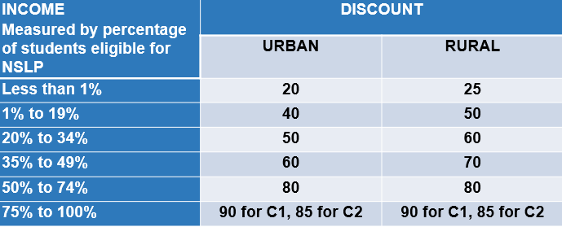
DISCOUNT MATRIX
©2019 Universal Service Administrative Co.

Slide 21
FUNDING REQUEST NUMBER (FRN)
© 2019 Universal Service Administrative Co.

Slide 22
FUNDING REQUEST NUMBER (FRN)
Applying for discounts
Applicants list the services and identify the costs for those services on the FCC Form 471.
Each of these funding requests is assigned a number – an FRN.
There can be one or many FRNs on an FCC Form 471.
©2019 Universal Service Administrative Co.

Slide 23

FUNDING REQUEST NUMBER (FRN)
FRNs are specific to:
A category of service
A service type
An FCC Form 470
A service provider (SPIN)
A contract, if you have one
An FRN can have one or many services, as long as the services have all the above in common.
©2019 Universal Service Administrative Co.

Slide 24
© 2019 Universal Service Administrative Co.

