Slide 1
Beginner Overview
2019 Applicant Training

Slide 2
AGENDA
Schools and Libraries (E-rate) Program
Application Process and Forms
©2019 Universal Service Administrative Co.

Slide 3
Schools and Libraries (E-rate) Program
©2019 Universal Service Administrative Co.

Slide 4
Mission Statement
Help ensure that schools and libraries can obtain high-speed internet access and telecommunications at affordable rates, and keep students and library patrons connected to broadband by providing a discount on eligible services.
©2019 Universal Service Administrative Co.

Slide 5
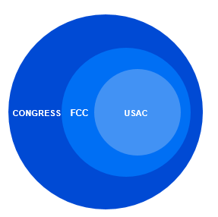
Overview
Congress wrote the Telecommunications Act of 1996, which directed the Federal Communications Commission (FCC) to establish the E-rate Program and other programs.
The FCC issues orders that set rules and policies for the program and gives direction to the Universal Service Administrative Company (USAC) through orders.
USAC is responsible for the day-to-day administration of the E-rate Program.
WHO MAKES THE RULES?
©2019 Universal Service Administrative Co.

Slide 6
Application Process
©2019 Universal Service Administrative Co.

Slide 7
What is the Applicant Process?
472
470
471
486
474
Competitive
Bidding
Apply for Discounts
Start
Services
Invoice USAC
©2019 Universal Service Administrative Co.

Slide 8
Competitive Bidding
470
Run an open and fair competitive bidding process.
Wait 28 days before choosing a service provider.
Evaluate bids using the price of the eligible services as the primary factor.
©2019 Universal Service Administrative Co.

Slide 9
Apply for Discounts
471
Provide information about your requests (discount level, costs of services, service providers).
Answer USAC review questions.
Receive your funding commitment decision.
©2019 Universal Service Administrative Co.

Slide 10
Start Services
486
Tell USAC your services have started.
Verify your CIPA* compliance.
  * CIPA = Children’s Internet Protection Act
Answer USAC review questions.
©2019 Universal Service Administrative Co.

Slide 11
Invoice USAC (BEAR Form)
472
Certify FCC Form 498 to provide your banking information – and backup documents – to USAC for review.
Pay your customer bill (the bill from your service provider) in full.
Answer any USAC review questions.
©2019 Universal Service Administrative Co.

Slide 12
Invoice USAC (SPI Form)
474
Pay your discounted customer bill (the bill from your service provider).
Your service provider will invoice USAC for the discount amount.
Answer any USAC review questions.
©2019 Universal Service Administrative Co.

Slide 13
QUESTIONS?
© 2019 Universal Service Administrative Co.

