Slide 1
BEGINNER BASIC CONCEPTS
2019 Applicant Training

Slide 2
AGENDA
Eligibility – entities, services, locations
Funding Year
Filing Window
Identifying Numbers (BEN, SPIN, CRN)
Discounts
Funding Request Number (FRN)
©2019 Universal Service Administrative Co.

Slide 3
Eligibility
Who is Eligible?
©2019 Universal Service Administrative Co.

Slide 4

ELIGIBILITY - School
Must provide elementary and/or secondary education, as determined under state law
Cannot have an endowment exceeding $50 million.
Cannot operate as a for-profit business.
©2019 Universal Service Administrative Co.

Slide 5
ELIGIBILITY – Libraries
Must be eligible for assistance from their state library agency under LSTA*.
Budget must be separate from any schools.
Cannot operate as a for-profit business.
*LSTA = Library Services Technology Act
©2019 Universal Service Administrative Co.

Slide 6
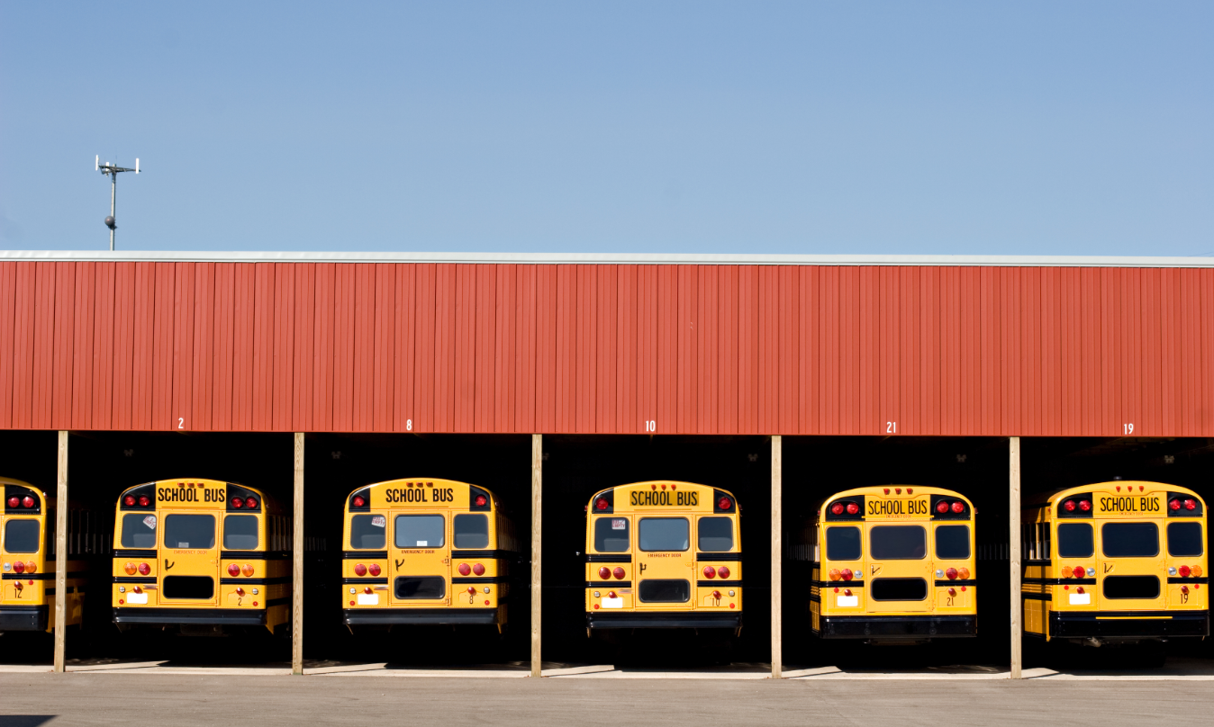
ELIGIBILITY – Non-instructional Facilities (NIFs)
Non-instructional facilities (NIFs) are eligible for discounts on some services.
NIFs are:
  School buildings that don’t have classrooms.
  Library buildings that don’t have public areas.
©2019 Universal Service Administrative Co.

Slide 7

ELIGIBILITY - Consortia
Schools and libraries can join together to form consortia.
Consortia are not themselves eligible for discounted services, but they can run competitive bid processes and/or apply for discounted services on behalf of their members.
© 2019 Universal Service Administrative Co.

Slide 8
Eligibility
What Services are Eligible?
©2019 Universal Service Administrative Co.

Slide 9
ELIGIBILITY - Services
Category One includes services from the service provider to the schools and/or libraries (demarcation point).
One service type:
  Data Transmission and/or Internet Access
©2019 Universal Service Administrative Co.

Slide 10
ELIGIBILITY - Services
Examples of Category One (C1) services:
Leased lit or dark fiber
Wireless services (e.g. microwave)
Satellite service
T-1, T-3, etc.
DSL
©2019 Universal Service Administrative Co.

Slide 11
ELIGIBILITY - Services
Category Two includes services and equipment needed for broadband connectivity within schools and libraries.
Three service types:
    Internal Connections
    Basic Maintenance of Internal Connections
    Managed Internal Broadband Services
©2019 Universal Service Administrative Co.

Slide 12
ELIGIBILITY - Services
Examples of Category Two (C2) services:
Routers & switches
Cabling, wireless access points
Basic maintenance of eligible internal connections
Managed internal broadband services (managed Wi-Fi)
©2019 Universal Service Administrative Co.

Slide 13
ELIGIBILITY - Services
Category One (C1) services are not limited in cost as long as they are cost-effective.
Category Two (C2) services are limited by a pre-discount budget
Budget period is five years
Budget is calculated based on number of students (schools) or square footage (libraries)
©2019 Universal Service Administrative Co.

Slide 14

ELIGIBILITY- Eligible Services List (ESL)
Each year, the FCC issues a list of services that are eligible for the upcoming funding year.
©2019 Universal Service Administrative Co.

Slide 15

ELIGIBILITY – Educational Purposes
Activities related to education that occur on school property.
Activities related to providing library services to individuals that occur on library property.
*Activities that are not on school or library property are generally not considered eligible for discounts.
©2019 Universal Service Administrative Co.

Slide 16
Funding Year
©2019 Universal Service Administrative Co.

Slide 17

FUNDING YEAR
A Funding Year (FY) starts on July 1 and ends the following June 30.
For example, FY2020 starts on July 1, 2020, and ends on June 30, 2021.
©2019 Universal Service Administrative Co.

Slide 18

FUNDING YEAR
Timing of program activities:
Competitive bidding and applying for discounts happen before the funding year starts.
©2019 Universal Service Administrative Co.

Slide 19

FUNDING YEAR
Timing of program activities:
Services generally start at the beginning of the funding year.
©2019 Universal Service Administrative Co.

Slide 20

FUNDING YEAR
Timing of program activities:
Invoicing can occur during the funding year and is generally completed after the funding year ends.
©2019 Universal Service Administrative Co.

Slide 21
FUNDING YEAR – Delivery and installation of services
Recurring services (e.g., monthly internet access) must be delivered during the funding year.
Non-recurring services (e.g., equipment installations) can generally be installed through September 30 following the close of the funding year.
The September 30 deadline can sometimes be extended, either automatically or by request.
Delivery and installation can sometimes start before the funding year.
©2019 Universal Service Administrative Co.

Slide 22
Filing Window
©2019 Universal Service Administrative Co.

Slide 23
FILING WINDOW
All FCC Forms 471 are filed during the FCC Form 471 application filing window.
The filing window generally opens in mid-January and closes in mid-March in advance of the start of the funding year
Applications (FCC Forms 471) filed outside of the filing window are not considered for funding.
©2019 Universal Service Administrative Co.

Slide 24
Identifying Numbers
©2019 Universal Service Administrative Co.

Slide 25
IDENTIFYING NUMBERS - BENs
Each applicant entity is assigned an “entity number” in the system.
Each entity that receives and pays bills is assigned a Billed Entity Number (BEN).
©2019 Universal Service Administrative Co.

Slide 26
IDENTIFYING NUMBERS - BENs
Examples of applicant entities with entity numbers:
Individual school
School district
Individual library branch
Bookmobile
Library system
Consortium
Educational service agency
©2019 Universal Service Administrative Co.

Slide 27

IDENTIFYING NUMBERS - SPINs
A Service Provider Identification Number (SPIN) is assigned to providers participating in E-rate.
Service providers may have more than one SPIN due to:
Different business units or service areas.
Mergers and acquisitions.
©2019 Universal Service Administrative Co.

Slide 28
IDENTIFYING NUMBERS - SPINs
A Service Provider Identification Number (SPIN) is assigned to providers participating in E-rate.
Service providers may have more than one SPIN due to:
Different business units or service areas.
Mergers and acquisitions.
©2019 Universal Service Administrative Co.

Slide 29

IDENTIFYING NUMBERS - CRNs
Each consultant is assigned a Consultant Registration Number (CRN) in the system.
A consultant may be a single individual or a consulting firm with multiple employees.
©2019 Universal Service Administrative Co.

Slide 30
Discounts
©2019 Universal Service Administrative Co.

Slide 31
DISCOUNTS – Overview
Discounts depend on two factors:
The level of poverty (the percentage of NSLP* eligibility) in the school district.
The urban or rural status of the school district or library system.
*NSLP = National School Lunch Program
©2019 Universal Service Administrative Co.

Slide 32
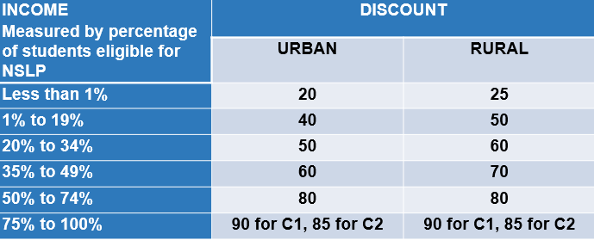
DISCOUNT MATRIX
©2019 Universal Service Administrative Co.

Slide 33
DISCOUNTS – School District NSLP Calculations
Determine the total number of students eligible for NSLP in the school district.
Determine the total number of students in the school district.
Divide the first number by the second number.
©2019 Universal Service Administrative Co.

Slide 34
DISCOUNTS – School District NSLP Calculations
EXAMPLE:
Orange School District has 1,070 students. Of those 1,070 students, 450 are eligible for NSLP.
The percentage of the student population eligible for NSLP:
450/1070 = 42%
©2019 Universal Service Administrative Co.

Slide 35

DISCOUNTS – School District Urban/Rural Determination
An individual school is urban if it is located in an “Urbanized Area” or “Urban Cluster” with a population of 25,000 or more. Otherwise it is rural.
©2019 Universal Service Administrative Co.

Slide 36

DISCOUNTS – School District Urban/Rural Determination
For a school district to be considered rural, more than 50% of its schools must be rural. Otherwise, it is urban. All schools in the school district share the same discount level.
You can use the Urban/Rural Lookup tool on the USAC website to find urban or rural status.
©2019 Universal Service Administrative Co.

Slide 37
DISCOUNTS – Library NSLP Calculation
Determine the main branch of the library.
Determine the school district in which the main branch of the library is located.
Use the NSLP percentage calculation for that school district.

Slide 38
DISCOUNTS – Library Urban/Rural Determination
A library is urban if it is located in an “Urbanized Area” or “Urban Cluster” with a population of 25,000 or more. Otherwise it is rural.

Slide 39
DISCOUNTS – Libraries District Urban/Rural Determination
For a library system to be considered rural, more than 50% of its libraries must be rural. Otherwise, it is urban. All libraries in the library system share the same discount level.
You can use the Urban/Rural Lookup tool on the USAC website to find the urban or rural status.
©2019 Universal Service Administrative Co.

Slide 40
DISCOUNTS – Consortia
The discount calculation for a consortium is the simple average of the discounts of its members.
However, the discount for a consortium on a particular application (FCC Form 471) is calculated based on the members of the consortium that are featured on that application.

Slide 41
Funding Request Number (FRN)
©2019 Universal Service Administrative Co.

Slide 42

FUNDING REQUEST NUMBER (FRN)
Applying for discounts
You list the services and identify the costs for those services on the FCC Form 471.
Each of these funding requests is assigned a number – an FRN.
You can have one or many FRNs on your form.
©2019 Universal Service Administrative Co.

Slide 43
FUNDING REQUEST NUMBER (FRN)
FRNs are specific to:
A category of service
A service type
An FCC Form 470
A service provider (SPIN)
A contract, if you have one
An FRN can have one or many services, as long as the services have all the above in common.
©2019 Universal Service Administrative Co.

Slide 44
RECAP
Eligibility
Entities
Services
Educational purposes
Funding year
Filing window
©2019 Universal Service Administrative Co.

Slide 45
RECAP
Identifying numbers
Service Provider Identification Numbers (SPINs)
Entity Numbers and Billed Entity Numbers (BENs)
Consultant Registration Numbers (CRNs)
Discounts
Funding Request Numbers (FRNs)
©2019 Universal Service Administrative Co.

Slide 46
QUESTIONS?
© 2019 Universal Service Administrative Co.

