Slide 1
Beginner Invoicing
2019 Service Provider Training

Slide 2
AGENDA
Preparing for Invoicing
Invoicing Methods
Before You Begin
FCC Form 498 (Service Providers)
Electronic Invoicing
When to File / Deadlines
Invoice Review Process
Case Studies
© 2019 Universal Service Administrative Co

Slide 3
Preparing for Invoicing
© 2019 Universal Service Administrative Co.

Slide 4
Preparing for Invoicing
The applicant and service provider receive an FCDL with a positive commitment.
The applicant certifies an FCC Form 486 and establishes the actual service start date for FRN(s).
USAC reviews and approves the FCC Form 486.
The service provider certifies an FCC Form 473 (SPAC Form) for each SPIN that will be featured on an invoice for that funding year.
© 2019 Universal Service Administrative Co

Slide 5
Invoicing Methods
© 2019 Universal Service Administrative Co.

Slide 6
Invoicing Methods
There are two methods to invoice USAC:
Applicant
  FCC Form 472
  Billed Entity Applicant Reimbursement (BEAR) Form
  Filed online
Service Provider
  FCC Form 474
  Service Provider Invoice (SPI) Form
  Filed online or electronically
© 2019 Universal Service Administrative Co

Slide 7
Invoicing Methods
Invoice method (BEAR or SPI) is the applicant’s choice.
Service providers and applicants should have this discussion as early as possible – ideally, before the applicant certifies the FCC Form 471.
Once the invoice method is set for a Funding Request Number (FRN), it cannot be changed.
  The invoice method is FRN-specific.
© 2019 Universal Service Administrative Co

Slide 8
Before You Begin
© 2019 Universal Service Administrative Co.

Slide 9

Before You Begin
Verify that all the prerequisites are in place.
  E.g., FCDL has been issued, FCC Form 486 has been filed, FCC Form 473 has been submitted, FCC Form 498 was approved, etc.
Have the BEAR/SPI discussion. Who will be filing invoices with USAC?
Make sure that you have the most recent commitment information from either the FCDL or the RFCDL, including discount rate, approved cost of service, FCC Form 471 number, FRN, service substitution, etc.
© 2019 Universal Service Administrative Co

Slide 10
Before You Begin
Determine the invoice frequency
  E.g., Monthly, bi-monthly, quarterly, one-time, etc.
Watch the SPI form walk-through videos in the Online Learning Library.
© 2019 Universal Service Administrative Co

Slide 11
Filing FCC Form 498 for Service Providers
© 2019 Universal Service Administrative Co.

Slide 12
FCC Form 498 for Service Providers – How do I File?
To receive a Service Provider Identification Number (SPIN), also known as a service provider 498 ID, service providers must file the FCC Form 498 (Service Provider and Billed Entity Identification Number and General Contact Information Form) in the E-File System.
    Provide the required information.
    Complete and certify the form.
  Your company officer can start, complete, submit, certify, modify, and deactivate FCC Forms 498.
  Your general contact or E-rate contact can complete but not certify the form.
  You must update the form if any of your information changes.
  Need help? Call USAC at 888-641-8722 and choose option 4 (contributors
© 2019 Universal Service Administrative Co

Slide 13
FCC Form 498 for Service Providers
Once the FCC Form 498/SPIN ID is approved, USAC will provide the following:
  Set up a user name and password in order to access the E-file system to allow:
    Updates to your FCC Form 498 online
    Set up permissions for other users in your company
    Set up access rights to view and approve certain applicant-filed forms and form attachments
© 2019 Universal Service Administrative Co

Slide 14
When to File Invoices
© 2019 Universal Service Administrative Co.

Slide 15

When to File Invoices
The invoice deadline is:
  120 days after the last date to receive service or 120 days after the date of the FCC Form 486 Notification Letter, whichever is later.
  If the calculated deadline falls on a weekend or federal holiday, the deadline is 11:59 PM ET on the following business day.
© 2019 Universal Service Administrative Co

Slide 16
When to File Invoices
File after services are delivered and paid
  Applicants – pay in full for services first
  Service providers – bill applicants for their non-discount share first
You can choose the frequency
File before the invoice deadline
  Generally, October 28 for recurring services
  Generally, January 28 for non-recurring services
© 2019 Universal Service Administrative Co

Slide 17
When to File Invoices
Invoice deadline extension requests
  File requests for FY2016 and later funding years in EPC.
    Service providers locate their SPIN under Records and choose Invoice Deadline Date Extension Requests from the Related Actions menu.
  File requests for FY2015 and previous funding years
    Service providers log in to the E-File System and choose the 472 BEAR Form.
© 2019 Universal Service Administrative Co

Slide 18
When to File Invoices
Invoice deadline extension requests must be filed ON OR BEFORE the invoice deadline date.
Filers can receive one 120-day extension of the time to file.
If applicants or service providers miss the deadline to file an invoice or to request an invoice deadline extension, they must file a request for waiver of the invoice deadline with the FCC.
  The FCC must grant the waiver request before USAC can process an invoice.
However, if USAC rejects a timely filed invoice, the applicant can appeal that rejection directly to USAC.
© 2019 Universal Service Administrative Co

Slide 19
Invoice Review
© 2019 Universal Service Administrative Co.

Slide 20
Invoice Review
USAC invoice review can involve two steps:
Automated Review
Manual Review
© 2019 Universal Service Administrative Co

Slide 21
Invoice Review – Automated Review
All invoices undergo a series of automated reviews.
Line items are automatically rejected if their information (FCC Form 471 number, FRN, discount percentage, available funding, etc.) is incorrect or inconsistent with the approved FRN.
Keep in mind that the online SPI Form has fewer built-in warnings, so accurate data entry is very important.
© 2019 Universal Service Administrative Co

Slide 22
Common Data Entry Errors
The FCC Form 471 and/or Funding Request Number (FRN) does not exist in our system.
Your SPIN is not featured on the FRN.
The FRN you entered is not on the FCC Form 471 number you entered.
The entire commitment has already been paid.
The FRN is for the previous funding year.
The line item is or appears to be a duplicate.
  This may be because the customer billed date is entered as the service start date in every line item rather than the first date that service was delivered for that line item.
© 2019 Universal Service Administrative Co

Slide 23
Note on Discount Data Entry
The system does not pre-populate the discount from the FRN record to the online SPI Form.
To complete each line item:
  Enter the pre-discount amount.
  Enter the discount percentage manually. This entry must be a number between 20 and 90.
  If the correct discount is less than 20, enter 20. (This will only occur for pre-FY2019 voice services subject to the voice phase-down.
  Calculate the post-discount amount manually and enter it.
© 2019 Universal Service Administrative Co

Slide 24
Invoice Review – Manual Review
  Some invoices also undergo manual review. These reviews verify, among other things, that:
    the customer bills are accurately reflected on the E-rate invoice and discounts are properly applied;
    the services are eligible and were approved on the FCDL;
    It the services are not on the FCDL, USAC approved a service substitution.
  USAC reviewers send questions to the service provider and ask for responses in seven days; one seven-day extension can be granted.
  USAC reviews the information provided and makes a disbursement decision.
  If payment is rejected, the service provider can resubmit the invoice once the issue has been corrected.
© 2019 Universal Service Administrative Co

Slide 25
Invoice Review - Service Certification
  Some manual reviews require additional documentation, such as:
    Proof that the applicant paid their share.
    Proof that the invoiced services were delivered and/or installed.
    Proof that progress payments were included in the contract.
  USAC reviewers send a Service Certification and instructions to the service provider so that they can forward it to the applicant.
  The applicant completes the certification and returns it directly to USAC.
  USAC reviews the information provided and makes a decision
© 2019 Universal Service Administrative Co

Slide 26
Tips for Invoicing
  Confirm the invoice method the applicant has chosen – ideally, before services start.
  Verify that the information on your current FCC Form 498 – especially bank account information – is correct. USAC does not issue paper checks.
  Gather the documents you will need to complete an invoice correctly: FCDLs, FCC Form 486 Notification Letters, SPIN change approvals, service substitution approvals, customer bills.
  Make sure that the applicant has filed – and USAC has approved – an FCC Form 486 for the FRN.
  Make sure you have certified an FCC Form 473 (SPAC Form) for the appropriate funding year.
  Forward service certifications with instructions to the applicant promptly.
  Check your entries carefully to be sure that they are consistent and accurate.
© 2019 Universal Service Administrative Co

Slide 27
Case Studies
© 2019 Universal Service Administrative Co.

Slide 28
Case Studies: Similar Line items
Invoice #1234567 was submitted on 7/1/2019 for $759.00 for FRN 190000010 with a customer billed date of 7/1/2019.
Invoice #1234789 was submitted on 8/1/2019 for $759.00 for FRN 190000010 with a customer billed date of 7/1/2019.
Question:
How will USAC process the second invoice?
© 2019 Universal Service Administrative Co

Slide 29
Case Studies: Similar Line items
Answer:
USAC’s system will flag the second invoice as a possible duplicate. To resolve the matter, a further review must be completed.
The invoice reviewer will request documentation to support both invoices and to demonstrate that the second is not a duplicate submission.
To avoid this problem:
The date on each line item should be the date service started for that line item. The second invoice should have shown a customer billed date of 8/1/2019.
© 2019 Universal Service Administrative Co

Slide 30
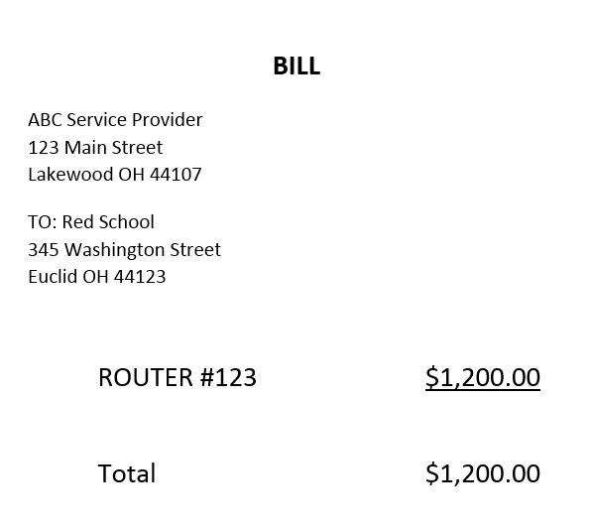
Case Studies: Applicant Share
Service provider submits a SPI Form for $800.00. During invoice review, the service provider provides this customer bill.
Question:
What information is missing from the customer bill?
© 2019 Universal Service Administrative Co

Slide 31
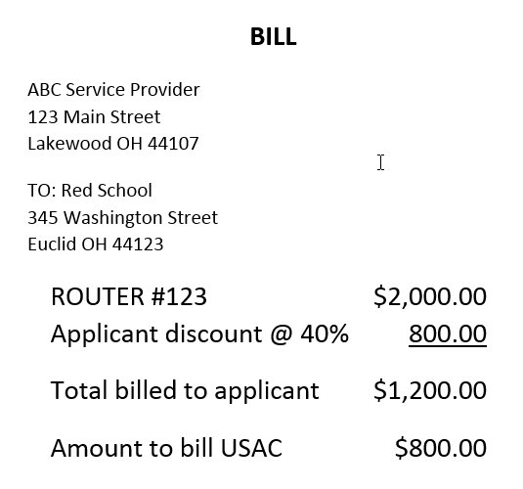
Case Studies: Applicant Share
Answer:
Applicant discount
Amount billed to applicant
Amount to be billed to USAC
To avoid this problem:
Provide sufficient detail on the customer bill.
© 2019 Universal Service Administrative Co

Slide 32
Case Studies: Eligible Services
Service provider submits an invoice for FRN 2345678 which was approved for Basic Maintenance services.
The invoice reviewer requests a copy of the customer bill from the service provider. The service provider sends the invoice reviewer a customer bill for Internal Connections.
Question:
What will USAC do?
© 2019 Universal Service Administrative Co

Slide 33
Case Studies: Services not approved on FRN
Answer:
The invoice reviewer will deny the invoice. Although Internal Connections can be eligible services, the FRN was not approved for Internal Connections.
To avoid this problem:
Check to make sure you have provided the correct customer bill and invoiced for the correct FRN. If you provided the wrong bill or invoiced for the wrong FRN, submit a new, corrected invoice.
If the services are truly Basic Maintenance services and were competitively bid as Basic Maintenance services, you or the applicant can file an appeal to correct the service type on the FRN.
© 2019 Universal Service Administrative Co

Slide 34
Case Studies: Service Certification
USAC receives an invoice for a router which includes installation.
The invoice reviewer sends a service certification to the service provider to verify that the router was delivered and installed. Since the verification must come directly from the applicant, the service provider is instructed to forward the entire message, including the service certification and the instructions for completing it, to the applicant.
The service provider takes no action.
Question:
What will USAC do?
© 2019 Universal Service Administrative Co

Slide 35
Case Studies: Service Certification
Answer:
The invoice reviewer will likely deny the invoice after seven days without a response from the applicant.
To avoid this problem:
The service provider should immediately forward the entire email – the service certification and the instructions – to the applicant.
It would be a good idea for the service provider to check in with the applicant before seven days have elapsed to make sure that the applicant has responded. If the applicant needs more time, the service provider can contact the invoice reviewer and ask for a seven-day extension.
© 2019 Universal Service Administrative Co

Slide 36
Questions?
© 2019 Universal Service Administrative Co.

Slide 37
© 2019 Universal Service Administrative Co.

