Slide 1
Beginner Track
Application Process
Part 1 (Pre-Commitment)
2019 Applicant Training

Slide 2
AGENDA
Application Process
Competitive Bidding (FCC Form 470)
Evaluating Bids
Requesting Funding (FCC Form 471)
Application Review
Funding Commitments
Document Retention
Case Studies
©2019 Universal Service Administrative Co.

Slide 3
Application Process
©2019 Universal Service Administrative Co.

Slide 4
How to Apply
Call our Client Service Bureau at call (888) 203-8100 to set up an account in EPC and make sure your school or library has an entity number (also called a Billed Entity Number or BEN).
1.
2.
3.
4.
Request services
(FCC Form 470),
run a competitive bid process, and select a vendor
Request funding
(FCC Form 471)
and undergo application review
Confirm the start of services and status of CIPA compliance
(FCC Form 486)
Request reimbursements (FCC Form 472)
OR receive discounts
(FCC Form 474)
©2019 Universal Service Administrative Co.

Slide 5
Know your role
Applicants | Service Providers
Determine services needed, file FCC Form 470 and RFP. Run competitive bidding process. Select winning bidder, with price of eligible products and services as primary factor. Respond to PIA. File other applicant forms (FCC Forms 471, 486, 472, 500, etc.). Document compliance with FCC rules on an ongoing basis. Retain documentation for at least ten years from last date of service delivery. | Respond to FCC Form 470 and RFPs. May assist with responding to PIA on technical services questions (but not competitive bidding). File other service provider forms (FCC Form 473, 474, etc.). Document their compliance on FCC rules on an ongoing basis. Retain documentation for at least ten years from last date of service delivery.
©2019 Universal Service Administrative Co.

Slide 6
Competitive Bidding
(FCC Form 470)
©2019 Universal Service Administrative Co.

Slide 7

Requesting Services
The FCC Form 470 opens the competitive bidding process.
It notifies potential bidders of the types and quantities of services requested.
Only the applicant or its authorized representative can prepare, sign, or submit the FCC Form 470.
©2019 Universal Service Administrative Co.

Slide 8
Competitive Bidding Requirements
The competitive bidding process must be open and fair.
  Open = information shared with one bidder must be shared with all.
  Fair = bidders must be evaluated fairly and equally.
28-Day Waiting Period
  FCC Form 470 must be posted on the USAC website for a minimum of 28 days before you select a vendor and file an FCC Form 471.
You must comply with all E-rate, state, and local procurement requirements.
©2019 Universal Service Administrative Co.

Slide 9
Requesting Services: Requests for Proposal
Requests for Proposals (RFPs) may be created to describe specific needs and circumstances in more detail.
USAC refers to an RFP or an RFP document generically. RFP documents are any documents that provide additional information to potential bidders on the scope or details of your project.
  For most types of service requests, RFPs are not required. However, you must issue an RFP for some requests or if you are required to do so by state/local rules.
  Services on your FCC Form 470 and RFP must match.
  All RFPs and RFP documents must be attached to your FCC Form 470 in EPC.
©2019 Universal Service Administrative Co.

Slide 10
Competitive Bidding Requirements: Imposing Restrictions
  You cannot list specific make and model of products or services sought without also allowing equivalent products and/or services to be bid.
    “XYZ manufacturer's router model 345J or equivalent”
  Bidder disqualification criteria must be spelled out in FCC Form 470 and/or RFP and be available to all potential bidders.
  EPC will automatically add the “or equivalent” language for you in the FCC Form 470, but remember to double check the language in your RFP, if you are issuing one, to include the words “or equivalent.”
  If you have bid disqualification factors, you must list them in your FCC Form 470.
©2019 Universal Service Administrative Co.

Slide 11
Competitive Bidding Requirements: Lowest Corresponding Price
Service providers are required to offer applicants their services at the lowest corresponding prices charged to other similarly situated customers throughout their geographic service area.
This rule ensures that you are not charged more than similarly situated non-residential customers for the same services because of E-rate participation.
Exceptions can be made if the provider can show that they face significantly higher costs to serve this customer due to volume, mileage from facility, and/or length of contract.
Applies to all service providers and for all service arrangements (tariff, month-to-month and contracted services).
©2019 Universal Service Administrative Co.

Slide 12
Requesting Services: FCC Form 470 Receipt Notification Letter
After posting FCC Form 470, USAC issues a Receipt Notification Letter (RNL) in your EPC News feed.
Review your submitted FCC Form 470 carefully. If you need to make corrections:
  For non-substantive changes, locate the form in EPC and choose “Related Actions” to submit allowable corrections.
  For a cardinal change to your requests, you must file a new FCC Form 470.
©2019 Universal Service Administrative Co.

Slide 13
Evaluating Bids
©2019 Universal Service Administrative Co.

Slide 14
Evaluating Bids
To evaluate incoming bids, create a bid evaluation matrix or similar document.
Develop evaluation criteria or factors to assess the bids.
  You can have one or many factors.
Assign each evaluation factor a point value or percentage.
  The price of the eligible products and services must be the most heavily weighted factor.
  Other factors, including other price factors, can be considered as well; but they cannot be weighted equally or higher than cost of the eligible goods and services.
The vendor with the most overall points is the winner.
©2019 Universal Service Administrative Co.

Slide 15
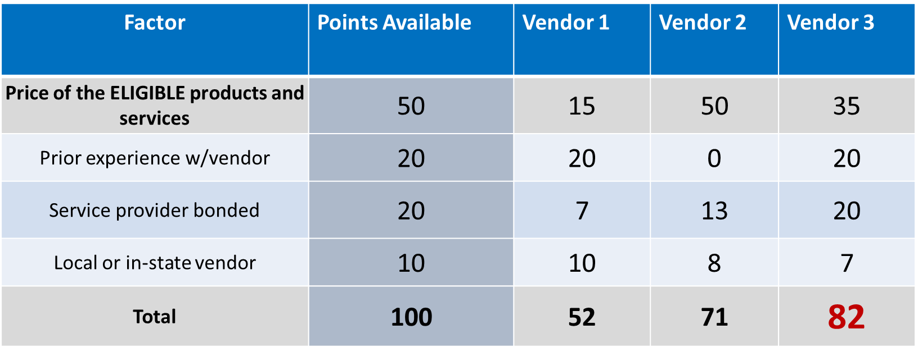
Sample: Bid Evaluation Matrix
Evaluate your bids using a matrix, filled in with your chosen factors and point values.
Vendor #3 wins. Note that this may not be the lowest cost vendor.
©2019 Universal Service Administrative Co.

Slide 16
Evaluating Bids: Zero or One Bid Received
If you receive only one bid, and it is cost-effective, you may accept it.
  Document your decision with a memo or email to your file.
If you did not receive any bids, you can solicit bids after the 28-day waiting period.
  Reach out to vendors in the area.
  Ask your current service provider to submit a bid or confirm they are willing to continue services at your current level and cost.
©2019 Universal Service Administrative Co.

Slide 17
Duplicative Services
Duplicative services are services that provide the same functionality for the same population in the same location during the same period of time.
Backup services - services sought to reduce reliance on any single service provider's network during an outage - are considered duplicative.
Services that provide necessary bandwidth requirements, such as multiple T-1 lines when appropriate for the population served and the services to be received, may not be considered duplicative. However, the applicant must still evaluate and choose the most cost-effective option from the bids received.
USAC cannot fund duplicative services.
©2019 Universal Service Administrative Co.

Slide 18
Fair and Open Competition: Gift Rules
Receipt or solicitation of gifts by applicants from service providers (and vice versa) and potential service providers is a competitive bidding violation.
Service providers may not offer or provide any gifts or thing of value to applicant personnel involved in E-rate.
Gift prohibitions are always applicable, not just during the competitive bidding process.
Exceptions for gifts must be limited to items worth $20 or less, including meals or prizes, and cannot to exceed $50 from one service provider to each individual per funding year.
Watch our Gift Rules video for more details on the gift rules.
©2019 Universal Service Administrative Co.

Slide 19
Contracts
Applicants must have a signed contract or other legally binding agreement in place prior to submitting their FCC Forms 471 to USAC.
Applicant must not sign a contract before the Allowable Contract Award Date (ACD).
Signed contracts constitute the best evidence that a legally binding agreement exists.
A verbal offer and/or acceptance will not be considered evidence of the existence of a legally binding agreement.
For additional information about State Master Contracts, see the USAC website.
©2019 Universal Service Administrative Co.

Slide 20
Requesting Funding
(FCC Form 471)
©2019 Universal Service Administrative Co.

Slide 21
Requesting Funding: FCC Form 471 Application Window
The filing window for the second program form – the FCC Form 471 – generally opens in mid-January and closes in mid-March.
You can file this form after you have completed your competitive bidding process, chosen your vendors, and signed contracts (if appropriate). You also must wait for the filing window to open.
©2019 Universal Service Administrative Co.

Slide 22
Requesting Funding: FCC Form 471
Your FCC Form 471 application can be broken into the following parts:
Basic information – information about the applicant and contact information.
Discount information – student counts, urban/rural status of your schools or libraries.
Funding Request Numbers (FRNs) – for each funding request, you provide:
  The service provider name and the Service Provider Identification Number (SPIN).
  Information about the contracts or month-to-month/tariff agreements.
  The eligible schools/libraries that will receive the services.
  Your chosen services and their costs.
Certifications to indicate your compliance with program rules.
©2019 Universal Service Administrative Co.

Slide 23
Requesting Funding: Next Steps
After submitting the FCC Form 471, USAC will issue a Receipt Acknowledgment Letter (RAL) in your EPC News feed.
Carefully review the letter and the certified FCC Form 471.
  If you notice mistakes on your form, you can make certain, allowable corrections. See Ministerial and Clerical Error Corrections for more details.
  To submit allowable corrections, navigate to your form in EPC, choose “Related Actions,” then “Submit Modification Request (RAL).”
  Your request for corrections will be reviewed along with your application.
©2019 Universal Service Administrative Co.

Slide 24
Requesting Funding: Helpful reminders
The category of service and service type for an FRN must match the category of service and service type that appeared on the FCC Form 470.
Separate your taxes and fees into a separate FRN line item.
If you are purchasing a multiple of something, remember to list the quantity and the unit cost, and do not bundle all costs under a quantity of one.
©2019 Universal Service Administrative Co.

Slide 25
Application Review
©2019 Universal Service Administrative Co.

Slide 26
Program Integrity Assurance (PIA)
After submitting FCC Form 471, USAC reviews your application.
Program Integrity Assurance (PIA) is the group at USAC that reviews your application and makes decisions on funding.
Your PIA reviewer may contact you to:
  Verify eligibility of one or more of your schools or libraries or your student counts.
  Verify eligibility of the requested services.
  Ask for additional documentation on a variety of topics related to your funding requests.
©2019 Universal Service Administrative Co.

Slide 27
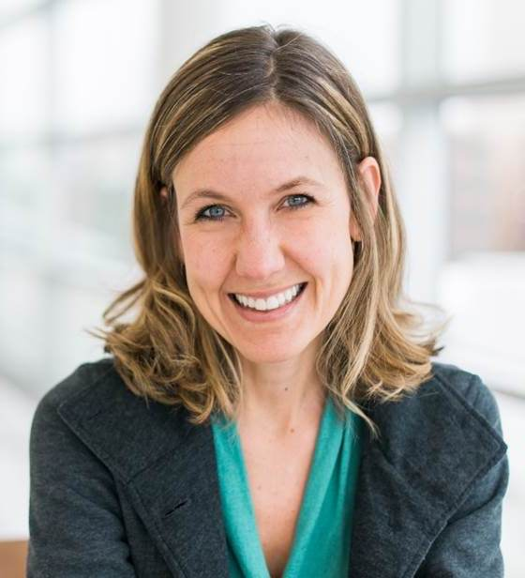
Responding to your PIA Reviewer
You have 15 days to respond to PIA questions.
  You can request one seven-day extension.
If you need help understanding the PIA questions, ask your reviewer for help.
To answer inquiries, ask for extensions, or find your reviewer’s contact info:
  Navigate to the FCC Form 471 in EPC.
  Choose “Related Actions,” then choose “Respond to Inquiries.”
©2019 Universal Service Administrative Co.

Slide 28
Funding Commitments
©2019 Universal Service Administrative Co.

Slide 29
Funding Commitment
When PIA’s review is complete, you and your service provider receive a notification called the Funding Commitment Decision Letter (FCDL).
Your FCDL will include USAC’s decisions on your funding requests — commitments, modifications, and/or denials – and next steps.
FCDLs will be emailed to the contact person on the FCC Form 471, and will also be available in the Notifications section of your EPC landing page.
If you disagree with one or more of USAC’s decisions, you or your service provider can file an appeal.
©2019 Universal Service Administrative Co.

Slide 30
Document Retention
©2019 Universal Service Administrative Co.

Slide 31

Document Retention
You must keep all documentation for 10 years from the last date to receive service.
  For multi-year contracts this means 10 years from the contract expiration date.
Retain receipt and delivery records relating to pre-bidding, bidding, contracts, application process, invoices, provision of services, and other matters relating to your applications.
For example, for recurring internet access service for FY2020, both the applicant and the service provider must retain all records until at least June 30, 2031.
©2019 Universal Service Administrative Co.

Slide 32
Case Studies
©2019 Universal Service Administrative Co.

Slide 33
Case Study – Make and Model
Red School District posted its FCC Form 470 in EPC. The form includes a request for internal connections equipment. The form has the words “or equivalent” following the manufacturer name for their current equipment – because Red School District wants the new equipment to be compatible with their existing equipment – but the RFP attached to the form specifically names the manufacturer without including the words “or equivalent.”
Does this violate the competitive bidding rules?
©2019 Universal Service Administrative Co.

Slide 34
Case Study – Make and Model
Yes. Putting the specific make in the RFP without the “or equivalent” language gives the appearance that Red School District is not open to considering equipment from other manufacturers that could nevertheless be compatible with their existing equipment.
How can this be corrected?
  Red School District can cancel the FCC Form 470 and issue a new form with a corrected RFP; OR
  Red School District can amend the existing RFP by attaching an RFP document to the existing form that corrects the original RFP. In this case, Red School District will have to restart the 28-day waiting period before selecting a service provider.
©2019 Universal Service Administrative Co.

Slide 35
Case Study – Duplicative Services
Yellow School files an FCC Form 471 that requests a fiber internet service from one service provider with a backup service from a second provider that only comes on if the first service fails.
Can USAC fund the backup service?
©2019 Universal Service Administrative Co.

Slide 36
Case Study – Duplicative Services
No. Backup services are considered duplicative, and USAC cannot fund duplicative services.
How can Yellow School receive the backup service?
  Yellow School cannot receive discounts on the backup service. Yellow School must pay for the service itself.
©2019 Universal Service Administrative Co.

Slide 37
Case Study – FCC Form 471 Corrections
Purple Service Provider reviewed the Receipt Acknowledgment Letter (RAL) that USAC issued for its client, Orange Library, and realized that Orange Library reported that the internet access service provided by Purple Service Provider cost $100 per month instead of $1,000 per month noted in the contract.
What can Purple Service Provider do?
©2019 Universal Service Administrative Co.

Slide 38
Case Study – FCC Form 471 Corrections
Purple Service Provider should bring this mistake to Orange Library’s attention and advise them to file a RAL modification in the E-rate Productivity Center (EPC) to correct the error. Orange Library should be prepared to explain the error by attaching a copy of the contract or explaining that the contract is available in the contract record in its EPC profile.
If USAC is already reviewing the application, Purple Service Provider can advise Orange Library to inform the reviewer of the error and ask that it be corrected. Again, Orange Library can provide a copy of the contract or remind the reviewer that the contract is available in Orange Library’s EPC profile.
©2019 Universal Service Administrative Co.

Slide 39
QUESTIONS?
© 2019 Universal Service Administrative Co.

