Slide 1
Advanced Invoicing
2019 Service Provider Training

Slide 2
AGENDA
Before You Begin
Electronic Invoicing
When to File / Deadlines
Invoice Review Process
Case Studies
© 2019 Universal Service Administrative Co

Slide 3
Before You Begin
© 2019 Universal Service Administrative Co.

Slide 4

Before You Begin
Verify that all the prerequisites are in place.
  E.g., FCDL has been issued, FCC Form 486 has been filed, FCC Form 473 has been submitted, FCC Form 498 was approved, etc.
Have the BEAR/SPI discussion. Who will be filing invoices with USAC?
Make sure that you have the most recent commitment information from either the FCDL or the RFCDL, including discount rate, approved cost of service, FCC Form 471 number, FRN, service substitution, etc.
© 2019 Universal Service Administrative Co

Slide 5
Before You Begin
Determine the invoice frequency
  E.g., Monthly, bi-monthly, quarterly, one-time, etc.
Watch the SPI form walk-through videos in the Online Learning Library.
© 2019 Universal Service Administrative Co

Slide 6
Electronic Invoicing (eSPI)
© 2019 Universal Service Administrative Co.

Slide 7
Electronic Invoicing (eSPI)
Service providers have the option to submit invoices electronically.
Helpful for service providers that invoice USAC frequently.
Reduces data entry errors because service providers can maintain and update the information on their own spreadsheets.
Speeds data entry for service providers by providing a mechanism for bulk data entry.
© 2019 Universal Service Administrative Co

Slide 8
Electronic Invoicing (eSPI)
To set up electronic invoicing:
Send a request to USAC at sldform@usac.org.
  Include your email address and SPIN.
USAC will then send you setup instructions by email.
First-time users usually need assistance with their first submission, which USAC will provide.
Most users do not have issues after the first submission has been corrected.
© 2019 Universal Service Administrative Co

Slide 9
Electronic Invoicing (eSPI)
The USAC email contains detailed instructions. Here are the basic steps to follow:
Prepare the information for your file. Be sure to check your entries for accuracy.
Convert your file to the comma-delimited format (.CSV) described in the instructions.
  The file cannot contain more than 2500 lines and must be less than 200 KB in size.
Attach your file to an email and include a copy of the FCC Form 474 certifications.
© 2019 Universal Service Administrative Co

Slide 10
Electronic Invoicing (eSPI) - continued
Email your file to USAC at sldform@usac.org. We will confirm receipt by email.
We will check your file for errors and communicate the results.
If there are errors, you can then correct the file and resubmit it.
After the file has been validated, we will convert it into the equivalent of a SPI Form and send you an invoice status report (ISR).
© 2019 Universal Service Administrative Co

Slide 11
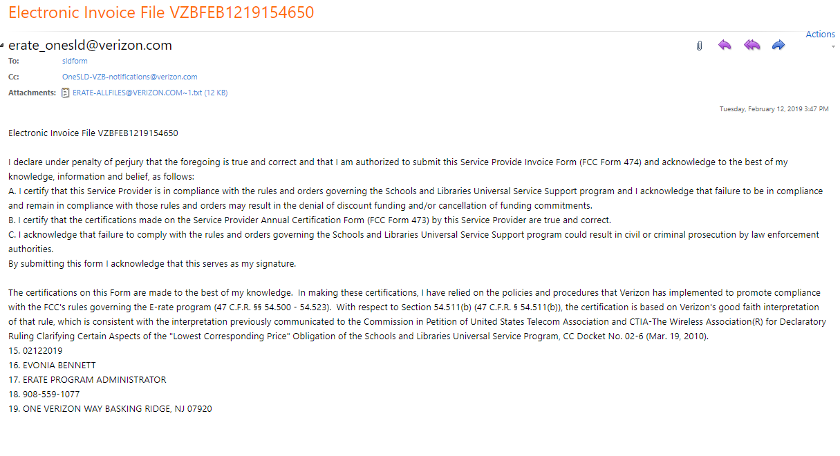
Electronic Invoicing – Sample FCC Form 474 Certifications
Electronic Invoice Number xxxxxxxxxxxxxxxx
15 Date
16 Authorized Person Name
17 Authorized Person Title
18 Authorized Person Telephone Number
19 Authorized Person Address, City, State, Zip
© 2019 Universal Service Administrative Co

Slide 12
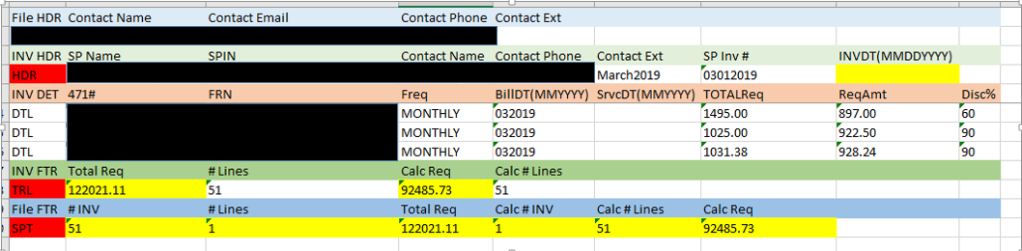
Electronic Invoicing – Error Check (FileParser)
We upload your file into FileParser and send you a screenshot identifying any errors.
For each line with an error, the left-hand cell will be red and the cell(s) with errors will be yellow.
You can then identify and fix the error(s) and resubmit the invoice.
© 2019 Universal Service Administrative Co

Slide 13
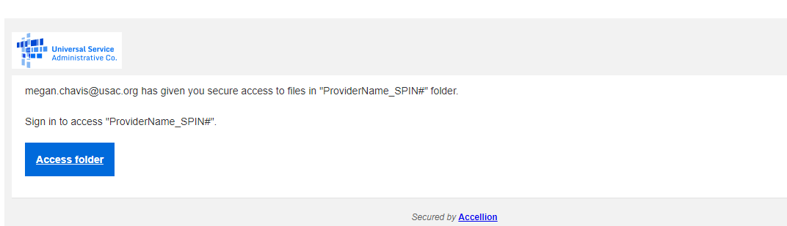
Electronic Invoicing – Secure File Transfer on Kiteworks
You can submit files by secure transfer. To do this:
Send a request to USAC at slform@usac.org.
We will create a folder for a single submission from you.
  The folder name is YourProviderName_Your SPIN.
© 2019 Universal Service Administrative Co

Slide 14
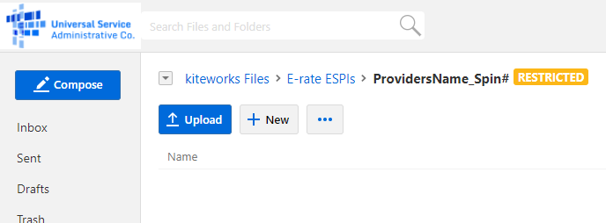
Electronic Invoicing – Secure File Transfer on Kiteworks
This folder is restricted. You can upload only to your specified folder and cannot download or maneuver on this site.
© 2019 Universal Service Administrative Co

Slide 15
Electronic Invoicing – Secure File Transfer on Kiteworks
After uploading the file, you must email your certifications separately to sldform@usac.org.
  If you upload more than one file, you must provide a copy of the certifications for each file.
  Label each set of emailed certifications so that we can match them to the appropriate invoice.
  Copy the certifications from the instructions (the electronic copy); do not retype them.
© 2019 Universal Service Administrative Co

Slide 16
When to File an Invoice
© 2019 Universal Service Administrative Co.

Slide 17

When to File
The invoice deadline is:
  120 days after the last date to receive service or 120 days after the date of the FCC Form 486 Notification Letter, whichever is later.
  If the calculated deadline falls on a weekend or federal holiday, the deadline is 11:59 p.m. ET on the following business day.
© 2019 Universal Service Administrative Co

Slide 18
When to File
File after services are delivered and paid
  Applicants – pay in full for services first
  Service providers – bill applicants for their non-discount share first
You can choose the frequency
File before the invoice deadline
  Generally, October 28 for recurring services
  Generally, January 28 for non-recurring services
© 2019 Universal Service Administrative Co

Slide 19
When to File
Invoice deadline extension requests
  File requests for FY2016 and later funding years in EPC.
    Service providers locate their SPIN under Records and choose Invoice Deadline Date Extension Requests from the Related Actions menu.
  File requests for FY2015 and previous funding years
    Service providers log in to the E-File System and choose the 472 BEAR Form.
© 2019 Universal Service Administrative Co

Slide 20
When to File
Invoice deadline extension requests must be filed ON OR BEFORE the invoice deadline date.
Filers can receive one 120-day extension of the time to file.
If applicants or service providers miss the deadline to file an invoice or to request an invoice deadline extension, they must file a request for waiver of the invoice deadline with the FCC.
  The FCC must grant the waiver request before USAC can process an invoice.
However, if USAC rejects a timely filed invoice, the applicant can appeal that rejection directly to USAC.
© 2019 Universal Service Administrative Co

Slide 21
Invoice Review
© 2019 Universal Service Administrative Co.

Slide 22
Invoice Review – Automated Review
All invoices undergo a series of automated reviews.
Line items are automatically rejected if their information (FCC Form 471 number, FRN, discount percentage, available funding, etc.) is incorrect or inconsistent with the approved FRN.
Keep in mind that the online SPI Form has fewer built-in warnings, so accurate data entry is very important.
© 2019 Universal Service Administrative Co

Slide 23
Common Data Entry Errors
The FCC Form 471 and/or Funding Request Number (FRN) does not exist in our system.
Your SPIN is not featured on the FRN.
The FRN you entered is not on the FCC Form 471 number you entered.
The entire commitment has already been paid.
The FRN is for the previous funding year.
The line item is or appears to be a duplicate.
  This may be because the customer billed date is entered as the service start date in every line item rather than the first date that service was delivered for that line item.
© 2019 Universal Service Administrative Co

Slide 24
Note on Discount Data Entry
The system does not pre-populate the discount from the FRN record to the online SPI Form.
To complete each line item:
  Enter the pre-discount amount.
  Enter the discount percentage manually. This entry must be a number between 20 and 90.
  If the correct discount is less than 20, enter 20. (This will only occur for pre-FY2019 voice services subject to the voice phase-down.)
  Calculate the post-discount amount manually and enter it.
© 2019 Universal Service Administrative Co

Slide 25
Invoice Review – Manual Review
  Manual reviews verify, among other things, that:
      the customer bills are accurately reflected on the E-rate invoice and discounts are properly applied;
      the services are eligible and were approved on the FCDL;
      It the services are not on the FCDL, USAC approved a service substitution.
  USAC reviewers send questions to the service provider and ask for responses in seven days; one seven-day extension can be granted.
  USAC reviews the information provided and makes a disbursement decision.
  If payment is rejected, the service provider can resubmit the invoice once the issue has been corrected.
© 2019 Universal Service Administrative Co

Slide 26
Invoice Review: Service Certification
  Some manual reviews require additional documentation, such as:
      Proof that the applicant paid their share.
      Proof that the invoiced services were delivered and/or installed.
      Proof that progress payments were included in the contract.
  USAC reviewers send a Service Certification and instructions to the service provider so that they can forward it to the applicant.
  The applicant completes the certification and returns it directly to USAC.
  USAC reviews the information provided and makes a decision
© 2019 Universal Service Administrative Co

Slide 27
Case Studies
© 2019 Universal Service Administrative Co.

Slide 28
Case Studies: Similar Line items
Invoice #1234567 was submitted on 6/10/2019 for $759.00 in recurring services for FRN 189900010 with a customer billed date of 6/1/2019.
Invoice #1234789 was submitted on 7/10/2019 for $759.00 in recurring services for FRN 189900010 with a customer billed date of 7/1/2019.
Question:
How will USAC process the second invoice?
© 2019 Universal Service Administrative Co

Slide 29
Case Studies: Similar Line items
Answer:
USAC will deny the second invoice.
Recurring services for the following funding year will have a new FRN, even if they are the same services and they are provided under a multi-year contract.
To avoid this problem:
Review your Funding Commitment Decision Letters for FY2018 and FY2019, then resubmit the second invoice with the approved FY2019 FRN.
© 2019 Universal Service Administrative Co

Slide 30
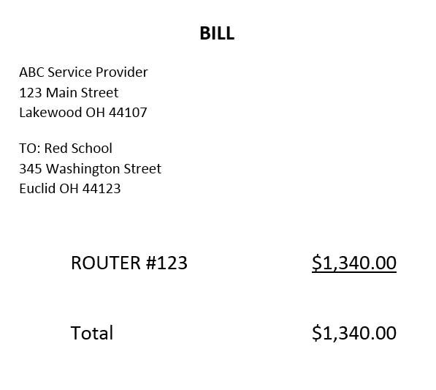
Case Studies: Applicant Share
Service provider submits a SPI Form for $660.00. During invoice review, the service provider provides this customer bill.
Question:
What information is missing from the customer bill?
© 2019 Universal Service Administrative Co

Slide 31
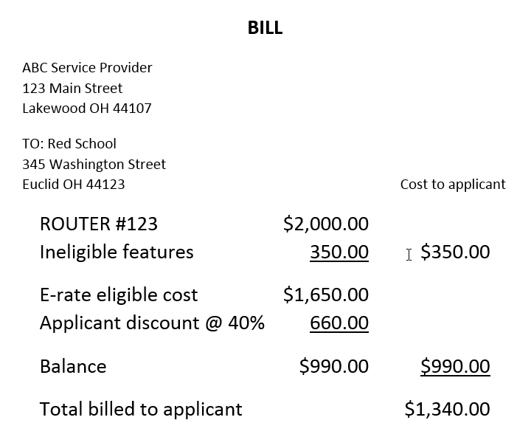
Case Studies: Applicant Share
Answer:
Ineligible products or services
Applicant discount
Amount billed to applicant
Amount to be invoiced to USAC
To avoid this problem:
Provide sufficient detail on the customer bill.
© 2019 Universal Service Administrative Co

Slide 32
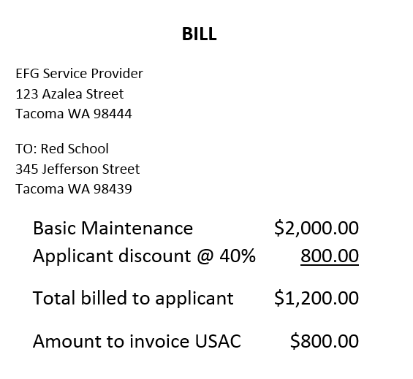
Case Studies: Basic Maintenance
Service provider submits a SPI Form for $800.00. During invoice review, the service provider provides this customer bill.
Question:
What information is missing from the customer bill?
© 2019 Universal Service Administrative Co

Slide 33
Case Studies: Basic Maintenance
Answer:
Basic Maintenance customer bills must provide the details of actual work performed – including hours worked and eligible products and parts that are repaired or replaced.
For eligible services such as software upgrades and patches (including bug fixes and security patches) and online and telephone-based technical assistance and tools – details of those services must be provided as well.
To avoid this problem:
Provide the required detail on the customer bills you issue, and make sure that the details and amounts on the SPI Form are consistent with those on the customer bills.
NOTE: USAC is required to manually review all invoices that feature Basic Maintenance. If you are only providing services such as software upgrades and patches, consider invoicing USAC quarterly or less often, even if you bill your customers monthly.
© 2019 Universal Service Administrative Co

Slide 34
Case Studies: Service Certification
During the review of an invoice, the reviewer requests verification from the applicant that services were delivered and installed.
The reviewer sends a service certification with instructions to the service provider to forward to the applicant for confirmation.
The service provider sends only the service certification (without instructions) to the applicant, who completes it and returns it to the service provider. The service provider then sends it to the invoice reviewer.
Question:
What will USAC do?
© 2019 Universal Service Administrative Co

Slide 35
Case Studies: Service Certification
Answer:
The invoice reviewer will attempt to contact the applicant to verify that the response was in fact from the applicant.
  If the applicant responds, the invoice reviewer can continue the review process.
  If the applicant does not respond, the invoice reviewer will deny the invoice.
To avoid this problem:
The service provider should forward the entire email – the service certification and the instructions – to the applicant.
It would be a good idea for the service provider to check in with the applicant before seven days have elapsed to make sure that the applicant has responded and returned the service certification directly to USAC.
  If the applicant needs more time, the service provider can contact the invoice reviewer and ask for a seven-day extension.
© 2019 Universal Service Administrative Co

Slide 36
Questions?
© 2019 Universal Service Administrative Co.

Slide 37
© 2019 Universal Service Administrative Co.

