Slide 1
Understanding the Audit Process
Fall 2018 Service Provider Training

Slide 2
Payment Quality Assurance (PQA)
Selection based on a statistically valid sample of disbursements
Assessments may occur simultaneously with audits
Request certification of compliance with Lowest Corresponding Price (LCP) rule
Visit https://www.usac.org/about/about/program-integrity/pqa.aspx for more information
© 2018 Universal Service Administrative Co.

Slide 3
Beneficiary and Contributor Audit Program (BCAP)
Selections are random or based on data analytics
Service Providers notified by phone and email with:
  Announcement letter
  List of documents requested
  Internal control / process interview questionnaires
Entrance conference to discuss audit details
  Auditors involved
  FRNs included
  Duration of audit
Visit https://www.usac.org/about/about/program-integrity/bcap.aspx for more information
© 2018 Universal Service Administrative Co.

Slide 4
Beneficiary Involvement in Service Provider Audit
May need beneficiary assistance to demonstrate compliance:
  Reconcile Billed Entity Application Reimbursement Form (BEAR) to the bills
  Demonstrate payment of non-discounted share
  Identify location of equipment (fixed asset listing):
    Physical inventory (site visit)
    Equipment/services timely delivered to eligible locations and is operational
© 2018 Universal Service Administrative Co.

Slide 5
Service Provider Involvement in Beneficiary Audit
May need service provider assistance to demonstrate compliance
  Reconcile Service Provider Invoices (SPI) to the bills
  Identify eligible services on the bills
  Explain differences between services delivered, billed, contracted for, and/or requested on the FCC Form 471
© 2018 Universal Service Administrative Co.

Slide 6
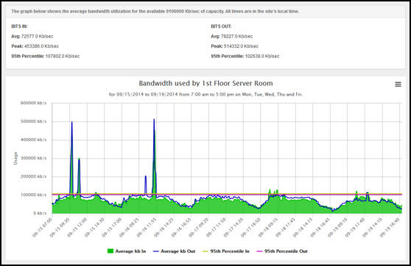
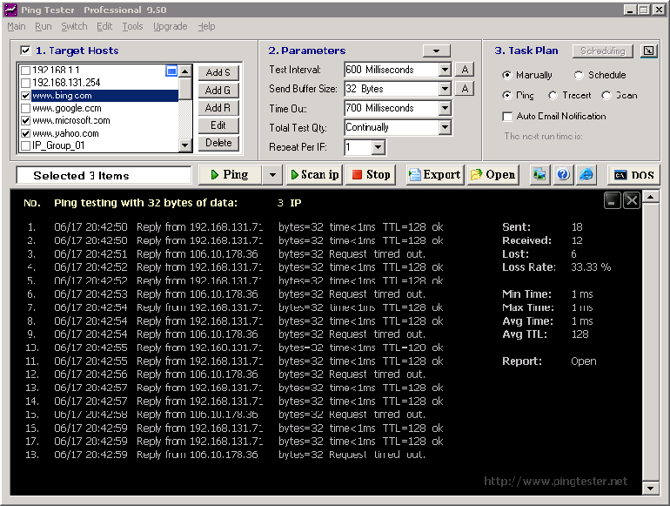
Services and Equipment Delivered
Circuit utilization reports
“Ping” reports
Network designs
Delivery tickets
© 2018 Universal Service Administrative Co.

Slide 7
Basic Maintenance of Internal Connections
“[R]eimbursements for BMIC will be paid only for actual work performed or for hours of labor actually used.” BMIC Clarification Order, WC Docket No. 02-60, 25 FCC Rcd 17324, 17325, at para. 4 (2010)
Documentation of actual services performed, either:
  Actual hours
  Actual services on eligible equipment
© 2018 Universal Service Administrative Co.

Slide 8

Rebates and Free Services
Beneficiary did not pay non-discounted portion
Additional services and equipment at no cost
Service and equipment upgrades for more expensive models at no additional charge
Downward adjustment of the price per unit for changes in quantities to stay within the Schools & Libraries Program (SLP) committed amounts
© 2018 Universal Service Administrative Co.

Slide 9

Lowest Corresponding Price (LCP)
© 2018 Universal Service Administrative Co.

Slide 10
Why is LCP audited?
To determine whether
  There are any non-residential, similarly situated customers receiving the same or similar service as a school/library participant.
    If not, documentation needed to demonstrate there are no other non-residential customers receiving same or similar service as a similarly situated school/library participant.
© 2018 Universal Service Administrative Co.

Slide 11
Why is LCP audited? (cont.)
To determine whether
  All bids received offered the lowest corresponding price. 47 C.F.R. § 54.511(b).
  Schools and libraries are being charged more for the same or similar service as other similarly situated non-residential customers receiving the same or similar service.
© 2018 Universal Service Administrative Co.

Slide 12

Who are the non-residential customers?
“Lowest corresponding price is the lowest price that a service provider charges to non-residential customers who are similarly situated to a particular school, library, or library consortium for similar services.” 47 C.F.R. § 54.500
© 2018 Universal Service Administrative Co.

Slide 13

What services are non-residential customers receiving?
“Service providers may request higher rates if they can show that the lowest corresponding price is not compensatory, because the relevant [beneficiary] is not… subscribing to a similar set of services to the customer paying the lowest corresponding price.” 47 C.F.R. § 54.504(c)(2)
© 2018 Universal Service Administrative Co.

Slide 14

When were the services delivered?
“[The Commission] will establish a rebuttable presumption that rates offered within the previous three years are still compensatory.”
First Report and Order, CC Docket No. 96-45, 12 FCC Rcd 8776, 9034, at para. 489 (1997)
© 2018 Universal Service Administrative Co.

Slide 15
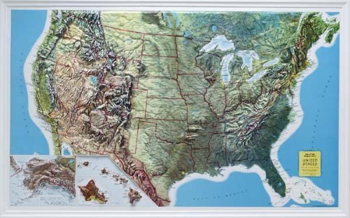
Where are the non-residential customers located?
“Service providers may request higher rates if they can show that the lowest corresponding price is not compensatory, because the relevant [beneficiary] is not similarly situated to… the customer paying the lowest corresponding price.”
47 C.F.R. § 54.504(c)(2)
© 2018 Universal Service Administrative Co.

Slide 16

Common Invoicing Findings
Eligible services are not identified in the bills
  Language is not clear to distinguish the services performed
© 2018 Universal Service Administrative Co.

Slide 17

Common Invoicing Findings
Pre-discounted costs of services billed do not agree to the pre-discounted costs in the SPIs
  SPI not reconciled
  Invoiced under incorrect FRN
  Applied incorrect discount rate
© 2018 Universal Service Administrative Co.

Slide 18

Common Invoicing Findings
Invoiced SLP for ineligible services
  Services not included on the FCC Form 471 and approved by SLP
    Services on FCC Form 471 that were not bid upon or contracted for
  Services delivered to locations not requested
  Services delivered to ineligible students or ineligible locations
© 2018 Universal Service Administrative Co.

Slide 19
Common Lack of / Inadequate Documentation Findings
“Service providers shall retain documents related to the delivery of supported services for at least 10 years after the latter of the last day of the applicable funding year or the service delivery deadline for the funding request.”
47 C.F.R. § 54.516(a)(2)
© 2018 Universal Service Administrative Co.

Slide 20
Documentation Examples
Policies & procedures to demonstrate compliance with FCC rules.
Bills, including reconciliation of invoices submitted to USAC
Equipment and services contracts
Maintenance logs, service tickets, work orders, etc., if BMIC services provided
Payment information to demonstrate beneficiaries paid their non-discounted share
Note: This list is not meant to be all-inclusive.
© 2018 Universal Service Administrative Co.

Slide 21
Understanding the audit results
If the auditor identifies a potential area of non-compliance:
  Service provider / beneficiary notified ASAP.
  Service provider / beneficiary able to provide additional documentation to demonstrate compliance with FCC rules.
  Auditor drafts audit report.
Exit conference to discuss audit results
  Discuss all audit findings (and other matters).
  Service provider / beneficiary provide a response to the audit findings.
  Auditor to send service provider / beneficiary post-audit survey.
© 2018 Universal Service Administrative Co.

Slide 22
Tips for Success
Review the Funding Commitment Decision Letter (FCDL)
  If the pre-discounted and discounted costs committed in the FCDL are not in agreement with the pre-discounted costs and calculated discounted costs of services to be delivered, contact the Beneficiary
Maintain supporting documentation for amounts included on the SPI.
© 2018 Universal Service Administrative Co.

Slide 23
Questions?

