Slide 1
Process Overview for Service Providers
E-rate Program Fall Training
December 3–5, 2018

Slide 2
AGENDA
Common questions
FCC Form 498 - SPIN and general contact
Applicant competitive bidding (FCC Form 470)
Applicant application for discounts (FCC Form 471)
FCC Form 473 - annual certification
Applicant services start (FCC Form 486)
FCC Form 474 - invoice USAC
Applicant invoice (FCC Form 472)

Slide 3
Common Questions

Slide 4

What is a Funding Year?
Runs from July 1 to the following June 30.
  FY2019 runs from July 1, 2019 to June 30, 2020.
Recurring services (e.g., monthly internet service) must be delivered by June 30.
Non-recurring services (e.g., equipment and installations) must be delivered and installed by the September 30 following the funding year.
  This deadline can be extended.

Slide 5

Who Can Apply?
Eligible independent schools and school districts.
Eligible independent libraries and library systems.
Consortia of eligible entities (e.g., regional consortia, statewide networks).

Slide 6
How Much Money is Available?
$3.9 billion funding cap for each funding year, starting with FY2015
Cap is indexed to inflation
FCC can roll over unused funds from prior funding years

Slide 7
How Do I File Program Forms and Get Information?
E-File System
  File FCC Form 498 for service providers
  File FCC Form 473
E-rate Productivity Center (EPC)
  Access your account and receive communications from USAC
USAC website
  File FCC Form 474
  Access program guidance and search tools

Slide 8
What Services are Eligible for FY2019?
Category One
  Data transmission and/or Internet access
  Voice services phased out completely for FY2019
Category Two
  Internal connections
  Basic maintenance of internal connections (BMIC)
  Managed internal broadband services (MIBS)

Slide 9
What is the Eligible Services List?
USAC sends a draft Eligible Services List (ESL) to FCC each year.
FCC issues a Public Notice with draft ESL.
  You have an opportunity to provide input in advance of the final ESL.
FCC reviews comments and reply comments and then issues a final list for the upcoming funding year.
  Descriptions of eligible services are set for the funding year once the final ESL is issued.

Slide 10
How Large are the Discounts for Eligible Services?
Category One: 20 – 90% of the cost
Category Two: 20 – 85% of the cost
Discounts are based on:
  Percentage of students eligible for the National School Lunch Program (NSLP) and
  Urban or rural status

Slide 11
How Long Should Records be Maintained?
Keep all records pertaining to the application process for at least ten years after the last date to receive service.
Some examples of documents to retain:
  Contracts
  Copies of filed FCC forms, letters and other communications from USAC
  Customer bills/bill information
  Filed requests (e.g., appeals, service substitutions, global SPIN changes)

Slide 12
FCC Form 498

Slide 13
FCC Form 498 – Service Provider and Billed Entity Identification Number and General Contact Information Form
Provides contact information for the service provider, along with the type of business and bank account information for ACH payments.
Original and revisions filed online.
  Can be submitted by company officer or general contact
  Must be certified by company officer
Helpline: 1-888-641-8722, option 4 (contributors)

Slide 14
Why is FCC Form 498 Important to You?
Establishes user IDs and passwords for online updates, submissions, access, etc.
Populates your profile in the E-rate Productivity Center (EPC.)
Populates USAC databases that applicants use to contact you and find your SPIN.
Provides electronic remittance information USAC uses to pay invoices.

Slide 15
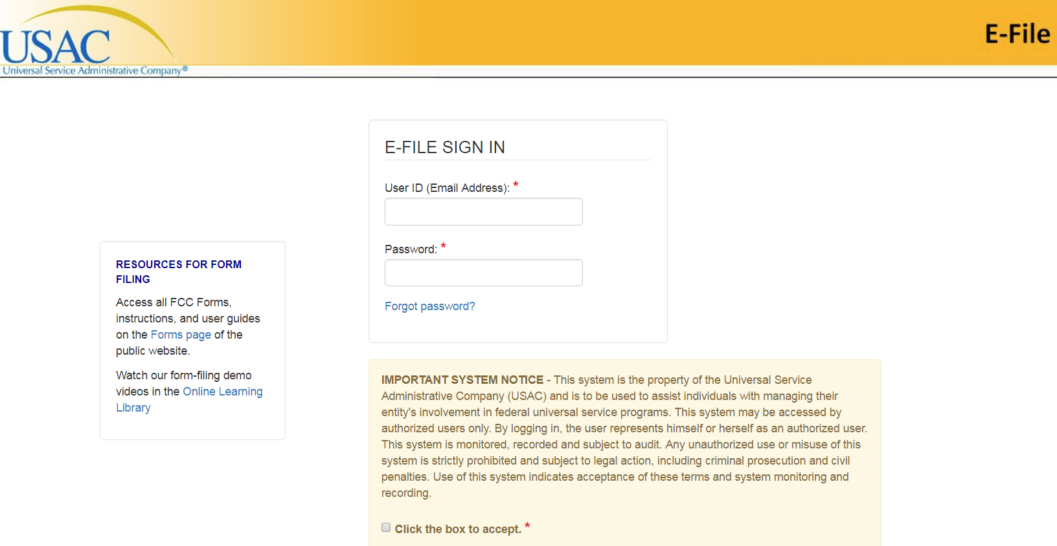
EPC log in page

Slide 16
Competitive Bidding (Applicants)

Slide 17
Applicants Open a Competitive Bidding Process
Applicants post an FCC Form 470 and may issue an RFP to open a competitive bidding process.
  FCC Form 470 is posted in EPC (online portal for program participants)
  All RFPs and RFP documents must be attached to the form.
Process must be open and fair.
Service providers can review and respond to posted FCC Forms 470 and/or download summary information.
  Follow applicant requirements and local and state procurement rules.
  Do not assist applicants with any step in this process.

Slide 18
After Waiting at Least 28 Days:
Applicants choose the most cost-effective bid using the price of the eligible products and services as the most heavily weighted factor in their evaluation.
Applicants can sign a contract or receive services under tariff or on a month-to-month basis from the winning service provider.

Slide 19
Applying for Discounts (Applicants)

Slide 20
Applicants File FCC Form 471 During the Filing Window
After applicants choose a service provider, they file the FCC Form 471.
Application filing window
  A period of about 75 days – generally from early January to mid-March – when FCC Forms 471 are filed for the upcoming funding year.
Each chosen service provider can assist the applicant with completing much of the information required for the FCC Form 471.
Services are reported on the FCC Form 471 by Funding Request Number (FRN).
  An FRN is specific to a category of service, a service type, a contract, and a service provider.

Slide 21
Service Providers Should:
Keep your FCC Form 498 contact information updated.
Offer assistance to applicants with product and service descriptions as part of the application process.
Verify the invoicing method the applicant chooses – FCC Form 474 (SPI) or FCC Form 472 (BEAR).
Review the Receipt Acknowledgment Letter (RAL) and notify applicant of any errors.

Slide 22
USAC Reviews the Applicant FCC Form 471
Applicants undergo review of their FCC Form(s) 471 by Program Integrity Assurance (PIA).
  Service providers can assist with specific questions on products and services, eligible uses, network/configuration questions.
  Service providers cannot assist with questions on the competitive bidding process.

Slide 23
USAC Issues Funding Decisions to the Applicant and Service Provider
USAC issues funding decisions to both the applicant and the service provider through a Funding Commitment Decision Letter (FCDL).
  FCDLs are issued in EPC.
  Requests can be funded (which includes partially funded or reduced), canceled, or denied.
Review FCDL details for each applicant.
  Help applicants prepare for start of services.
  If funding is reduced or denied, you or the applicant can consider filing an appeal of the USAC decision with USAC.

Slide 24
FCC Form 473

Slide 25
FCC Form 473 – Service Provider Annual Certification (SPAC) Form
Contains certifications of compliance with E-rate program rules.
  Must be filed for each funding year.
  Must be on file with USAC before an invoice can be paid for that funding year.
We suggest that you file the FCC Form 473 early so you don’t forget.
Read the certifications carefully and be sure you can certify truthfully.
Check the SPIN Contact Search Tool to verify that we have received and processed your form.
  Each funding year for which we have an FCC Form 473 shows in SPAC column on the right-hand side of the search results.

Slide 26
Starting Services (Applicants)

Slide 27
Applicant Files FCC Form 486 after Services Start
Applicant files FCC Form 486 to indicate:
  Service start date(s)
  Status under the Children’s Internet Protection Act (CIPA)
FCC Form 486 must be successfully processed – which includes passing any USAC reviews – before USAC will pay invoices.
Service providers can:
  Encourage applicants to file an FCC Form 486 early if they are eligible.
  Notify applicants if services have started and no FCC Form 486 has been filed.
  Verify the service start date for each Funding Request Number (FRN).

Slide 28
Invoicing

Slide 29
SPI Method and BEAR Method of Invoicing
Two invoicing methods – the method is chosen by the applicant on an FRN basis:
  FCC Form 474 (SPI Form) is filed by service provider after billing applicant for non-discount share; USAC reimburses the service provider.
  FCC Form 472 (BEAR Form) is filed by applicant after applicant has paid for service in full; USAC reimburses the applicant.
First invoice for an FRN sets the invoicing method for that FRN.

Slide 30
For the SPI /method:
For the BEAR Method:
Bill the applicant for the non-discount share.
  Program rules require the applicant to pay the non-discount share.
  The expectation is that the applicant will pay your bill within 90 days.
Respond promptly to USAC requests for documentation or other information.
Bill the applicant for the full cost of the eligible products and services.
Remind the applicant not to wait until the last minute to file a BEAR Form.
Respond promptly to USAC requests for documentation or other information.

Slide 31
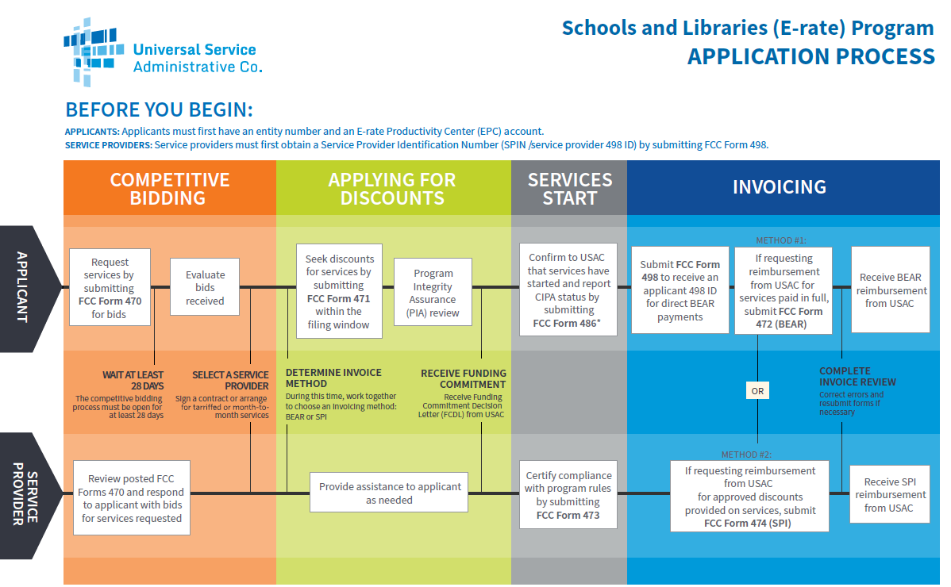

Slide 32
Questions?

