Slide 1
BEGINNERS: TOOLBOX DEMONSTRATION
2018 APPLICANT TRAINING

Slide 2
TOOLBOX – Schools and Libraries Website
DAY ONE - BEGINNERS
Search
Glossary of Terms and Reference Area
Applicant and service provider process steps
Forms
Tools
Trainings & Outreach
Client Service Bureau

Slide 3
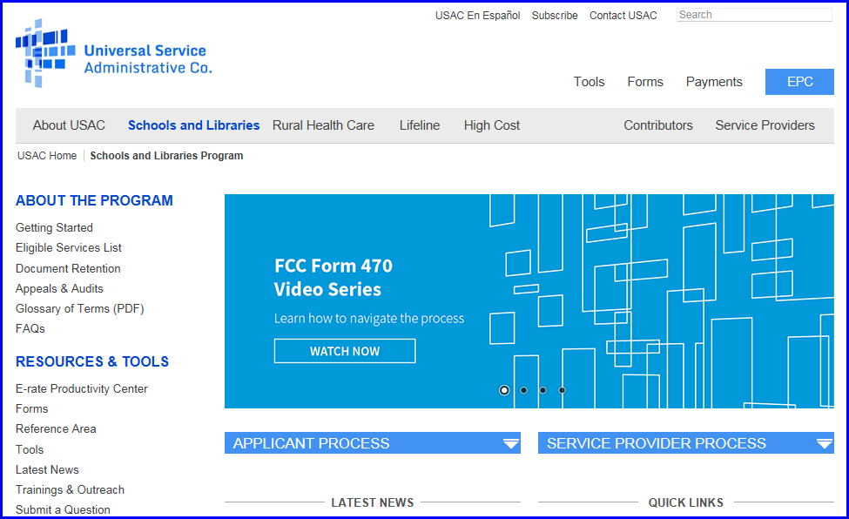
Website – www.usac.org/sl

Slide 4
Website

Slide 5
Search

Slide 6
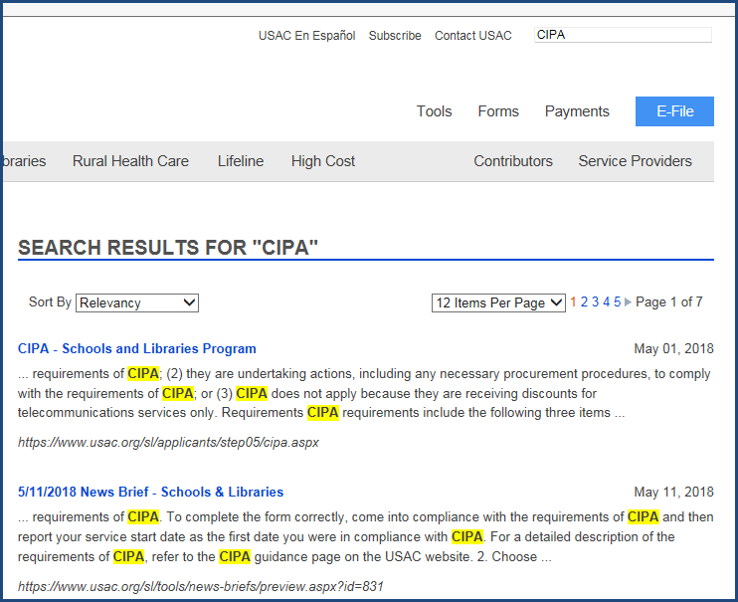
Search

Slide 7
ABOUT THE PROGRAM

Slide 8
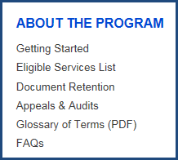
Eligible Services List and Glossary

Slide 9
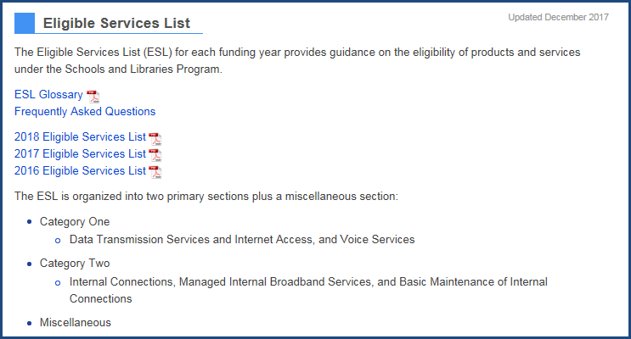
Eligible Services List (ESL)

Slide 10
Glossary of Terms

Slide 11
Process Steps

Slide 12
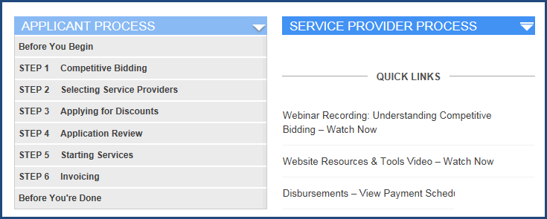
Applicant Process Steps

Slide 13
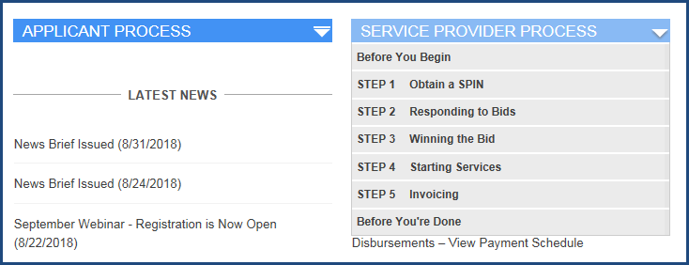
Service Provider Process Steps

Slide 14
RESOURCES & TOOLS

Slide 15
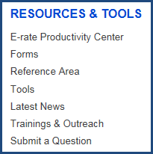
Forms, Reference, Tools, Training

Slide 16
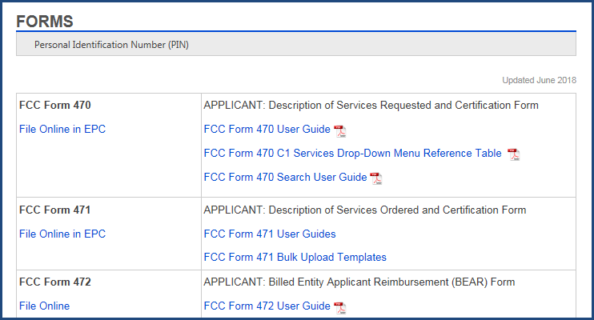
Forms

Slide 17
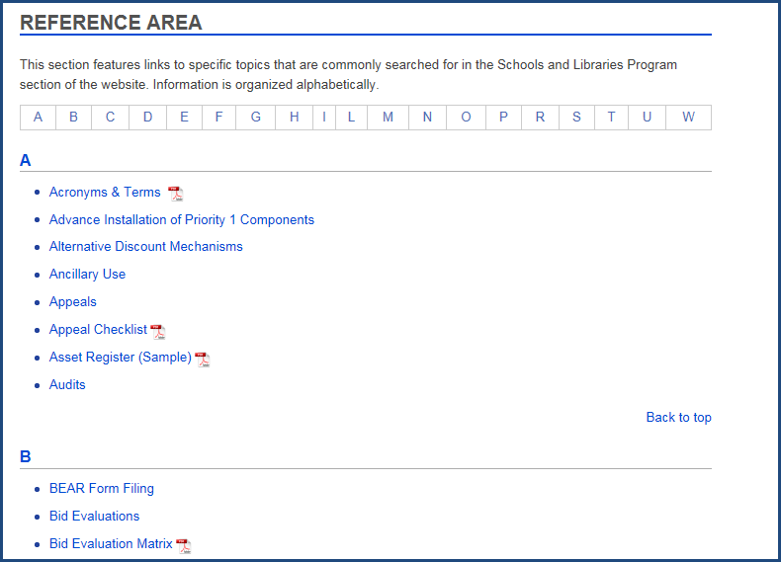
Reference Area

Slide 18
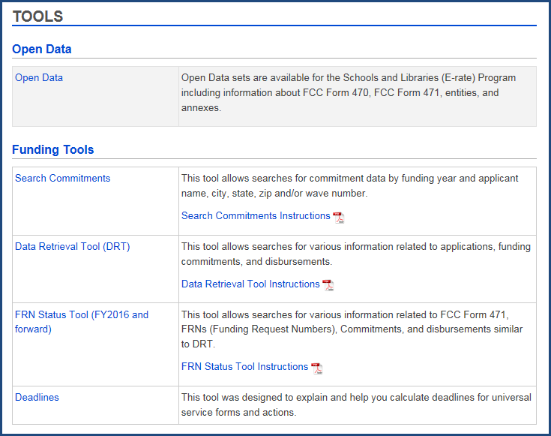
Tools

Slide 19
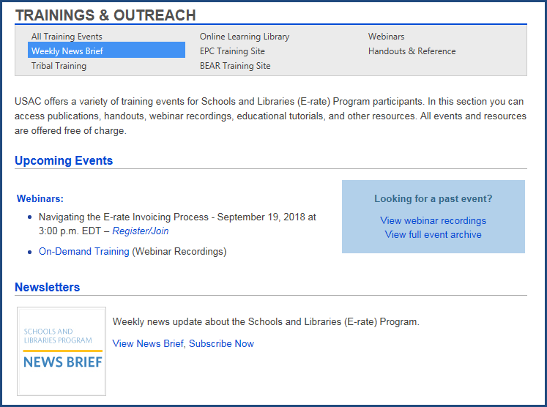
Training & Outreach

Slide 20
CLIENT SERVICE BUREAU (CSB)
To call: 888-203-8100
8:00 a.m. – 8:00 p.m. ET Monday through Friday
Extended hours during the last week of the filing window.
To open a customer service case in EPC:
Choose “Contact Us” from Actions or Landing Page.
Provide contact information, ask your question, attach any documents that would be helpful.

