Slide 1
Introduction to the E-rate Productivity Center (EPC)
2018 Applicant Training

Slide 2
AGENDA
What is the E-rate Productivity Center (EPC)?
Logging into EPC
New Users: Terms and Conditions
My Landing Page
Navigation Bar
Your EPC Entity Profile

Slide 3
What is the E-rate Productivity Center (EPC)?

Slide 4

Poll the Audience -
  Who in the audience has logged into EPC?
  Who in the audience is an Account Administrator?
  Who in the audience has User rights in EPC?
  Who has no idea?

Slide 5

E-RATE PRODUCTIVITY CENTER (EPC)
What is EPC?
  Account and application management portal
  Manage program processes, receive notifications, and contact customer service.
What can you do in EPC?
  File most program forms
  Maintain a list of your related entities
  Update entity information
  Account Administrators can add users on their organization’s account and assign them rights (permissions) to file program forms.

Slide 6
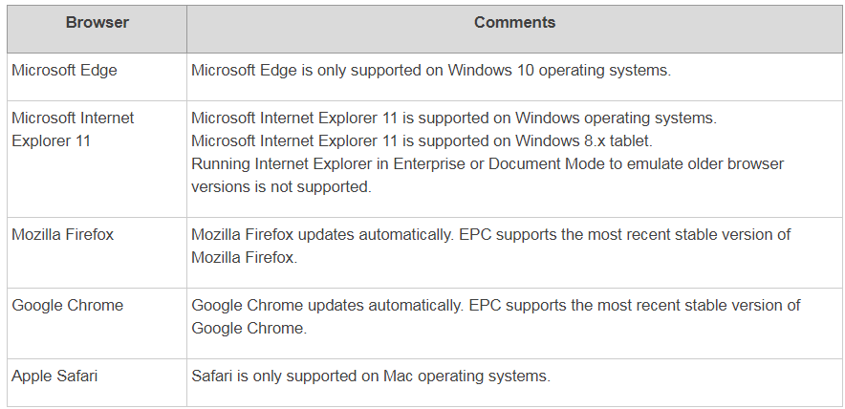
E-RATE PRODUCTIVITY CENTER (EPC)
What web browsers are supported by EPC?

Slide 7
Logging into EPC

Slide 8

Step 1:
Go to EPC:
https://portal.usac.org/suite/

Slide 9
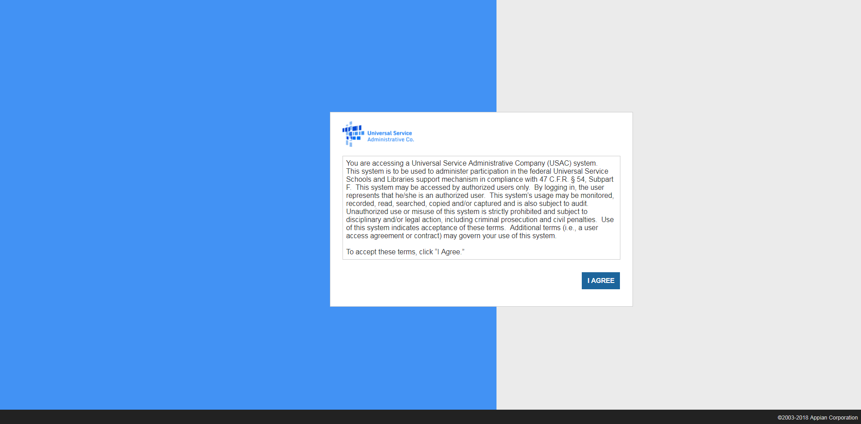
Step 1:

Slide 10
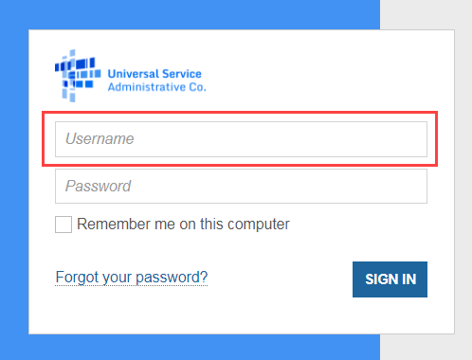
Step 2: Logging In
Tips for Entering your Username
  Type in your username instead of copying and pasting.
  Enter it in all lowercase.
  Make sure there are no spaces or erroneous characters in the username.
  Check for typos.

Slide 11
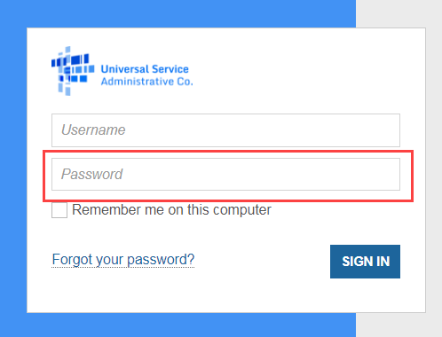
Step 2: Logging In (Continued)
Tips for Creating your Password
  Be at least eight characters
  Has not been used in the previous four passwords
  Contains at least one numeral (0 through 9)
  Contains at least one special character (such as !, $, #, %)
  Contains at least one uppercase letter (A through Z)
  Contains at least one lowercase letter (a through z)

Slide 12
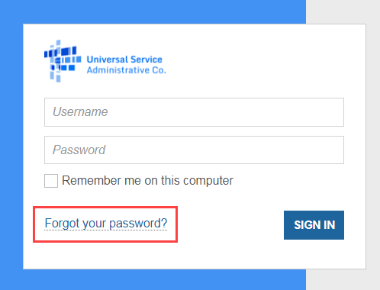
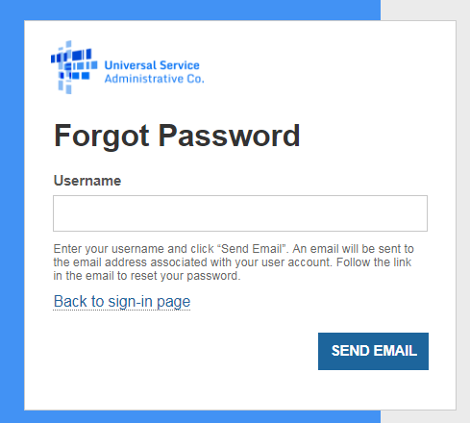
Step 2: Logging In (Continued)
Forgot your Password?
Enter the email address associated with the account (the EPC username).
Click SEND EMAIL.
You will receive email from portal@usac.org, subject "Universal Service Administrative Company (USAC) Password Reset".

Slide 13
New Users: Terms and Conditions

Slide 14

NEW EPC USERS: Terms and Conditions
In order to access EPC functions, every user must accept Terms & Conditions.
New user accounts are considered inactive and will not have access to anything within EPC until the Terms & Conditions are accepted.
When a new user is created from an organization, the new user will not appear under the organization’s profile until they have accepted the Terms and Conditions.

Slide 15
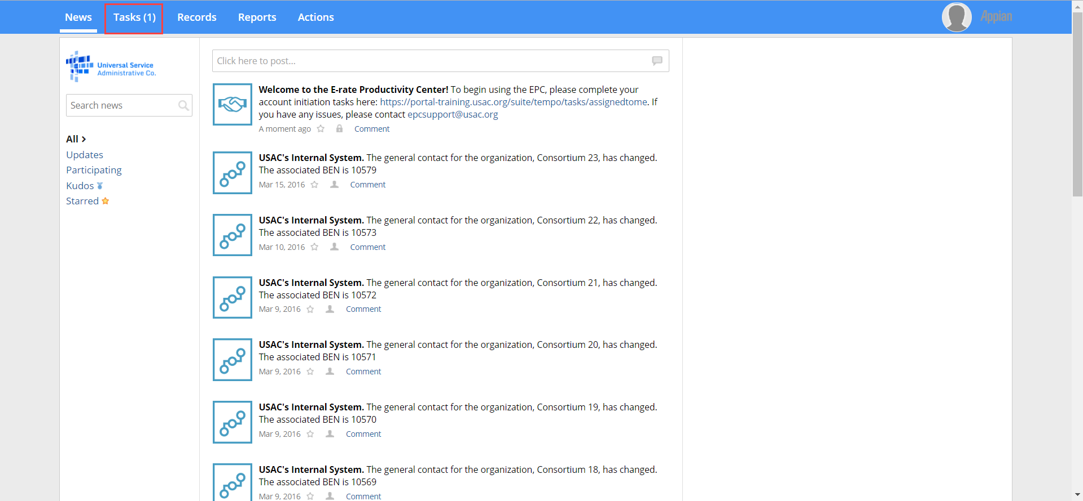
DEMO NEW EPC USERS: Terms and Conditions
Once you are created as a new user in EPC:
  Log in to EPC
  Once you are logged in, you will be routed to your News screen.
  Click Tasks (1) on the top left corner

Slide 16
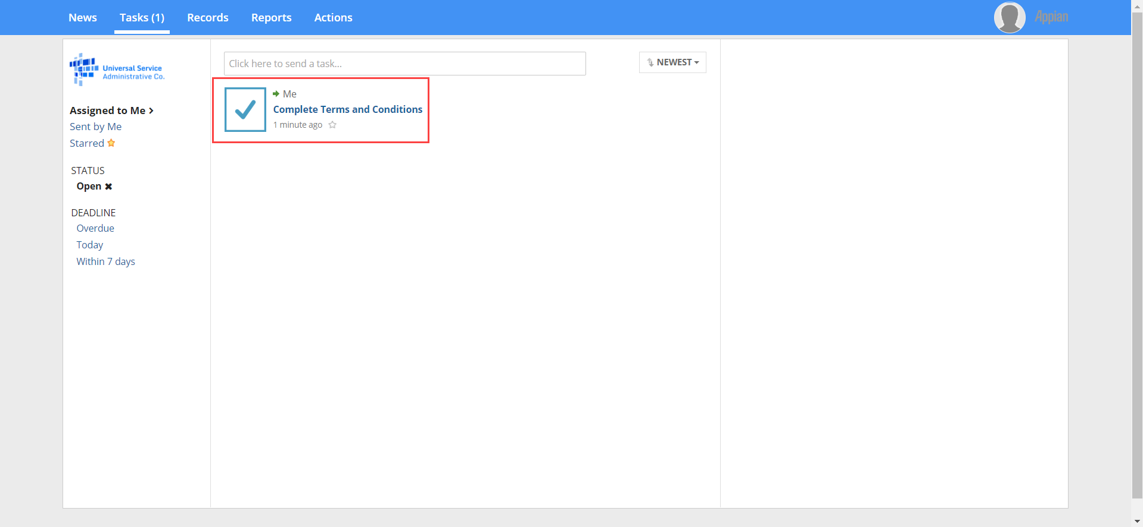
DEMO NEW EPC USERS: Terms and Conditions

Slide 17
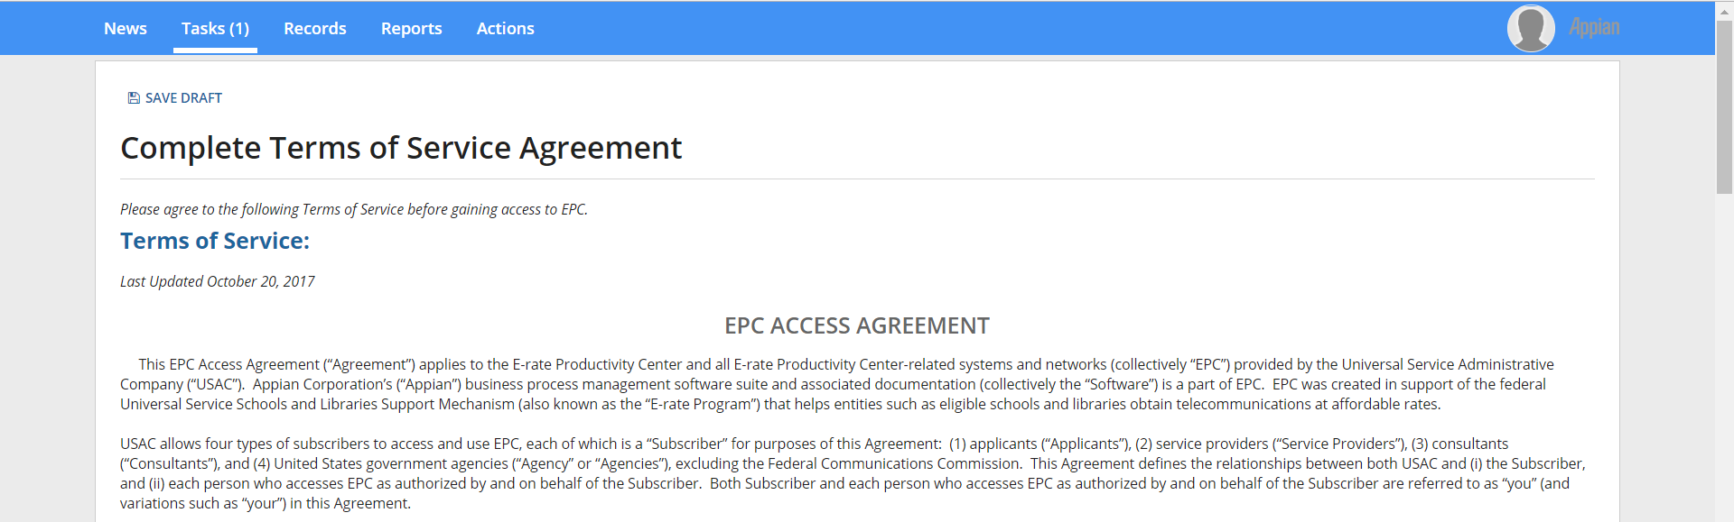
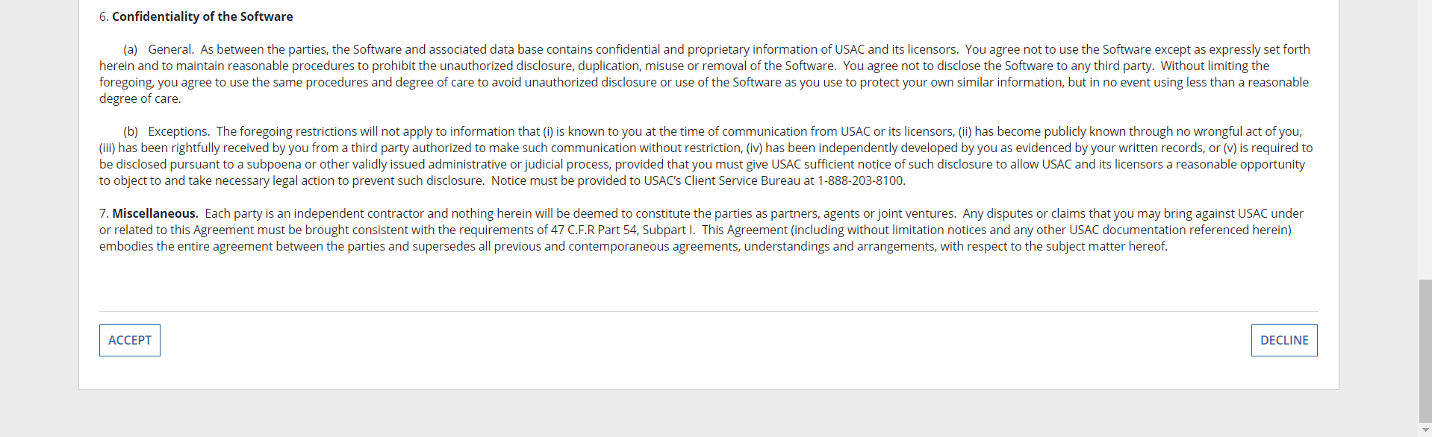
DEMO NEW EPC USERS: Terms and Conditions
Read the Terms of Service
Click the Accept button at the bottom of the screen.
You will now be able to access your EPC user account and your organization's account!

Slide 18
My Landing Page

Slide 19
Ask the Audience -
What functions can be performed from your landing page?

Slide 20
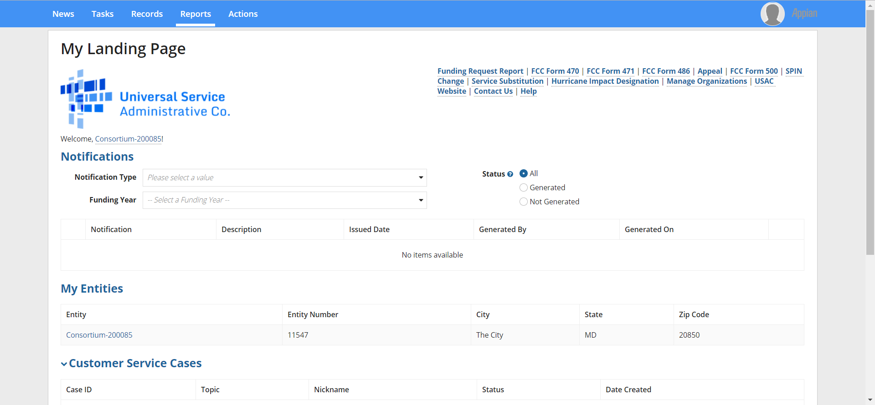
DEMO SLIDE My Landing Page

Slide 21
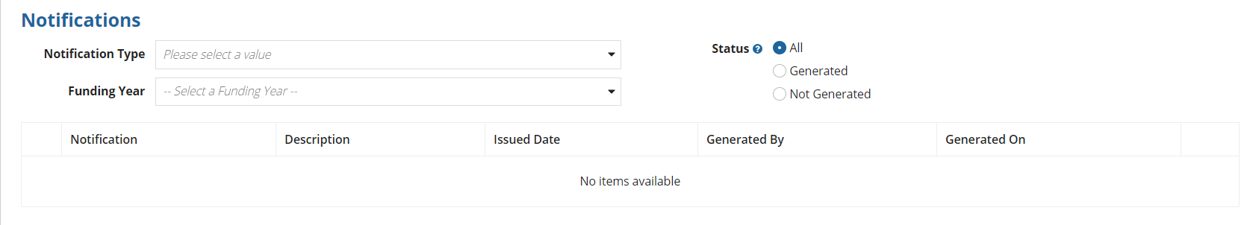
DEMO SLIDE My Landing Page: Notifications
Notifications
  Applicants can view their decision letters (FCDL, FCC Form 486 Notification Letters, FCC Form 486 Certification, etc.) by funding year.

Slide 22
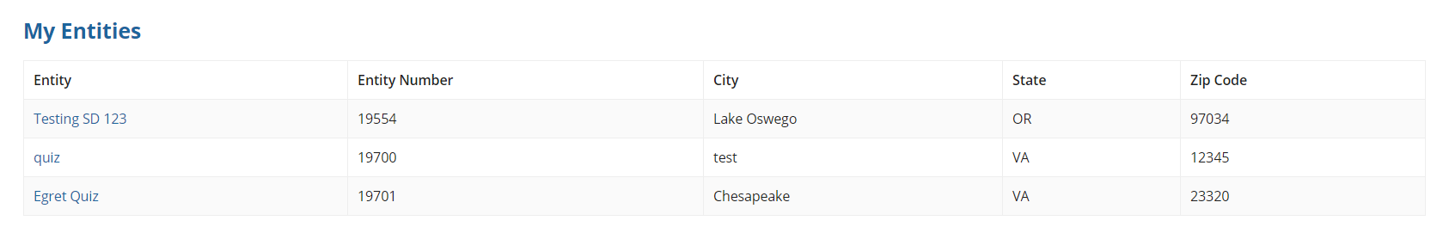
DEMO SLIDE My Landing Page: My Entities
My Entities
  For applicants: My Entities will display all entities you have rights to access.
  For consultants: My Clients will display all client entities associated with the consulting firm.

Slide 23
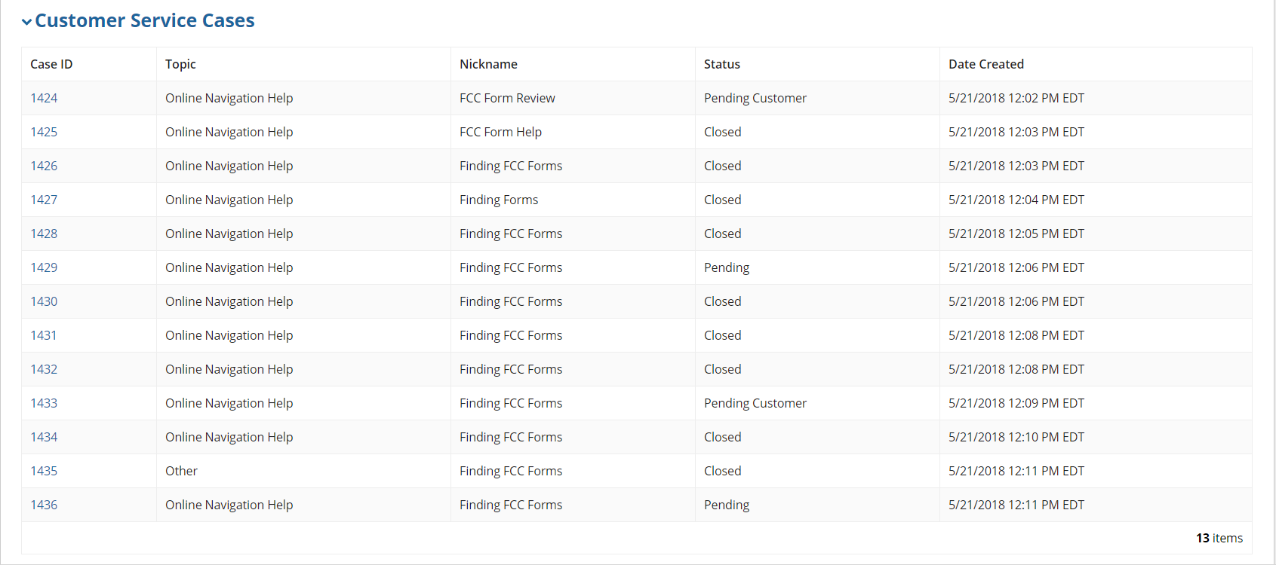
DEMO SLIDE My Landing Page: Customer Service Cases
Customer Service Cases
  You will see all the customer service cases you have opened.

Slide 24
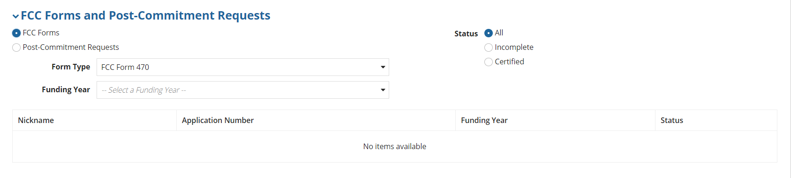
DEMO SLIDE My Landing Page: FCC Forms and Post-Commitment Requests
FCC Forms and Post Commitment Requests
  Users can view all of their FCC Forms by funding year.
    FCC Form 470, FCC Form 471, FCC Form 486, FCC Form 500

Slide 25
EPC Navigation Bar

Slide 26
EPC Navigation Bar
Made up of five tabs:
  News
  Tasks
  Records
  Reports
  Actions

Slide 27
EPC Navigation Bar – News
Populate notifications on actions taken in EPC
Entity Changes
Successful application submissions
All USAC Notifications (e.g., Funding Commitment Decision Letter)

Slide 28
EPC Navigation Bar – Tasks
Tasks populate notifications that require action by the user.
  Leaving an incomplete form (whether voluntary or accidental) will populate a task.
  Completing data entry on a form will populate a task to certify the form.
  PIA inquiries will populate a task.

Slide 29
EPC Navigation Bar – Records
Contains all the records within EPC
  All Entities
  Applications
  Customer service cases

Slide 30
EPC Navigation Bar – Reports
This tab allows users to view various Reports depending on their rights in EPC.
  My Submitted Modification Requests (RAL)
  My Landing Page

Slide 31
EPC Navigation Bar – Actions
This tab allows users to take various Actions depending on their rights in EPC.
  Create a Customer Service Case (Contact Us)
  Create a Whistleblower Case
  Search and Export Certified FCC Forms 470 and 471

Slide 32
Your EPC Entity Profile

Slide 33
Ask the Audience -
How can you navigate to your EPC profile?

Slide 34
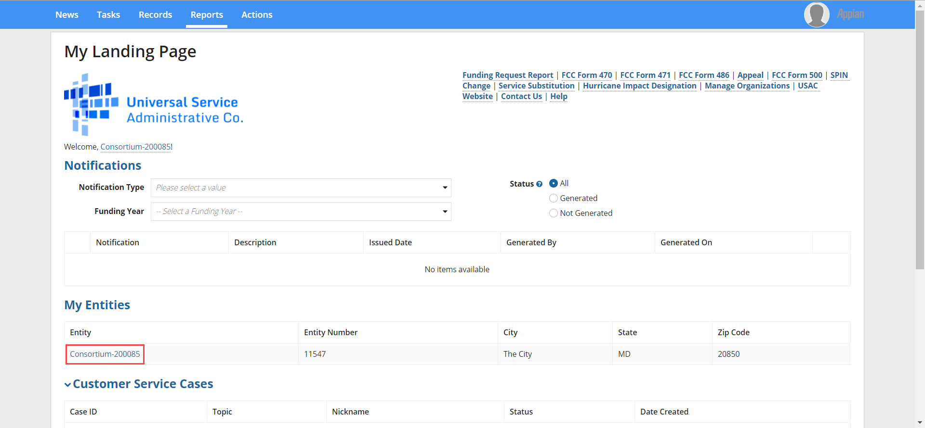
EPC Entity Profile – How do I get there from My Landing Page?

Slide 35
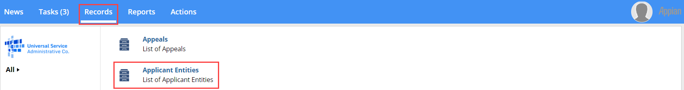
EPC Entity Profile – How do I get there from the Records tab?

Slide 36
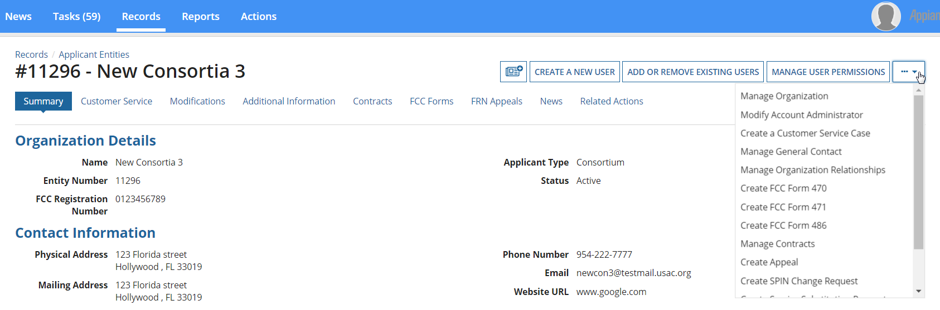
EPC Entity Profile – Account Administrator View

Slide 37
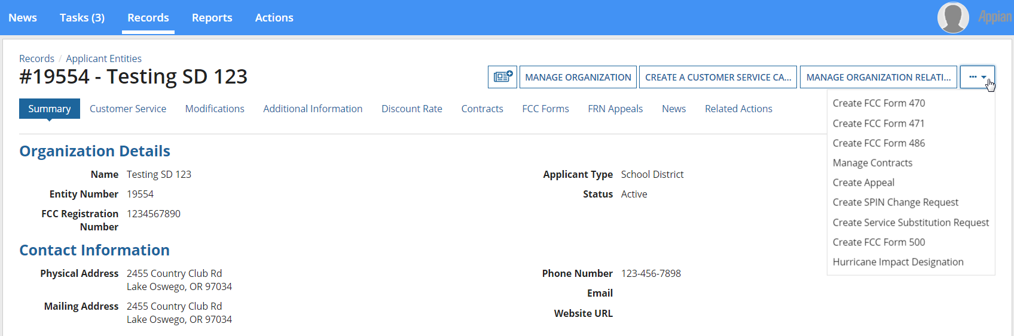
EPC Entity Profile – Full Rights User View

Slide 38
Ask the Audience -
What is the difference between the Account Administrator’s rights and a regular user?
Who can be an Account Administrator?

Slide 39
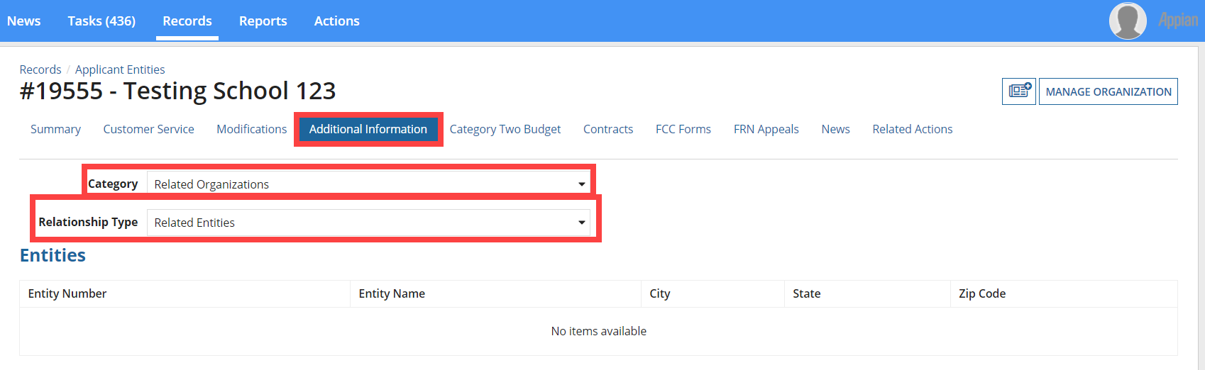
EPC Entity Profile: Parent-Child Relationship (School District or Library System)
To see if other entities are linked to your organization, use the Additional Information Tab.
For Example: A School district would like to know if the correct schools are linked to them in EPC.
  Click Additional Information.
  Under category selected Related Organizations.
  Under Relationship Type select Related Entities.

Slide 40
EPC Entity Profile: Contracts
From your Entity Profile Page.
Click Contracts
All contracts that were completed in EPC will populate.
  To enter a contract into EPC select Manage Contracts.

Slide 41
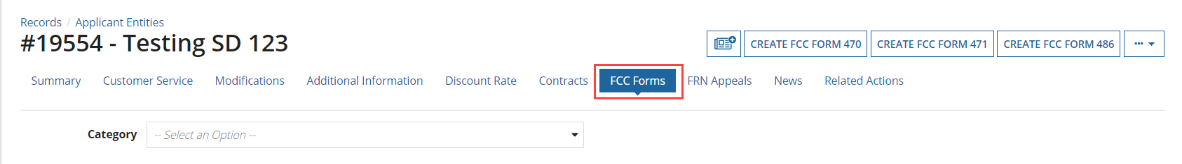
EPC Entity Profile: FCC Forms
To find information on FCC Forms 470, 471, 486 or 500 by funding year, use the FCC Forms tab on your Entity Profile

Slide 42
EPC Entity Profile: FRN Appeals
To find information on all appeals submitted by the entity use the FRN Appeals tab.

Slide 43
EPC Entity Profile: News
To view recently issued decision letters (Funding Commitment Decision Letters, FCC Forms 486 Notification Letters, etc.) for this entity use the News tab.

Slide 44

Pop Quiz-
What are the 3 areas you can locate your Funding Commitment Decision Letter?
Where can you find your Program Integrity Assurance (PIA) inquiries?
Who can create a new entity?
Who can manage user permissions?
If all fails who can help you?

