Slide 1


E-rate Program: Data
2018 Applicant Training
© 2018 Universal Service Administrative Co.

Slide 2
AGENDA
Tools
Category Two Budgets
Open Data Platform

Slide 3
Tools

Slide 4
Tools
Available from the E-rate Tools page:
  https://www.usac.org/sl/tools/default.aspx
Data is updated as of 9:00 PM ET
Popular tools:
Tool | Description | Funding Years
FRN Status Tool | Search and download FRN data by FY and state, BEN, SPIN, or CRN. Includes data related to commitments, FRN status, waves, disbursements, etc. | FY2016+
Category 2 Budget Tool | View C2 budget data by entity and FY | FY2015+
470 View and Download Tools | Search and download data by FY, state, and date range including RFP attachments and services requested | FY2016+
471 Download Tool | Search and download data by FY, state, and form version | FY2016+
Search Commitments | View commitment data by funding year, state, and waves | FY1998+

Slide 5
Other Tools
Tool | Description | Funding Years
Entity Download Tool | Download latest EPC entity profile data by state including student counts, library square footage, entity subtypes, urban/rural status, etc. Includes last date updated. | Current EPC data
Service Provider Download Tool | Download all service provider data including FCC Form 473 (SPAC) filed by funding year | Current EPC data
Data Retrieval Tool | Search and download data similar to FRN Status Tool for FY2015 and prior | FY2015 and prior

Slide 6
Tools Pop Quiz
  Which tool provides the latest EPC entity profile data including student counts?
  Search Commitments Tool
  Entity Download Tool
  FRN Status Tool

Slide 7
Tools Pop Quiz
  Which tool provides FRN status, wave date, wave #, and disbursements for FY2017?
    Data Retrieval Tool
    470 Download Tool
    FRN Status Tool

Slide 8
Category Two Budget Data

Slide 9
C2 Budget Data
C2 Budget Data sources:
Source | Description | Update Frequency
EPC | Entity profile page with cost allocations for FY 2016 and forward | Real time
C2 Budget Tool | C2 budget and cost allocations by funding year for FY 2015 and forward | Nightly as of 9:00 PM EST

Slide 10
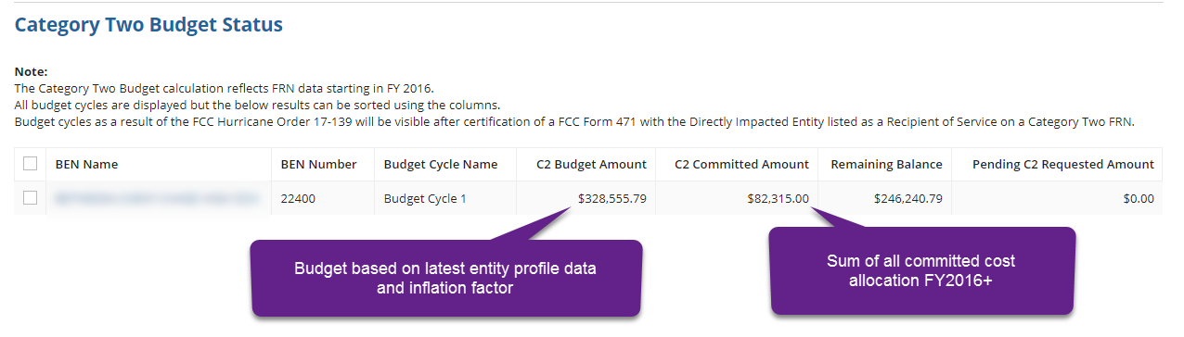
C2 Budget Data - EPC
FY2016+ cost allocations only
Select Category Two Budget from the entity profile page
C2 Budget Amount is based on current student counts from entity profile and latest inflation factor

Slide 11
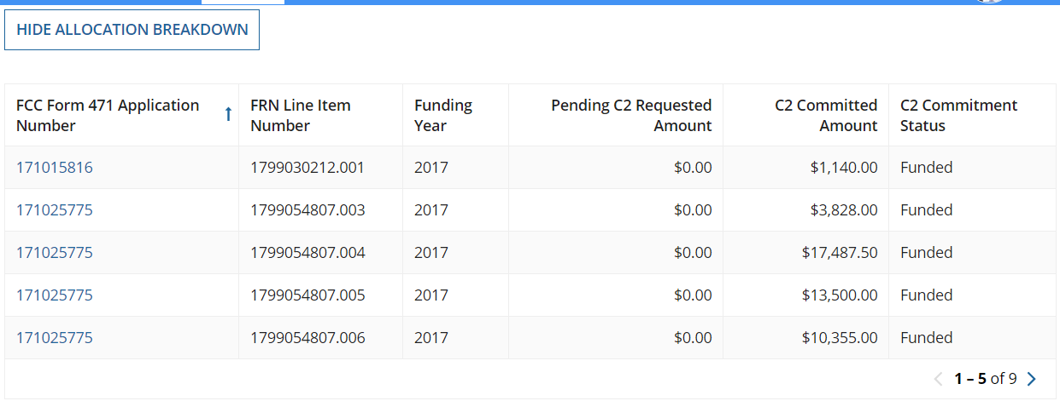
C2 Budget Data - EPC
Check box and select “Show Allocation Breakdown” to see C2 cost allocation details

Slide 12
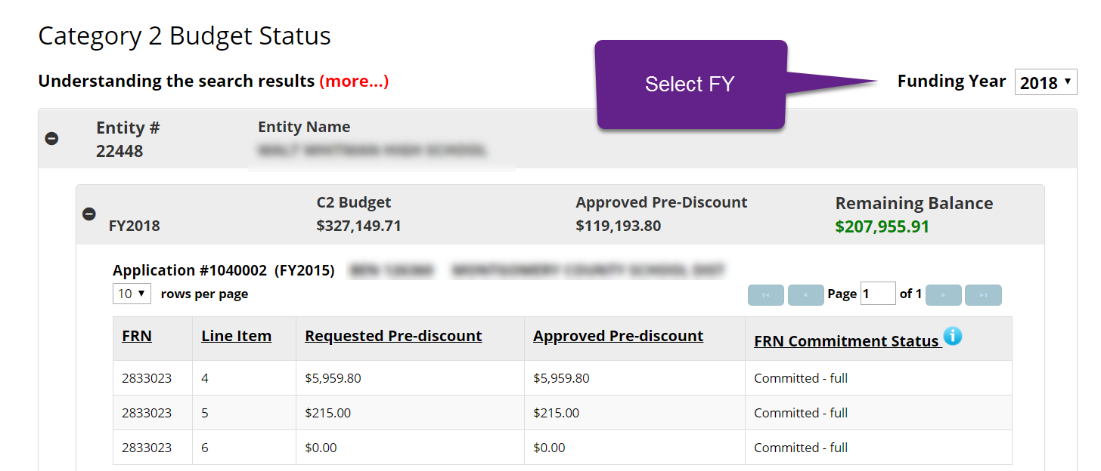
C2 Budget Tool
FY2015+ cost allocations
Enter or paste up to 100 entities into tool
C2 Budget is based on latest FCC Form 471 version student counts and inflation factor for the fund year selected
Shows committed, pending, and cancelled FRNs

Slide 13
Open Data Platform

Slide 14
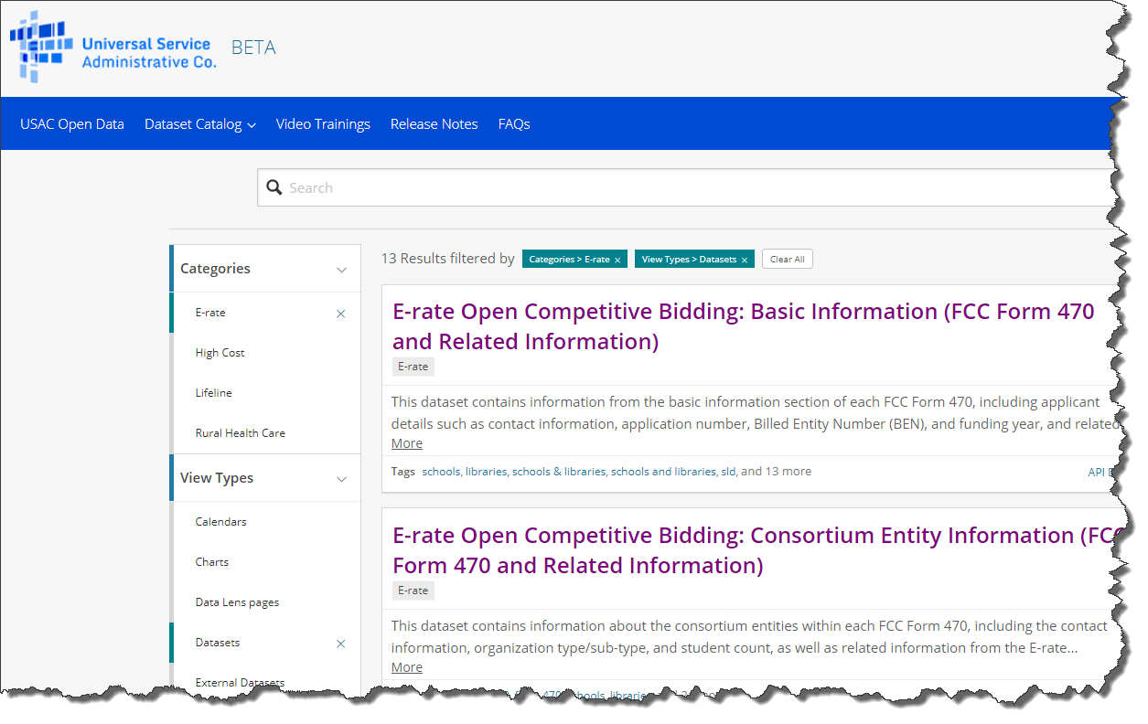
Open Data Platform
Web based platform launched Oct 2017
URL: https://opendata.usac.org/
View, filter, sort, aggregate, visualize, imbed, download, and consume data in a number of formats (Excel, CSV, XML, RSS, API, JSON, etc.)
E-rate data sets for FY2016+:
  FCC Form 470: 4 sets
  FCC Form 471: 7 sets
  EPC Entity Profile Data: 2 sets
  New data set coming for E-rate Recipient Details and Commitments

Slide 15

Open Data Platform Demo
Scenario #1: What are the commitments by funding year for libraries in CA?
Scenario #2: What services and products were received by a school and how much do they cost?

Slide 16
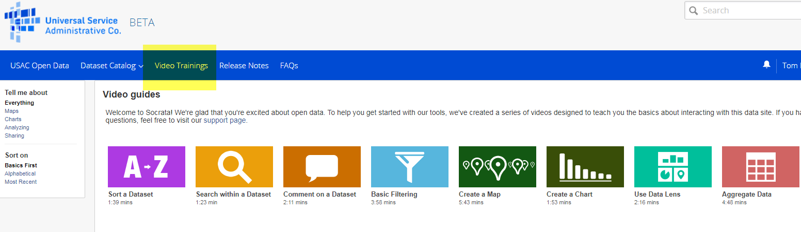
Open Data Platform Online Training

Slide 17
QUESTIONS?

