Slide 1


BEGINNERS: BASIC CONCEPTS
2018 APPLICANT TRAINING

Slide 2
BASIC CONCEPTS
Eligibility – entities, services, locations
Funding Year
Filing Window
Identifying Numbers (BEN, SPIN, CRN)
Discounts
Funding Request Numbers (FRNs)

Slide 3
ELIGIBILITY
Who Is Eligible?

Slide 4

ELIGIBILITY - Schools
Must provide elementary and/or secondary education, as determined under state law.
Cannot have an endowment exceeding $50 million.
Cannot operate as a for-profit business.

Slide 5
ELIGIBILITY - Libraries
Must be eligible for assistance from their state library agency under LSTA*.
Budget must be separate from any schools.
Cannot operate as a for-profit business.
* LSTA = Library Services and Technology Act

Slide 6
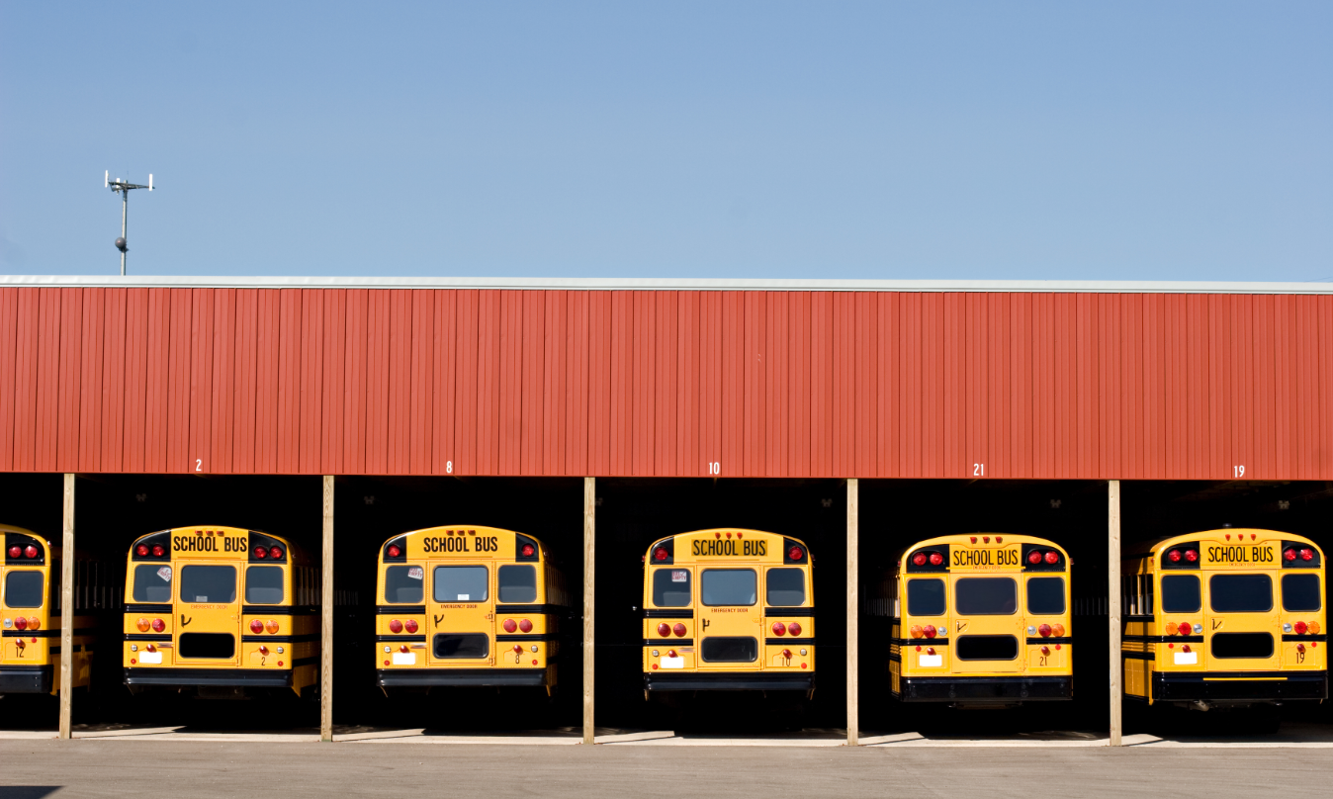
ELIGIBILITY – Non-instructional Facilities (NIFs)
Non-instructional facilities (NIFs) are eligible for discounts on some services. NIFs are:
School buildings that don’t have classrooms.
Library buildings that don’t have public areas.

Slide 7

ELIGIBILITY - Consortia
Schools and libraries can join together to form consortia.
Consortia are not themselves eligible for discounts, but they can run competitive bid processes and/or apply for discounts on behalf of their members.

Slide 8
ELIGIBILITY
What Services Are Eligible?

Slide 9
ELIGIBILITY - Services
Category One includes services from the service provider to the schools and/or libraries (demarcation point).
One service type –
Data Transmission and/or Internet Access
Voice services are completely phased out in FY2019.

Slide 10
ELIGIBILITY - Services
Category Two includes services and equipment needed for broadband connectivity within schools and libraries.
Three service types –
Internal Connections
Basic Maintenance of Internal Connections
Managed Internal Broadband Services

Slide 11
ELIGIBILITY - Services
Category One (C1) services are not limited in cost as long as they are cost-effective.
Category Two (C2) services are limited by a pre-discount budget.
Budget period is five years.
Budget is calculated based on number of students (schools) or square footage (libraries).

Slide 12
ELIGIBILITY - Services
Examples of Category One (C1) services:
Leased lit or dark fiber
Wireless services (e.g. microwave)
Satellite service
T-1, T-3, etc.
DSL

Slide 13
ELIGIBILITY - Services
Examples of Category Two (C2) services:
Routers & switches
Cabling, wireless access points
Basic maintenance of eligible internal connections
Managed internal broadband services (managed wi-fi)

Slide 14

ELIGIBILITY – Eligible Services List (ESL)
Each year, the FCC issues a list of services that are eligible for the upcoming funding year.

Slide 15
ELIGIBILITY

Slide 16

ELIGIBILITY – Eligible Purposes
Activities related to education that occur on school property.
Activities related to providing library services to individuals that occur on library property.
*Activities that are not on school or library property are generally not considered eligible for discounts.

Slide 17
FUNDING YEAR

Slide 18

FUNDING YEAR
A Funding Year (FY) starts on July 1 and ends the following June 30.
For example, FY2019 starts on July 1, 2019, and ends on June 30, 2020.

Slide 19

FUNDING YEAR
Timing of program activities:
Competitive bidding and applying for discounts happen before the funding year starts.

Slide 20

FUNDING YEAR
Timing of program activities:
Services generally start at the beginning of the funding year.

Slide 21

FUNDING YEAR
Timing of program activities:
Invoicing can occur during the funding year and is generally completed after the funding year ends.

Slide 22
FUNDING YEAR – Delivery and installation of services
Recurring services (e.g., monthly internet access) must be delivered during the funding year.
Non-recurring services (e.g., equipment installations) can generally be installed through September 30 following the close of the funding year.
The September 30 deadline can sometimes be extended, either automatically or by request.
Delivery and installation can sometimes start before the funding year.

Slide 23
FILING WINDOW

Slide 24
FILING WINDOW
All FCC Forms 471 are filed during a specific period of time – the FCC Form 471 application filing window.
The filing window generally opens in mid-January and closes in mid-March in advance of the start of the funding year.
*Applications (FCC Forms 471) filed outside of the filing window are not considered for funding.

Slide 25
IDENTIFYING NUMBERS

Slide 26
IDENTIFYING NUMBERS - BENs
Each applicant entity is assigned an “entity number” in the system.
Each entity that receives and pays bills is assigned a Billed Entity Number (BEN).

Slide 27
IDENTIFYING NUMBERS - BENs
Examples of applicant entities with entity numbers:
Individual school
School district
Individual library branch
Bookmobile
Library system
Consortium
Educational service agency

Slide 28

IDENTIFYING NUMBERS - SPINs
A Service Provider Identification Number (SPIN) is assigned to providers participating in E-rate.
Service providers may have more than one SPIN due to:
Different business units or service areas.
Mergers and acquisitions.

Slide 29

IDENTIFYING NUMBERS - CRNs
Each consultant is assigned a Consultant Registration Number (CRN) in the system.
A consultant may be a single individual or a consulting firm with multiple employees.

Slide 30
DISCOUNTS

Slide 31
DISCOUNTS - Overview
Discounts depend on two pieces of information:
The level of poverty (the percentage of NSLP* eligibility) in the school district.
The urban or rural status of the school district or library system.
* NSLP = National School Lunch Program

Slide 32
DISCOUNT MATRIX
INCOME Measured by percentage of students eligible for NSLP | DISCOUNT
 | URBAN | RURAL
Less than 1% | 20 | 25
1% to 19% | 40 | 50
20% to 34% | 50 | 60
35% to 49% | 60 | 70
50% to 74% | 80 | 80
75% to 100% | 90 for C1, 85 for C2 | 90 for C1, 85 for C2

Slide 33
DISCOUNTS – School District NSLP Calculation
Determine the total number of students eligible for NSLP in the school district.
Determine the total number of students in the school district.
Divide the first number by the second number.

Slide 34
DISCOUNTS – School District NSLP Calculation
EXAMPLE:
Orange School District has 1,070 students. Of those 1,070 students, 450 are eligible for NSLP.
The percentage of the student population eligible for NSLP:
450/1070 = 42%

Slide 35

DISCOUNTS – School District Urban/Rural Determination
An individual school is urban if it is located in an “Urbanized Area” or “Urban Cluster” with a population of 25,000 or more. Otherwise it is rural.

Slide 36

DISCOUNTS – School District Urban/Rural Determination
For a school district to be considered rural, more than 50% of its schools must be rural. Otherwise, it is urban. All schools in the school district share the same discount level.
You can use the Urban/Rural Lookup tool on the USAC website to find urban or rural status.

Slide 37
DISCOUNTS – Library NSLP Calculation
Determine the main branch of the library.
Determine the school district in which the main branch of the library is located.
Use the NSLP percentage calculation for that school district.

Slide 38
DISCOUNTS – Library Urban/Rural Determination
A library is urban if it is located in an “Urbanized Area” or “Urban Cluster” with a population of 25,000 or more. Otherwise it is rural.

Slide 39
DISCOUNTS –Libraries District Urban/Rural Determination
For a library system to be considered rural, more than 50% of its libraries must be rural. Otherwise, it is urban. All libraries in the library system share the same discount level.
You can use the Urban/Rural Lookup tool on the USAC website to find the urban or rural status.

Slide 40
FUNDING REQUEST NUMBER (FRN)

Slide 41

FUNDING REQUEST NUMBER (FRN)
Applying for discounts
You list the services and identify the costs for those services on the FCC Form 471.
Each of these funding requests is assigned a number – an FRN.
You can have one or many FRNs on your form.

Slide 42
FUNDING REQUEST NUMBER (FRN)
FRNs are specific to:
A category of service
A service type
A service provider (SPIN)
A contract, if you have one
An FRN can have one or many services, as long as the services have all the above in common.

Slide 43
RECAP
Eligibility
Entities
Services
Educational purposes
Funding year
Filing window

Slide 44
RECAP
Identifying numbers
Entity numbers and Billed Entity Numbers (BENs)
Service Provider Identification Numbers (SPINs)
Consultant Registration Numbers (CRNs)
Discounts
Funding Request Numbers (FRNs)

