Slide 1
Advanced Invoicing
Fall 2018 Service Provider Training

Slide 2
AGENDA
Preparing for Invoicing
Invoicing Methods
Before You Begin
FCC Form 498 (Service Providers and Applicants)
Electronic Invoicing
When to File / Deadlines
Invoice Review Process
Case Studies

Slide 3
Preparing for Invoicing

Slide 4
Preparing for Invoicing
The applicant and service provider receive an FCDL with a positive commitment.
The applicant certifies an FCC Form 486 and establishes the actual service start date for FRN(s).
USAC reviews and approves the FCC Form 486.
The service provider certifies an FCC Form 473 (SPAC Form) for each SPIN that will be featured on an invoice for that funding year.
© 2018 Universal Service Administrative Co.

Slide 5
Invoicing Methods

Slide 6
Invoicing Methods
There are two methods to invoice USAC:
1. Applicant
2. Service Provider
FCC Form 472
Billed Entity Applicant Reimbursement (BEAR) Form
Filed online
FCC Form 474
Service Provider Invoice (SPI) Form
Filed online or
electronically

Slide 7
Invoicing Methods
Invoice method (BEAR or SPI) is the applicant’s choice.
Service providers and applicants should have this discussion as early as possible – ideally, before the applicant certifies the FCC Form 471.
Once the invoice method is set for a Funding Request Number (FRN), it cannot be changed.
  The invoice method is FRN-specific.
© 2018 Universal Service Administrative Co.

Slide 8
Before You Begin

Slide 9

Before You Begin
Verify that all the prerequisites are in place.
  E.g., FCDL has been issued, FCC Form 486 has been filed, FCC Form 473 has been submitted, FCC Form 498 was approved, etc.
Have the BEAR/SPI discussion. Who will be filing invoices with USAC?
Make sure that you have the most recent commitment information from either the FCDL or the RFCDL, including discount rate, approved cost of service, FCC Form 471 number, FRN, service substitution, etc.
© 2018 Universal Service Administrative Co.

Slide 10
Before You Begin
Determine the invoice frequency
  E.g., Monthly, bi-monthly, quarterly, one-time, etc.
Watch the BEAR or SPI form walk-through videos in the Online Learning Library.
Applicants should review the BEAR Form Filing Guide.
© 2018 Universal Service Administrative Co.

Slide 11
Filing an FCC Form 498 for Service Providers

Slide 12
FCC Form 498 For Service Providers – How Do I File?
To receive a Service Provider Identification Number (SPIN), also known as a service provider 498 ID, service providers must file the FCC Form 498 (Service Provider and Billed Entity Identification Number and General Contact Information Form) in the E-File System.
    Provide the required information.
    Complete and certify the form.
  Your company officer can start, complete, submit, certify, modify, and deactivate FCC Forms 498.
  Your general contact or E-rate contact can complete but not certify the form.
  You must update the form if any of your information changes.
  Need help? Call USAC at 888-641-8722 and choose option 4 (contributors).

Slide 13
FCC Form 498 For Service Providers
Once the FCC Form 498/SPIN ID is approved, USAC will provide the following:
  Set up an user name and password in order to access the E-file system to allow:
    Updates to your FCC Form 498 online
    Set up permissions for other users in your company
    Set up access rights to view and approve certain applicant-filed forms and form attachments

Slide 14
Electronic Invoicing

Slide 15
Electronic Invoicing
Service providers have the option to submit invoices electronically.
Helpful for service providers that invoice USAC frequently.
Reduces data entry errors because service providers can maintain and update the information on their own spreadsheets.
Speeds data entry for service providers by providing a mechanism for bulk data entry.

Slide 16
Electronic Invoicing
To set up electronic invoicing:
Send a request to USAC by email.
  Include the email address where you want to receive updates.
  Include your SPIN.
USAC will then send you setup instructions by email.
Please note that first-time users usually need assistance with their first submission.
  USAC will help users with diagnosing issues in that submission.
  We can provide additional help if needed, but most users do not have issues after the first submission has been corrected.

Slide 17
Electronic Invoicing
To prepare your electronic files, follow the instructions in the USAC email. At a high level, here are the steps in the process:
Prepare the information for your file. Be sure to check your entries for accuracy and consistency.
Convert your file to a comma-delimited format (.CSV) if your data is in a different format. You can use PGP (Pretty Good Protection) encryption if you desire.
Email your file to USAC. We will decrypt it (if needed) and confirm our receipt.
We will check your file for errors and email you an error file if corrections are necessary so you can correct the file and resubmit it.
After the file has been validated, we will convert it into the equivalent of a SPI Form and send you an invoice status report (ISR).

Slide 18
When to File an Invoice

Slide 19

When to File
The invoice deadline is:
  120 days after the last date to receive service or 120 days after the date of the FCC Form 486 Notification Letter, whichever is later.
  If the calculated deadline falls on a weekend or federal holiday, the deadline is 11:59 PM ET on the following business day.
  For example, the invoice deadline for FY2017 recurring services is Monday, October 29, 2018, since October 28 falls on a Sunday.
© 2018 Universal Service Administrative Co.

Slide 20
When to File
File after services are delivered and paid
  Applicants – pay in full for services first
  Service providers – bill applicants for their non-discount share first
You can choose the frequency
File before the invoice deadline
  Generally, October 28 for recurring services
  Generally, January 28 for non-recurring services
© 2018 Universal Service Administrative Co.

Slide 21
When to File
Invoice deadline extension requests
  File requests for FY2016 and later funding years in EPC.
    Service providers locate their SPIN under Records and choose Invoice Deadline Date Extension Requests from the Related Actions menu.
    Applicants locate their billed entity record under Records and choose Invoice Deadline Date Extension Requests from the Related Actions menu.
  File requests for FY2015 and previous funding years
    Service providers log in to the E-File System and choose the 472 BEAR Form.
© 2018 Universal Service Administrative Co.

Slide 22
When to File
Invoice deadline extension requests must be filed ON OR BEFORE the invoice deadline date.
Filers can receive one 120-day extension of the time to file.
If applicants or service providers miss the deadline to file an invoice or to request an invoice deadline extension, they must file a request for waiver of the invoice deadline with the FCC.
  The FCC must grant the waiver request before USAC can process an invoice.
However, if USAC rejects a timely filed invoice, the applicant can appeal that rejection directly to USAC.
© 2018 Universal Service Administrative Co.

Slide 23
Invoice Review

Slide 24
Invoice Review
USAC’s invoice review can involve two steps
1.
2.
Automated
review
Manual review
(may include service certification)

Slide 25
Invoice Review
All invoices undergo a series of automated reviews.
Line items are automatically rejected if their information (FCC Form 471 number, FRN, discount percentage, available funding, etc.) is incorrect or inconsistent with the approved FRN.
Keep in mind that the online SPI Form has fewer built-in warnings, so accurate data entry is very important.
© 2018 Universal Service Administrative Co.

Slide 26
Common Data Entry Errors
The FCC Form 471 and/or Funding Request Number (FRN) does not exist in our system.
Your SPIN is not featured on the FRN.
The FRN you entered is not on the FCC Form 471 number you entered.
The entire commitment has already been paid.
The FRN is for the previous funding year.
The line item is or appears to be a duplicate.
  This may be because the customer billed date is entered as the service start date in every line item rather than the first date that service was delivered for that line item.
© 2018 Universal Service Administrative Co.

Slide 27
Note on Discount Data Entry
The system does not pre-populate the discount from the FRN record to the online SPI Form.
To complete each line item:
  Enter the pre-discount amount.
  Enter the discount percentage manually. This entry must be a number between 20 and 90. If the correct discount is less than 20, enter 20.
  Calculate the post-discount amount manually and enter it.
© 2018 Universal Service Administrative Co.

Slide 28
Invoice Review
  Some invoices also undergo manual review. These reviews verify, among other things, that:
      the customer bills are accurately reflected on the E-rate invoice and discounts are properly applied;
      the services are eligible and were approved on the FCDL;
        It the services are not on the FCDL, USAC approved a service substitution.
  USAC reviewers send questions to the service provider and ask for responses in seven days; one seven-day extension can be granted.
  USAC reviews the information provided and makes a disbursement decision.
  If payment is rejected, the service provider can resubmit the invoice once the issue has been corrected.
© 2018 Universal Service Administrative Co.

Slide 29
Invoice Review: Service Certification
  Some manual reviews require additional documentation, such as:
      Proof that the applicant paid their share.
      Proof that the invoiced services were delivered and/or installed.
      Proof that progress payments were included in the contract.
  USAC reviewers send a Service Certification and instructions to the service provider so that they can forward it to the applicant.
  The applicant completes the certification and returns it directly to USAC.
  USAC reviews the information provided and makes a decision.
© 2018 Universal Service Administrative Co.

Slide 30
Tips for Invoicing – Service Providers
  Confirm the invoice method the applicant has chosen – ideally, before services start.
  Verify that the information on your current FCC Form 498 – especially bank account information – is correct. USAC does not issue paper checks.
  Gather the documents you will need to complete an invoice correctly: FCDLs, FCC Form 486 Notification Letters, SPIN change approvals, service substitution approvals, customer bills.
  Make sure that the applicant has filed – and USAC has approved – an FCC Form 486.
  Make sure you have certified an FCC Form 473 (SPAC Form) for the appropriate funding year.
  Forward service certifications with instructions to the applicant promptly.
  Check your entries carefully to be sure that they are consistent and accurate.
© 2018 Universal Service Administrative Co.

Slide 31
Case Studies

Slide 32
Case Studies: Service certification error
During the review of an invoice, the reviewer requests verification from the applicant that services were delivered and installed.
The reviewer sends a service certification with instructions to the service provider to forward to the applicant for confirmation.
The service provider sends only the service certification (without instructions) to the applicant, who completes it and returns it to the service provider. The service provider then sends it to the invoice reviewer.

Slide 33
Case Studies: Service certification error
Answer:
The invoice reviewer attempts to contact the applicant to verify that the response was in fact from the applicant, but the applicant does not respond.
The invoice reviewer then denies the invoice because the applicant did not respond.

Slide 34
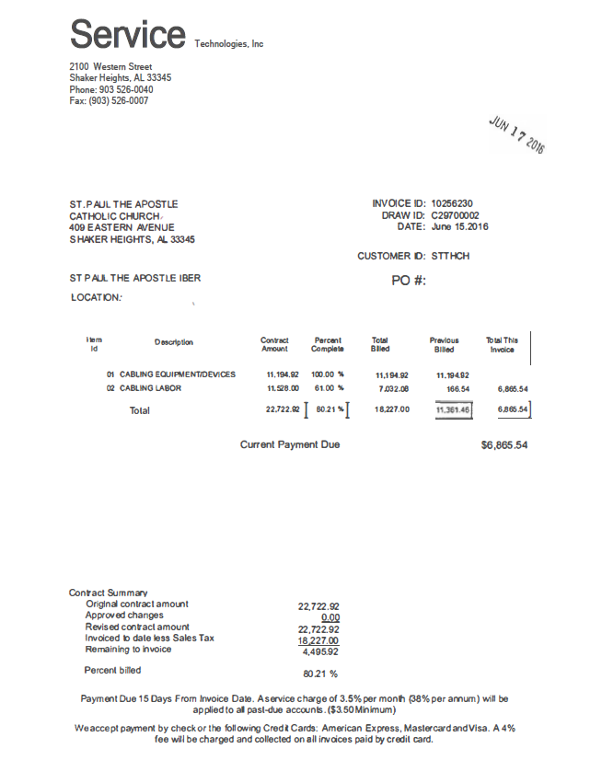
Invoice Examples Submitted To SLD (1 of 4)
Is this an acceptable invoice? Yes or No
If Yes, explain why the invoice is acceptable.
If No, explain what makes this invoice unacceptable.

Slide 35
Invoice Examples Submitted To SLD (1 of 4)
Is this an acceptable invoice? No
Eligibility
Generic Description of Equipment

Slide 36
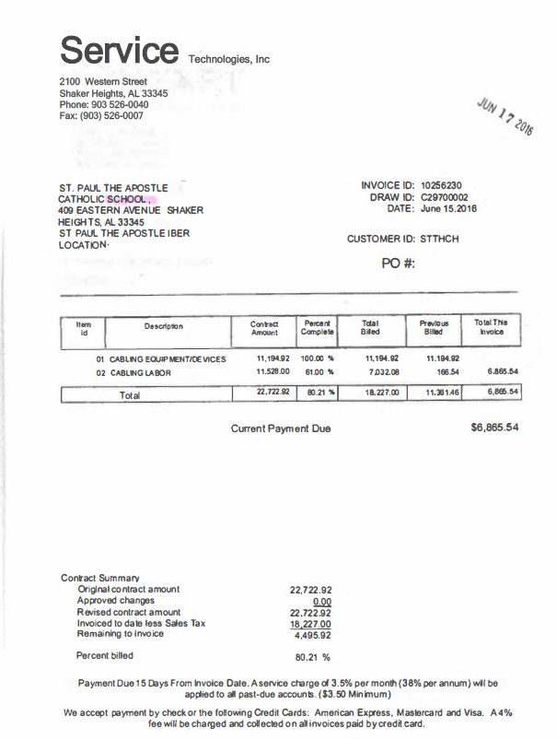
Invoice Examples Submitted To SLD (2 of 4)
The service provider was contacted by SLD concerning the entity eligibility.
This is a copy of the invoice that was resubmitted to SLD.
Is this invoice now acceptable?

Slide 37
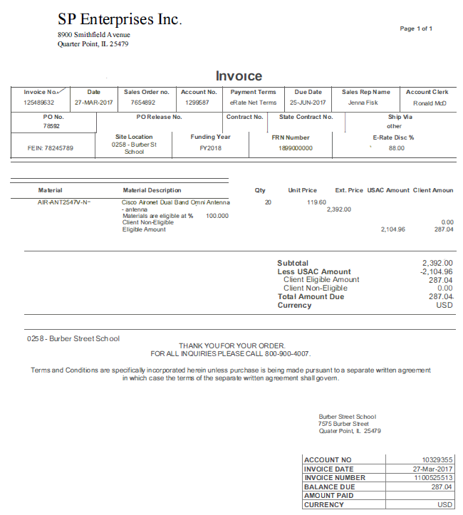
Invoice Examples Submitted To SLD (3 of 4)
Is this an acceptable invoice? Yes or No
If Yes, explain why the invoice is acceptable.
If No, explain what makes this invoice unacceptable.

Slide 38
Invoice Examples Submitted To SLD (3 of 4)
Is this an acceptable invoice? Yes
A good example of a service provider bill that have detail E-rate information.

Slide 39
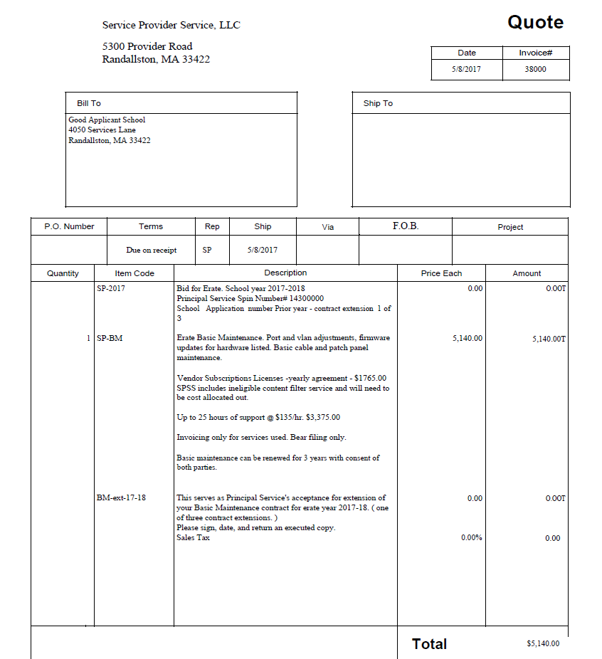
Invoice Examples Submitted To SLD (4 of 4)
Is this an acceptable invoice? Yes or No
If Yes, explain why the invoice is acceptable.
If No, explain what makes this invoice unacceptable.

Slide 40
Invoice Examples Submitted To SLD (4 of 4)
Is this an acceptable invoice? No
This is a quote, not bill.
Does not give the actual hours for the BMIC services rendered on eligible products.

Slide 41
Questions?

