Slide 1


Top Ten Tips for Tribal Applicants
2017 E-rate Tribal Training
© 2017 Universal Service Administrative Co.

Slide 2
AGENDA
Check The Tribal Box
Non-Traditional Education
Tribal Library Participation
Voice Phase Down
Competitive Bidding
Category Two Budgets
Managing Deadlines
Streamlining Your Workload
Tribal State Match
BIE School Guidance

Slide 3
CHECK THE TRIBAL BOX
Check the “Tribal” box located in the entity profile in EPC
Checking the box helps USAC understand who is participating in the program
  Provide Tribal outreach and training
  Assess Tribal training efforts through participation

Slide 4
NON-TRADITIONAL EDUCATION
Examples of non-traditional, Tribal facilities are:
  Pre-K
  Head Start
  Juvenile justice
  Adult education
These entities are eligible if they fit the definition of elementary/secondary education for the state within which they are geographically located
Look up non-traditional facility eligibility on our website

Slide 5
TRIBAL LIBRARY PARTICIPATION
(Eligibility)
Tribal libraries are eligible for E-rate if they are:
  Not-for profit
  Financially independent from any school budget
  Eligible for LSTA funding in the state within which they are geographically located
    Find out if your library is eligible for state LSTA funding by contacting the state librarian
    Some state librarians provide an approval letter
    The Tribal Liaison can help coordinate with state librarian

Slide 6
TRIBAL LIBRARY PARTICIPATION
(Calculating Discounts - Poverty)
The E-rate program uses the National School Lunch Program (NSLP) to determine poverty level
  An independent library uses the NSLP figure for the public school district in which it is located
  If the library is not physically located within a district, it should use the figure for the school district to which it’s geographically closest
  If the library is a system with multiple branches, they should use the figure for the school district in which the main branch of the library is located

Slide 7
TRIBAL LIBRARY PARTICIPATION
(Calculating Discounts – Urban/Rural)
Urban or rural status is based on 2010 census data
  Check your status on our website
  Enter your physical address in your entity’s EPC profile and urban/rural status will be determined automatically
  Ensure that the address is accurate to calculate the correct status
  If EPC doesn’t recognize your address, manually enter latitude and longitude (from Google Earth or another source)

Slide 8
VOICE PHASE DOWN
What does it mean?
Eligible voice services are subject to an annual 20% phase down of E-rate support, which began in FY 2015
In FY2019 dedicated voice services will no longer be eligible
  Applicants can still receive discounts on voice services if they are combined with internet – no part of the circuit can be dedicated to voice
The “maximum discount” available applies to applicants who receive the highest E-rate discount level of 90%
  Those with less than a 90% discount level phase down earlier

Slide 9
FY2016
VOICE PHASE DOWN
The maximum voice discount last year was 50%
Invoices you submitted this fall reflect this discount
The maximum voice discount this year is 30%
The maximum voice discount next year will be 10%
Last year for voice services

Slide 10
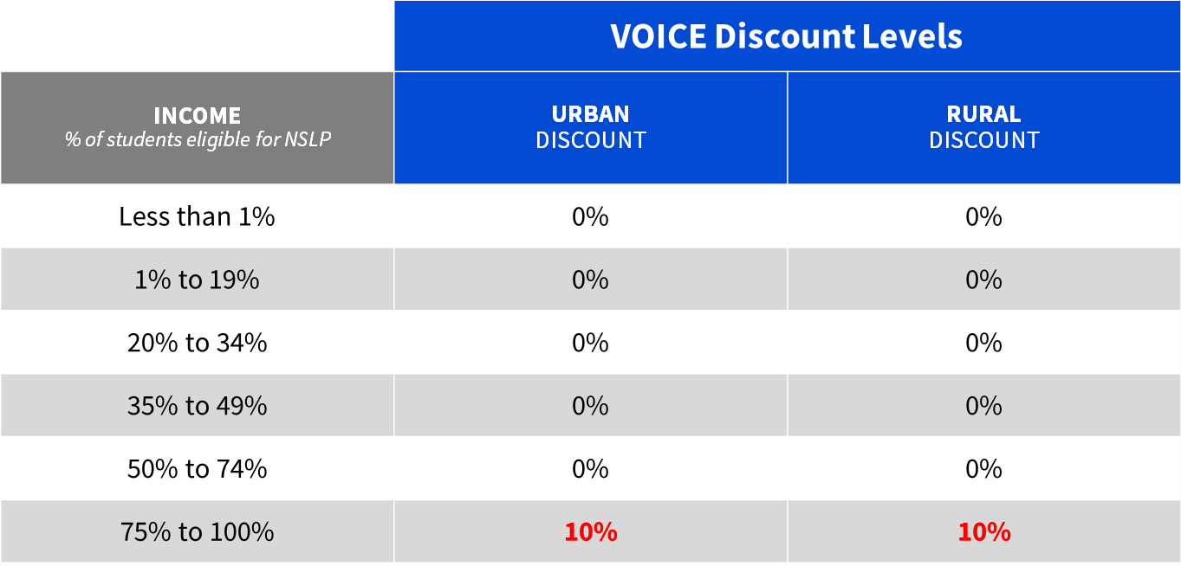
VOICE SERVICE DISCOUNT FOR FY2018
(Last year of phase down)

Slide 11

COMPETITIVE BIDDING
(Reminders)
Competitive bidding is a formal process to choose the vendors/service providers who provide your products and services
  Describe your desired services and requirements using FCC Form 470 (and RFP if applicable)
  Service providers read your documents and bid on your services
  Wait 28 days then compare the offers you receive
  Select the most cost-effective bid using price of the eligible products and services as the primary factor in a bid evaluation matrix

Slide 12
COMPETITIVE BIDDING
(Bidding during a multi-year contract)
Applying for E-rate for the first time but already receiving services in a multi-year contract?
  File FCC Form 470
  Consider your current contract as a bid along with any other incoming bids
  Evaluate all bids fairly and equally using a competitive bidding matrix
  You cannot receive discounts on the pre-existing contract if another bid was more cost-effective

Slide 13
COMPETITIVE BIDDING
(My tribe’s telco wants to submit a bid)
What you shouldn’t do:
  Don’t share knowledge of the competitive bidding process
  Don’t share staff
  Don’t share finances
  Don’t accept the bid if it’s not cost-effective

Slide 14
COMPETITIVE BIDDING
(My tribe’s telco wants to submit a bid)
What you should do:
  Keep the competitive bidding process open and fair
  Track any helpful information your tribe’s company might have access to and make sure the knowledge is shared with all potential bidders via FCC Form 470 or RFP
  Document the processes and procedures you put in place to make sure the line between applicant and service provider do not blur

Slide 15
COMPETITIVE BIDDING
(Only one vendor serves my region)
What you can’t do:
  Don’t neglect conducting a competitive bidding process
    Always follow the competitive bidding rules and the 28-day waiting period unless you have an FCC Form 470 exemption
  Don’t accept the bid if it’s not cost-effective
What you can do:
  Solicit a bid if you don’t receive one
  Ask your current service provider to submit a bid
  Accept a single incoming bid if it’s cost effective
  Always document your decision with a memo or email for your records

Slide 16
CATEGORY TWO (C2) BUDGETS
USAC calculates a C2 budget for each individual school or library
  An entity cannot share its budget with other schools or libraries
The school or library can receive discounts on the cost of C2 services up to its C2 budget amount
The budget lasts 5 years
  Use the entire budget in one funding year
  Allocate over five different funding years
  Spend the budget on one, two, or all three of the C2 service types

Slide 17
CATEGORY TWO (C2) BUDGETS
The C2 budget is re-calculated every year
  More students in a school or expansion of the library results in a budget increase
  Fewer students in a school or downsizing in a library results in a budget decrease
    If the C2 budget decreases below funding already spent for the five-year period, the school or library does not have to reimburse USAC for the discount on the difference between the budget and the pre-discount amount

Slide 18
WHAT’S MY FIVE-YEAR C2 BUDGET?
(All figures are for FY2017)
Budget calculations are based on the total number of students – including peak part-time (for schools) or the total internal square footage (for libraries)
The C2 budget multiplier is adjusted each year for inflation.
  Schools:
    # of students x $153.47 (multiplier) x Discount
  Libraries:
    Square footage x $2.35 (multiplier) x Discount
    $5.12 for urban libraries

Slide 19
WHAT’S MY FIVE-YEAR C2 BUDGET?
(All figures are for FY2017)
There is a minimum budget of $9,412.80 for small schools and libraries
  If the budget calculation results in a value less than $9,412.80, the school or library’s pre-discount budget is set at this minimum pre-discount budget
Remember to subtract previously committed C2 funding since FY2015.
  (Pre-discount budget) – (Pre-discount amounts committed in prior funding years) = Remaining C2 Budget

Slide 20
MANAGING DEADLINES
(Fixed deadlines)
FCC Form 470 deadline
  Always file a minimum of 28 days before the last day of the FCC Form 471 filing window
    We recommend filing earlier
FCC Form 471 deadline
  Always file only during the application filing window (exact dates vary each year)
  File by 11:59 PM EDT on the last day of the filing window

Slide 21
MANAGING DEADLINES
(Moving deadlines)
Use the deadlines tool
FCC Form 486
  Deadline is 120 days after service start date or 120 days after the date of the FCDL — whichever is later
FCC Forms 472 and 474 (invoicing)
  Deadline is 120 days after the last day to receive service or 120 days after the date of the FCC Form 486 Notification Letter — whichever is later

Slide 22
MANAGING DEADLINES
(Post-commitment deadlines)
Invoice Deadline Extensions
  You can request and receive one 120-day extension of the invoice deadline
  The request must be submitted on or before the original invoice deadline.
  You do not need to provide a reason for your request
Appeal Deadline
  60 days from the date of the decision

Slide 23
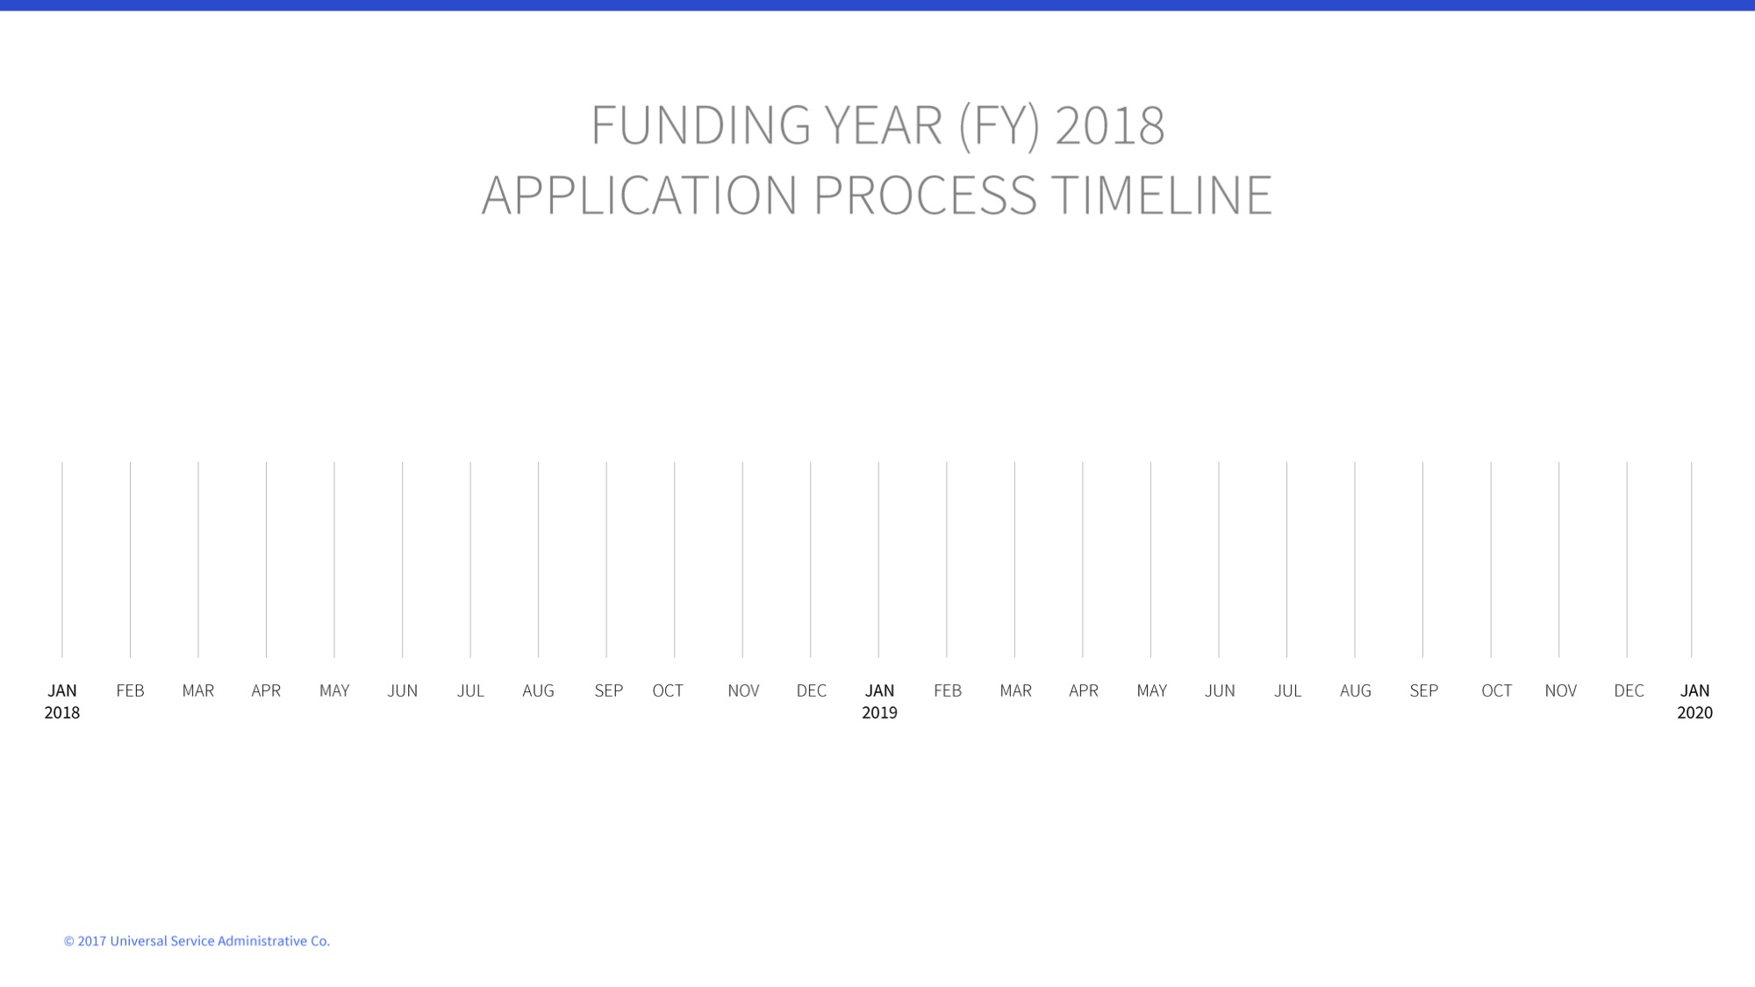

Slide 24
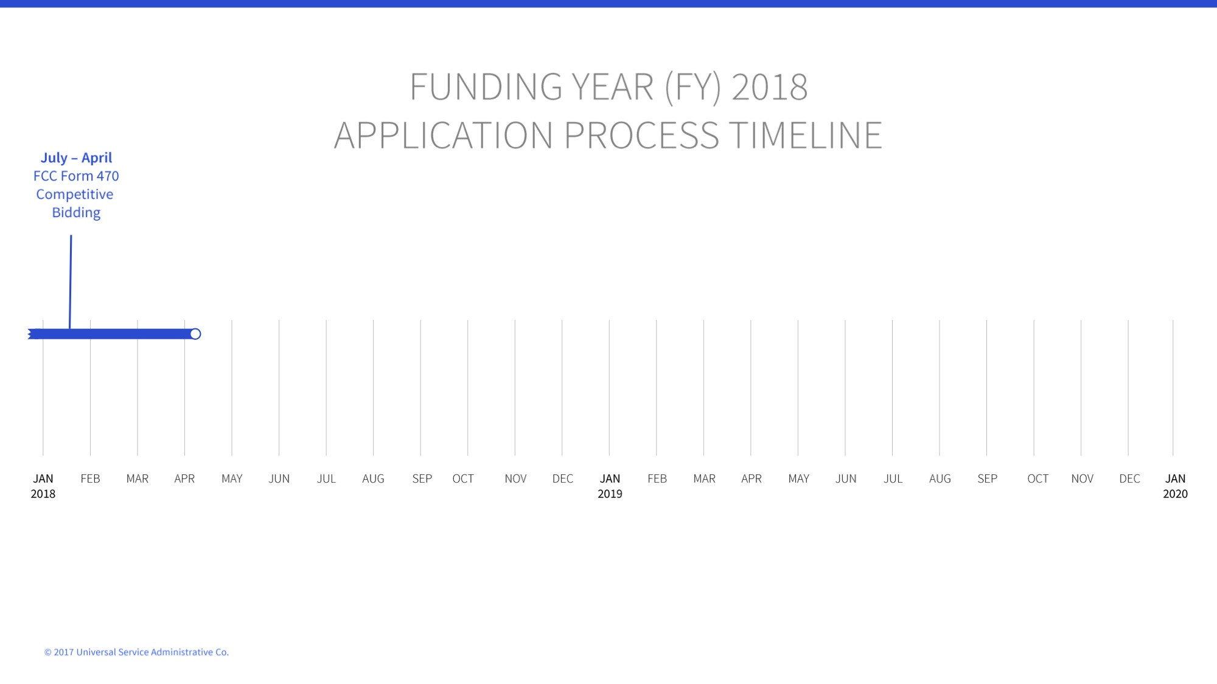

Slide 25
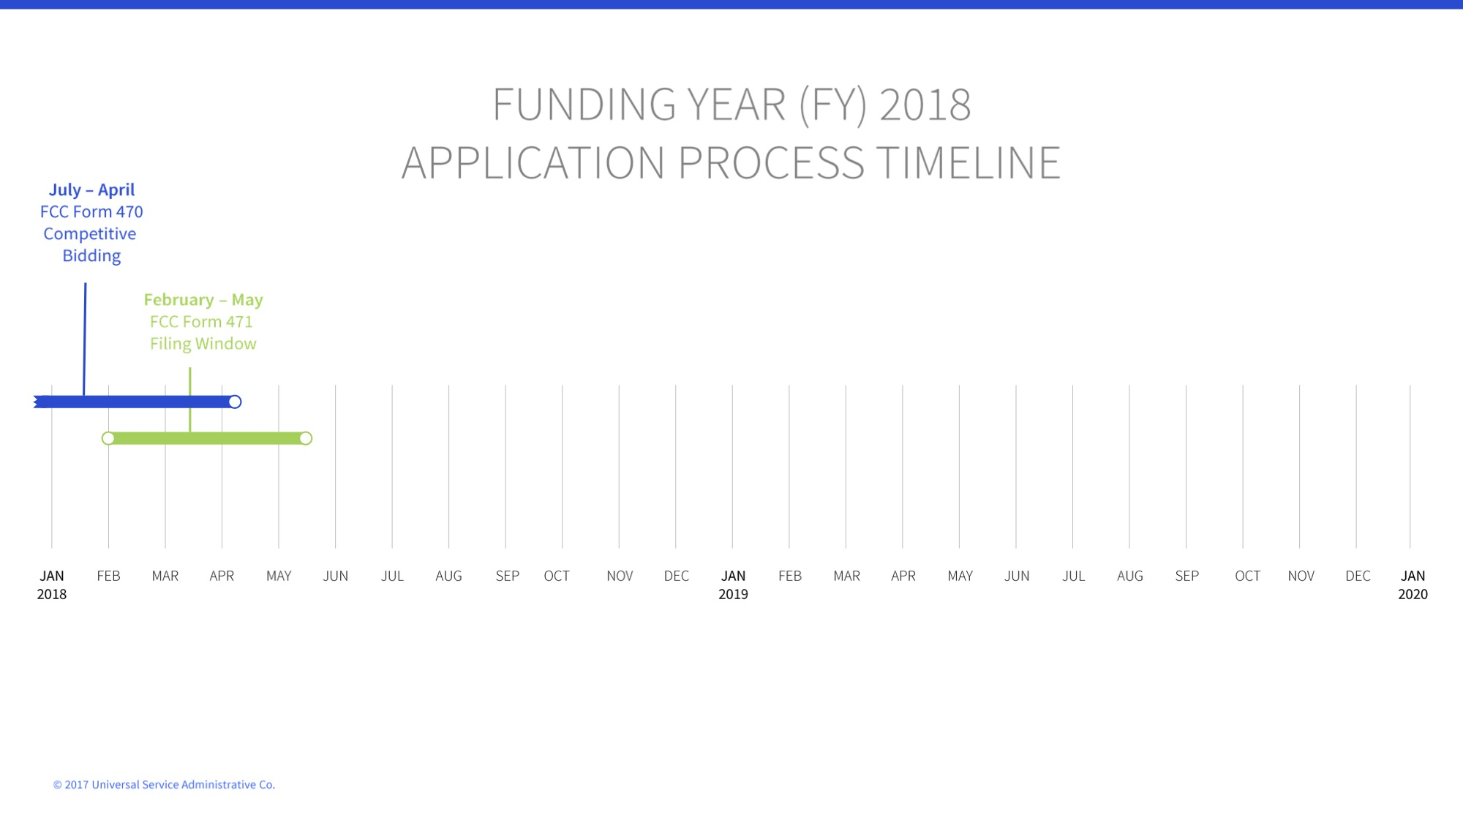

Slide 26
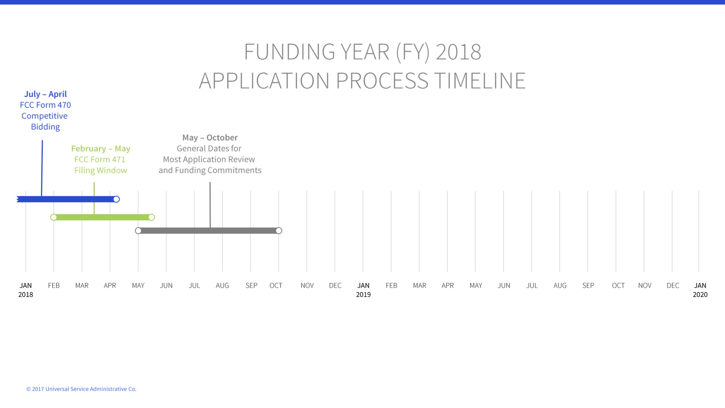

Slide 27
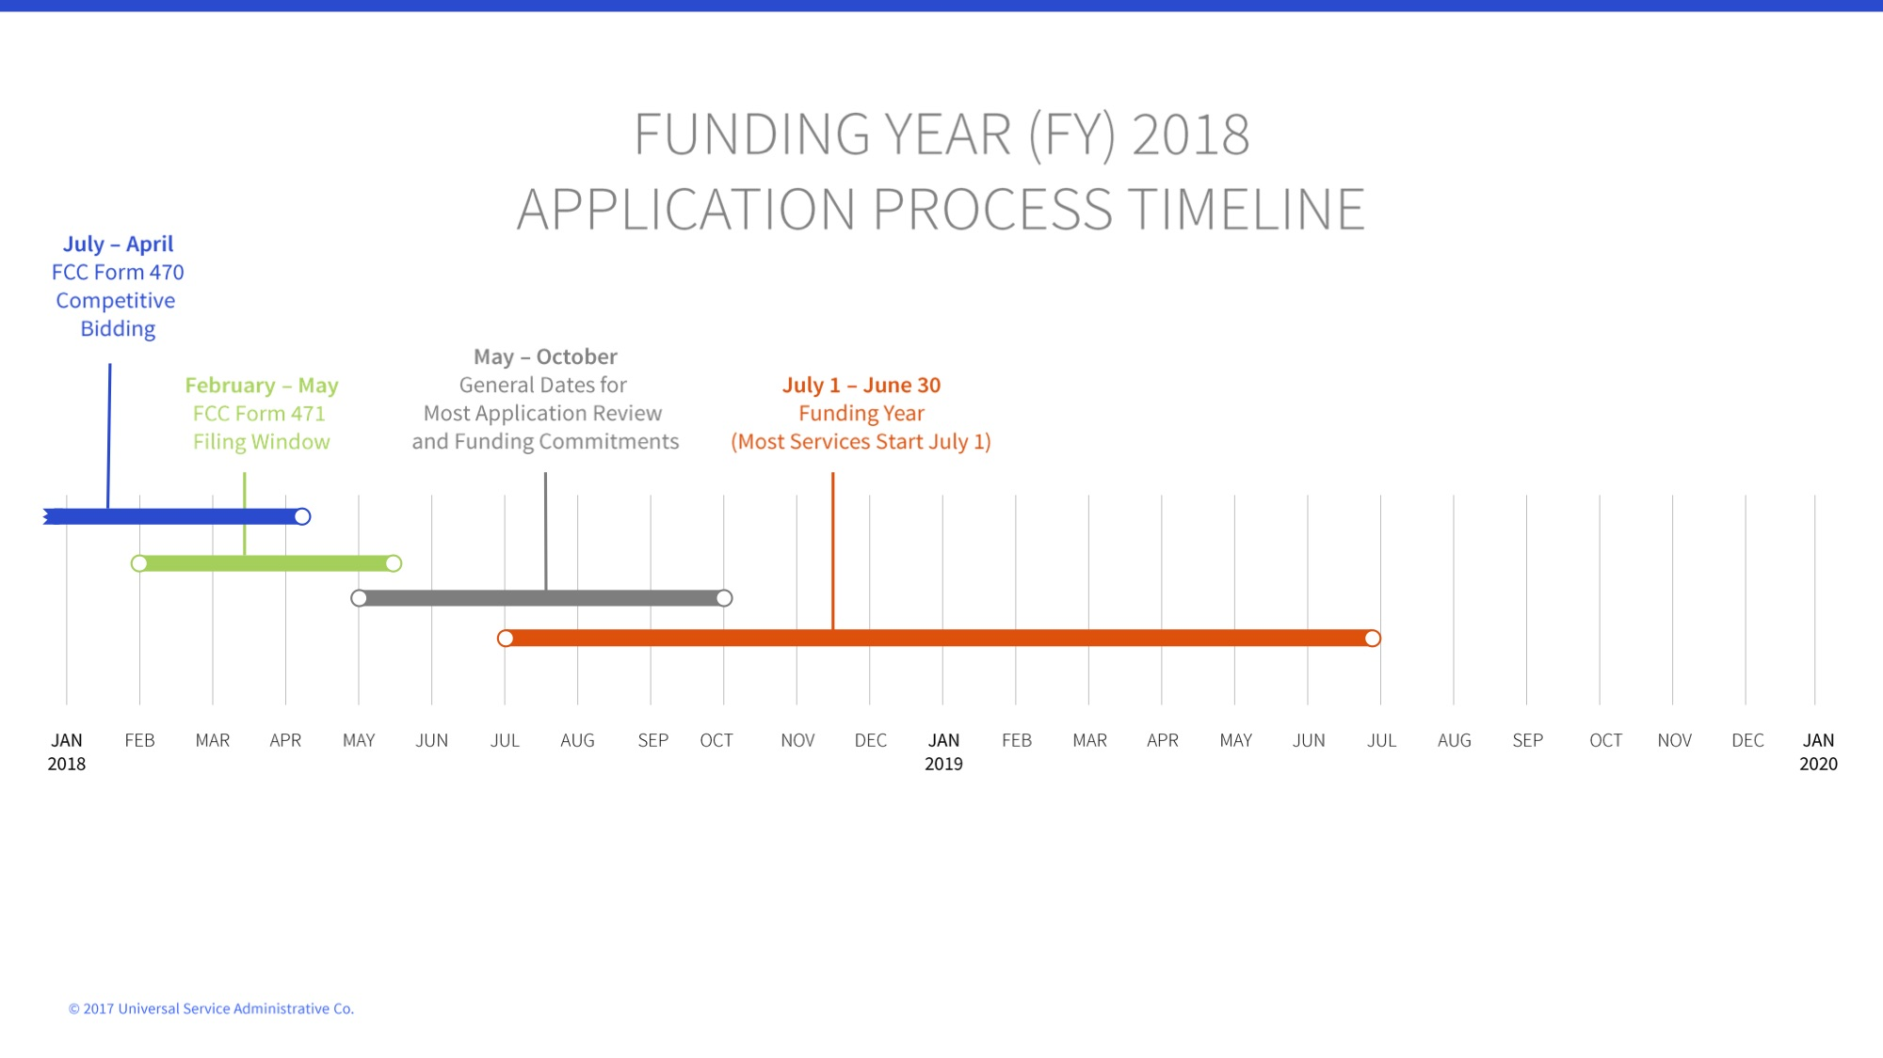

Slide 28
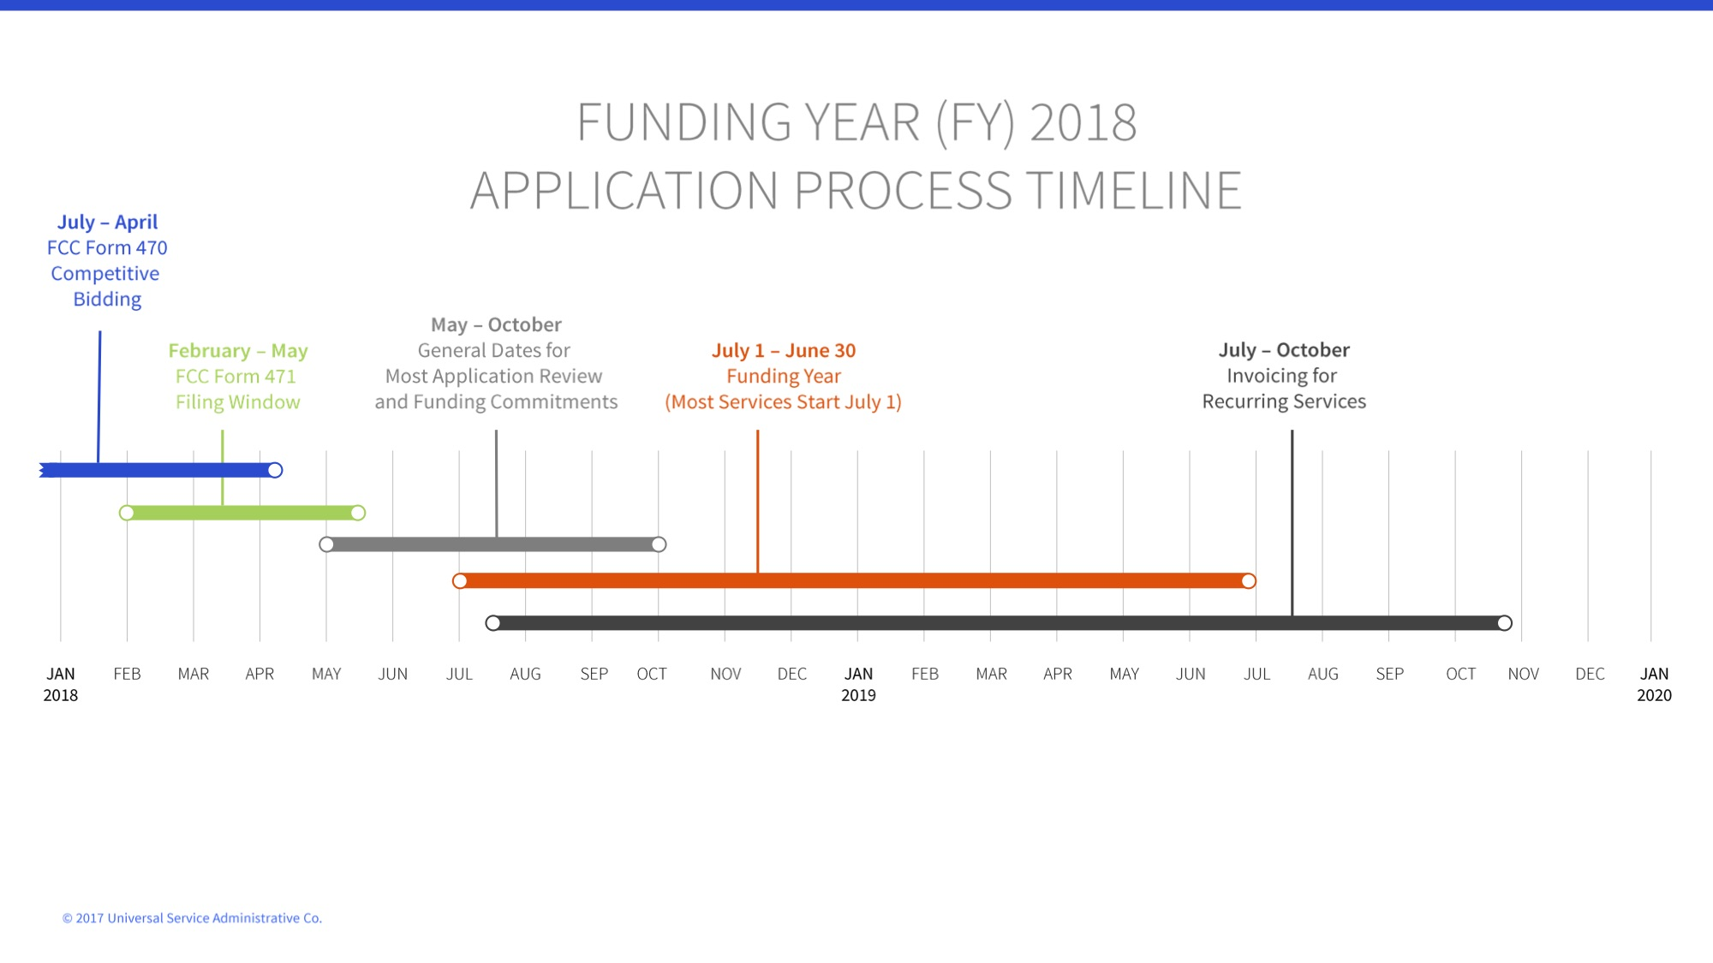

Slide 29
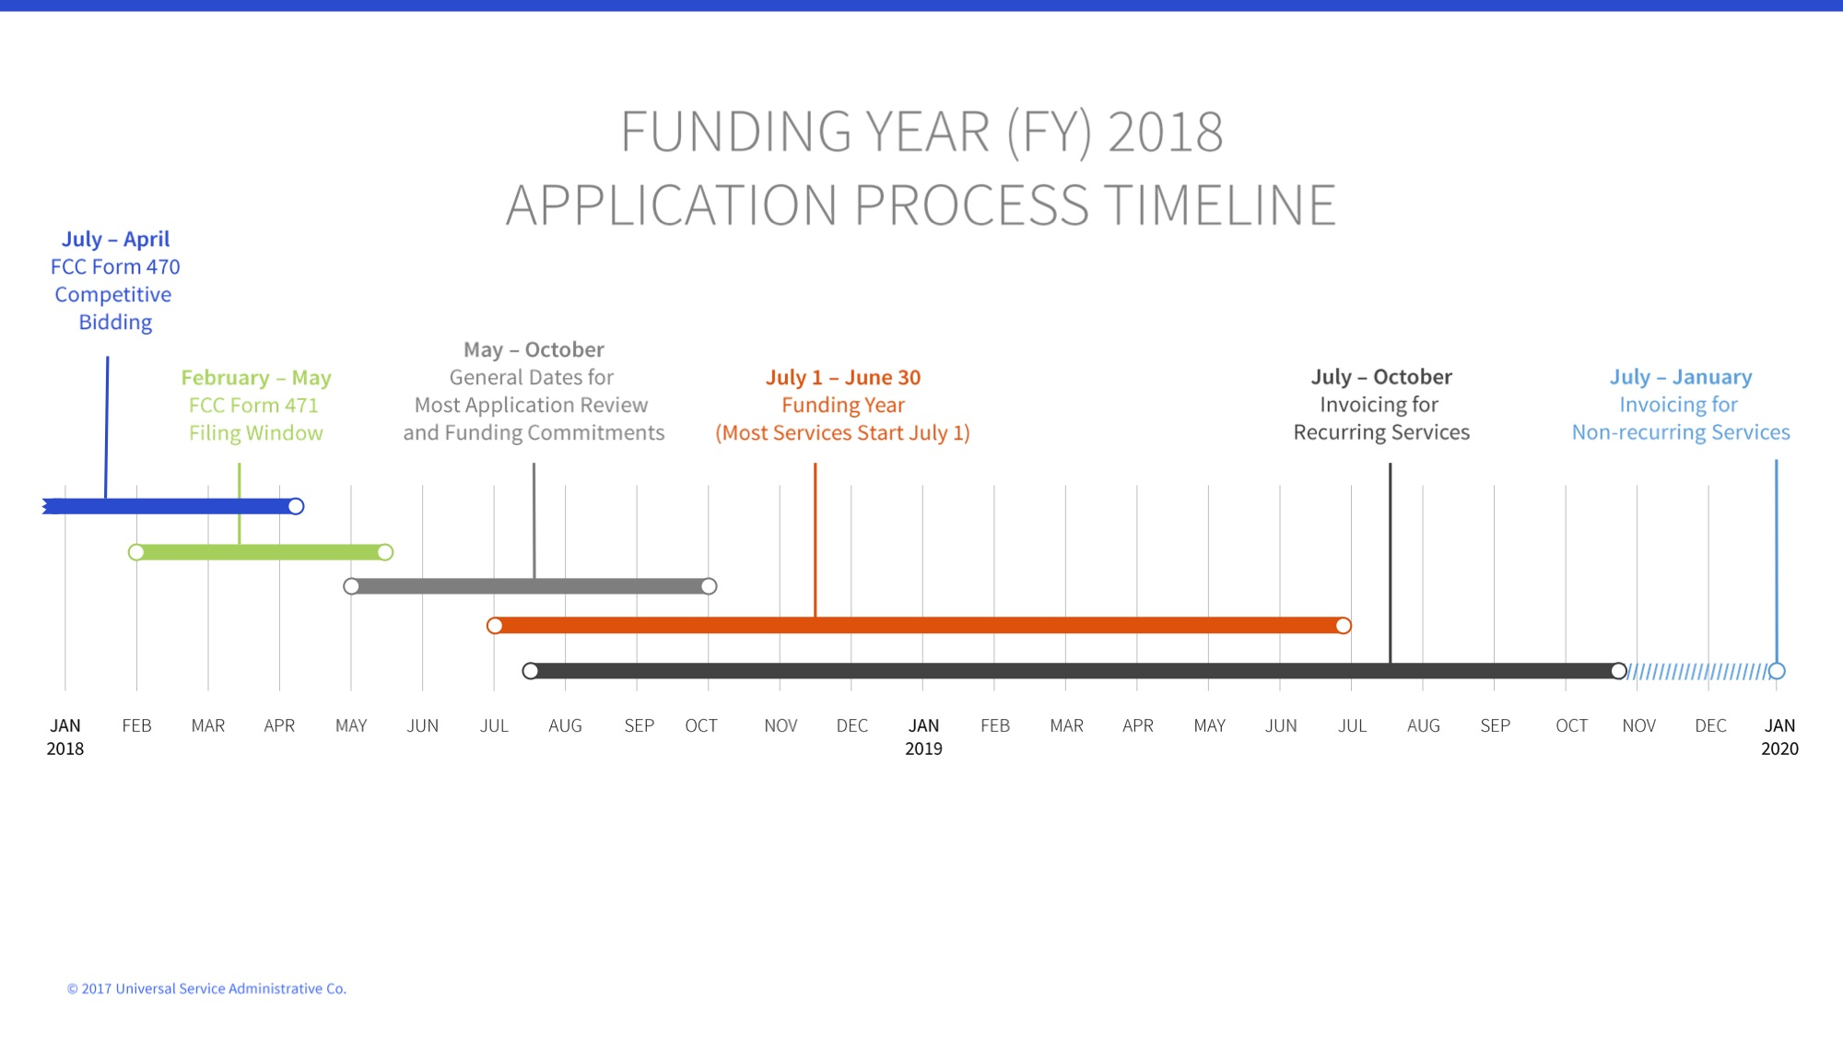

Slide 30
STREAMLINE YOUR WORKLOAD
Options to file fewer forms
  Multi-year contracts mean fewer FCC Forms 470
  SPI or discounted billing method mean fewer invoicing forms
Group form filing - file forms twice per year
  File three forms in October:
    FCC Form 470 (for upcoming year)
    FCC Form 486 (for current year if you’ve received your FCDL)
    FCC Form 472 BEAR (for previous year)
  File FCC Form 471 during window

Slide 31
STREAMLINE YOUR WORKLOAD
Form or join a consortium
  Only one member of the consortium files forms on behalf of all members (the consortium leader)
  Beneficial for small schools and libraries or those inexperienced with E-rate
  Apply together on one application
  Share expertise by combining knowledge resources
  Consortia can also include ineligible entities under limited circumstances and subject to cost allocation requirements

Slide 32
TRIBAL STATE MATCH
If a state provides eligible schools and libraries with funding for special construction charges for high-speed broadband that meets the FCC's long-term connectivity targets, the E-rate Program will increase an applicant's discount rate for these charges up to an additional ten percent to match the state funding on a one-to-one dollar basis.

Slide 33
TRIBAL STATE MATCH
For Tribal schools and libraries, the E-rate Program will also match special construction funding provided by states, Tribal governments, or other federal agencies on a one-to-one basis, up to an additional ten percent for the applicant's discount rate. Total E-rate support with matching funds may not exceed 100 percent.

Slide 34
BIE SCHOOL GUIDANCE
Tribally-operated schools can join the BIE consortium
  Need to submit LOA
  Consortium files internet on your behalf, but you cannot file for separate internet on your own
BIE-operated schools must invoice on your own, but under one shared FCC Form 498 ID (filed by BIE consortium leader)
  Tribally controlled schools must still obtain their own FCC Form 498 ID
BIE’s goal is to get all consortium members to 100 Mbps

Slide 35
BIE SCHOOL GUIDANCE
BIE Operated Schools are fully on a federal network – the Education Native American Network (ENAN)
  Here are some general guidelines:
    All users must take security training annually
    There can be no non-federal connections to ENAN within the school
      Any additional circuits used by the school must be completely and physically separate (air gap)
    Only government furnished equipment (GFE) may be attached to the network
  All federal entities must comply with DOI security policies and federal security regulations

Slide 36
BIE SCHOOL GUIDANCE
Tribal Controlled Schools may use ENAN to obtain internet access
  Tribal Controlled Schools will use VPN to access BIE federal resources
  There can be no non-federal connections to ENAN within the school
  Any additional circuits used by the school must be completely and physically separate (air gap)
  Tribal schools' internal networks are not subject to regulations specific to federal entities

Slide 37
Q&A SESSION

Slide 38
THANK YOU!

