Slide 1
Competitive Bidding for Service Providers
Service Provider Training I July 25, 2017

Slide 2
Welcome
In this presentation, you will learn:
1. The basics of the competitive bidding process
2. What you can and cannot do during the competitive bidding process
3. What to do if you win the bid

Slide 3
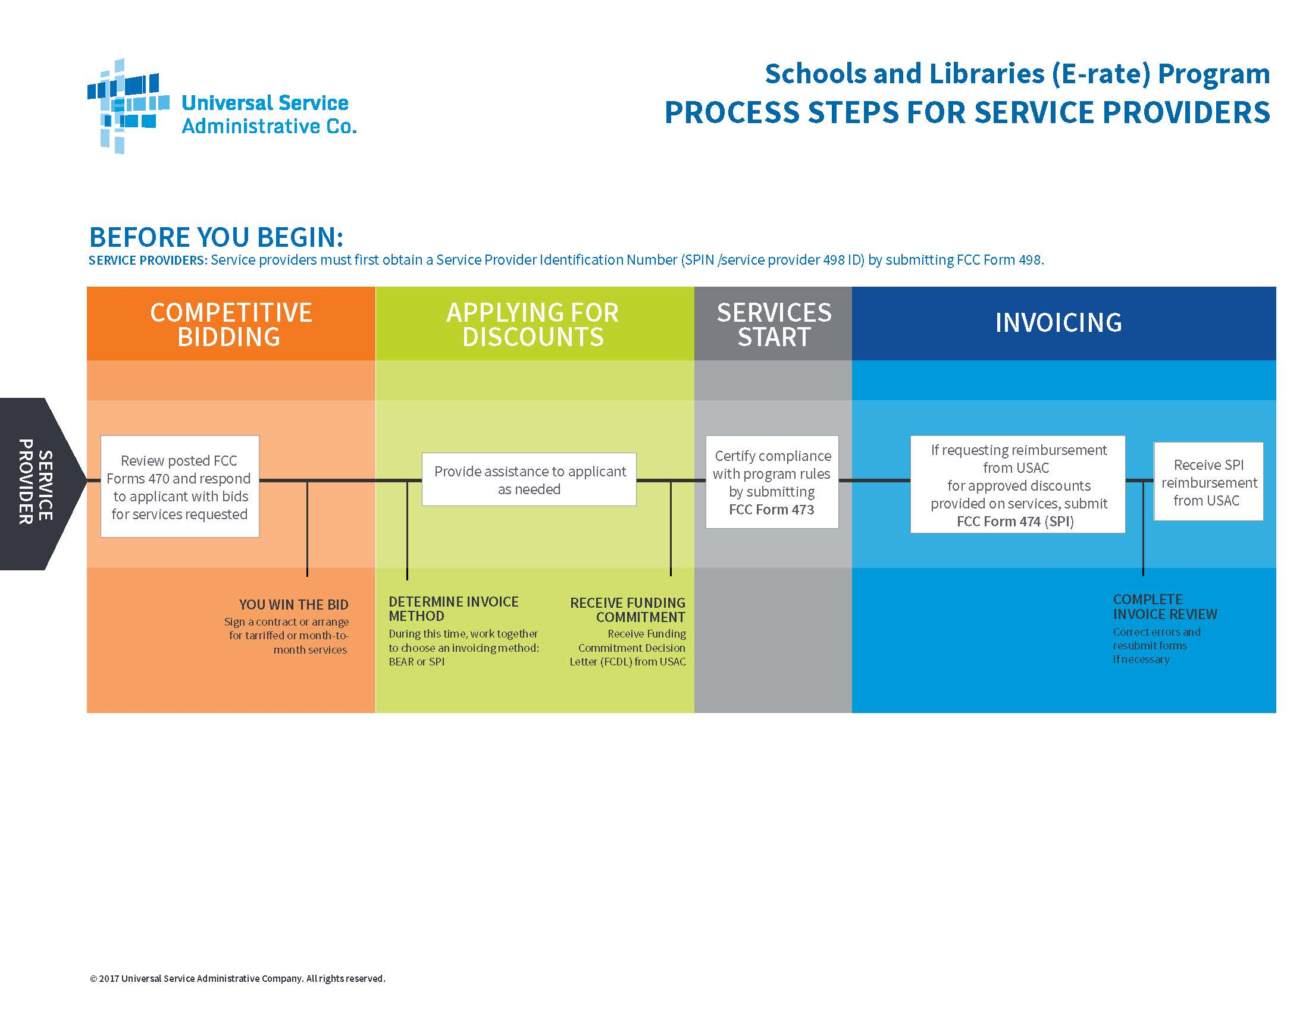

Slide 4
What is Competitive Bidding?
Competitive bidding is a formal process for applicants to choose the vendors/service providers who provide their products and services.

Slide 5
Overview of the Competitive Bidding Process
Applicants describe their desired services and requirements using FCC Form 470 (and RFP, if applicable).
Service providers review the documents and bid on the requested services.
Applicants wait at least 28 days then evaluate the bids received and select a service provider
Applicants must select the most cost-effective service using the price of eligible products and services as the primary factor (weighted more heavily than any other single factor).

Slide 6
Competitive Bidding: The Role of the Service Provider
Service providers can:
Respond to FCC Forms 470 and RFPs.
Assist applicants with preparing their funding request information.
Provide technical answers to questions regarding specific goods and services requested but NOT on competitive bidding questions.

Slide 7
Competitive Bidding: The Role of the Service Provider
Service Providers may not:
Have a relationship with applicants that would unfairly influence the outcome of the competitive bidding process.
Receive inside information regarding competitive bidding.
Compete for services with an applicant who has ownership interest in your company competing for services
Have ownership interest in a service provider’s company competing for services.
Pay for applicant’s termination charges incurred in breaking a contract.
Have conflicts of interest.

Slide 8
The FCC Form 470
First program form certified by applicants, which indicates specific details about the services applicants are seeking.
RFP document(s), if issued, must be posted to the FCC Form 470.
In the FCC Form 470 and RFP document(s), applicants must describe the desired products and services with sufficient specificity for service providers to be able to submit responsive bids.
All potential bidders must have access to the FCC Form 470and RFP documents.
Applicants are responsible for running an open and fair competitive bidding process.
  "Open" means that information shared with one bidder must be shared with all.
  "Fair" means that bidders must be evaluated fairly and equally.

Slide 9
The FCC Form 470 (continued)
The FCC Form 470 and RFP must contain certain important information:
If applicants list a specific manufacturer as a guide for compatibility issues, they must indicate “or equivalent” when specifying the manufacturer.
Applicants must describe any special requirements (e.g., required site visit or walkthrough, deadline for bid responses).
Applicants must indicate disqualification factors – if there are any – in the FCC Form 470 narrative and/or RFP.
Disqualification factors must be binary – either the bid or the bidder meets the factor or does not. They cannot be evaluated on a sliding scale.

Slide 10
The FCC Form 470 (continued)
The FCC Form 470 requires applicants to list specific services and quantities (e.g., feet of cabling, number of routers).
USAC advises applicants to take their best guess when listing products, services, and quantities, but to include descriptions in the narrative fields of the scope and details of their projects.
You may be able to provide an alternate solution that accomplishes the same goals but that differs from the specific list of products and services on the FCC Form 470.
HOWEVER, if the FCC Form 470 and RFP include very specific requests rather than requesting a range, applicant will be limited to what is in the FCC Form 470 and RFP.

Slide 11
The FCC Form 470 (continued)
The applicant does not have to file an FCC Form 470 if:
There is a multi-year contract that has already been competitively bid.
There is a contract with voluntary extensions that have already been competitively bid and the service provider and the applicant have agreed to extend the contract.
The applicant is getting commercially available, high-speed internet access that meets certain requirements. 47 CFR § 54.503(e).

Slide 12
The 28-day Minimum Waiting Period
FCC Form 470 and any RFPs, if applicable, must be posted on the USAC website for a minimum of 28 calendar days (including weekends and holidays) before selecting vendors, signing contracts, and certifying the FCC Form 471.
The 28th day – the Allowable Contract Date (ACD) is calculated by the system from the date the FCC Form 470 is certified. HOWEVER:
If the RFP is not available until after the FCC Form 470 is certified, the applicant must calculate the 28 days starting with the first day that the RFP is available.
If the applicant makes a cardinal change to the RFP or RFP documents (the FCC Form 470 itself cannot be changed after it is certified), the applicant must restart the 28-day clock and calculate the new ACD itself.

Slide 13

Test Your Knowledge
Using the information below, jot down the date the selected service provider could sign a contract:
Tuesday, May 2, 2017 at 11:59 PM
Answer: Tuesday, May 30, 2017 at 12:01 AM

Slide 14
Service Providers and Gifts
To provide for a fair and open competitive bidding process, there are significant restrictions on the direct or indirect solicitation or acceptance of gifts, gratuities, favors, entertainment, loans or any other thing of value by E-rate applicants from service providers or prospective service providers.

Slide 15
Service Providers and Gifts
Gifts, gratuities, favors, entertainment or any other thing of value that E-rate service providers or prospective service providers can offer or provide E-rate applicants are also restricted.
Gift rules are always in effect, not just during the competitive bidding process.

Slide 16





Service Providers and Gifts
Modest refreshments not offered as part of a meal
Items with little intrinsic value intended solely for presentation (e.g., certificates and plaques)
Items worth $20 or less as long as those items do not exceed $50 per funding year, per employee from any one source.
Charitable donations, as long as those contributions are not directly or indirectly related to E-rate procurement activities or decisions.
Personal gifts to family members can be made from the personal funds of the donor (without reimbursement from the employer) and are not related to a business transaction or relationship.

Slide 17
Service Providers and Gifts
Applicants may return or dispose of gifts, and should keep a record of the return or disposal.
Applicants may repay the value of the gift – should repay immediately and record the repayment.
Must deduct the value of the “free stuff”, discounts, trade-in etc., from the pre-discount amount in order get equal comparison between offerings
Cost of eligible goods and services cannot be inflated to cover the “free” ineligible stuff.

Slide 18

Service Providers and Gifts

Slide 19

Test Your Knowledge
Take a look at the items displayed by your presenter. When asked, raise your hand if you believe the meets or does not meet the guidelines for gifts.

Slide 20
Understanding Cost Effectiveness
Applicants must be able to demonstrate why the service it selects is cost-effective.
Service providers may work with applicants to formulate responses to questions about whether a service is cost-effective.

Slide 21
The Lowest Corresponding Price (LCP)
Service providers may not submit bids for or charge applicants prices above the lowest corresponding prices charged to other similarly situated customers for similar services.
Ensures schools and libraries in the E-rate program are not charged more for the same services because of their E-rate participation.
Exceptions can be made if the provider can show that they face significantly higher costs to serve this customer due to volume, mileage from facility, and/or length of contract.
Applies to all service providers and for all service arrangements (tariff, month-to-month and contracted services).

Slide 22
Evaluation Bids
Applicants must use price as the primary factor when evaluating bids.
Other factors, including other price factors, can be considered as well; but they cannot be weighted equally or higher than cost of the eligible goods and services.
It’s possible for the lowest priced bid to not win.

Slide 23
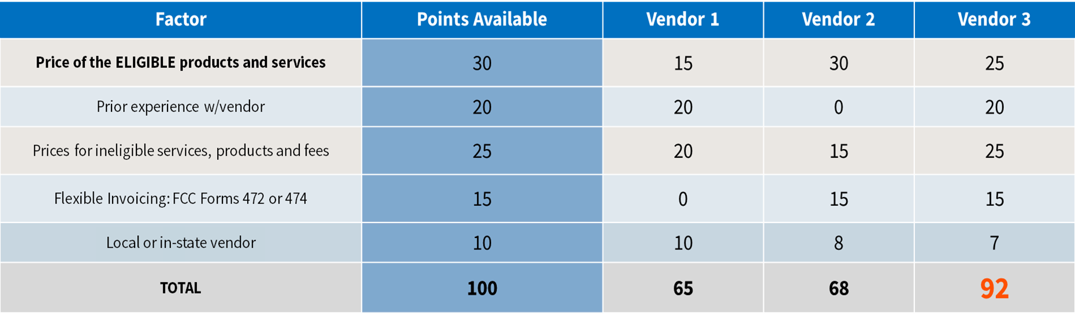
Sample: Bid Evaluation Matrix

Slide 24
Contracts
Applicants must have a signed contract or other legally binding agreement in place prior to submitting their FCC Form 471 to USAC.
Applicant must not sign a contract before the Allowable Contract Award Date (ACD).
Signed contracts constitute the best evidence that a legally binding agreement exists.
  A verbal offer and/or acceptance will not be considered evidence of the existence of a legally binding agreement.

Slide 25
Contracts
Services under tariff or on a month-to-month based service are considered contracted services if they are purchased under a contract.
Purchase orders will not be considered valid unless they are considered a contract or legally binding agreement in that state.
Voluntary contract extensions are allowable only when the option is stated in the original provisions of the contract, and the extension must be exercised before the applicant certifies the FCC Form 471 for the funding year covered by the extension.
  Applicant must rebid the services (i.e., file a new FCC Form 470) if contract extensions are not stated in the contract or RFP.

