Slide 1


E-rate Program Overview
2017 E-rate Training
© 2017 Universal Service Administrative Co.

Slide 2
AGENDA
The Basics
Discounts
Category 2 Budgets
How to Apply

Slide 3
WHAT IS THE SCHOOLS AND LIBRARIES (E-RATE) PROGRAM?
Helps ensure that schools and libraries can obtain high-speed Internet access and telecommunications at an affordable rate
Keeps students and library patrons connected to broadband by providing a discount on eligible services

Slide 4
WHO MAKES THE RULES?
Congress wrote the Telecommunications Act of 1996.
  Part of this act directed the FCC to establish and oversee the E-rate program.
The FCC sets rules and policies for the program through “Orders”.
  These orders determine how USAC administers the day-to-day operations of the E-rate program.
USAC develops procedures, such as how to process applications.
  USAC’s procedures are reviewed and approved annually by the FCC.
CONGRESS
FCC
USAC

Slide 5
TIMELINE
The Funding Year (FY)
E-rate funding commitments are made by funding year.
USAC refers to the funding year as the year in which most services will begin.
Funding years run from July 1 to June 30
(e.g., FY2017 = July 1, 2017 to June 30, 2018).
JANUARY 2018
JULY
DECEMBER
FY2017 ends June 30
FY2018 begins July 1

Slide 6
WHO CAN GET DISCOUNTS?
Elementary and secondary schools and school districts
  Public, private, charter, parochial, and Tribal, are types of schools and school districts.
  Non-traditional facilities (Pre-K, Head Start, juvenile justice, and adult education) are eligible if they fit their state’s definition of elementary/secondary education.
  Look up non-traditional facility eligibility on our website.
Notes:
S & L = Not for profit
S = Must fit state definition; L = Must be eligible for LSTA funding
S = No endowment over 50 mill; L = Budget separate from school

Slide 7
WHO CAN GET DISCOUNTS?
Libraries and library systems
  Public, private, academic, research, Tribal are types of libraries and library systems.
  Bookmobiles and kiosks are eligible if they are considered library branches in their state.
Consortia
  Eligible entities can form consortia by banding together to aggregate demand and negotiate lower prices.
Notes:
S & L = Not for profit
S = Must fit state definition; L = Must be eligible for LSTA funding
S = No endowment over 50 mill; L = Budget separate from school

Slide 8
CONSORTIUM BENEFITS
Beneficial for small schools and libraries or those inexperienced with E-rate.
  Only one member of the consortium files forms (the consortium leader)
  Apply together on one application
  Share expertise by combining knowledge resources
Consortium applications are more streamlined than previous years.
Consortia can also include ineligible entities under limited circumstances and subject to cost allocation requirements.
Notes:
Also consortia may be formed just to seek bids. For instance, consortium members may join together to seek bids and then each file their own FCC Form 471s.

Slide 9
WHAT PRODUCTS AND SERVICES ARE ELIGIBLE?
Category One (C1)
Category Two (C2)
Data Transmission Services and Internet Access
Internal Connections, Managed Internal Broadband Services, and Basic Maintenance of Internal Connections
Notes:
CAT 1: No budget (limit) on funding request; Funding requested each year
CAT 2: Budget (limit) on funding request; Budget covers a five-year period

Slide 10
PRODUCTS & SERVICES ELIGIBLE FOR E-RATE
Every year, the FCC publishes the Eligible Services List, which governs the eligibility of products and services in the upcoming funding year.
  FCC issues a Public Notice attaching a draft eligible services list and seeking comments on it
  FCC reviews comments received, then issues an order with the final list
  Some examples of products and services include:
CATEGORY ONE EXAMPLES | CATEGORY TWO EXAMPLES
Leased lit fiber | Access points
Ethernet | Switches
Multi-Protocol Label Switching (MPLS) | Routers
OC-1, OC-3, OC-12, OC-n | Supporting software used to distribute high-speed broadband
Satellite Service | Installation, activation, and initial configuration

Slide 11
E-RATE PROGRAM BUDGET
Funding is capped at $3.99 billion.
  The cap is adjusted annually for inflation.
  $1 billion funding target for “Category Two” funding.
Once per year, the FCC may direct USAC to roll over unused funds from prior funding years into the next funding year.

Slide 12
YOUR E-RATE DISCOUNT
Discounts range from 20% to 90% for Category 1 services and from 20 to 85% for Category 2 services.
Discounts are calculated using three pieces of information:
  Poverty level
  Urban or rural status
  Service type
Notes:
-Your discount is calculated automatically as part of the 471 application since the information is gathered in your EPC profile
-It’s also calculated automatically in the EPC profile once the address is entered and
Student numbers are entered if you’re in a school
Associated School District is listed if you’re a library

Slide 13
DISCOUNTS: YOUR POVERTY LEVEL
The E-rate program uses the National School Lunch Program (NSLP) to determine poverty level.
  Alternative Discount Mechanisms can also be used
Discounts depend on the percentage of students who are eligible for NSLP.
Notes:
Examples of acceptable alternative methods: Survey, CEP, matching siblings, existing sources, provision 1,2,3
Examples of unacceptable methods: Feeder, Title 1

Slide 14
DISCOUNTS: YOUR POVERTY LEVEL
Discounts are calculated for the school district or the library system (not for individual schools or library branch).
  Library system members must use the NSLP calculation from the school district of the main branch’s location.
  Schools that are members of school districts use their district’s average.
  An independent school or library: An independent school calculates its NSLP figures based on its own student population, and an individual library uses the NSLP figure for the school district in which it is located.

Slide 15
DISCOUNTS: URBAN OR RURAL STATUS
Urban or rural status is based on 2010 census data.
Check your status on our website.
School districts are considered rural if more than 50% of its schools are rural.
Library systems are considered rural if more than 50% of its branches are rural.
Notes:
If your address isn’t recognized in EPC, enter the latitude / longitude of your entity into your EPC profile manually.
Then the urban/rural status will appear

Slide 16
CATEGORY ONE
DISCOUNTS: CATEGORIES OF SERVICE AND VOICE PHASE DOWN
Your discount also depends on what type of service you are purchasing:
UP TO 90%
UP TO 85%
Up to 10% for FY2018

Slide 17
LOOK UP YOUR DISCOUNT
 | Category One Discount Levels |  | Category Two Discount Levels
INCOME % of students eligible for NSLP | URBAN DISCOUNT | RURAL DISCOUNT | URBAN DISCOUNT | RURAL DISCOUNT
Less than 1% | 20% | 25% | 20% | 25%
1% to 19% | 40% | 50% | 40% | 50%
20% to 34% | 50% | 60% | 50% | 60%
35% to 49% | 60% | 70% | 60% | 70%
50% to 74% | 80% | 80% | 80% | 80%
75% to 100% | 90% | 90% | 85% | 85%

Slide 18
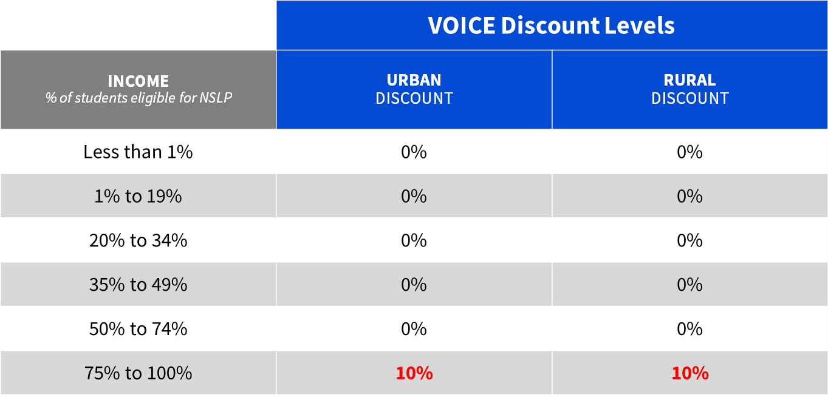
VOICE SERVICE DISCOUNT FOR FY2018
(last year of voice phase down)
For FY 2018 – only applicants at a 90% discount level will be eligible for support at 10%
Notes:
For the 10 percent discount level – note this is the last year for voice services

Slide 19
CONSORTIUM DISCOUNTS
A consortium’s discount is the simple average of its members’ discount levels.
  Members still use district-wide discount rates for their individual calculation.
  Only consortia can get a discount that doesn’t appear on the discount matrix.
  The discount calculation for each consortium FCC Form 471 is based on the discounts of the members who share the services on that form.
    In other words, consortia do not always have the same discount across all of their program forms.

Slide 20
FIVE-YEAR CATEGORY TWO (C2) BUDGETS
USAC calculates a C2 budget for each individual school or library branch.
  The budget for one entity cannot be shared with other entities in a consortium, district, or system.
The school or library can receive discounts on the cost of C2 services up to its C2 budget amount. It can:
  Spend the budget over a five-year period,
  Use the entire budget in one funding year,
  Allocate over five different funding years,
  Spend the budget on one, two, or all three of the C2 service types.
Notes:
-As a reminder: C2 services are internal connections, managed internal broadband services, and basic maintenance of internal connections
-Recalculate budget annually and take changes in population into account
-There is no budget for Category One services

Slide 21
FIVE-YEAR CATEGORY TWO (C2) BUDGETS
The C2 budget is re-calculated every year.
  More students in a school or expansion of the library results in a budget increase.
  Fewer students in a school or downsizing in a library results in a budget decrease.
    If the C2 budget decreases below funding already spent for the five-year period, the school or library does not have to reimburse USAC for the discount on the difference between the budget and the pre-discount amount.
The C2 budget multiplier is adjusted each year for inflation.
Notes:
-As a reminder: C2 services are internal connections, managed internal broadband services, and basic maintenance of internal connections
-Recalculate budget annually and take changes in population into account
-There is no budget for Category One services

Slide 22
WHAT’S MY FIVE-YEAR C2 BUDGET?
(All figures are for FY2017)
Pre-discount budget calculations are based on the number of students (for schools) or the square footage (for libraries).
  Schools:
    Total students (including peak part-time) x $153.47
  Libraries:
    Total internal square footage x $2.35
    For urban libraries with Institute of Museum and Library Services (IMLS) locale code of 11, 12, 21, the calculation is total internal square footage x $5.12

Slide 23
WHAT’S MY FIVE-YEAR C2 BUDGET?
(All figures are for FY2017)
Minimum budget of $9,412.80
  If the budget calculation results in a value less than $9,412.80, the school or library’s pre-discount budget is set at the minimum budget
Remaining C2 Budget = (Pre-discount budget) – (Pre-discount amounts committed in prior funding years)

Slide 24
C2 BUDGET EXAMPLES
Example #1 – School (using FY2017 numbers)
Formula:
# students x $153.47 = FY2017 five-year pre-discount C2 budget
Total number of students: 1,000
FY2017 multiplier: $153.47
Calculation:
FY2017 C2 pre-discount budget : 1,000 students x $153.47 = $153,470
The school then subtracts any pre-discount C2 funding requests from FY2016 and FY2015.
If the school requested support for $90,000 in C2 services in FY2016 and $10,000 in FY2015 ($100,000 pre-discount), theFY2017 remaining balance would be $53,470.

Slide 25
C2 BUDGET EXAMPLES
Example #2 - Library (using FY2017 numbers)
Formula:
Internal ft2 x $2.35 = FY2017 five-year C2 pre-discount budget
Total internal square footage: 5,000
FY2017 Multiplier: $2.35
Calculation:
FY2017 calculation: 5,000 square feet x $2.35 = $11,750 pre-discount
The library then subtracts any pre-discount C2 funding requests from FY2016 and FY2015.
If the library requested $0 in FY2016 and $5,000 in FY2015 ($5,000 pre-discount), the FY2017 remaining balance would be $6,750.

Slide 26
C2 BUDGET EXAMPLES
Example #3 –Small School (using FY2017 numbers)
Formula:
# students x $153.47 = FY2017 five-year C2 pre-discount budget
Total number of students: 45
FY2017 multiplier:$153.47
Budget floor in FY2017: $9412.80
Calculation:
C2 budget calculation: 45 students x $153.47 = $6,906.15
$6,906.15 < $9,412.80, so the school’s budget is automatically raised to the budget minimum of $9,412.80
Actual C2 pre-discount budget amount: $6906.15 → $9412.80
The school then subtracts any pre-discount C2 funding requests from FY2016 and FY2015. If the library requested $0 in FY2016 and $9,200 in FY2015 (pre-discount), the remaining balance would be $212.80 in FY2017.

Slide 27
OTHER CATEGORY 2 BUDGET INFORMATION
NIFs are school buildings with no classrooms or library buildings not open to the public (e.g., administrative buildings). NIFs do not have C2 budgets.
  If the NIF is essential for the transport of the services to a school or library, the entities benefiting from the services must allocate the costs from their budgets.
  If the NIF receives services for itself, those costs must be allocated out of the funding request.
Read the C2 Budget Tool User Guide and check the Category Two Budget Tool and using your entity number on the USAC Tools website.
  Applicants can return unused committed funds from prior funding years using the FCC Form 500.

Slide 28
E-RATE PRODUCTIVITY CENTER (EPC)
EPC is the E-rate account management and application portal for applicants, service providers and consultants.
In EPC you can:
  File most program forms
  Maintain a list of your related entities (e.g. individual schools for districts, library branches for library systems, and consortium members for consortia)
  Update your entity information (e.g. contact information and entity information such as student counts and square footage)
  Add additional users on your organization’s account and assign them rights (permissions) to file forms.

Slide 29
HOW TO APPLY
Call our Client Service Bureau at call (888) 203-8100 to set up an account in EPC and make sure your school or library has a Billed Entity Number (an ID number assigned by E-rate).
1.
2.
3.
4.
Request services
(FCC Form 470),
run a competitive bid process, and select a vendor
Request funding
(FCC Form 471)
and undergo application review
Confirm the start of services and status of CIPA compliance
(FCC Form 486)
Request reimbursements (FCC Form 472)
OR receive discounts
(FCC Form 474)
Notes:
Request reimbursements if using FCC Form 472 or receive discounts on bill if service provider files FCC Form 474.

Slide 30
Q&A SESSION

Slide 31
THANK YOU!

