Slide 1
Eligible Fiber Options for the E-rate Program
2017 E-rate Training

Slide 2
AGENDA
Identifying E-rate eligible fiber services and charges
Installment Plans and State Match Funds (Special Construction)
Requesting proposals for fiber service options (FCC Form 470)
Evaluating cost-effectiveness of fiber service options
Preparing a fiber funding request (FCC Form 471)
Service delivery deadlines and extensions (FCC Form 500)
Service provider’s role in process and FCC Form 471 Tips

Slide 3
Leased Lit Fiber
E-RATE ELIGIBLE TRANSPORT
A fiber-based broadband service where the service provider owns and manages the network, and the E-rate applicant pays a recurring fee to have data transported over the network.
The E-rate applicant leases capacity (i.e., a specific number of strands) on a service provider-owned and maintained fiber network. The applicant pays separately for modulating equipment to light the fiber in order to transmit data over that fiber.
Complete applicant ownership of a high-speed broadband network. The applicant hires a vendor to construct the network or a portion of the network, and thereafter owns and maintains that network or portion of the network, including all of the fiber strands and conduit.
*Note: Although included as a fiber option, applicants may seek support for self-provisioned networks using technologies other than fiber, such as cable or Microwave.

Slide 4
Leased Lit Fiber
E-RATE ELIGIBLE FIBER AND SELF-PROVISIONED NETWORK CHARGES
Applicants may request E-rate support for the following charges (by type of service):
Monthly recurring charges
Special construction charges
Basic installation charges
Recurring dark fiber lease or IRU payments
Maintenance and operations charges
Special construction charges
Basic installation charges
Network equipment
Maintenance and operations charges
Special construction charges
Network equipment

Slide 5
SPECIAL CONSTRUCTION OVERVIEW
Special construction charges are the upfront, non-recurring costs of deploying new fiber or upgraded network facilities to eligible entities.
Special construction charges eligible for Category One (C1) support consist of three components:
  Construction of network facilities;
  Design and engineering; and
  Project management.
Applicants may seek funding for special construction charges in connection with leased lit fiber, leased dark fiber, and self-provisioned networks.

Slide 6
SPECIAL CONSTRUCTION OVERVIEW
Special construction charges do not include:
Charges for Network Equipment necessary to light fiber (i.e., modulating electronics and other equipment necessary to make a C1 service functional), or maintenance and operations (M&O) of the fiber.
  If seeking bids for Network Equipment and/or M&O in relation to Leased Dark Fiber service, bids for these services must be requested on the same FCC Form 470 as the Leased Dark Fiber service.
  Funding requests for network equipment and M&O costs associated with lighting Leased Dark Fiber must be included in the same FCC Form 471 that requests support for the Dark Fiber Lease or IRU.

Slide 7
SPECIAL CONSTRUCTION OVERVIEW
Special construction charges incurred up to six months prior to the beginning of the funding year (i.e., January 1) are eligible for support if:
  Construction begins after selection of a service provider pursuant to a valid competitive bidding process;
  A Category One recurring service depends on the installation of the infrastructure; and
  Actual service start date is on or after the start of the funding year (i.e., July 1).
Note: Applicants that start construction early, before a funding request is approved, assume the risk that the request will be denied or that a reduced commitment amount is approved.

Slide 8
SPECIAL CONSTRUCTION OVERVIEW
Milestone Payments
  Applicants may submit invoices for special construction charges at any point during the funding year
Note: Applicants may not receive E-rate support for any recurring charges incurred before the start of the funding year (i.e., July 1).

Slide 9
SPECIAL CONSTRUCTION OVERVIEW
  To be eligible for E-rate discounts for special construction charges – whether for leased lit fiber, leased dark fiber, or a self-provisioned network – special construction must be completed in time for the fiber to be lit (or for a self-provisioned network involving another technology to be in use) by the end of the relevant funding year (i.e., June 30). If this June 30 deadline is not met, the special construction charges will not be eligible for support under program rules.

Slide 10
INSTALLMENT PAYMENTS FOR SPECIAL CONSTRUCTION
Applicants can enter into installment payments plans to pay the non-discounted share of costs for special construction.
Applicants must indicate their interest in installment payment plans on their FCC Form 470.
Service providers are not obligated to offer installment payment plans to applicants.

Slide 11
INSTALLMENT PAYMENTS FOR SPECIAL CONSTRUCTION
If a service provider chooses to offer an installment payment plan, they must disclose all material terms, including the interest rate and the term of the payment plan.
  Payment plans may not exceed four (4) years.
  Interest and finance charges are not E-rate eligible charges and must be deducted from the funding request.

Slide 12
ADDITIONAL DISCOUNT TO MATCH STATE/TRIBAL FUNDING FOR SPECIAL CONSTRUCTION
If a state provides eligible schools and libraries with funding for special construction charges for high-speed broadband that meets the FCC's long-term connectivity targets, the E-rate program will increase an applicant's discount rate for these charges up to an additional ten percent to match the state funding on a one-to-one dollar basis. State funding can be funds authorized directly by a state legislature or provided by one or more state agencies.
For Tribal schools and libraries, the E-rate program will also match special construction funding provided by states, Tribal governments, or other federal agencies.

Slide 13
ADDITIONAL DISCOUNT TO MATCH STATE/TRIBAL FUNDING FOR SPECIAL CONSTRUCTION
State Match Eligibility Requirements:
  The broadband service must meet the FCC's long-term targets.
  The funding must be from an eligible source.
  The terms and conditions associated with the state funding must not conflict with E-rate rules.
  The total amount of support, including matching funds, may not exceed 100 percent of the cost of the project.
  State match funds may not be applied to any other cost – applicants should create separate funding requests on their FCC Forms 471 for special construction.

Slide 14
SEEKING COMPETITIVE BIDS BY SUBMITTING THE FCC FORM 470
Applicants initiate the required competitive bidding process by submitting the FCC Form 470 in E-rate Productivity Center (EPC).
In EPC, the FCC Form 470 has a drop-down menu of eligible services; applicants must select the services for which they would like to seek bids.

Slide 15
FIBER SPECIFIC COMPETITIVE BIDDING RULES
Leased lit fiber: If an applicant is only interested in seeking bids for leased lit fiber, they may do so by posting an FCC Form 470 in EPC that only specifies leased lit fiber as the requested service. (Utilize the “Leased Lit Fiber” drop-down option in EPC when submitting the FCC Form 470.)
Leased dark fiber: Program rules require applicants considering a Leased Dark Fiber solution for their connectivity must also request bids for a Leased Lit Fiber solution. (Utilize the “Leased Dark Fiber and Leased Lit Fiber” drop-down option in EPC when submitting the FCC Form 470.)

Slide 16
FIBER SPECIFIC COMPETITIVE BIDDING RULES
Self-provisioned network: Applicants that are considering a Self-Provisioned Network solution for their connectivity needs to must also request bids for services provided over third-party networks. (Utilize the “Self-Provisioned Network and Services Provided Over Third-Party Networks ” drop-down option in EPC when submitting the FCC Form 470.)

Slide 17
FCC FORM 470 AND REQUESTS FOR PROPOSALS (RFPS)
The FCC Form 470 and requests for proposals (RFPs) should provide enough information to solicit comprehensive proposals from service providers, but not so much information that the applicant states or implies a preference for a particular connectivity solution, a particular construction route, or particular method of construction.
If posting an RFP for multiple service types make certain that your RFP:
  Addresses all of the broadband solutions services for which you are seeking bids.
  Does not indicate a preference for one broadband solution over another.

Slide 18
FCC FORM 470 AND REQUESTS FOR PROPOSALS (RFPS)
Although the E-rate rules do not specifically require applicants to prepare a separate RFP for any eligible service, applicants seeking bids for leased dark fiber services, self-provisioned networks, or the "Other" option will need to upload an RFP in EPC.

Slide 19
COST-EFFECTIVENESS REQUIREMENT
Applicants are required to demonstrate that they selected the most cost-effective service offering.
When an applicant considers bids for the fiber options, the cost-effectiveness analysis should include:
  A comprehensive explanation of the cost breakdown of the chosen service option over the other available service options.
  An evaluation of the expected useful life of the facility, and compare the combined upfront and recurring costs associated with the service.
  If considering a leased dark fiber options, this would include, for example, comparing the charges associated with leasing the fiber, costs for any modulating equipment, and M&O costs with the cost of leased lit fiber options over a comparable period of time.

Slide 20
COST-EFFECTIVENESS FOR FIBER SERVICE OPTIONS
The comparison time period must be defensible and aligned with the applicant’s anticipated use of the assets.
Decisions must have a tangible basis and the result should be reasonable.
Include explanations on any assumptions made during the evaluation, such as expected useful life, frequency of equipment refreshes, etc.

Slide 21
COST-EFFECTIVENESS FOR FIBER SERVICE OPTIONS
Service Specific Considerations for Cost-Effectiveness
  Self-Provisioned Networks: Consider all costs of owning, operating, and maintaining a network (e.g., recurring fees for maintenance and operations, network equipment, equipment refreshes).
  Leased Dark Fiber: Consider all of the costs of leasing, lighting, maintaining, and/or operating the dark fiber.
  Leased Lit Fiber: Comparison should project demand for bandwidth over the comparison period and how costs of bandwidth may vary over time.

Slide 22
PREPARING YOUR FUNDING REQUEST
Applicants will be asked to provide an explanation of the cost effectiveness of their service selection.
  Provide line item level details on any charges related to the service.
  Work with your service provider to understand and be able to explain the reasonableness and need for any associated costs. Examples:
    Pole make ready cost (aerial)
    Large number of splices
    Large quantity of hand holes or vaults (buried)
  Provide a map utilizing GIS data as part of the cost-per-foot evaluation.
  Communicate the time frame when the investment of USF will yield cost savings.

Slide 23
COST-ALLOCATION: FIBER
Subject to the same cost-allocation requirements as all E-rate eligible services and funding requests:
  E-rate funds may only be used to pay for services and products used by eligible entities for an eligible purpose (i.e., a primarily educational purpose).
  All costs associated with fiber installed for use by an ineligible entity or for an ineligible purpose must be allocated out of a special construction funding request.
  Includes all costs above and beyond what would be incurred if only the fiber required to serve the applicant were installed.

Slide 24
COST-ALLOCATION: FIBER
A cost-allocation requires a clear delineation of costs.
Must be based on a reasonable, tangible basis that reaches a realistic result.
Cost-allocations must be supported by documentation.
Reminder: All fiber and facilities installed as part of a self-provisioned network must be owned by eligible schools/libraries and may not be used by other entities (i.e., resold). Limited exception per program rules for consortia

Slide 25
COST-ALLOCATION: FIBER
Special construction charges are only eligible for support if the new fiber is lit by the end of the funding year:
  Excess fiber strands (i.e., fiber strands that are not lit for the applicant’s use in the same FY) may be installed for the applicant’s exclusive future use.
  Cost of the fiber strands not lit within that FY must be allocated out of the funding request.
  Remaining special construction charges need not be cost-allocated.
  Recurring charges of using the excess fiber strands will be eligible for support in the funding year that they are lit for the applicant’s use.

Slide 26
COST-ALLOCATION: FIBER EXAMPLES
Example 1: Leased lit fiber or leased dark fiber provider installs 12-strands in fiber run to a large school district hub and wants to add 36 additional strands for its own ineligible use, resulting in additional labor costs (e.g., splicing) and plant costs (e.g., larger termination boards, additional handholes).
  Result: Cost of 36 additional fiber strands and all associated incremental increases in costs (e.g., the additional labor/outside plant costs) above what would be incurred if only the 12-strands of fiber were installed must be allocated out of the applicant’s special construction funding request.

Slide 27
COST-ALLOCATION: FIBER EXAMPLES
Example 2: School district seeks to install 48 strands of fiber in a self-provisioned network, only plans to light 12 strands within the FY. The remaining 36 stands will be reserved for the applicant’s exclusive future use.
  Result: Applicant must allocate the cost of the excess fiber strands out of the funding request, but no portion of the remaining special construction costs.

Slide 28
COST-ALLOCATION: FIBER EXAMPLES
Example 3: School district seeks to install 48 strands of fiber in a self-provisioned network that will be used by the school district, the State Department of Social Services, and a non-profit organization.
  Result: Funding request denied. Self-provisioned networks must be owned by eligible schools and libraries, which may not resell E-rate-supported services and products.

Slide 29
COST-ALLOCATION: FIBER EXAMPLES
Example 4: The applicant is an E-rate consortium comprised of schools and municipal entities. It seeks to self-provision a network that will be owned entirely by the schools, but will also be used by the municipal entities.
  Result: The cost of all fiber strands used by the municipal entities must be allocated out of the funding request, as well as any additional special construction costs incurred because of the installation of those fiber strands (e.g., any increased labor charges, increased plant costs, 100% of the costs of any laterals built to the municipal entities).

Slide 30
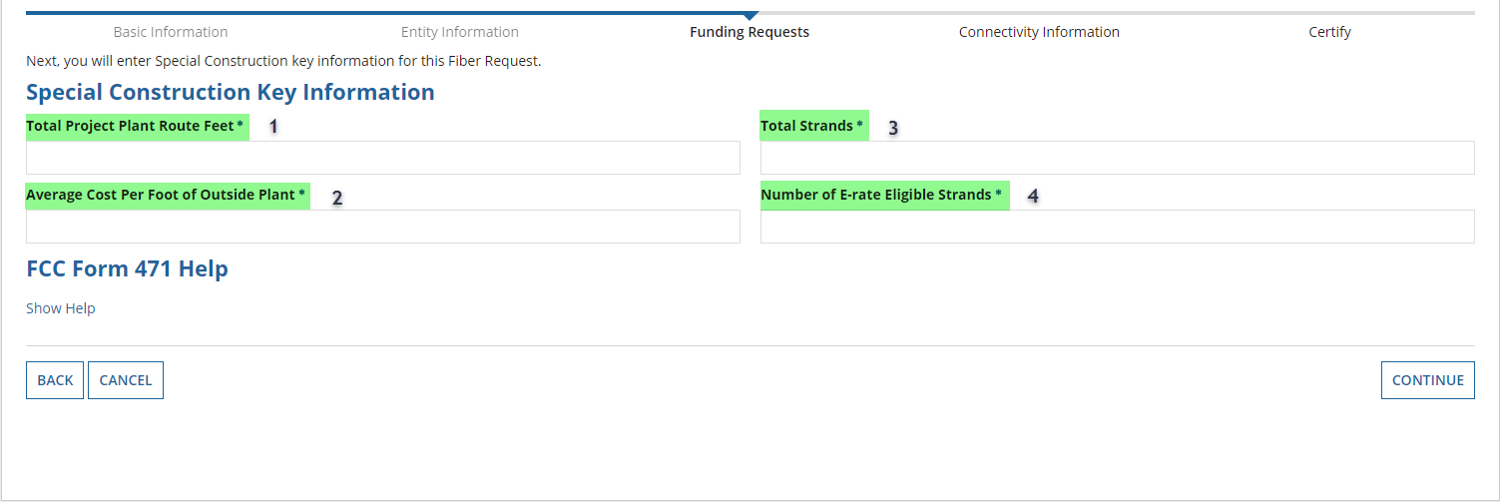
SPECIAL CONSTRUCTION FUNDING REQUEST INFORMATION
Tips for entering responses to the highlighted fields when submitting an FCC Form 471 seeking special construction support.
Total Project Plant Route Feet - This measure only accounts for newly deployed fiber, and should not include any existing fiber. (e.g., If the total project covers 150,000 feet but 5,000 feet is existing infrastructure that will be spliced to the newly deployed fiber, the response to this field would be 145,000 feet.)

Slide 31
SPECIAL CONSTRUCTION FUNDING REQUEST INFORMATION
Average Cost Per Foot of Outside Plant - This will equal the “Total Special Construction Charges” divided by “Total Project Route Feet.” (See the example from Item 1: If total special construction charges are $5,000,000.00, then the response in this field should be $5,000,000.00/145,000 feet = $34.48/foot.)

Slide 32
SPECIAL CONSTRUCTION FUNDING REQUEST INFORMATION
Total Strands - This is the total number of strands installed at the time of construction. (If the build is segmented into a backbone segment with a 48 strand cable and a lateral segment with a 12 strand cable, then the response for this field would be 60 strands. You can provide additional explanation in the Narrative field.)

Slide 33
SPECIAL CONSTRUCTION FUNDING REQUEST INFORMATION
Number of E-rate Eligible Strands - This is the total number of strands that (a) will be lit within the current funding year and (b) are for the exclusive use of eligible E-rate entities. (See the example from Item 3. If 12 strands are being lit in the backbone segment and 8 strands in the lateral segment for the exclusive use of the E-rate eligible entities, then the response to this field would be 20 strands.)

Slide 34
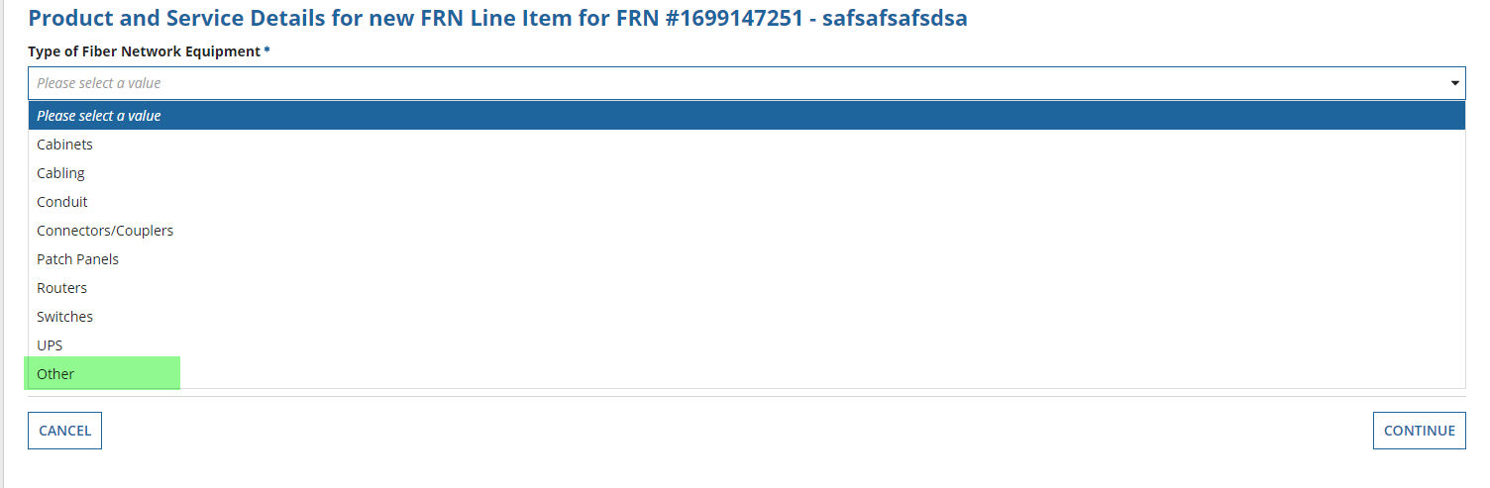
NETWORK EQUIPMENT FUNDING REQUEST INFORMATION
If you do not see an option in the drop-down menu that describes your equipment within the “Type of Fiber Network Equipment”, use the “Other” choice and enter the description in the “Enter the Type of Fiber Network Equipment” field. This will provide USAC with an accurate description of the equipment and help to streamline the review process. (For example, if your Network Equipment is a “Transceiver” use the “Other” choice and enter the description of “Transceiver.”)

Slide 35
INSTALLATION PERIOD (ALL C1 NON-RECURRING CHARGES)
Installation of all Category One non-recurring services (including special construction charges) may begin six months prior to the July 1 start of the funding year (i.e., or after January 1) if the following conditions are met:
  Construction begins after selection of the service provider pursuant to a valid competitive bidding process.
  A Category One recurring service must depend on the installation of the infrastructure.
  The actual service start date for that recurring service is on or after the start of the funding year (July 1).

Slide 36
SERVICE DELIVERY DEADLINES (RECURRING CHARGES)
To be eligible for E-rate discounts for recurring charges related to an eligible Category One service, the service must be in use by the end of the relevant funding year (i.e., June 30). If this June 30 deadline is not met, the recurring charges will not be eligible for support under program rules. There is no extension available for recurring charges.

Slide 37
SERVICE DELIVERY DEADLINES (RECURRING CHARGES)
Applicants may not receive E-rate support for any recurring charges incurred before the start of the funding year (i.e., July 1).
Applicants may only receive E-rate support for recurring charges for leased lit fiber services delivered within the funding year.
Applicants may not receive E-rate support for recurring charges for leased dark fiber until the fiber is lit.
Applicants may not receive E-rate support for recurring charges associated with a self-provisioned network until the network is constructed and is in use.

Slide 38
SERVICE DELIVERY DEADLINES (SPECIAL CONSTRUCTION CHARGES)
Applicants may only request E-rate support for special construction charges related to leased lit fiber and leased dark fiber if the fiber is lit within the same funding year (i.e., by June 30) as the funding request.
Applicants may only receive E-rate support for special construction charges for a self-provisioned network if the network is constructed and is in use by the end of the same funding year as the funding request.

Slide 39
SPECIAL CONSTRUCTION DEADLINE EXTENSION
  Applicants may request a one-year extension to complete special construction and light the fiber (or use a self-provisioned network if another technology is employed), if the applicant can demonstrate that construction was unavoidably delayed due to weather or other reasons. Examples of circumstances causing unavoidable delay include:
  Unforeseen weather event or pattern resulting in saturated or frozen ground, which prevents work;
  Natural disaster causing an unavoidable delay;
  Scheduled delivery of required plant components do not arrive;
  USAC issues an FCDL too late for applicant to complete special construction and light fiber by the end of funding year.

Slide 40
SPECIAL CONSTRUCTION DEADLINE EXTENSION
  Note: To obtain a one-year extension based on an unforeseen, unavoidable construction delay, applicants must submit an extension request to USAC before the end of the funding year (i.e., June 30).

Slide 41
SERVICE PROVIDER ROLE DURING THE APPLICATION AND REVIEW PROCESS
After the competitive bid process has concluded and a contract is entered into, service providers can:
  Assist applicants in preparing their FCC Form 471/Funding Request(s).
  Speak directly to and respond to Program Integrity Assurance (PIA) questions. (Applicants should still be aware of any correspondence.)
  Assist with explaining why your service offering is cost-effective and providing any required cost-allocation documentation. Service providers can request confidentiality of their data. (See, e.g., 47 C.F.R. §§ 0.457 and 0.459.)
  Work with the applicant to provide sufficiently detailed responses to PIA information requests.

Slide 42
Q&A SESSION

Slide 43
THANK YOU!

