Slide 1
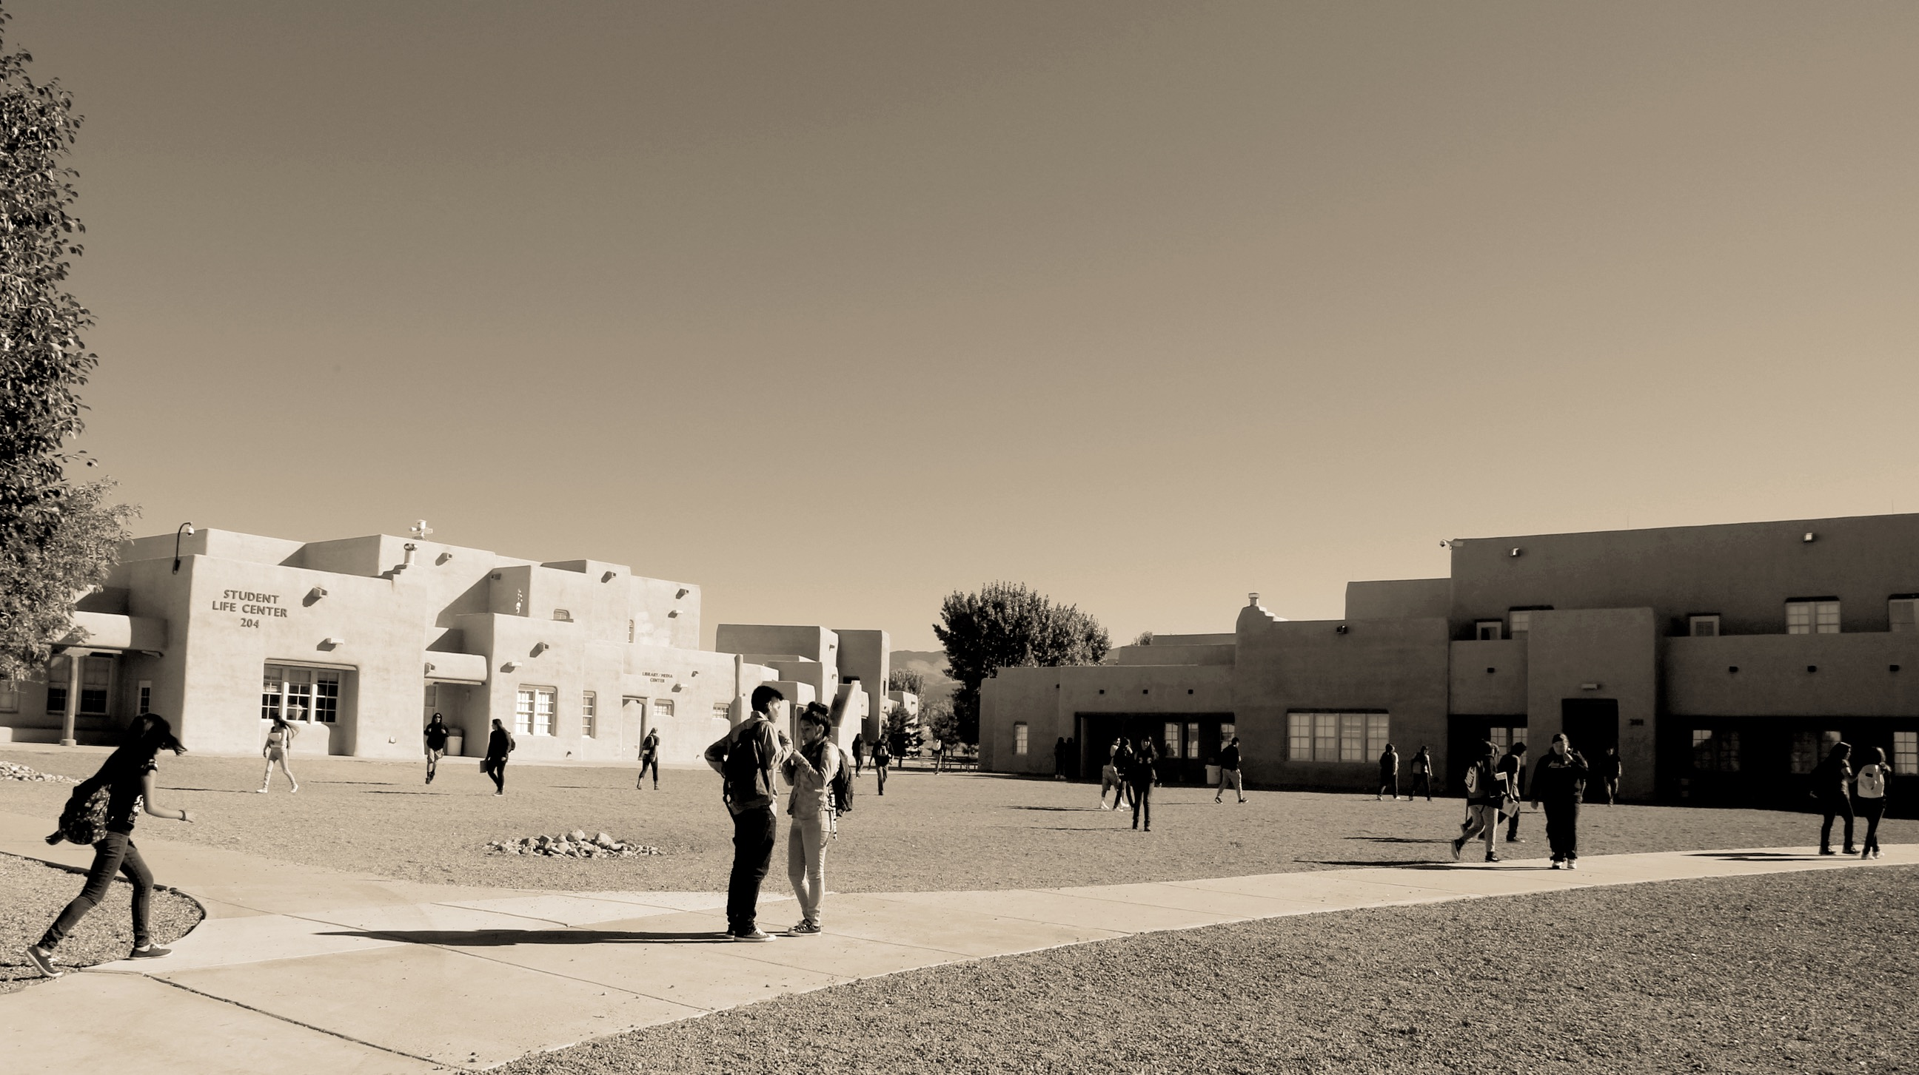

E-RATE PROGRAM APPLICATION PROCESS, PART 2
E-RATE PROGRAM TRIBAL APPLICANT TRAINING
2016

Slide 2
AGENDA
WELCOME
Application Review and funding commitments
Start Services
  FCC Form 486
Invoicing
  FCC Forms 472 and 474
Adjust Funding
  FCC Form 500
Document Retention

Slide 3
WELCOME
Notes:
First, we’ll cover competitive bidding (FCC Form 470) and applying for discounts (FCC Form 471).

Slide 4
WELCOME
Notes:
First, we’ll cover competitive bidding (FCC Form 470) and applying for discounts (FCC Form 471).

Slide 5
WELCOME
Notes:
Now, we’ll cover funding commitments, starting services (FCC Form 486), invoicing (FCC Form 472 or 474), and other forms.

Slide 6
APPLICATION REVIEW AND FUNDING COMMITMENTS
E-RATE PROGRAM APPLICATION PROCESS, PART 2

Slide 7
AFTER YOU SUBMIT FCC FORM 471
COMPETITIVE BIDDING
YOU
ARE
HERE

Slide 8
PROGRAM INTEGRITY ASSURANCE (PIA)
APPLICATION REVIEW
After filing FCC Form 471, an application reviewer may contact you with questions about your form
Program Integrity Assurance (PIA) is the group at USAC that:
  Reviews your application
  Checks your form for completeness and accuracy
  Verifies eligibility of the schools and libraries you listed, their discount levels, and the services requested
  Makes funding decisions
  Helps you make allowable corrections to your form

Slide 9
QUESTIONS FROM YOUR PIA REVIEWER
APPLICATION REVIEW
PIA reviewers may contact you for:
  Questions about your application
  Proof that you are following program rules
You have 15 days to respond to PIA questions
  You can ask for more time if you need it
  Your PIA reviewer can help you respond to their question
Some applications undergo additional review
  In “selective review,” the PIA reviewer may request more detailed responses

Slide 10
DECISION LETTER
APPLICATION REVIEW
You’ll receive a letter with a decision about your funding
  FCDL = Funding Commitment Decision Letter
  Delivered via the E-rate Productivity Center (EPC)
  Your service provider receives a copy too
The letter will show:
  Approved funding amount
  Denied funding amount
  Next steps

Slide 11
QUICK QUIZ!
APPLICATION REVIEW

Slide 12
QUESTIONS?
APPLICATION

Slide 13
START SERVICES (FCC FORM 486)
E-RATE PROGRAM APPLICATION PROCESS, PART 2

Slide 14
AFTER RECEIVING YOUR FUNDING COMMITMENT
START SERVICES
YOU
ARE
HERE

Slide 15
START SERVICES
Start your E-rate-supported services
  Many applicants start service on July 1, the first day of the funding year
Use FCC Form 486 to notify the E-rate Program that your services started

Slide 16
ABOUT FCC FORM 486
START SERVICES
FCC Form 486 is the “receipt of service confirmation and CIPA and technology plan certification form”
Notifies USAC that your eligible services have started or been delivered
  After approval invoices can now be processed and paid
Confirms that you’re compliant with the Children’s Internet Protection Act (CIPA)
  A law with specific requirements on Internet safety policies
The form deadline is 120 days after the service start date or 120 days after receiving your FCDL (whichever is later)
Use the deadlines tool on our website to determine your deadline

Slide 17
CHILDREN’S INTERNET PROTECTION ACT (CIPA)
START SERVICES
CIPA requires schools and libraries to certify that they are enforcing Internet safety
Internet safety policy
Technology protection measure (filter)
Reasonable public notice of and hearing/meeting
(For schools) education for students on Internet safety
  Focus on social networking, chat rooms, and cyberbullying
Notes:
CIPA requires schools and libraries to certify that they are enforcing Internet safety
Required if you’re receiving discounts on data transmission and Internet access, internal connections, managed internal broadband services and/or basic maintenance
Internet safety policy
Technology protection measure (filter)
Reasonable public notice of and hearing/meeting
(For schools) education for students on Internet safety
Focus on social networking, chat rooms, and cyberbullying

Slide 18
OTHER NOTES…
START SERVICES
Pick your invoicing method first
After submitting FCC Form 486, you’ll receive two confirmations
  Your service provider gets a copy too
Can submit FCC Form 486 early if your services start in July

Slide 19
QUICK QUIZ!
START SERVICES

Slide 20
QUESTIONS?
START SERVICES

Slide 21
INVOICING (FCC FORMS 472 AND 474)
E-RATE PROGRAM APPLICATION PROCESS, PART 2

Slide 22
ABOUT INVOICING
INVOICING
Invoicing is how you actually receive your committed funds
Two options available:
  E-rate sends the funding directly to your bank
  Your service provider applies the discount to your bill
The form deadline is 120 days after the last day of service or the FCC Form 486 confirmation letter’s issue date (whichever is later)
  A one-time 120-day invoicing extension is available if you request it by the invoice deadline
Use the deadlines tool on our website to determine your deadline

Slide 23
INVOICING REQUIREMENTS
INVOICING
Before invoicing USAC for your funding, you must have:
  A funding commitment decision letter (FCDL) for the services being invoiced
  Filed an FCC Form 486 and received a confirmation letter
Your service provider must have:
  Completed FCC Form 473, the service provider annual certification, which is due each funding year
The services must have been delivered and paid for
  Exception for progress payments specified in a contract

Slide 24
TWO OPTIONS FOR INVOICING
INVOICING
BEAR
SPI
Billed entity applicant reimbursement (BEAR)
Paid directly to your bank
FCC Form 472
File after the services have been paid in full
Service provider invoice (SPI)
Discount on your bill
FCC Form 474
Filed by service provider after the applicant has been billed for the non-discount portion of eligible services
Applicants can choose their method of invoicing.

Slide 25
DIRECT PAYMENT TO YOUR BANK
INVOICING
If you choose BEAR invoicing, USAC will send the funding via electronic transfer
  Direct to your organization’s bank account
Share your banking information on FCC Form 498
  Your “Form 498 ID” allows USAC to send money to you
  Available in the E-rate Productivity Center (EPC)
  Takes USAC ~1 week to process the form and verify your banking information
  Federal Communications Commission registration number (FCCRN) required to do business with the FCC

Slide 26
QUICK QUIZ!
INVOICING

Slide 27
QUESTIONS?
INVOICING

Slide 28
FUNDING ADJUSTMENTS (FCC FORM 500)
E-RATE PROGRAM APPLICATION PROCESS, PART 2

Slide 29
ABOUT FCC FORM 500
FUNDING ADJUSTMENTS
FCC Form 500 is the “funding commitment adjustment request form”
Use FCC Form 500 to:
  Adjust funding commitments and modify dates
  Adjust the Service Start Date you reported on FCC Form 486
  Adjust the contract expiration date listed on FCC Form 471
  Cancel or reduce a Funding Request Number (FRN)
  Request a service delivery extension request
  Notify USAC of an equipment transfer

Slide 30
WHEN TO FILE FCC FORM 500
FUNDING ADJUSTMENTS
File FCC Form 500 only after receiving a Funding Commitment Decision Letter (FCDL)
Changes that result from filing an FCC Form 500 will affect other parts of the application process
  FCC Form 500 must be filed before those changes can occur
  Example: You want to extend a contract. In order to do that, the contract expiration date must be changed in USAC's records. Otherwise, it cannot pay invoices for services delivered and installed after the original contract expiration date.

Slide 31
FCC FORM 500 AND CATEGORY TWO BUDGETS
FUNDING ADJUSTMENTS
Refresher: Category Two budgets
  Internal connections, internal broadband service, basic maintenance of internal connections
  Funding limit for a five-year period
Once you receive a funding commitment, USAC assumes you will invoice for the full amount
If you change your mind (and want to spend the money during a different year instead), submit FCC Form 500
Notes:
Refresher: Category Two budgets
Internal connections, internal broadband service, basic maintenance of internal connections
Funding limit for a five-year period
Once you receive a funding commitment, USAC assumes you will invoice for the full amount
If you change your mind (and want to spend the money during a different year instead), submit FCC Form 500
Returns the funding commitment back to USAC
Allows you to use it during a different year instead

Slide 32
QUICK QUIZ!
FUNDING ADJUSTMENTS

Slide 33
QUESTIONS?
FUNDING ADJUSTMENTS

Slide 34
DOCUMENT RETENTION
E-RATE PROGRAM APPLICATION PROCESS, PART 2

Slide 35
DOCUMENT RETENTION
Keep all documentation for 10 years from the last date of service
  If multi-year: 10 years after contract expires
Keep all receipt and delivery records for:
  Pre-bidding
  Competitive bidding
  Contracts
  The numbers cited on your application
  Invoices
  All other program matters

Slide 36
QUESTIONS?
DOCUMENT RETENTION

Slide 37
RESOURCES & HELP
E-RATE PROGRAM APPLICATION PROCESS, PART 2

Slide 38
TRIBAL TRAINING
RESOURCES & HELP
Tribal Training is designed to promote awareness and participation in the E-rate Program
  Goal: reduce the digital divide and promote high-speed broadband connectivity to Tribal schools and libraries
The Tribal Liaison is dedicated to helping applicants from schools and libraries on Tribal lands
  Contact me for assistance! TribalTraining@usac.org
Monthly conference call
Live training events

Slide 39
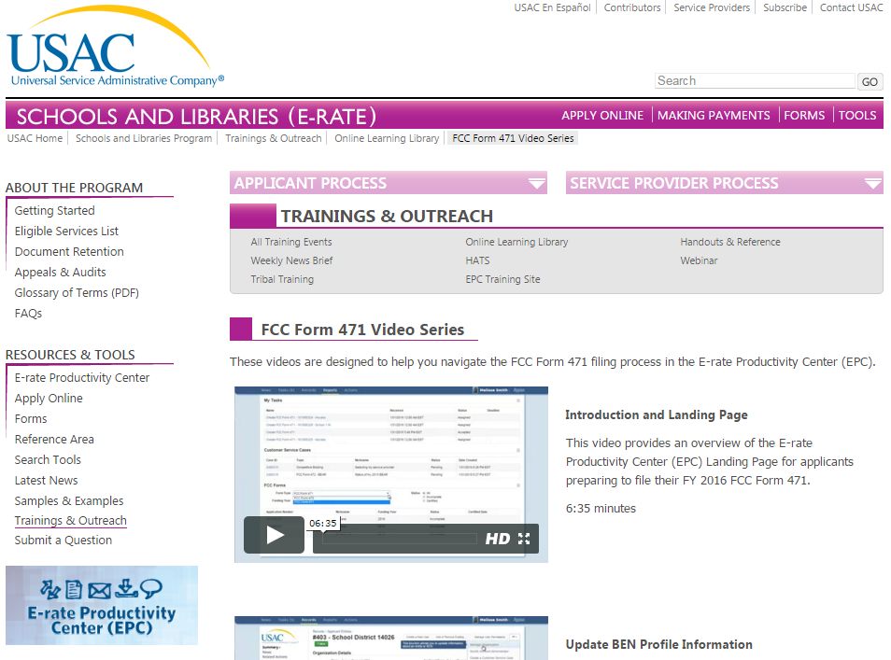
VIDEO TUTORIALS
RESOURCES & HELP
FCC Form 470 video series
FCC Form 471 video series
Navigating EPC
Visit usac.org/sl, select “Trainings and Outreach,” then “Online Learning Library”

Slide 40
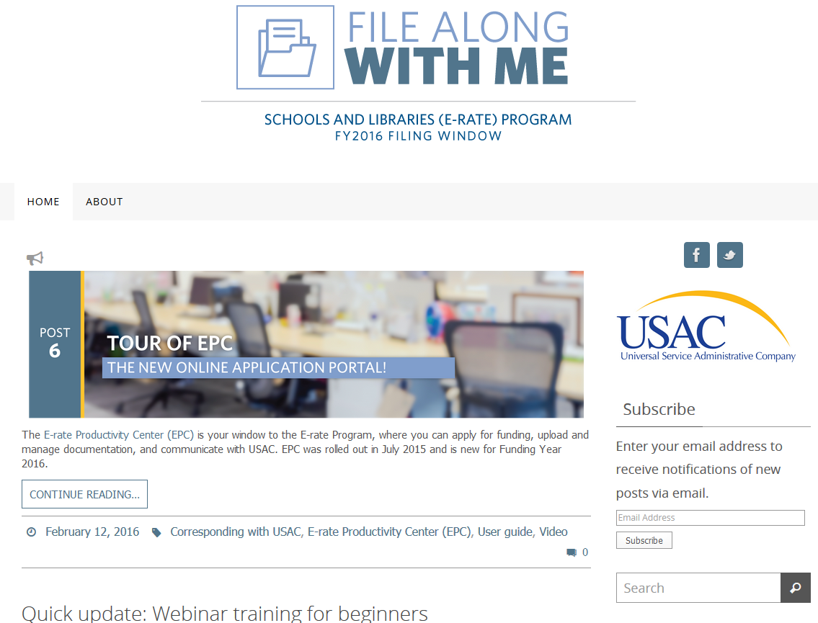
FILE ALONG WITH ME
RESOURCES & HELP
“File Along with Me” is a blog that covers the E-rate Program application process step-by-step
Follow along and complete the step in each post
Sign up for alerts of new posts
filealongwitherate.org

Slide 41
THANK YOU!
NEXT PRESENTATION: EPC FUNDAMENTALS

