Slide 1
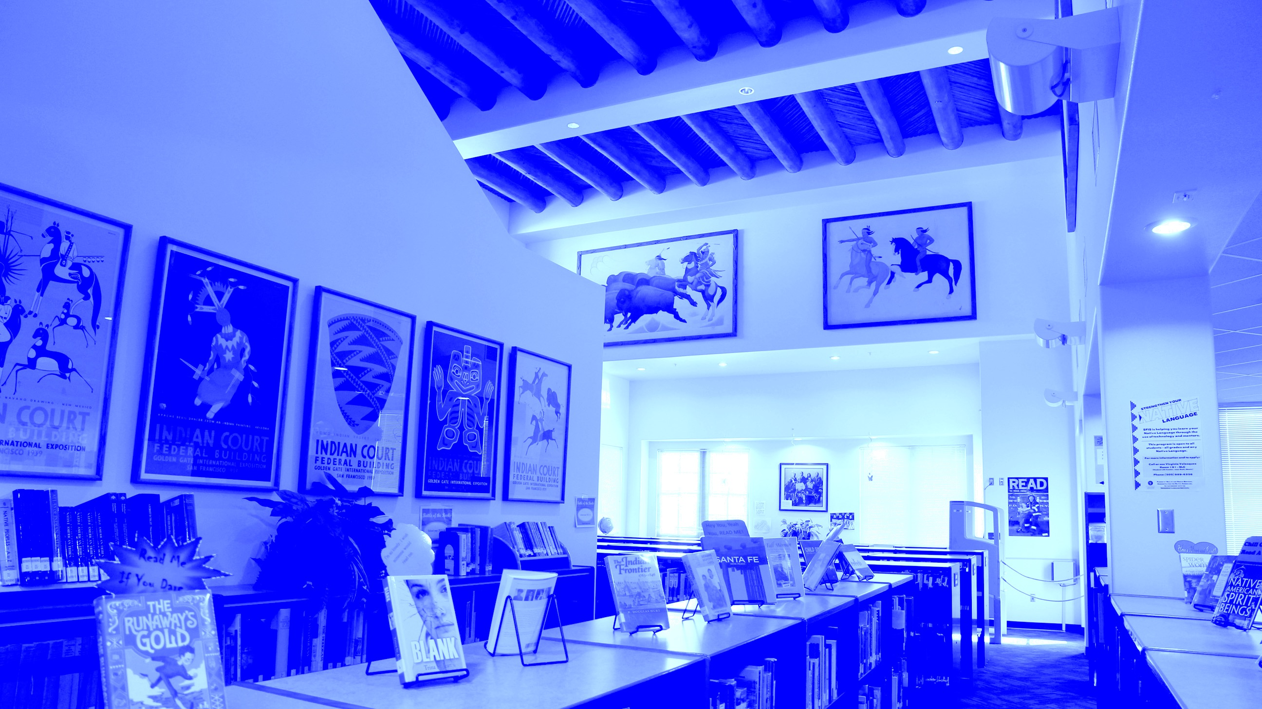

E-RATE 101: INTRO TO THE E-RATE PROGRAM
E-RATE PROGRAM TRIBAL APPLICANT TRAINING
2016

Slide 2
AGENDA
E-RATE 101: INTRO TO THE E-RATE PROGRAM
The Basics
  What is the E-rate Program?
  Managers of the Program
  Timeline
  Eligibility
  Funding Cap
Discounts
Category Two Budgets
Application Process

Slide 3
THE BASICS
E-RATE 101: INTRO TO THE E-RATE PROGRAM

Slide 4
WHAT IS THE E-RATE PROGRAM?
THE BASICS
The Schools and Libraries
(E-rate) Program connects our country’s schools and libraries to broadband
Provides a discount on
high-speed Internet access, telecommunications services, and equipment

Slide 5
WHO MANAGES THE E-RATE PROGRAM?
THE BASICS
The Federal Communications Commission (FCC)
established and oversees the E-rate Program
The Universal Service Administrative Company (USAC) handles day-to-day program operations

Slide 6
WHO MAKES THE RULES?
THE BASICS
Congress wrote the statute for E-rate into law
  Part of the Telecommunications Act of 1996
The FCC creates rules and policies for the program through “Orders”
  Must stay within the statute
USAC develops processes and procedures, such as how to process application
  Under the direction of the FCC
CONGRESS
FCC
USAC

Slide 7
OUR BUDGET
THE BASICS
Funding is limited to $3.9B per year
  Indexed for inflation
  Unused funds roll over to the next funding year
$1B funding target for “Category Two” (internal connections) funding
  Included in the $3.9B
Notes:
Emphasize that this funding cap will be indexed for inflation, so it’s designed to grow with demand

Slide 8
TIMING
THE BASICS
Funding Year (FY)
Application Filing Window
From July 1 to June 30
FY2016 = July 2016 to June 2017
The period when services are generally delivered
4-6 months before the funding year starts
Varies by year, but often January - March
JAN
JUL
DEC
Filing Window
Funding Year starts
Funding Year ends

Slide 9
WHO CAN GET DISCOUNTS?
THE BASICS
Elementary and secondary schools and school districts
  Public, private, charter, parochial, Tribal
  Non-traditional facilities (Pre-K, Head Start, juvenile justice, adult education) are eligible if they fit their state’s definition of elementary/secondary education
  Look up non-traditional facility eligibility on our website
Libraries and library systems
  Public, private, academic, research, Tribal
  Bookmobiles and kiosks
Consortia
  Eligible entities that band together to aggregate demand and negotiate lower prices
Notes:
Not for profit
Must fit state definition or be eligible for LSTA funding
No endowment over 50 mill or budget separate from school

Slide 10
BENEFITS OF A CONSORTIUM
THE BASICS
  Beneficial for small schools and libraries
  Consortium applications are more streamlined than previous years
  Only one member of the consortium (the leader) files forms
  Apply together on one application filed by one person
  Tribal schools and libraries can share expertise on E-rate by combining knowledge resources they otherwise wouldn’t have
For example:
  All schools and libraries on a reservation could work together
  Several small Tribal lands in a region could join forces e.g. pueblo libraries of New Mexico

Slide 11
WHAT PRODUCTS AND SERVICES ARE ELIGIBLE?
DISCOUNTS
Category One
Category Two
Services are data transmission services, internet access, and voice services
Services are internal connections, managed internal broadband services, and basic maintenance of internal connections
Funding provided for each year
Funding provided for a 5-year period
Budget (limit) on funding amount

Slide 12
PRODUCTS & SERVICES ELIGIBLE FOR E-RATE
THE BASICS
Some examples include:
Wireless Internet (including microwave) | Routers, switches, and modems
Satellite service | Access points for LANs or WLANs
Basic technical support | Installation, activation, and initial configuration
T-1, T-3, etc. | Supporting software
Leased fiber | Repair and upkeep of hardware
VoIP and voice services (phasing down support but still eligible!) | Firewall services
Every year, the FCC publishes a list of products and services that are eligible for E-rate funding.

Slide 13
PRODUCTS & SERVICES ELIGIBLE FOR E-RATE: SPECIAL CONSTRUCTION
THE BASICS
Special construction projects for lit fiber, leased dark fiber, and self-provisioning are a Category One service. The eligible components are:
  Construction of network facilities
  Design and engineering
  Project management
Installment payments up to four years are allowed
Receive guidance on Requests for Proposal (RFPs)
Notes:
Add graphic that says “new!”

Slide 14
STATE MATCHING FOR SPECIAL CONSTRUCTION
THE BASICS
The E-rate program will match certain outside funding up to an additional 10% for special construction
For Tribal school & libraries including BIE schools, the funding must come from states, Tribal governments, or other federal agencies
Out-of-pocket costs on special construction could be reduced to zero
Notes:
Give an example to show how 100% of costs could be covered
e.g. if your project costs $100,000 and you’re at a 90% discount coming up with $10,000 still might hinder the project going forward.

Slide 15
QUICK QUIZ!
THE BASICS

Slide 16
QUESTIONS?
THE BASICS

Slide 17
DISCOUNTS
E-RATE 101: INTRO TO THE E-RATE PROGRAM

Slide 18
YOUR E-RATE DISCOUNT
DISCOUNTS
Discounts range from 20% to 90% for Category 1 and 20% to 85% for Category 2
Discount rate depends on three things:
  Poverty level of your school/school district
  Urban or rural status
  What category of service you’re requesting
Tribal schools and libraries are usually eligible for a discount of 80 to 90%
Notes:
-Your discount is calculated automatically as part of the 471 application since the information is gathered in your EPC (applicant portal) profile
-It’s also calculated automatically in the EPC profile once the address is entered and
Student numbers are entered if you’re in a school
Associated School District is listed if you’re a library

Slide 19
YOUR LOCAL POVERTY LEVEL
DISCOUNTS
Most applicants use the National School Lunch Program (NSLP) to determine their poverty level
  Alternate methods are available
Use the NSLP numbers from your school district
  Libraries use the district they’re located in
  Library systems must use the district the main branch is located in
  Schools that are members of districts use district average
  Exception: Independent schools calculate based on their own student population
Notes:
Give examples of acceptable and unacceptable alternative methods e.g.
+ Survey, CEP, matching siblings, existing sources, provision 1,2,3
- Feeder, Title 1,

Slide 20
URBAN OR RURAL STATUS
DISCOUNTS
Based on 2010 census data
  Many tribal schools and libraries are rural
Check your status on our website
School districts and library systems
  The whole district or system is considered rural if more than 50% of the district’s schools or system’s libraries are rural
Notes:
If your address isn’t recognized in EPC, enter the latitude / longitude of your entity into your EPC profile manually.
Then the urban/rural status will appear

Slide 21
CATEGORIES OF SERVICE
DISCOUNTS
Your discount also depends on what type of service you are purchasing
Category One
Category Two
Up to 90%
Up to 85%
Notes:
ADD GRAPHIC

Slide 22
LOOK UP YOUR DISCOUNT
DISCOUNTS
 | Category One Discount Levels |  | Category Two Discount Levels
INCOME % of students eligible for NSLP | URBAN DISCOUNT | RURAL DISCOUNT | URBAN DISCOUNT | RURAL DISCOUNT
Less than 1% | 20% | 25% | 20% | 25%
1% to 19% | 40% | 50% | 40% | 50%
20% to 34% | 50% | 60% | 50% | 60%
35% to 49% | 60% | 70% | 60% | 70%
50% to 74% | 80% | 80% | 80% | 80%
75% to 100% | 90% | 90% | 85% | 85%
Notes:
ADD SLIDE FOR VOICE MATRIX

Slide 23
CONSORTIUM DISCOUNTS
DISCOUNTS
A consortium’s discount is the simple average of its members’ discount levels
  Members still use district-wide discount rates
  Only consortia can get a discount that doesn’t come straight from the discount matrix

Slide 24
QUICK QUIZ!
DISCOUNTS

Slide 25
QUESTIONS?
DISCOUNTS

Slide 26
CATEGORY 2 BUDGETS
E-RATE 101: INTRO TO THE E-RATE PROGRAM

Slide 27
5-YEAR CATEGORY TWO BUDGETS
CATEGORY 2 BUDGETS
Category Two services are internal connections, managed internal broadband services, and basic maintenance of internal connections
The full-price cost of products/services that can receive E-rate discounts during this five-year period is called the “Category Two budget”
Spend the budget during a five-year period
  Use all funding in one year, or
  Use a little bit each of the five years
Each individual school or library branch gets its own budget (budgets cannot be shared with other entities)
There is no budget for Category One services

Slide 28
WHAT’S MY BUDGET?
CATEGORY 2 BUDGETS
Budgets are based on the number of students (for schools) or the square footage (for libraries)
Schools: total students (including part-time) x $150
Libraries: all internal square footage x $2.30
($5/sqft for some urban libraries)
$9,200 funding floor
Budget amount is re-calculated every year
More students or construction on library means increased budget
Less students or downsizing means decreased budget
  You don’t have to pay back funds already used

Slide 29
CATEGORY TWO BUDGET EXAMPLES
CATEGORY 2 BUDGETS
EXAMPLE #1: SCHOOL
# of students x $150 =
Your five-year Category Two budget
5,063 students x $150 = $759,450
$759,450 is the pre-discount (full price) cost of the products and services that you can receive E-rate program funding for over your
five-year period.
$759,450 x 85% = $645,532.50
If the school has an 85% discount rate, it can receive E-rate discounts of up to $645,532.50 over five years.

Slide 30
CATEGORY TWO BUDGET EXAMPLES
CATEGORY 2 BUDGETS
EXAMPLE #2: LIBRARY
# of square feet x $2.30 =
Your five-year Category Two budget
6,088 ft² x $2.30 = $14,002.40
$14,002.40 is the pre-discount (full price) cost of the products and services that you can receive E-rate program funding for over your
five-year period.
$14,002.40 x 85% = $11,902.04
If the library has an 85% discount rate, it can receive E-rate discounts of up to $11,902.04 over five years.

Slide 31
CATEGORY TWO BUDGET EXAMPLES
CATEGORY 2 BUDGETS
EXAMPLE #3: SMALL SCHOOL
# of students x $150 =
Your five-year Category Two budget
45 students x $150 = $6,750 –> $9,200
The school’s budget is automatically raised to the Category Two
budget floor of $9,200.
$9,200 x 85% = $7,820
If the library has an 85% discount rate, it can receive E-rate discounts of up to $7,820 over five years.

Slide 32
NON-INSTRUCTIONAL FACILITIES (NIFS)
CATEGORY 2 BUDGETS
NIFs are buildings with no classrooms or areas for library patrons
  e.g. administrative buildings
No Category Two services for non-instructional facilities unless it is essential for the transport of information to a school or library
No Category Two budgets for NIFs
  If NIF is essential for transport cost-allocate the NIF costs to the entities benefiting from the service

Slide 33
OTHER NOTES…
CATEGORY 2 BUDGETS
Unlike funding for Category One services, a Category Two budget must be spent by the specific school/library it was calculated for
  The funds cannot be shifted or averaged across school districts or library systems
Use it or lose it
  No carry-over if you don’t use your budget during the 5-year period

Slide 34
QUICK QUIZ!
CATEGORY 2 BUDGETS

Slide 35
QUESTIONS?
CATEGORY 2 BUDGETS

Slide 36
HOW TO APPLY
E-RATE 101: INTRO TO THE E-RATE PROGRAM

Slide 37
APPLICATION PROCESS
HOW TO APPLY
To apply for E-rate Program funding…
1.
2.
3.
4.
Post an RFP
(FCC Form 470)
Request Discounts
(FCC Form 471)
Start Services
Invoice

Slide 38
How to Apply
Apply online
  The E-rate Productivity Center (EPC) is the account and application management portal for E-rate
  Call (888) 203-8100 to set up a new account
Still migrating from our old system
  Most, but not all, forms available in EPC

Slide 39
QUESTIONS?
HOW TO APPLY

Slide 40
THANK YOU!
E-RATE 101: INTRO TO THE E-RATE PROGRAM

Slide 41
BREAK
NEXT PRESENTATION: E-RATE PROGRAM APPLICATION PROCESS, PART 1
usac.org/sl • TribalTraining@usac.org • (888) 203-8100

