Slide 1
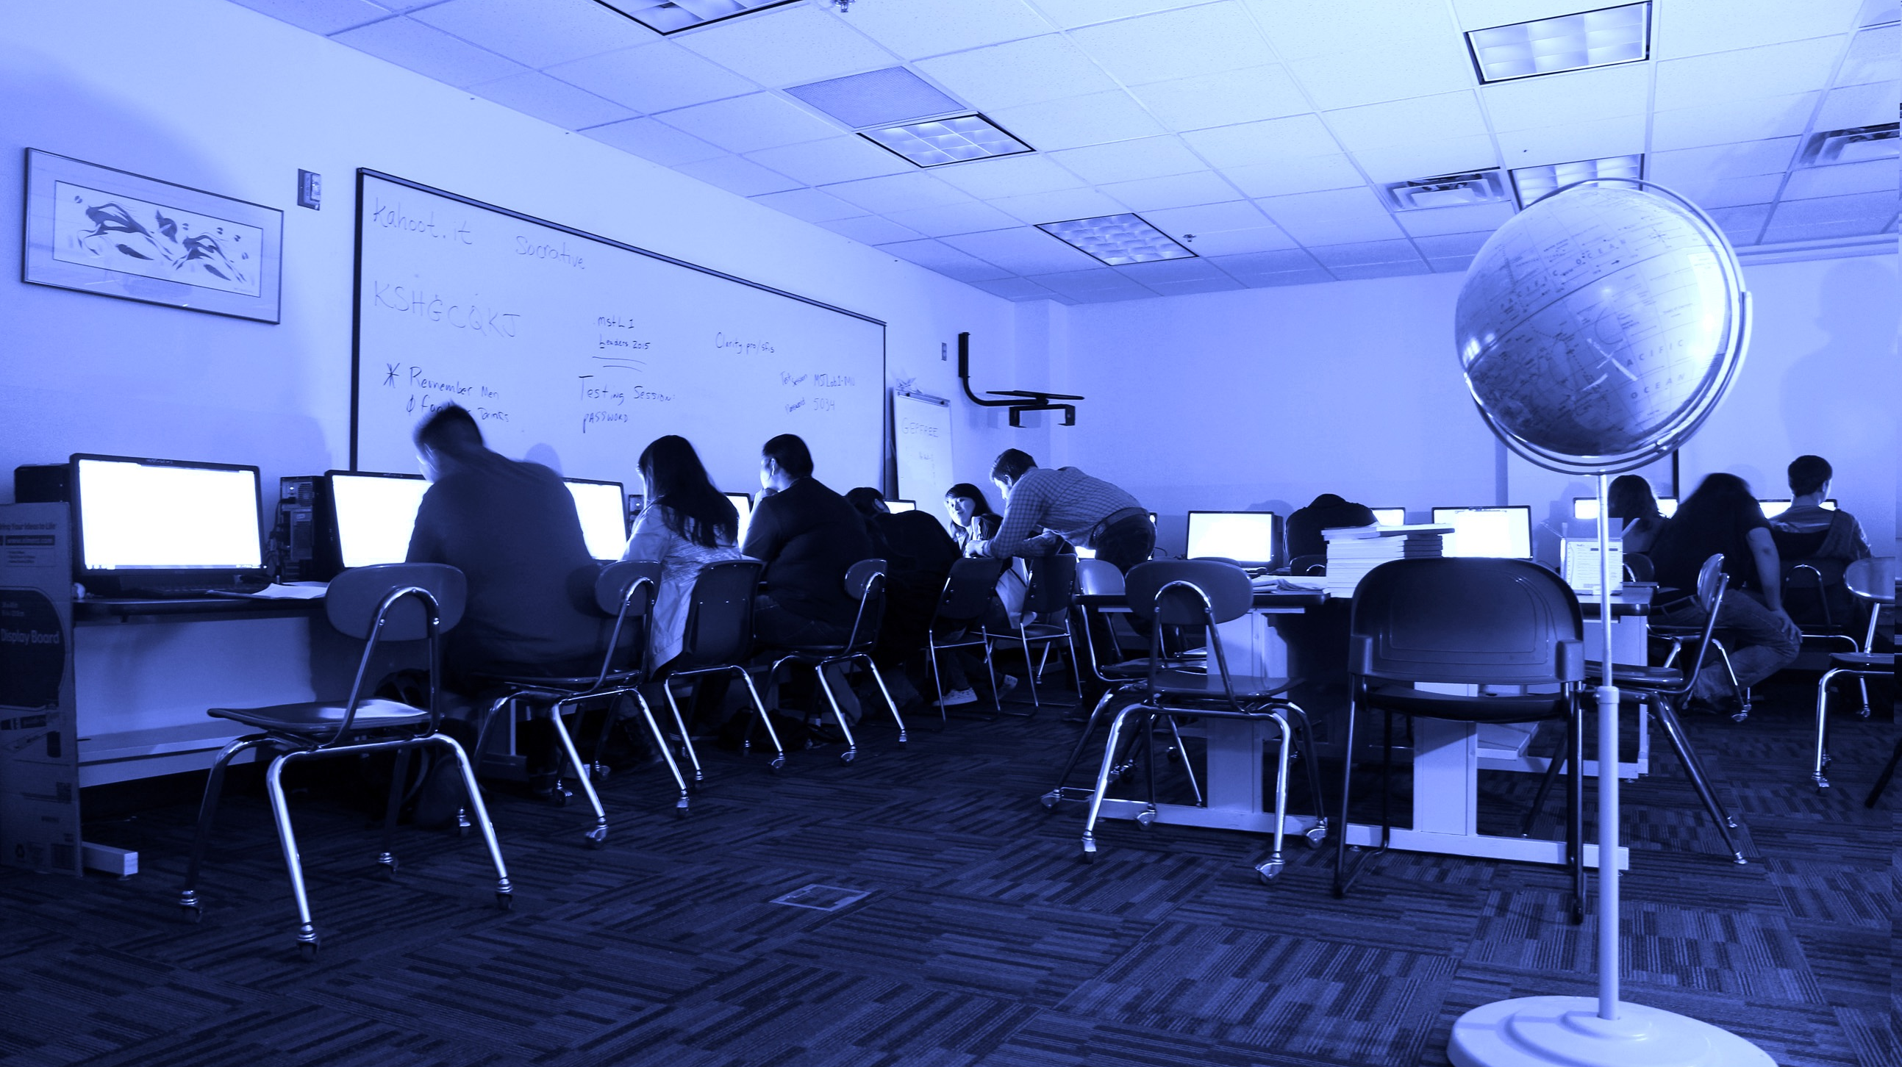

THE IMPORTANCE OF BROADBAND
E-RATE PROGRAM TRIBAL APPLICANT TRAINING
2016

Slide 2
AGENDA
HIGH-SPEED INTERNET FOR TRIBAL SCHOOLS & LIBRARIES
Connectivity
  Tribal communities
  Schools
  Libraries
Affordability
Stories
Getting Started

Slide 3
WHY IS BROADBAND IMPORTANT?
HIGH SPEED INTERNET FOR TRIBAL SCHOOLS & LIBRARIES
Prepares students with the skills they need for a 21st century economy
  Improves educational outcomes
  Broadband skills are essential to succeed in college and careers
Connects your community to the rest of the country, and the world
  High-speed connections at schools can support broader plans to increase broadband access in Tribal Lands
Make sure your school or library is future ready
Notes:
-In addition to supporting educational outcomes, high-speed connections at schools can support broader plans to increase broadband access in Tribal Lands

Slide 4
CONNECTIVITY IN TRIBAL COMMUNITIES
THE IMPORTANCE OF BROADBAND

Slide 5
TRIBAL CONNECTIVITY
Historically, Tribal communities have lacked
meaningful access to communications services.
“It is critical that Native American students have the
same opportunity as their non-Native counterparts
to access high capacity broadband Internet technologies.
Otherwise, Native children will be left behind
as education tools increasingly become digital.”
- The Benton Foundation

Slide 6
TRIBAL CONNECTIVITY VS. NATIONWIDE
TRIBAL CONNECTIVITY
of Bureau of Indian Education (BIE) schools don’t have adequate digital broadband access to be aligned with college-and-career-readiness standards
of Americans living on Tribal lands lack access to 25 Mbps /
3 Mbps broadband
41%
60%
  Compare to 10% of all Americans and 4% of urban Americans
  FCC short-term benchmark of 100 mbps per 1,000 students
  And 68% of Americans living in rural areas of tribal lands lands lack access
Notes:
60% - From NIEA one-pager
41% - from FCC Fact Sheet: 2016 Broadband Progress Report https://apps.fcc.gov/edocs_public/attachmatch/FCC-16-6A1.pdf
67% - Pew home broadband 2015 http://www.pewinternet.org/2015/12/21/home-broadband-2015/

Slide 7
BROADBAND IN SCHOOLS & LIBRARIES
THE IMPORTANCE OF BROADBAND

Slide 8
STUDENTS NEED FAST INTERNET!
BROADBAND
Prepares students with the skills they need for a 21st century economy
  Improves educational outcomes
  Broadband skills are essential to succeed in college and careers
  Filling the homework gap
Upgraded college/career-ready standards for grades 3-12
  Engage in learning beyond textbooks
  Greater use of technology for research and homework
  Standards for technology research and media skills
  From the NIEA one-pager: State Standards and E-rate in Tribal Communities
Notes:
From the NIEA one-pager:
State Standards and E-rate in Tribal Communities

Slide 9
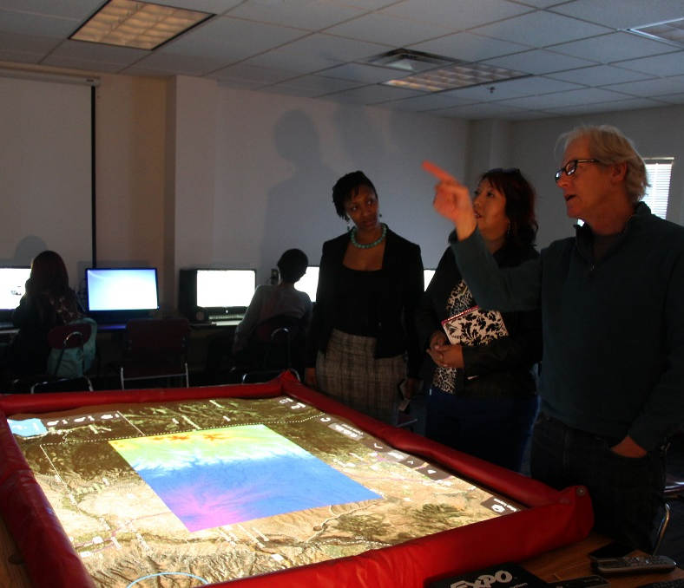
WITH BROADBAND, YOU CAN…
BROADBAND
Have an interactive, personalized learning experience
Use blended learning
  Digital and face-to-face activities
Have better access to Native language-learning resources
Take advanced placement (AP) classes remotely
Practice and take online testing and lectures
Connect teachers, students, and parents
Assess students, do lesson planning, and complete administrative tasks
Connects your community to the rest of the country, and the world
  High-speed connections at schools can support broader plans to increase broadband access in Tribal Lands
Notes:
Examples:
Interactive, personalized learning experience:
Real-time feedback about each student’s progress
Self-guided learning
Also mention: research and media skills
Slide content heavily borrowed from the president’s ConnectEd speech https://www.whitehouse.gov/the-press-office/2014/02/04/remarks-president-connected

Slide 10
THE IMPORTANCE OF TRIBAL LIBRARIES
BROADBAND
38% of Tribal libraries are the only source of free public Internet access in their communities*
Tribal libraries serve as a communication lifeline
  Preserve language, sacred materials, acting as cultural guardians
  Serve large and geographically diverse areas
  Offer a connection to higher education
  Provide Digitized content, eBooks, online catalogs, the opportunity for research, job applications, homework space, and more

Slide 11
CONNECTIVITY IN TRIBAL LIBRARIES VS. NATIONWIDE
TRIBAL CONNECTIVITY
61 percent of the nation’s public libraries receive E-Rate discounts
15 percent of reporting Tribal libraries receive E-Rate discounts
61%
15%
  Over 95% offer free public Internet access
  90% offer free public Internet access
Notes:
Figures from ATALM 2013 Report on the disconnect between E-rate and Tribal Libs: http://www.atalm.org/sites/default/files/ATALM%20E-Rate%20Brief.pdf

Slide 12
CHALLENGES
THE IMPORTANCE OF BROADBAND

Slide 13
CHALLENGES FOR TRIBAL LIBRARIES
BROADBAND
Tribal libraries do not have the same funding sources as public libraries
  Solution: E-rate funds can help
On average, 50% of Tribal Libraries are unaware of the E-rate Program
  Solution: Attendance at conferences such as ATALM
  Solution: Help us spread the word!
Of the libraries that are aware, almost 30% find it too complicated or don’t have the time to apply
  Solution: Having access to the Tribal Liaison and our resources can help
Notes:
Public Libraries often receive funding from local property taxes and state government
It is estimated that tribal libraries, on average, receive less than $3 per capita per year

Slide 14
BROADBAND EXPENSES
AFFORDABILITY
FCC goal of 100 Mbps per 1,000 students (short-term)
  Average $5.07/Mbps for districts meeting the FCC's goals
  Average $12.33/Mbps for districts not meeting the goals
  Long-term goal of 1 Gbps per 1,000 students
Affordability remains a primary roadblock to high-speed connections for schools
  Tribal schools and libraries do not have the same funding sources as public entities
Notes:
Prices: http://stateofthestates.educationsuperhighway.org/

Slide 15
PAY THE EDUCATION RATE (E-RATE)!
AFFORDABILITY
Discounts range from
E-rate funds can help. The FCC’s Schools and Libraries (E-rate) Program provides discounts on broadband to schools and libraries. The program is designed to connect our nation’s schools and libraries
20% to 90%
Tribal schools and libraries typically receive a 80 to 90% discount
Notes:
Average discount calculated from independent Tribal schools and libraries that applied for E-rate in FY2016.

Slide 16
DISCOUNTS ON HIGH-SPEED INTERNET
AFFORDABILITY
$3.9B in funding
is available per year through the FCC’s Schools and Libraries (E-rate) Program
Discounts for
schools and libraries
Broadband service for
elementary schools, secondary schools, and libraries
Notes:
The $3.9B available per year includes a $1B target for Category Two funding
Voice is still eligible but being phased down. FY2017 will be 30% (if you started at 90%).

Slide 17

STORIES: LETCHER COUNTY, KY

Slide 18
STORY: LETCHER COUNTY SCHOOLS (KY)
STORIES
“
Letcher County is very rural, with 3,100 students and an 85% E-rate discount.
They used a $409,010 funding commitment for a complete refresh of internal building wiring, wireless access Points and switches.
The district can now implement BYOD for the first time.
These upgrades will give us the capacity to allow students to use the devices they already own in the BYOD environment. The upgrades also give us the capacity to consider one-to-one solutions in the future. The benefits are endless. I honestly cannot imagine where we would be without the E-rate program.”
– Randy Bailey, Director of Tech

Slide 19

STORIES: QUAPAW TRIBE, OK

Slide 20
STORY: QUAPAW TRIBAL LIBRARY (OK)
STORIES
“
Because of the E-Rate funding we are able to offer a faster Internet connection to our patrons (T-1 line). Before we started receiving E-Rate funding, our Internet connection was DSL, which is much slower. Not having to pay for internet service means we are able to spend more on library materials.
Patty Billings, Librarian, Quapaw Tribe of OK
The Quapaw Tribe is located on the northeast tip of Oklahoma.
They have been committed $44,000 since 2012 to increase their library’s bandwidth and upgrade from DSL to T-1 lines.

Slide 21
QUESTIONS?
THE IMPORTANCE OF BROADBAND

Slide 22
GETTING STARTED
THE IMPORTANCE OF BROADBAND

Slide 23
TRIBAL TRAINING
RESOURCES & HELP
Tribal Training is designed to promote awareness and successful participation in the E-rate Program
  Goal: reduce the digital divide and promote high-speed broadband connectivity to Tribal schools and libraries
The E-rate Tribal Liaison is dedicated to helping applicants from schools and libraries on Tribal lands
  Contact me for assistance: mhoward@usac.org • (202) 772-4535

Slide 24
TRIBAL TRAINING RESOURCES
RESOURCES & HELP
http://www.usac.org/sl/about/outreach/tribal.aspx
The Tribal Training Page (above) contains information on resources:
Monthly conference call (hosted by E-rate Tribal Liaison)
  Guidance, tips, reminders and Q&A
Live training events:
  In-depth training for Tribes on how to apply for E-rate Program funds
One on one training:
  Contact me directly with your program questions or issues

Slide 25

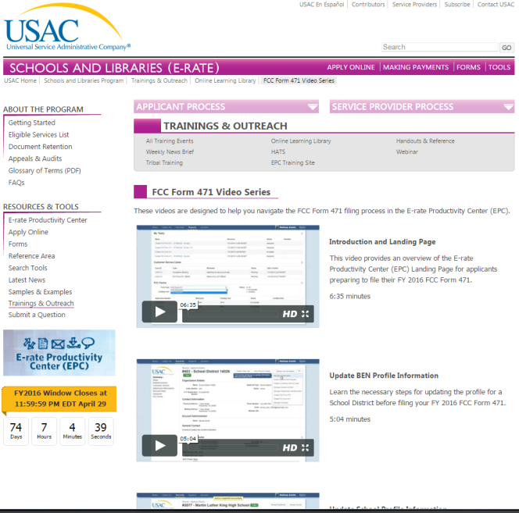
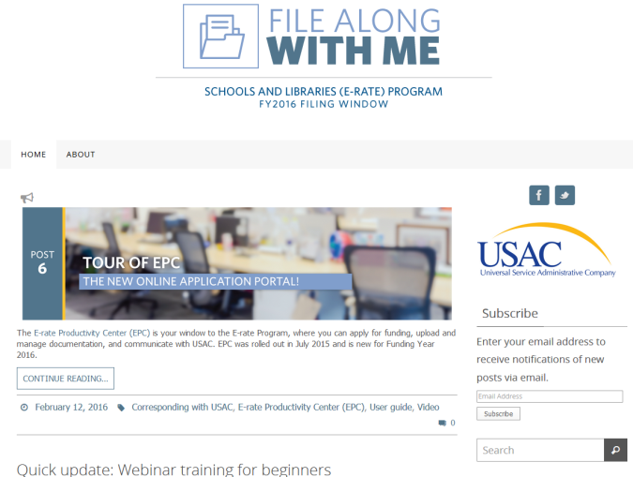
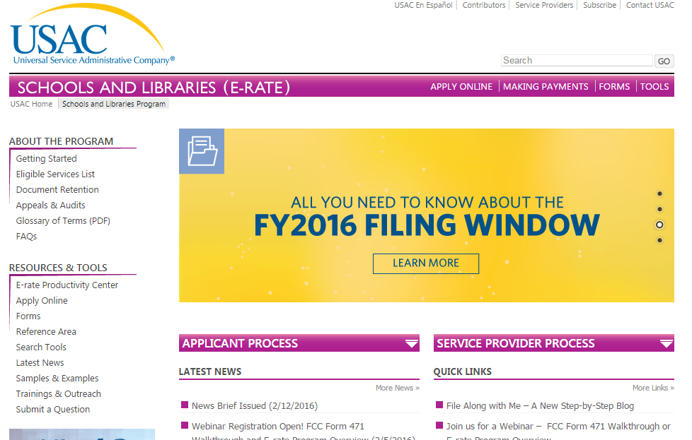
OTHER RESOURCES
usac.org/sl
Notes:
News Brief
Training & Outreach Pages, which lead to the OLL and Tribal Training pages
FAWM
Filing Window HQ

Slide 26
THANK YOU!
NEXT PRESENTATION: E-RATE 101
usac.org/sl • TribalTraining@usac.org • (888) 203-8100

