Slide 1
2016 Applicant Training
FY2016 Search Tools
September – November 2016

Slide 2
FY2016 Public Search Tools
Tool | Function | New Features
View 470 | View and download form PDF & RFP documents for certified forms | Form and document URLs can be forwarded and downloaded from anywhere
Download 470 | Download 470 data for certified forms
View & Download 471 | View PDF of 471 + download 471 data | Form URLs can be forwarded and downloaded from anywhere
Search Commitments | View and download wave and commitment data | FRN, congressional district and contact data provided FY2015 and previous data no longer double counts

Slide 3
FY2016 Public Search Tools (cont’d)
Tool | Function | New Features
FRN Status Tool – Standard Report (FY2016 & forward) | Similar functionality to the Funding Request Data Retrieval Tool (DRT) All fields in the existing DRT standard report will be included in the new FRN Status Tool | Search by Consulting Firm Registration Number (CRN) New fields include: 471 Review Status, FRN Status, Billed Entity Name, SP Name, CRN
FRN Status Tool – Detailed Report (FY2016 & forward) | Similar functionality to the current DRT Available in October 2016 All fields in the existing DRT detailed report will be included in the new FRN Status Tool | Many new fields (next slide)

Slide 4
New FRN Status Tool Fields for Detailed Report
FRN Nickname
471 Nickname
471 Review Status
471 Contact Name & Email
BEN Urban/Rural Status
BEN Account Administrator & Email
School State LEA Code
School State Code
Library Locale Code
Library FSCS Key
Library Square Footage
Library FSCS SEQ
CRN & Consulting Firm Name
SPAC Filed for SPIN? (FY)
Remaining Contract Extensions

Slide 5
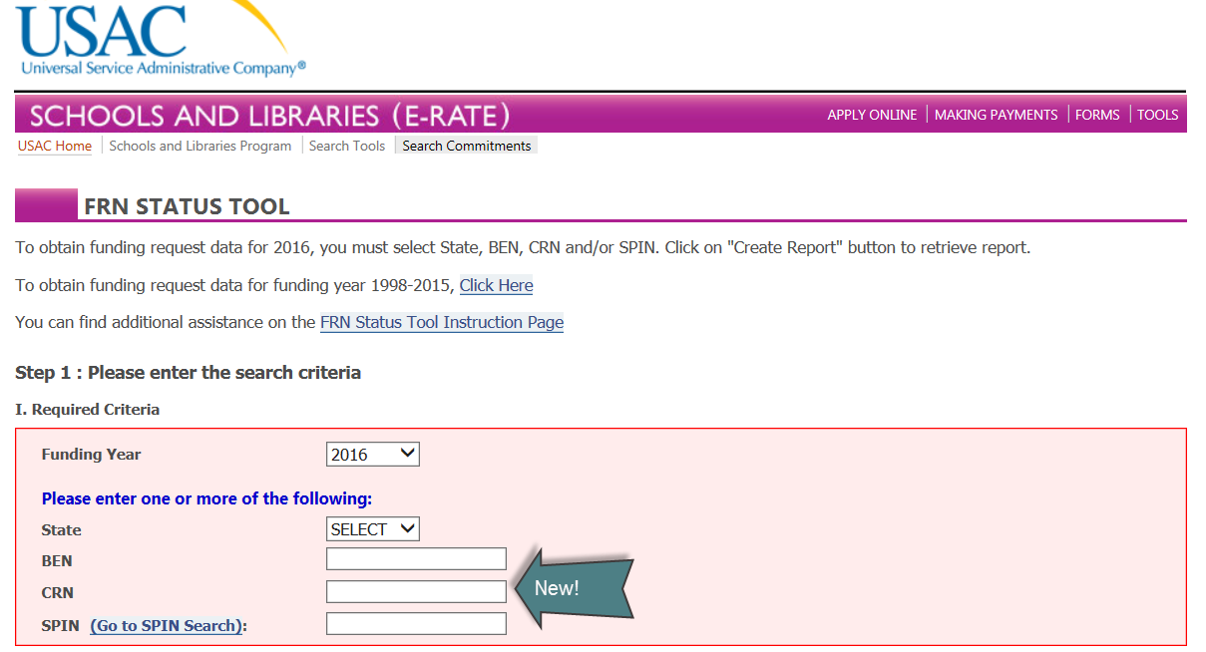
FRN Status Tool FY2016

Slide 6
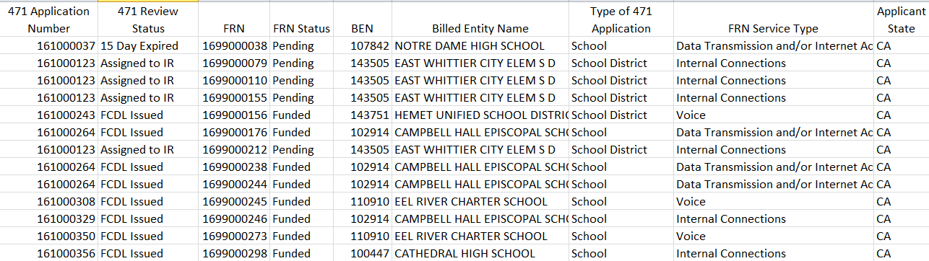
FRN Status Tool FY2016
Standard Report Data Fields

Slide 7
FRN Status Tool FY2016
Standard Report Data Fields

Slide 8
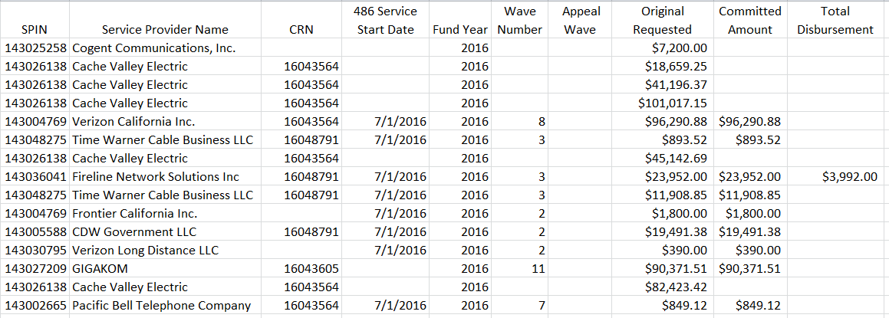
FRN Status Tool FY2016
Standard Report Data Fields

Slide 9
FRN Status Tool FY2016
Standard Report Data Fields

Slide 10
Questions?

Slide 11
Thank you!

