Slide 1
2016 Applicant Training
Audit Compliance
September – November 2016

Slide 2
Overview
Overview
USAC Audit Program
  Payment Quality Assurance (PQA) Program
  Beneficiary and Contributor Audit Program (BCAP)
Audit Documents
Common Audit Findings
Document Retention

Slide 3
Audit Compliance
USAC Audit Program

Slide 4
USAC Audit Program
Payment Quality Assurance (PQA)
PQA assessments support the Improper Payments Improvement Act of 2002 (IPIA) and the Improper Payments Elimination and Recovery Act of 2010 (IPERA) requirements.
PQA assessments are conducted to calculate improper payments. USAC assesses specific payments made to applicants and determines if the payments were made in accordance with Federal Communications Commission (FCC) rules.
Improper payment rate is reported to the FCC annually.

Slide 5
USAC Audit Program
Beneficiary and Contributors Audit Program (BCAP)
The primary purpose of audits is to ensure compliance with FCC rules and program requirements.
“Schools, libraries, and service providers shall be subject to audits and other investigations to evaluate their compliance with the statutory and regulatory requirements for the schools and libraries universal service support mechanism, including those requirements pertaining to what services and products are purchased, what services and products are delivered, and how services and products are being used.” (§ 47 CFR 54.516)
BCAP audits are based upon agreed-upon procedures approved by the FCC.

Slide 6
USAC Audit Program
 | PQA | BCAP
Who Is Reviewed? | Beneficiaries are randomly selected from disbursements made in the prior calendar year. The Beneficiary’s service providers is asked to certify compliance with lowest corresponding price (LCP). | Beneficiary or service Provider prior funding year disbursements are reviewed. Most audits are limited in scope.
What Should You Expect? | Applicants are emailed questions. Responses are reviewed by PQA assessors. Applicants have 10 business days to submit responses | An announcement letter requesting the documents to be reviewed to ensure compliance. Applicants will receive a questionnaire about the service provider’s process (e.g., were services delivered timely) -Service Provider Audits ONLY
Will You Have A Site Visit? | Majority do not require a site visit. Some applicants are selected for a site visit. USAC’s Internal Auditors will verify equipment installation and use. | A site visit may be performed.

Slide 7
USAC Audit Program
 | PQA | BCAP
Who Will Perform the Review? | USAC’s Internal Audit Division | USAC’s Internal Audit Division and outside audit firms.
What Happens If I Fail To Demonstrate Program Compliance? | It will be noted as an Exception. | It will be noted in the audit report. USAC will determine, based on FCC guidance, whether recovery is warranted. You may provide a response to the audit. Your response shall be included in the final audit report.
Can I Appeal A Finding? | The Exception is not an appealable event. You can appeal a COMAD or RIDF decision that cites the violation identified in the audit. | The audit report is not an appealable event. You can appeal a COMAD or RIDF decision that cites the violation identified in the audit.

Slide 8
Audit Documents
PQA and BCAP

Slide 9
Documents Requested
Auditors will request documents to support:
Competitive bidding compliance, contracts
Applicants paid their non-discounted share
CIPA compliance
Maintenance was conducted on equipment (if applicable)
Services and/or products were delivered and installed
Invoices were submitted for only eligible services and products
Only eligible entities received services
Auditors may select samples of documents provided

Slide 10
Lowest Corresponding Price
Service Provider’s Obligation
The lowest corresponding price (LCP) was offered.
  47 CFR § 54.511(b) Lowest corresponding price. Providers of eligible services shall not charge schools, school districts, libraries, library consortia, or consortia including any of these entities a price above the lowest corresponding price for supported services, unless the Commission, with respect to interstate services or the state commission with respect to intrastate services, finds that the lowest corresponding price is not compensatory.

Slide 11
Lowest Corresponding Price
Who should complete the LCP certification?
Service providers are required to complete LCP certification for PQA assessment
The certification is completed and signed by a company officer.
Return the certification within the 10 business day response period.
Service providers do not have to submit supporting documentation (i.e., price list, customer bills, etc.) with the certification.
What happens if the certification is incomplete or not returned?
This could result in a PQA exception – this is a service provider violation.

Slide 12
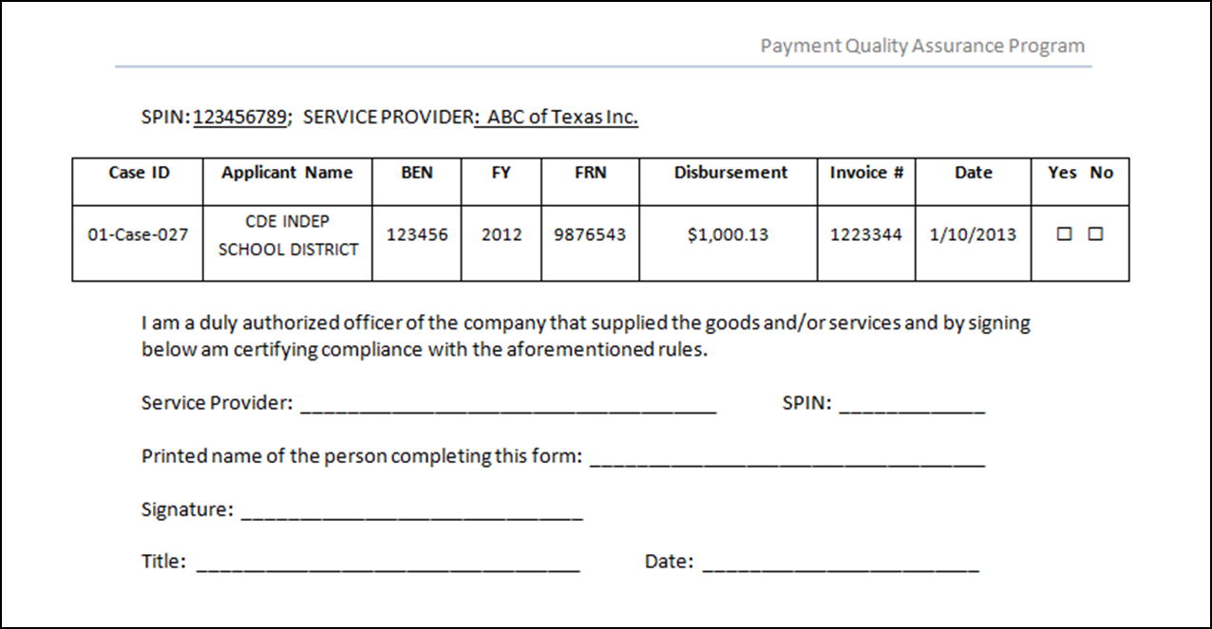


Lowest Corresponding Price
PQA Certification
Complete the entire form
Complete the entire form
Complete the entire form

Slide 13
Audit Compliance
Common Audit Findings

Slide 14
Common Audit Findings
Competitive Bidding and Contracts
  State and local procurement rules not followed. Applicants must follow E-rate and state and local procurement rules when conducting the competitive bidding process.
  Most cost effective solution not selected. Applicants should select the most cost effective solution with price being the primary factor when conducting competitive bid evaluation. Documenting the bid evaluation will help demonstrate how your vendor selection was conducted.
  Not restarting the 28 day waiting period. Applicants should restart the 28 day waiting period when a cardinal change to the RFP or similar document is made. Applicants should not start to evaluate bids until the final 28 day waiting period ends.

Slide 15
Common Audit Findings
Competitive Bidding and Contracts cont’d
  RFP or similar document not shared with all potential bidders. Applicants must conduct a fair and open competitive bid process. Information should be available to all potential bidders.
  Contract was signed prior to the 28 day waiting period. Applicants should not award or select the vendor prior to the 28 day waiting period.

Slide 16
Common Audit Findings
Invoicing Errors
  Overbilling. Applicants should review service provider bills for errors prior to paying the bill to ensure overbilling does not occur.
  Submitting invoicing to the cap. Applicants should submit invoices for services they received.
  Services not approved. Applicants should only submit invoices for services approved in the Funding Commitment Decision Letter (FCDL). Compare your FCDL to the services you requested on your FCC Form 471 or Item 21 attachment.
  Ineligible entities. Applicants should include eligible entities approved in the FCDL. Remove ineligible entities and associated costs from invoice.

Slide 17
Common Audit Findings
Invoicing Errors cont’d
  Invoiced for recurring services delivered beyond service deadline. Recurring services must be delivered during the fund year requested. Applicants should not invoice for services beyond the delivery deadline.
  Invoice beyond the invoice deadline. Submit invoices timely. Request an invoice deadline extension if needed.
  Services delivered or installed are not at the correct physical location. Applicants should ensure equipment is installed at the correct location. Update your address with USAC if the location has changed.

Slide 18
Common Audit Findings
Service and Equipment Delivery
  Products not delivered and/or installed. Applicants should not invoice for items prior to the delivery or installation. Do invoice once items are delivered and/or installed. Retain delivery and installation records.
  BMIC not supported by actual services performed. Applicants should not use generic blanket terms that do not differentiate between eligible and ineligible services. Do maintain documentation that demonstrates the amounts and services actually delivered.

Slide 19
Audit Compliance
Document Retention

Slide 20
Document Retention
Documentation must be retained for at least 10 years after the latter of the last day of the applicable funding year or the service delivery deadline for the funding request. Documents can be in electronic format or paper as stated in the E-rate Modernization Order (FCC 14-99).
Applicants and service providers must retain ALL documentation that shows compliance with all FCC rules.
Any document from a prior year that supports current year activities must be kept for a period of 10 years after the last day of service delivered.
  E.g., contract from 2005, used to support FY2016 recurring service FRNs, must be kept until at least June 30, 2027.

Slide 21
Document Retention
Required documents to retain
This list is for illustrative purposes. Service providers and applicants must retain pursuant to recordkeeping requirement, as applicable.
RFPs or similar documents
All bid responses and correspondence
Contracts, service agreements, addendums, etc.
Purchase requisitions, POs, packing slips, customer bills
Delivery and installation records
Maintenance logs
Payments (canceled checks, credit card receipts, ACH transactions)
USAC-approved SPIN changes and/or service substitutions (request, supporting documentation, and approval)
USAC-approved invoice deadline extension, service delivery and service substitution (request, supporting documentation, and approval)
Documents used to prepare forms
FCC forms and letters received from USAC (e.g., FCC Forms 498, 474)
Service provider price listings

Slide 22
Questions?

Slide 23
Thank you!

