Slide 1
Invoicing 2016
E-rate Program Applicant Training
September – November 2016

Slide 2
Agenda
Invoicing 2016
FCC Form 498
FCC Form 472 (BEAR)
PIN
Invoice Review Issues
Deadlines

Slide 3
FCC Form 498
Invoicing 2016

Slide 4
FCC Form 498
FCC Form 498: Purpose and What You Need
Purpose: FCC Form 498 used to collect contact and banking information that USAC will use to deposit BEAR reimbursements to applicants that receive universal service support
What you need for the FCC Form 498
  Contact information
  Applicant identification numbers
  Banking information

Slide 5
FCC Form 498
What You Need: Contact Information
Two types of contacts for financial information
    (1) School or Library Official
      Someone who occupies a position of authority for the school, library, district or county, or consortium applicants, and would typically be a Superintendent, Assistant Superintendent, Principal or Assistant Principal, Library Director, County or District Administrator, or state education department or state library leads
      Must be authorized to certify that the data set forth in the FCC Form 498 is true, accurate, and complete
      Note: This CANNOT be a consultant

Slide 6
FCC Form 498
What You Need: Contact Information
Two types of contacts for financial information (cont.)
    (2) General Financial Contact
      Someone authorized to retrieve the FCC Form 498 information on file with USAC and access EPC
      This person will also be able to create and edit these forms, but cannot certify updates (School or Library Official must certify)

Slide 7
FCC Form 498
What You Need: Applicant Identification Numbers
You will need three identification numbers:
  Federal Employer Identification Number (EIN/Tax ID)
    Note: This EIN/Tax ID must match information on file with FCC (FRN)
  DUNS Number
  FCC Registration Number (FRN) or (CORES ID)

Slide 8
FCC Form 498
What You Need: Applicant Identification Numbers
DUNS Number
  DUNS (Data Universal Numbering System or D-U-N-S), is a proprietary system developed and regulated by Dun & Bradstreet (D&B) that assigns a unique numeric identifier, referred to as a "DUNS number," to a single business entity upon request.
  D&B will issue a DUNS number for FREE to any business required to register with the federal government for contracts or grants
  Before applying, check to see if your organization already has a DUNS number. You can search for your organization in D&B’s online database: https://iupdate.dnb.com/iUpdate/companylookup.html or call (866) 705-5711

Slide 9
FCC Form 498
What You Need: Obtaining a DUNS Number
DUNS number (cont.):
  To obtain a DUNS number, you can apply online through D&B’s website: http://www.dnb.com/get-a-duns-number.html
  You will need:
    Name & address of organization
    Name of the chief executive officer (CEO) or organization owner
    Legal structure of the organization (e.g., corporation, partnership, proprietorship)
    Year the organization started
    Primary type of business
    Total number of employees (full and part-time)

Slide 10
FCC Form 498
Applicant Identification Section
(3) FCC Registration Number (FRN) or (CORES ID)
  An FCC Registration Number is required by all entities that do business with the FCC. If you have filed an FCC Form 471 in the last several years, you already have one because you have been required to provide it on the form.
  If you do not yet have an one, you can apply on the FCC’s CORES website: https://apps.fcc.gov/coresWeb/publicHome.do
  Note: It should not be confused with the “Funding Request Numbers” (FRNs) that USAC assigns to each funding request on FCC Form 471 applications.

Slide 11
FCC Form 498
What You Need: Bank Information
Bank Information
  Bank Name
  Account Number
  Routing Number (nine-digit number)
    (Note the order of the fields!)
Note: This cannot be a consultant’s bank account.

Slide 12
FCC Form 498
What You Need: Bank Information Section
Associated Billed Entities
  Billed Entity Number (BEN)
  Billed Entity Name
Enter any BENs that will be reimbursed using this bank account number

Slide 13
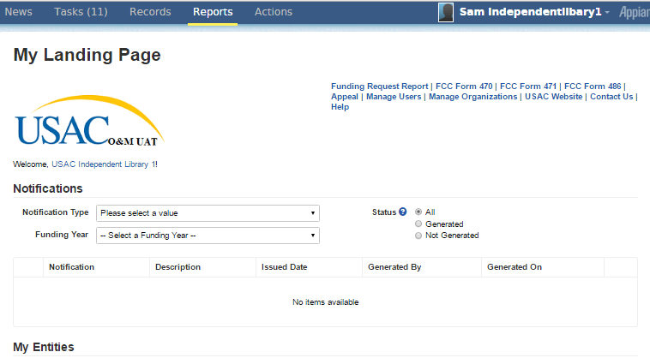
FCC Form 498
How to Access the FCC Form 498: My Landing Page
Click name

Slide 14
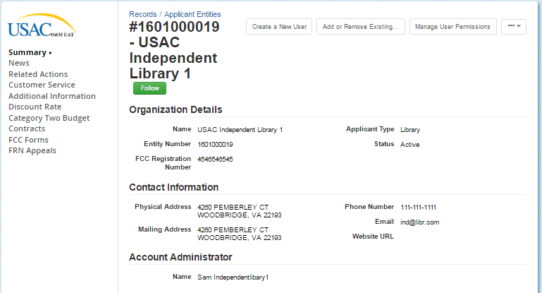
FCC Form 498
Click on “Related Actions”
Click “Related Actions”

Slide 15
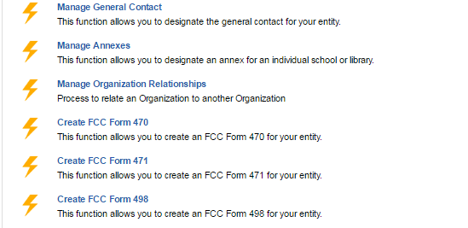
FCC Form 498
Select “Create FCC Form 498”
Click “Create FCC Form 498”

Slide 16
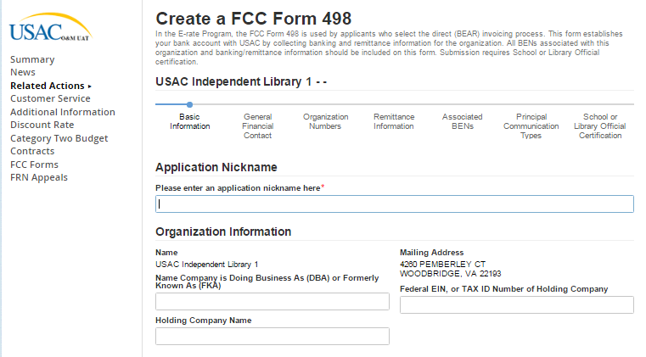
FCC Form 498
Enter Form Information

Slide 17
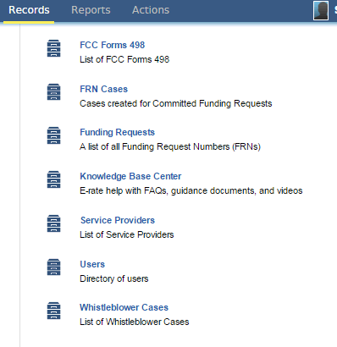
FCC Form 498
How to Modify an FCC Form 498

Slide 18
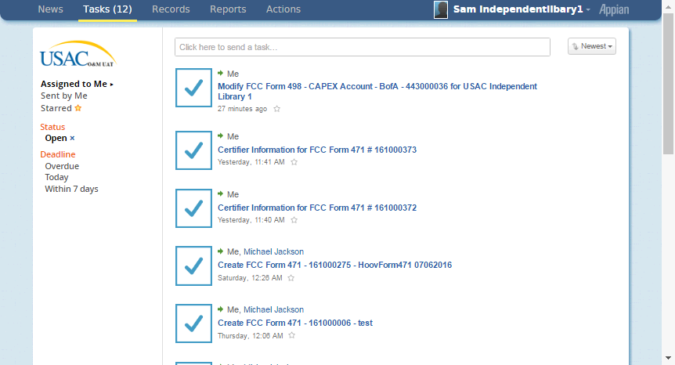
FCC Form 498
How to Modify an FCC Form 498: Select desired form
Select desired form

Slide 19
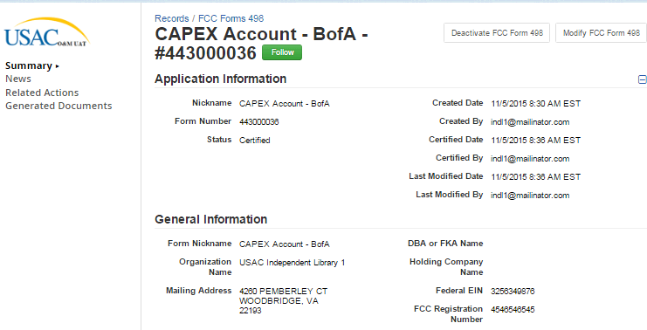
FCC Form 498
Select “Modify FCC Form 498”
Select to Modify

Slide 20
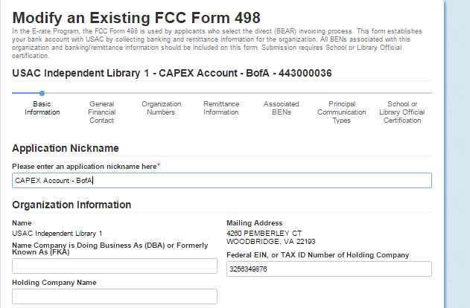
FCC Form 498
Edit form as needed.

Slide 21
What happens next?
FCC Form 498
Form reviewed by USAC
  Requests for supporting documentation sent by email (M/W/F)
  Banking data can be verified by a bank statement or voided check
Form approved by USAC
  Confirmation of approval emailed to the General Financial Contact on FCC Form 498
  Immediate access in online BEAR

Slide 22
Other Information
FCC Form 498
Who may file FCC Form 498?
  The Billed Entity or controlling authority. The controlling authority for a school or library may be the town or county.
Can I use multiple bank accounts?
  Yes, but you must file an FCC Form 498 for each account
What if multiple BENs are using the same bank account?
  List all associated BENs on the FCC Form 498
What if information changes after the FCC Form 498 has already been filed?
  Changes must be certified – please notify USAC

Slide 23
FCC Form 472
Invoicing 2016

Slide 24
FCC Form 472
FCC Form 472: Billed Entity Applicant Reimbursement
Purpose of FCC Form 472 (BEAR)
  Applicants file to request reimbursement for the discount amount on eligible services that have already been billed by the service provider and paid in full by the applicant to the service provider
Recent Changes
  Online Only (Paper BEAR was discontinued July 1, 2016)
  No longer requires Service Provider certification
  May require some information during invoice review
  Applicants paid directly via electronic transfer

Slide 25
FCC Form 472
Direct Payment
Payments scheduled twice a week when invoice approved – no longer two-week delay for Service Provider notification
BEAR payments only via electronic transfer to applicant
Billed Entities will be paid directly to bank account
BEAR Notification Letters still issued
Remittance Statement sent to General Financial Contact when paid

Slide 26
Getting a PIN
Getting a PIN
A PIN is needed to enter the online BEAR.
A PIN is issued automatically for contacts on FRN
Call the Customer Service Center or submit a case in EPC to request a PIN if not automatically issued
  Request must provide the following information :
    BEN , Billed Entity Name, Full Name, Employer Name, Date of Request
    Street Address, City, State, Zip Code, Zip+4
    Email address
  Note: Must be a user on the Billed Entity’s profile. If not, contact the Account Administrator for the BEN to be added as a user

Slide 27
Getting a PIN
Getting a PIN
Case will indicate when PIN has been issued
Mailers are run and printed once a week
May take one to two weeks
Call Customer Support if a PIN is needed sooner

Slide 28
FCC Form 472
FCC Form 472 Applicant Process
Provide service provider identification number (SPIN)
Provide FCC Form 471 Application Number, Funding Request Numbers, Dates, Amounts for that SPIN
Review, certify, and submit information
  Again, no service provider certification required

Slide 29
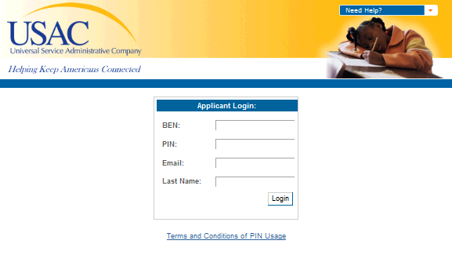
FCC Form 472
FCC Form 472 – Login Screen

Slide 30
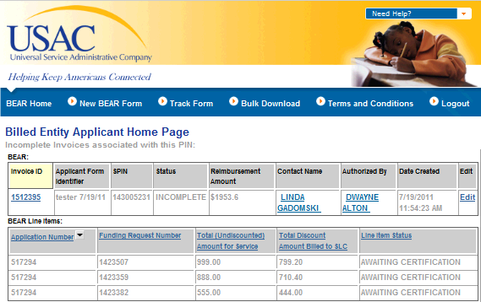
FCC Form 472
FCC Form 472 – Line Item View

Slide 31
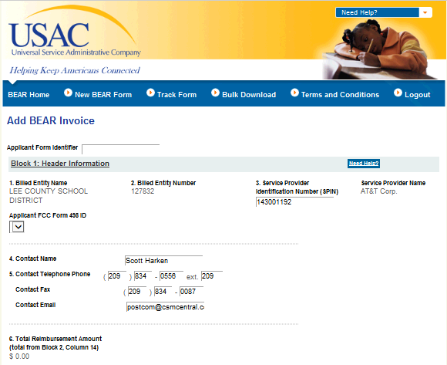
FCC Form 472
FCC Form 472 – Block One

Slide 32
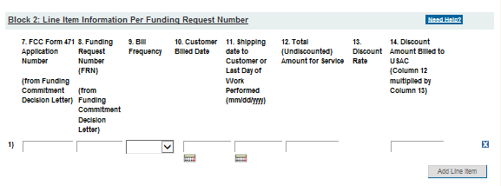
FCC Form 472
FCC Form 472 – Block Two

Slide 33
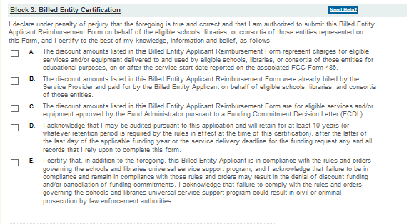
FCC Form 472
FCC Form 472 - Certification

Slide 34
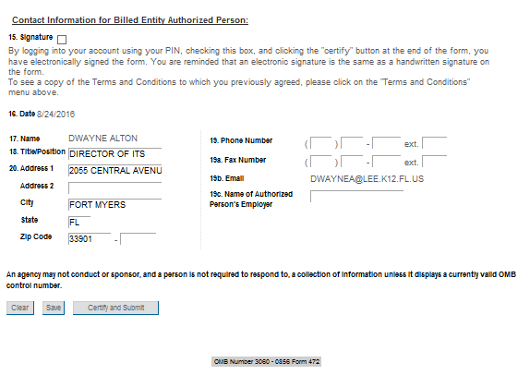
FCC Form 472
FCC Form 472 - Signature

Slide 35
Invoice Review Issues
Invoicing 2016

Slide 36
Invoice Review Issues
Common Invoicing Issues
Services must be delivered
Services must be eligible
Services must be delivered by service provider approved on FCDL
Services must be billed to party on FCC Form 471
Services must be listed on application line item (Item 21)
Services must be delivered within funding year
Services must be delivered to location on FCC Form 471

Slide 37
Invoice Review Issues
Common Invoicing Issues (continued)
Service provider FCC Form 473 not on file
Customer bill does not identify services
Items on customer bill not specified on committed funding request
Services delivered outside contract dates
Name on bill does not match FCC Form 471
Applicant has not returned service certification during invoice review.

Slide 38
Invoice Review Issues
Common Invoicing Issues (continued)
Other service certification issues
  Certification returned by provider and not confirmed by applicant
  Date to install is outside funding year
  Date to install not completed for products delivered
  Signature not provided
  Form not dated

Slide 39
Invoice Review Issues
Common Invoicing Issues (continued)
  Payment of beneficiary portion
    Proof of payment not returned when requested
    Check does not demonstrate clearing bank
    Check already shows payment for another invoice
    Documents not from bank website

Slide 40
Deadlines
Invoicing 2016

Slide 41
Deadlines
Invoice Extension
Invoice Filing Deadline
  Invoices must be submitted to USAC by
    (1) 120 days after the last day to receive service, or
    (2) 120 days after the date of the FCC Form 486 Notification Letter, whichever is later – 47 CFR § 54.514 (a)

Slide 42
Deadlines
Invoice Deadline Extension
Invoice Deadline Extension
  Service providers or billed entities may request a one-time 120-day extension of the invoicing deadline
  Note: The request MUST be made in advance of the deadline

Slide 43
Deadlines
Invoice Extension
Invoice Deadline Extension
  If an invoice is timely filed but was rejected or reduced for a ministerial or clerical error, an appeal to USAC can be requested to correct the error.
  Must be requested within 60 days of BEAR notification letter

Slide 44
Deadlines
Service Delivery Extension for Non-Recurring Services
An extension is automatic (Extends until Sept. 30 of the following year) if:
  (1) FCDL issued after March 1
  (2) SPIN Changes, Service Substitutions after March 1
Applicants or service providers may request an extension (when service provider unable to complete implementation for reasons beyond its control)
  Must be filed on FCC Form 500
  – Provide new contract end date too
  Must provide a reason
  Must file by service delivery deadline (typically Sept. 30 following the funding year).

Slide 45
Assistance
Where to Go for Help
FCC Form 498 Status Tool
FRNs with Extended Deadlines
Applicant Process
  Invoicing
  Before You’re Done

Slide 46
QUESTIONS?
Invoicing

Slide 47
Thank you!
Invoicing

