Slide 1
EPC Fundamentals
E-rate Program Applicant Training
September – November 2016

Slide 2
Overview
Overview
What is EPC?
What do I need to begin using EPC?
How do I log in for the first time?
How do I navigate to and complete the actions I want to take?
Where can I go for help?

Slide 3
What is EPC?
Getting Started
EPC is the E-rate Productivity Center – the main point of contact for applicants with the E-rate Program
  Complete and certify program forms including FCC Forms 498, 470, 471 and 486
  Obtain the status of applications and requests
  Submit appeals and post-commitment change requests (e.g., SPIN changes and service substitutions COMING SOON)
  Receive timely reminders and notifications
  Respond to PIA questions
  Ask USAC questions

Slide 4
What do I need to begin using EPC?
Getting Started
Organization account
  Independent school
  Independent library
  School district
  Library system
  Consortium
  NOTE: There are also accounts for service providers and for consultants.
Account administrator

Slide 5
What do I need to begin using EPC?
Getting Started
Organization account
  Your organization account contains information about your organization and any related organizations.
  The information for each organization is located in its profile.
    Profiles for individual schools are managed through the school district profile.
    Profiles for library branches are managed through the library system profile.
    Consortium members manage their own profiles, and the members are listed in the consortium profile.

Slide 6
What do I need to begin using EPC?
Getting Started
Account administrator
  The account administrator can:
    Create other users on the organization account.
    Assign user rights (permissions) to those users.
      Full rights – view, complete, and certify program forms, update profile information.
      Partial rights – view and complete program forms, update profile information.
      View-only rights – view program forms and profile information.
    Update his or her own rights.

Slide 7
How do I log in for the first time?
Logging In
First, USAC sets up accounts for the following (if they do not already exist):
  The organization.
  The individual schools or library branches that belong to the organization, if any.
  The account administrator.
The account administrator must go to portal.usac.org, create a password, log in to EPC, and accept the terms and conditions of EPC use before he or she can take any actions.
Account users created by the account administrator must go through the same process (create, log in, accept).

Slide 8
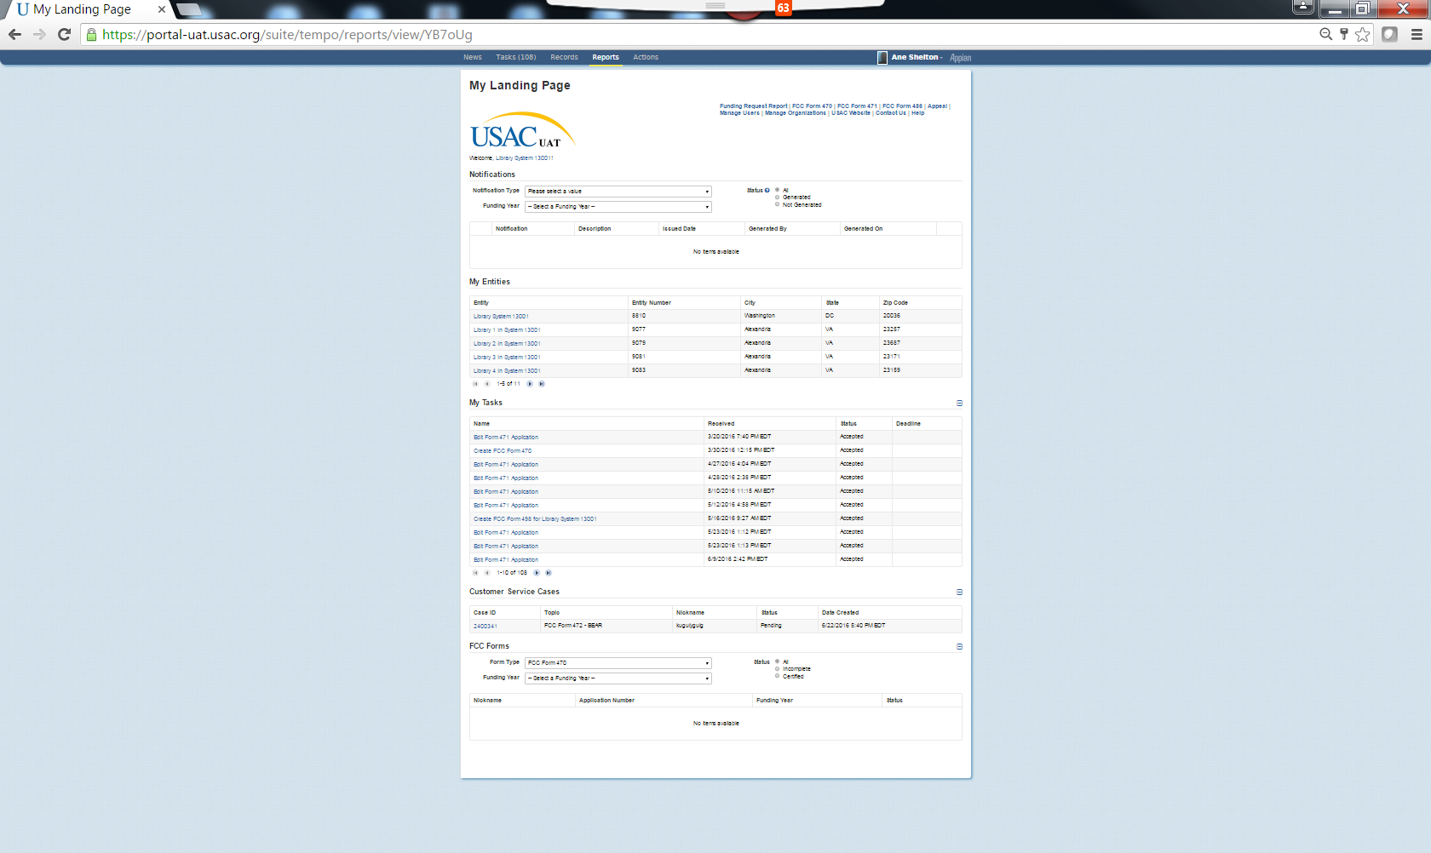
Menu Bar
Quick Links
Notifications
My Entities
My Tasks
Customer Service Cases
FCC Forms

Slide 9
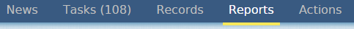
Menu Bar
My Landing Page - Navigation
The News tab contains your “letters,” other notifications from USAC (e.g. FCDL), and information on program activities – for example, if someone certifies a form.
The Tasks tab includes actions for someone in your organization to do, such as respond to PIA requests.
The Records tab features lists of related groups, such as applicants, service providers, and program forms.

Slide 10
Menu Bar (continued)
Navigation
At this point, the Reports tab is limited to landing pages and RAL modification requests, but other reports can be added later.
Actions include things you can do, such as submitting a customer service request or exporting FCC Form 470 or 471 data.

Slide 11

Quick Links
Navigation
Quick links to actions you can take
  File a program form (FCC Forms 470, 471, 486)
  Manage users (edit, create, change permissions)
  Manage organizations (edit information)
  Contact us (open a customer service case)

Slide 12
Notes on filing program forms
Navigation
FCC Forms 470, 471, 486 can be filed from:
  The links below the menu bar – OR –
  The parent organization’s main page (click “Related Actions” and then the appropriate form, or click “FCC Forms” and then the appropriate button at the top of the page)
FCC Form 498 can be filed from the parent organization’s main page by clicking “Related Actions.”
  Only the school or library official or general financial contact will be able to see the FCC Form 498 link.

Slide 13
Notes on filing program forms
Navigation
FCC Form 472 (BEAR) must be filed in the legacy system (from the Forms page on the USAC website).
FCC Form 500 must be filed on paper for now.
Other program forms:
FCC Form 474 (SPI), a service provider form, must be filed in the legacy system.
FCC Form 473 (SPAC), a service provider form, must be filed in the E-File System.

Slide 14
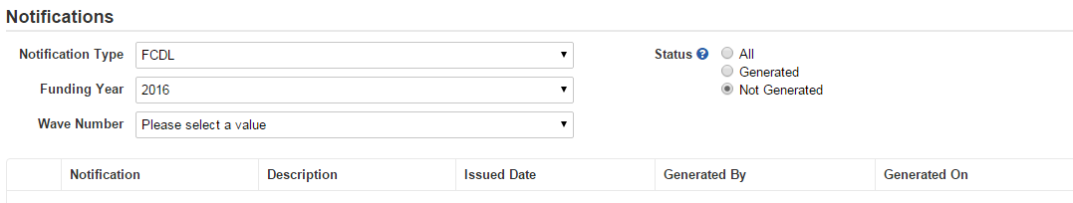
Notifications
Navigation
From this section, you can search for, generate, and view notifications such as a Funding Commitment Decision Letter or FCC Form 486 Notification Letter.

Slide 15
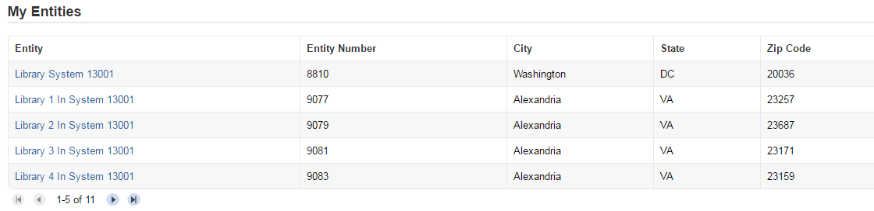
My Entities
Navigation
From this section, you can access and edit profile information for each of your entities (individual schools, library branches, non-instructional facilities, annexes).

Slide 16
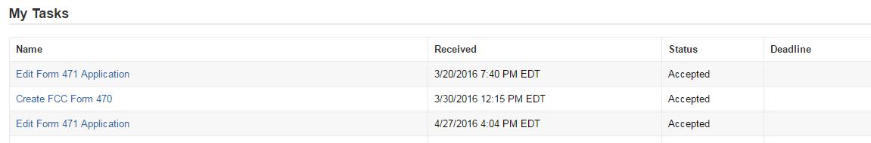
My Tasks
Navigation
From this section, you can access tasks that need to be completed, such as certifying a form.
If you start but do not certify a form, the system will create a task for you to return to and finish your work from where you left off.

Slide 17
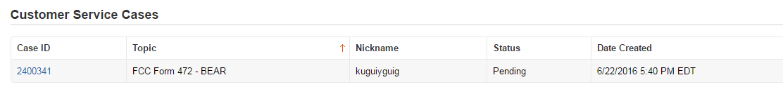
Customer Service Cases
Navigation
EPC users can file customer service cases, which are requests sent to the Client Service Bureau (our call center).
  To create a case, go to the Actions tab in the Menu Bar and choose “Contact Us.”
  You can ask a question, provide information, or make certain requests.

Slide 18
Customer Service Cases
Navigation
From this section, you can view a customer service case that you have already submitted, track USAC actions on the case, attach documentation, and/or ask follow-up questions.
More interactivity is possible than with the Submit a Question function.

Slide 19

FCC Forms
Navigation
From this section, you can search for and view program forms started and/or certified by your organization.

Slide 20
How to submit RNL modifications
Additional Actions
USAC issues a Receipt Notification Letter (RNL) in the News feed immediately after an FCC Form 470 is certified.
Applicants can submit modifications to the form, including adding an RFP document.
Navigate to the specific form and select the application.
Under “Related Actions,” choose the specific modification you want to make.
Complete and submit the information requested.

Slide 21
How to submit RAL modifications
Additional Actions
USAC issues a Receipt Acknowledgment Letter (RAL) in the News feed immediately after an FCC Form 471 is certified.
Applicants can submit modifications (Submit Modifications).
  Navigate to the specific form and select it.
  Under “Related Actions,” choose “Submit Modification Request (RAL).” You can submit one or multiple modifications by navigating to the appropriate section(s) of the request.

Slide 22
How to respond to PIA questions
Additional Actions
During USAC’s review of an FCC Form 471, USAC may have questions for the applicant.
USAC notifies the applicant of the questions through email to the contact person and an item in the News feed.
The person who will answer the questions goes to Records and enters the application number to access the questions.
All questions must be answered before the response can be submitted.

Slide 23
How to submit appeals
Additional Actions
Applicants can appeal a USAC decision.
  Click “Appeal” in the list of options just under the menu bar on the landing page. -OR-
  Under the organization’s profile page, click “Related Actions” from the left-hand menu and “Create Appeal” from the list of options.
  Identify the FRN(s) and provide the information requested.
  Receipt confirmation sent (COMING SOON)

Slide 24
Where to go for help
Getting Assistance
Call the Client Service Bureau at (888) 203-8100 for help with the following:
  Verifying accounts and account administrators
  Updating profile information
  Creating new users and updating existing users
  Linking organizations
  General questions about the portal

Slide 25
Where to go for help
Getting Assistance
Visit the USAC website for the following:
  Glossary of terms
  Frequently asked questions
  Applicant user guides
  Video tutorials
  Copy of the portal terms and conditions

Slide 26
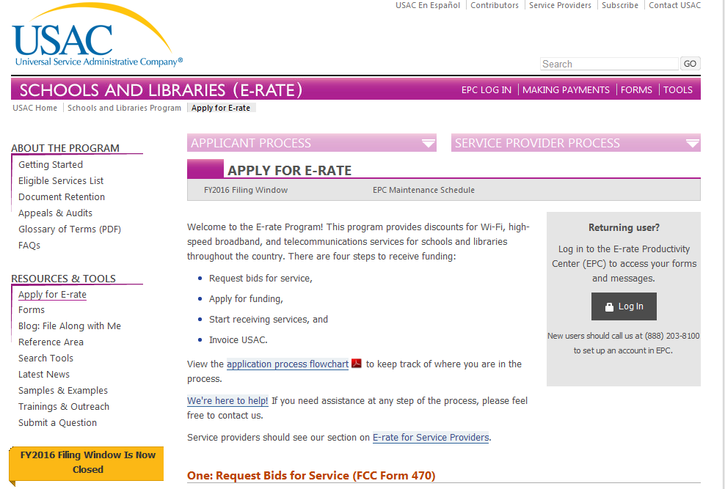
Apply for E-rate page

Slide 27
Questions?
EPC Fundamentals

