Slide 1
E-rate Program
Avoid the Dirty Dozen Mistakes
Fall 2013 Applicant Trainings

Slide 2
Avoid the Dirty Dozen Mistakes
Overview
Submitting paper forms containing errors
Missing deadlines
Not following competitive bidding rules
Not communicating with service providers after the competitive bidding process
Mixed bucket funding requests
Incorrect discount calculations
Incomplete PIA responses
Missing or incomplete Item 21 attachments
Ignoring USAC letters
Poor invoicing practices
Inadequate document retention
Not managing your E-rate process

Slide 3
Paper Forms
Submitting paper forms containing errors
We suggest that you file your FCC forms electronically. If you file on paper, complete every field in FCC Forms and check for accuracy before submitting. Otherwise:
The Client Service Bureau (CSB) must first contact you and ask for corrections. If you didn’t include identifying information on your paper form, CSB may not be able to reach you.
Your FCC Form 470 may not be posted by the deadline.
(Forms filed online are posted immediately.)
Paper invoice forms (FCC Forms 472 and 474) with incomplete information may be rejected upfront (“pass zero”).

Slide 4
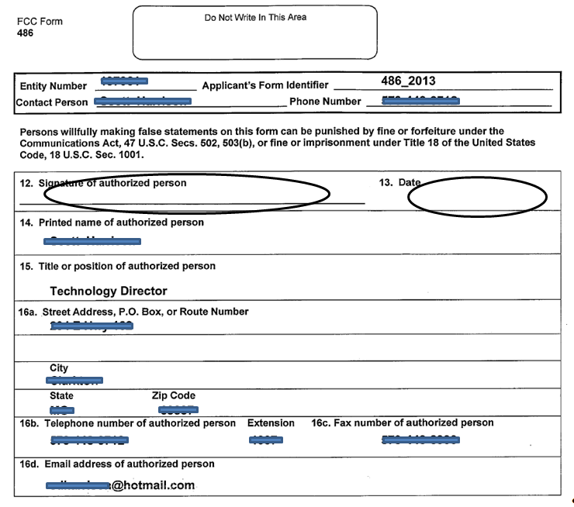
Paper Forms
Unsigned, undated FCC Form 486 paper certification

Slide 5
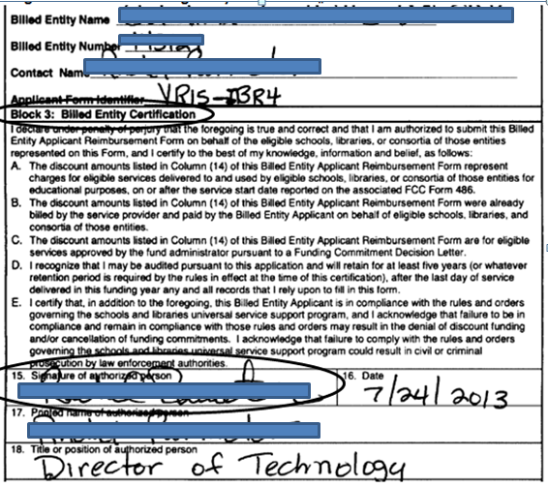
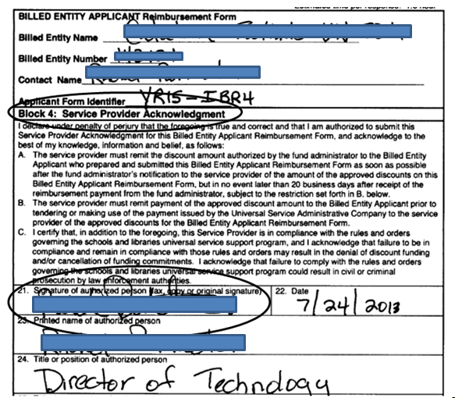
Paper Forms
FCC Form 472 – applicant certification page 3 signed by applicant
FCC Form 472 – service provider certification page 4 signed by same applicant

Slide 6
Paper Forms
Submitting paper forms containing errors
To avoid delays and/or denials:
File online if possible.
Check your work for accuracy.
Refer to the source documents that contain the correct information (e.g., Funding Commitment Decision Letter, FCC Form 486 Notification Letter) when you work on your forms.
Ask CSB for help if you need it.
  Submit a Question or call (888) 203-8100.

Slide 7
Deadlines
Missing deadlines
Many FCC forms and requests are subject to deadlines. Missing a deadline can have negative consequences, including:
An FCC Form 471 submitted after the close of the filing window will not be considered for funding.
An FCC Form 486 submitted after the deadline will have its service start date adjusted to the date 120 days before receipt or postmark of the form. Invoices for services delivered before the adjusted service start date will not be paid.
An appeal submitted after the 60-day deadline will be dismissed.

Slide 8
Deadlines
Missing deadlines
Common problems (cont.)
A service delivery deadline extension requests submitted after the last day to receive services will be rejected.
An invoice submitted after the invoice deadline will be rejected. To resubmit, an invoice deadline extension request must first be submitted to USAC and approved.
Ministerial or clerical error corrections submitted after the FCDL is issued will not be made by PIA.
PIA questions that are not answered result in a decision based on the information at hand, which may lead to a reduction or a denial.

Slide 9
Deadlines
Missing deadlines
To avoid delays and/or denials:
Don’t wait until the last minute to file forms, submit requests, or respond to questions.
Track your upcoming deadlines and manage your time wisely to meet them.
Check your submissions for completeness and accuracy.
Use the Deadlines tool if you’re not sure of a deadline.
Ask CSB for help if you need it.

Slide 10
Competitive Bidding
Not following competitive bidding rules
Posting an FCC Form 470 opens a competitive bidding process governed by program rules. Any of the following violations of those rules can lead to funding denials:
Not waiting 28 days after posting an FCC Form 470 to the USAC website or after issuing a Request for Proposal (RFP) – whichever is later – before closing your competitive bidding process, selecting a service provider, signing a contract, and filing an FCC Form 471.

Slide 11
Competitive Bidding
Not following competitive bidding rules
Common problems (cont.):
Stating on the FCC Form 470 that you have not issued or do not intend to issue an RFP or similar document describing the desired services or procurement process, when in fact you have or later do issue an RFP or similar document.
Neglecting to conduct a bid evaluation.
Not considering the price of the E-rate–eligible products and services as the most heavily weighted factor in your bid evaluation.

Slide 12
Competitive Bidding
Not following competitive bidding rules
Common problems (cont.)
Neglecting to evaluate all comparable options on a state master contract, using the same criteria you would use to evaluate bids received in response to your own FCC Form 470.
Accepting assistance with your competitive bidding process from a service provider.
Having improper communications with the selected service provider or accepting prohibited gifts from the selected service provider prior to or during the competitive bidding process.

Slide 13
Competitive Bidding
Not following competitive bidding rules
To avoid delays and/or denials:
Review the competitive bidding and bid evaluation guidance and related documents on the USAC website and follow them.
Make sure your competitive bidding process is open and fair.
Ask CSB for help if you need it.

Slide 14
Service Providers
Not communicating with service providers after the competitive bidding process is over
Communication with the service provider AFTER the competitive bidding process is over is an important part of the application process. Lack of communication can result in:
Contractual disputes where no program rules were violated – USAC’s ability to provide assistance is extremely limited in these circumstances.
Incorrect SPINs featured on FCC Form 471 funding requests.
Service providers not prepared to assist applicants with technical information requested during PIA review.
Ineligible products and/or services delivered.

Slide 15
Service Providers
Not communicating with service providers after the competitive bidding process is over
Common problems (cont.)
Invoicing issues, for example:
  Confusion about invoicing method (BEAR vs. SPI).
  Services that must be invoiced under separate FRNs or separate SPINs.
  BEAR reimbursements sent to the wrong address or entity.
  Services delivered before the service start date that are ineligible for discounts because of timing.
  Invoicing for products/services that, while eligible, were not approved as part of a funding request.

Slide 16
Service Providers
Not communicating with service providers after the competitive bidding process is over
To avoid delays and/or denials:
Use the Search for SPIN Information tool to find your service provider E-rate contact information if you do not know it.
Review your contract and related documents BEFORE signing them.
Verify with the service provider how many funding requests to file and which SPINs and costs to feature on each one.
Discuss service delivery, services, invoicing and other program issues with your service provider(s) EARLY in the process but NOT before the competitive bidding process has ended.

Slide 17
Mixed Bucket Funding Requests
Mixed bucket funding requests
Mixing Priority 1 (Telecommunications Services and Internet Access) and Priority 2 (Internal Connections and Basic Maintenance) on the same funding request or the same application causes delays.
Mixed bucket funding requests filed as Priority 1 must be separated out by your PIA reviewer, and you will be asked to confirm the separation.
Mixed bucket funding requests filed as Priority 2 may not be reviewed until Priority 2 reviews start.

Slide 18
Mixed Bucket Funding Requests
Mixed bucket funding requests
To avoid delays and/or denials:
Review the Eligible Services List for the appropriate funding year to understand which products and services fall under Priority 1 and which fall under Priority 2.
If your Priority 1 request contains leased equipment, also review the On-Premise Priority 1 Equipment guidance to verify that it is eligible under Priority 1.
Check your FCC Form 471 and Item 21 attachment for accuracy.
Ask CSB for help if you need it.

Slide 19
Discount Calculations
Incorrect discount calculations
PIA reviews discount calculations and information carefully. Poor documentation and incorrect or outdated data can delay funding decisions. Here are some of the most common problems:
If the discount for an entity has increased from the previous year, not providing National School Lunch Program (NSLP) or other discount validation documentation up front.
Providing discount data from a previous funding year to substantiate the current year’s discount calculation (unless program guidance allows for this, e.g., survey data used for two consecutive funding years).

Slide 20
Discounts
Incorrect discount calculations
Problems with applicants not using NSLP data to calculate their discounts:
Using NSLP forms as surveys.
Not keeping copies of surveys.
Projecting discounts from surveys with a return rate below 50%.
Using Community Eligibility Option (CEO) data to validate the reported discount.
  NOTE: CEO schools use NSLP data from the year before they started participation in CEO. The FCC has not indicated whether it will provide a waiver for FY2014 applications to use old data.

Slide 21
Discounts
Incorrect discount calculations
To avoid delays and/or denials:
Read the Calculating Discounts guidance to understand how discounts are calculated and what documentation you need.
Review and follow the Alternative Discount Mechanisms guidance if you are not using NSLP data.
Maintain your discount calculation source documentation – e.g., NSLP data, surveys, list of matching siblings, direct certification list – for each year it affects so that you can produce it if requested.

Slide 22
Responses to PIA
Incomplete responses to PIA
Program Integrity Assurance (PIA) reviews applications for compliance with program rules. If PIA emails or faxes questions but receives incomplete responses, or no response, the funding decision is based on the information at hand. Incomplete responses include:
A response that does not directly address the PIA questions.
A response that addresses some but not all of the PIA questions.
A response that does not include documentation when documentation was specifically requested.

Slide 23
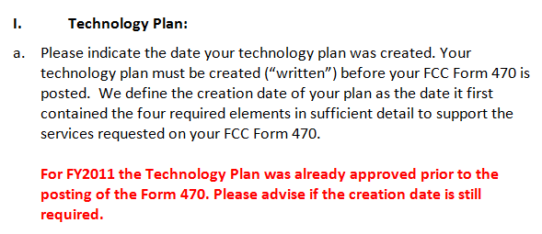
Responses to PIA
Insufficient response

Slide 24
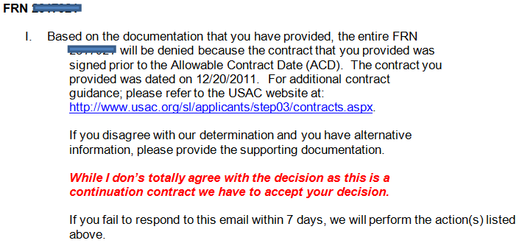
Responses to PIA
Insufficient response

Slide 25
Responses to PIA
Incomplete responses to PIA
To avoid delays and/or denials:
If PIA emails or faxes questions to you, read them carefully.
  If you understand the questions and the documentation requested, respond promptly.
  If you do not understand what is being requested, contact the initial reviewer immediately for clarification and document such contact.
If you need more time, ask for it.
If you feel you are not communicating successfully with your initial reviewer, ask to speak to a manager.

Slide 26
Item 21 Attachments
Missing or incomplete Item 21 attachments
The Item 21 attachment is a detailed description of the services in each funding request and an FCC Form 471 will be considered incomplete until the Item 21 attachment is submitted. PIA uses this information in its review. Common problems include:
Missing Item 21 attachments. If an Item 21 attachment is not submitted by the deadline, the associated funding request will be denied.
Incomplete information. PIA will reach out for additional information or clarification if needed. Without this information, PIA must make its funding decision based on the information provided.

Slide 27
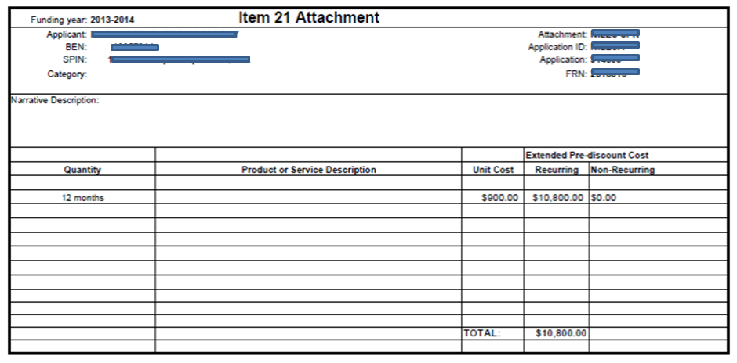
Item 21 Attachments
Item 21 attachment missing information

Slide 28
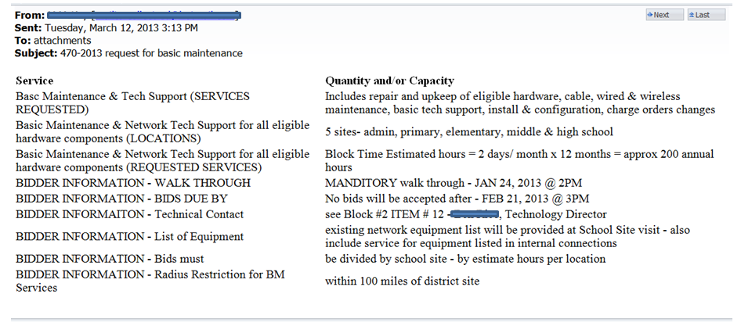
Item 21 Attachments
Item 21 attachment with no identifying information (FCC Form 471 application number, FRN, BEN, etc.)

Slide 29
Item 21 Attachments
Missing or incomplete Item 21 attachments
To avoid delays and/or denials:
Read and carefully follow the Item 21 Attachment guidance.
Identify your work – contact information, FRN, etc.
Check your work for completeness and accuracy.
File online if possible.
File early.
If you file by email, fax, or on paper, include all the Item 21 attachments for a single FCC Form 471 in one clearly labeled submission. USAC stores these by form number, not by FRN.

Slide 30
USAC Letters
USAC receipt acknowledgment and notification letters
Each time you file an FCC form, USAC issues a letter containing useful information. You should review the contents of the letter carefully. If you don’t:
You may miss errors that could be corrected by using the procedure described in the letter.
You may not be aware of the next steps in the process, including upcoming deadlines.
The processing of your next program form may be delayed if you do not refer to the information in the current letter when completing that next form.

Slide 31
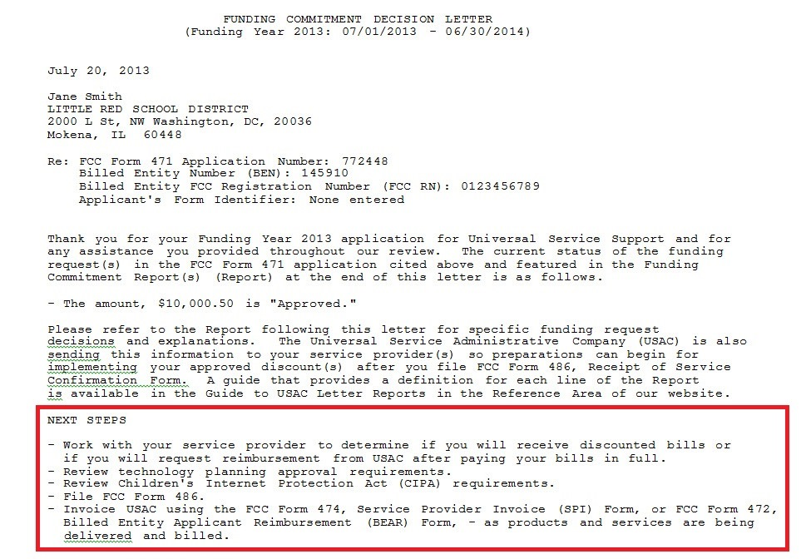
USAC Letters
FCDL Next Steps

Slide 32
USAC Letters
Ignoring USAC letters
To avoid delays and/or denials:
Review the funding report in the Receipt Notification Letter and Receipt Acknowledgment Letter for ministerial or clerical errors you can correct.
Take note of the next steps and any deadlines described in the letter and be prepared to act on them.
Note any changes from your original submission (e.g., an adjusted service start date in the FCC Form 486 Notification Letter) and take action as appropriate.

Slide 33
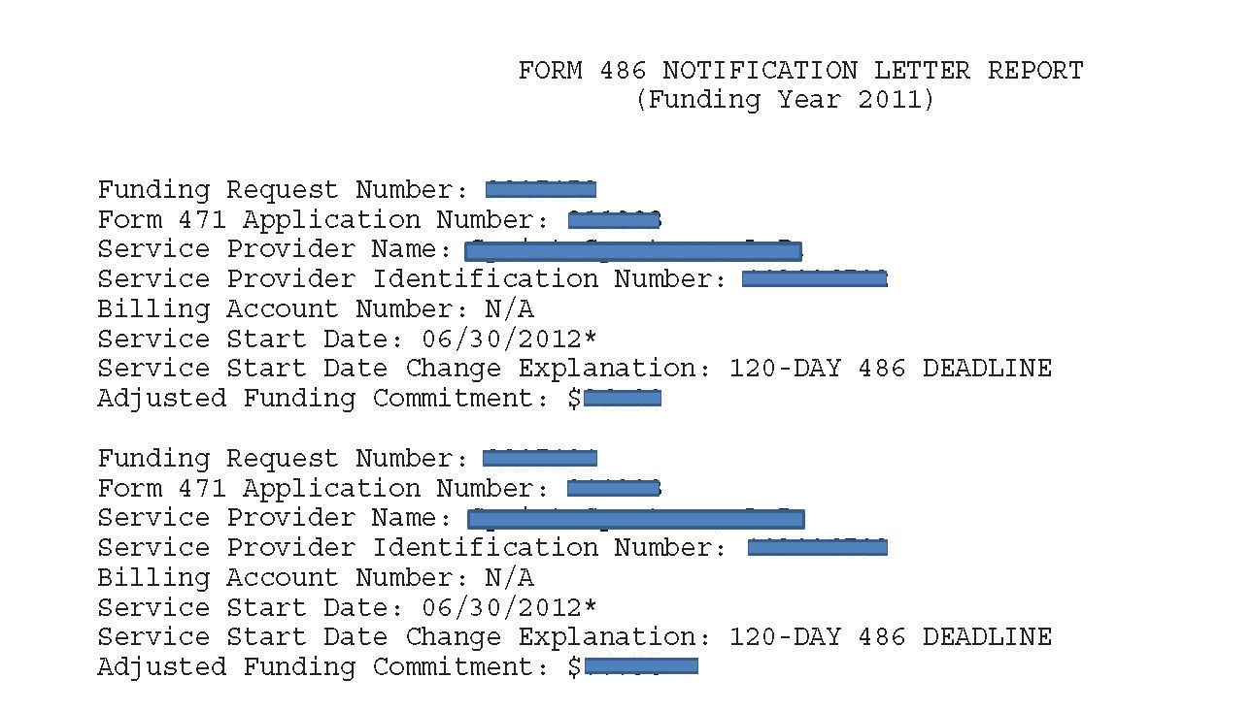
USAC Letters
Adjusted Service Start Date

Slide 34
Invoicing
Poor invoicing practices
USAC must be invoiced – either through the applicant FCC Form 472 (BEAR Form) or service provider FCC Form 474 (SPI Form) – for discounts on services actually delivered and installed. Delays or denials can occur if:
Invoices are filed after the invoicing deadline.
Invoice-related forms are not filed first (FCC Form 473 for service providers, FCC Form 486 for applicants).
Invoice entries are incomplete or inconsistent.
If the invoice undergoes review, requested documentation (e.g., proof of payment, copy of contract) is unavailable.

Slide 35
Invoicing
Poor invoicing practices
To avoid delays and/or denials:
Review and follow the Invoicing guidance, the FCC Form 472 instructions, and (for service providers) the FCC Form 474 instructions to avoid common mistakes.
Check your work.
Submit invoices in a timely fashion. (Note that applicants can file BEAR Forms monthly or quarterly if they want to.)
Maintain and/or be able to produce backup documentation for invoices (e.g., proof of delivery of services, contracts stipulating specific payment arrangements).

Slide 36
Document Retention
Inadequate document retention
The E-rate program has stringent document retention requirements. Failure to retain documents for the required time period (at least five years from the last date of service delivery) can result in:
Funding reduction or denial after PIA review.
Adjusted service start date.
Invoice rejection.
Audit findings.
Commitment adjustment (COMAD).

Slide 37
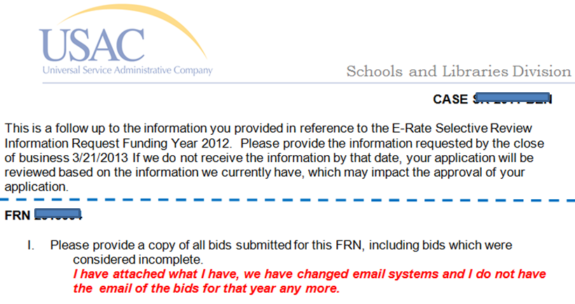
Document Retention
Response to additional selective review question

Slide 38
Document Retention
Inadequate document retention
To avoid delays and/or denials:
Review the E-rate Binder guidance for a suggested checklist of documents to retain and how to organize them.
Store your documents in such a way that you – or your successor – can find them easily if needed.
Remember that even if your local or state regulations require a shorter time period for document retention, you must follow the FCC program rule for documents related to E-rate.
Keep in mind that some documents (e.g., multi-year contracts, notice of public hearing or meeting for CIPA) must be kept for five years after the latest funding year they affect.

Slide 39
Managing the Process
Managing your E-rate process
Applicants are often surprised by parts of the process, such as required forms or requests, looming deadlines, or requests for supporting documentation. Not being prepared can lead to:
Incorrectly filed forms or requests due to unexpected and impending deadlines.
Denials or reductions in funding due to the inability to support requests.
Inability to provide documentation for audits, especially when the responsible staff member is no longer there.

Slide 40
Managing the Process
Managing your E-rate process
To avoid delays and/or denials:
Stay informed.
  Review the guidance information on the USAC website.
  Subscribe to the SL News Brief.
Plan ahead.
  Create a timeline of your E-rate activities and follow it.
  Submit required forms and requests well before the deadline.

Slide 41
Managing the Process
Managing your E-rate process
To avoid delays and/or denials (cont.):
Track your submissions.
  Call CSB for the status of paper form data entry.
  Familiarize yourself with the tools on the Search Tools page to verify postings and certifications, and to track the progress of reviews and requests.
If you need it, request an extension before the deadline.
Ask questions.

Slide 42
Questions?

