Slide 1
E-rate Program
Program Compliance
May 2012

Slide 2
Overview
Overview
Know Your Role
Technology Plans
Fair and Open Competition
Lowest Corresponding Price
Contracts
Pre-Commitment Issues
Document Retention

Slide 3
Know Your Role
Applicants
  Write tech plan (Priority 2 services only), file FCC Form 470 and write RFP, evaluate bids, select provider, document the process, file FCC Form 471 and Item 21, get tech plan approved, file FCC Form 486, select invoice method, file BEARs, retain docs
Service Providers
  Respond to FCC Forms 470/RFPs, assist with preparing Item 21 attachments, provide technical answers on questions regarding specific goods and services requested, but NOT on competitive bidding; file SPIs and/or approve BEARs; file SPAC, retain docs
Consultants
  Follow the role of their client – either applicant or service provider, obtain a consultant registration number, retain docs

Slide 4
Technology Plans
Technology Plan Requirements for Priority 2 Services
Created by schools or libraries ONLY (no service provider involvement)
Contains sufficient detail to support and validate the services requested and covers the funding year
Must follow FCC rules and state or local technology plan requirements
Four Required Elements
    Goals and Strategies; Professional Development; Needs Assessment; and Evaluation
  Plans must be approved prior to start of service or filing of FCC Form 486, whichever is earlier.

Slide 5
Fair and Open Competition
The Competitive Bidding Process
Must be a fair and open process
Avoid conflicts of interest
  Applicant consultant ⬄Service Provider
  Applicant ⬄ Service Provider
Open competition and bid evaluation
Follow all rules – FCC and state/local
Read the Form 470/RFP responses and contract fine print
6th Report and Order provides further clarifications and examples of rule violations

Slide 6
Fair and Open Competition
Service Providers Cannot:
Determine the types of service the applicant will seek on an FCC Form 470
Prepare, assist applicants with the filling out of the FCC Form 470
Sign, certify and/or submit FCC Form 470
Negotiate with prospective bidders
Assist or run the competitive bidding process for the applicant

Slide 7
Fair and Open Competition
Service Providers Cannot:
Be privy to information about the bid not shared with other potential bidders (“inside information”)
Provide charitable donations that have a relationship to the competitive bid and would circumvent FCC competitive bidding rules or influence the E-rate competitive bidding process
Provide charitable donations that function as inducements to make additional purchases of eligible products or services

Slide 8
Fair and Open Competition
Service Providers Cannot:
Offer or provide gifts worth $20 or more or exceed $50 per school or library employee from any single service provider participating in or seeking to participate in the E-rate program per year.
  Gifts include meals, travel and entertainment (e.g., sporting events, trips etc.)

Slide 9
Fair and Open Competition
Service Providers Can:
Have pre-bidding discussions with applicants
  Discuss their product offering with applicants
  Teach applicants about new technologies
  Present product demonstrations
Provide de minimis items to applicants
  Modest refreshments, not offered as a part of a meal
  Items with little intrinsic value such as certificates and plaques

Slide 10
Fair and Open Competition
Applicants Cannot:
Have a relationship with service providers that would unfairly influence the outcome of the competition
Furnish service providers with inside competitive information
Have ownership interest in a service provider’s company competing for services
Violate applicant’s own ethical regulations policy
Fail to describe the desired products and services with sufficient specificity to enable interested parties to bid.

Slide 11
Fair and Open Competition
FCC Form 470
Indicates the services and categories of service which entities are seeking
Must be based on tech plan for Priority 2 services
Must be posted for at least 28 days
Indicates if they are planning/have issued RFP
Indicates any special requirements and/or disqualification factors
Indicates who will be receiving the services

Slide 12
Fair and Open Competition
Requests for Proposal
FCC rules refer to RFPs generically but they may have a variety of names (Request for Quotes, Scope, or Work)
FCC rules do not require RFPs but state and local procurement rules may
Must be based on entities’ tech plan (if applicable)
Must be available to bidders for at least 28 days
  Applicants must count 28 calendar days from whichever (FCC Form 470 or RFP) was posted or available last
    Example: RFP posted on December 1, Form 470 posted on December 15, December 15 starts the 28-day count

Slide 13
Fair and Open Competition
Form 470 and RFP Issues
Applicants must ensure that they post for the correct category of service
  PIA can switch the category of services if applicants make a mistake on their Form 471
Sufficient detail in Form 470
  Cannot provide generic descriptions (e.g., all eligible telecom services, Digital Transmission Services)
  Cannot provide laundry lists of products and services

Slide 14
Fair and Open Competition
Form 470 and RFP Issues
Third party entities
  Non-state agencies that conduct the competitive bidding and contract negotiations on behalf schools or libraries must have Letter of Agency to act on behalf of applicants.
  If multiple vendors are selected, applicants must conduct a mini-bid to award contract
    Applicants must memorialize their decision
    Document retention rules apply

Slide 15
Fair and Open Competition
Imposing Restrictions
Set some eligible services requirements
  Applicants may require service providers to provide services that are compatible with one kind of system over another (e.g. Cisco compatible)
Bidder disqualification criteria must be spelled out in FCC Form 470 and/or RFP and be available to all.
Starting in FY 2013, applicants are not allowed to list the specific make and model of services sought without also allowing equivalent products and/or services to be bid.

Slide 16
Fair and Open Competition
Bid Evaluation
Retain all vendor selection documentation
  Winning and losing bids, correspondences, memos, bid evaluation documents, etc.
Price of the eligible goods and services must be primary factor or most heavily weighted overall in any tier.
  USAC sample evaluation matrix available
Evaluation begins after 28-day waiting period
Service Providers may not pay for applicant’s termination charges incurred in breaking a contract.

Slide 17
Fair and Open Competition
Most Cost Effective
Selecting the winning bidder
  Price of the ELIGIBLE goods and services must be the primary factor.
  Other factors, including other price factors, can be considered as well but they cannot be weighted equally or higher than cost of the eligible goods and services
  See Construct An Evaluation for weighting samples

Slide 18
Fair and Open Competition
Cost Effectiveness
Solution must be cost-effective (not just the most cost-effective)
    Ysleta Order, para. 54: Routers priced at two or three times greater than the prices available from commercial vendors would not be cost-effective, absent extenuating circumstances.
    Receiving only one bid does not automatically make it cost-effective
    Applicants must be able to demonstrate why a solution with higher than average pricing is cost-effective
    Service Providers may work with the applicant to help them understand the technical needs for this expensive solution.

Slide 19
Fair and Open Competition
Free Services
Can’t use E-rate to get free stuff (ineligible or eligible)
Must deduct the value of the “free stuff”, discounts, trade-in etc, from the pre-discount amount in order get equal comparison between offerings
    Example: Discount rebate
      Cost for product = $100 pre-discount
      Rebate of 20% is available
      Can ONLY apply for $80 ($100*80%) pre-discount

Slide 20
Fair and Open Competition
Free Services
A proportionate cost allocation is required between eligible and ineligible components.
Cost of eligible goods and services cannot be inflated to cover the “free” ineligible stuff
  Example: “Free products” included in a bid
  Vendor A: $10,000 products includes $1,000 of free ineligible products (Deduct $1,000 free products)
  Vendor B: $8,000 for eligible products – no free products
  Must compare:
    Vendor A: $9,000 ($10,000 -$1,000) to Vendor B: $8,000

Slide 21
Lowest Corresponding Price
What is the Lowest Corresponding Price (LCP) rule?
47 CFR § 54.500(f): Lowest corresponding price is the lowest price that a service provider charges to non-residential customers who are similarly situated to a particular school, library, or library consortium for similar services.

Slide 22
Lowest Corresponding Price
What is the Lowest Corresponding Price (LCP) rule? (cont.)
47 CFR § 54.511(b): Providers of eligible services shall not charge schools, school districts, libraries, library consortia, or consortia including any of these entities a price above the lowest corresponding price for supported services, unless the Commission, with respect to interstate services or the state commission with respect to intrastate services, finds that the lowest corresponding price is not compensatory.

Slide 23
Lowest Corresponding Price
What is the purpose of the LCP rule?
To ensure that service providers do not charge schools and libraries in the E-rate program more than they would charge their other customers for the same services.
To ensure that any lack of experience in negotiating in a service market does not prevent applicants from receiving competitive prices.

Slide 24
Lowest Corresponding Price
What is “similarly situated”?
Service providers are required to offer schools and libraries their services at the lowest corresponding prices throughout their geographic service areas. The “geographic service area” is the area in which a serviced provider is seeking to serve customers with any of its E-rate services.

Slide 25
Lowest Corresponding Price
What is “similarly situated”? (cont.)
Service providers may not avoid the obligation to offer the lowest corresponding price to schools and libraries for interstate services by arguing that none of their non-residential customers are identically situated to a school or library or that none of their service contracts cover services identical to those sought by a school or library.

Slide 26
Lowest Corresponding Price
What is “similarly situated”? (cont.)
The Commission will only permit providers to offer schools and libraries prices above prices charged to other similarly situated customers when those providers can show that they face demonstrably and significantly higher costs to serve the school or library seeking service. Factors that could affect the cost of service – volume, mileage from facility, and length of contract.
Similar services include those provided under contract as well as those provided under tariff.

Slide 27
Lowest Corresponding Price
Who is responsible for ensuring the LCP is provided?
All service providers regardless of the size of the company!
The applicant is not obligated to ask for the LCP, but must receive it!

Slide 28
Lowest Corresponding Price
Who is responsible for ensuring the LCP is provided? (cont.)
A service provider’s obligation to provide the LCP is not tied to a response to an FCC Form 470 or RFP. The service provider must charge a rate that is the LCP – it is not sufficient merely just to offer the LCP in a bid response. If a service provider does not know that a school or library is participating in E-rate and therefore does not offer the LCP rate, the service provider must actually charge the LCP once they realize the school or library is participating in the E-rate program.

Slide 29
Lowest Corresponding Price
Who is responsible for ensuring the LCP is provided? (cont.)
Note: A service provider should be aware of a school’s or library’s participation in E-rate prior to the funding year as the service provider receives a copy of the FCC Form 471 Receipt Acknowledgment Letter (RAL) for the FRNs on which they are cited. At the very least a service provider will know when they receive a copy of the FCDL.

Slide 30
Lowest Corresponding Price
What can a school or library do if they think they did NOT get LCP?
47 CFR § 54.504(c)(1): Schools, libraries, consortia including those entities may request lower rates if the rate offered by the carrier does not represent the lowest corresponding price.

Slide 31
Lowest Corresponding Price
What can a service provider do if it thinks the LCP is not enough for the service?
47 CFR 54.504(c)(2): Service providers may request higher rates if they can show that the lowest corresponding price is not compensatory, because the relevant school, library, or consortium including those entities is not similarly situated to and subscribing to a similar set of services to the customer paying the lowest corresponding price.

Slide 32
Lowest Corresponding Price
Commission orders also mandate:
There is a rebuttable presumption that rates offered within the previous three years are still compensatory.
Promotional rates offered by a service provider for a period of more than 90 days must be included among the comparable rates upon which the lowest corresponding price is determined.

Slide 33
Contracts
Contracts Overview
A contract must be signed and dated by the applicant prior to the Form 471 certification postmark date
  Applicant must not sign a contract before the Allowable Contract Award Date (CAD)
  Service providers may sign before the CAD
  When state and/or local contract law doesn’t require signature and/or date, the applicant will be given the opportunity to complete a certification statement.
A purchase order may be considered a contract ONLY if your state considers it a contract

Slide 34
Contracts
Voluntary Contract Extensions
Are allowable when the option for contract extensions is stated in the original provision of the contract.
Applicant must rebid the services (i.e., file a new FCC Form 470) if contract extensions are not stated in the contract or RFP.
If a contract is extended post-commitment, applicants must notify USAC by filing an FCC Form 500.

Slide 35
Contracts
State Master Contracts
A state master contract (SMC) is competitively bid and put in place by a state government for use by multiple entities in that state
Single winner: Single vendor wins the bid
Multiple winners: State awards contract to several bidders
Multiple Award Schedule (MAS): State awards contract for same goods and services to multiple vendors that can serve the same population

Slide 36
Contracts
State Master Contracts
Multiple winners always require vendor selection justification
If multiple vendors can provide the services to applicants, then the applicant must conduct a mini-bid based on FCC rules.
  Applicants do not need to file another FCC Form 470
  But they must comply with all FCC Rules regarding vendor selection (i.e., most cost effective, price must be primary, cost-effectiveness)
Contract Award Date = Date applicant decides to purchase off State Contract.

Slide 37
Pre-Commitment Issues
Necessary Resources
Check applicant’s certification that they have them.
  Are there end user computers?
    Must have reasonable plans to fully utilize all internal connections for which you are requesting discounts (e.g., 2-year plan to get computers for all network drops)
  Do they have software to run on the computers?
  Staff trained on how to use the technology?
  Is there sufficient electrical capacity?
  Can the applicant maintain all of the equipment ?

Slide 38
Pre-Commitment Issues
Paying Non-Discount Share
All E-rate applicants must pay their non-discount share
Service providers cannot give the money (directly or indirectly) to pay for the non-discount share
  Non-discount share cannot be a charitable donation from the provider or an entity with which the selected service provider has a relationship.
  Funds cannot come from the service provider or an entity controlled by the service provider
  Service provider bills can’t be ignored or waived.
  If applicant can’t show proof of payment during invoice review, invoice may be denied.

Slide 39
Pre-Commitment Issues
Payment Plans
Are NOT Allowed
Applicants are required to pay their share at the same time that USAC pays the discount amount
  Service Provider certifies that the invoices they submit are for services that “have been billed to service provider’s customers.”
  Deferred payment plans that allow the applicant to pay after USAC has paid will jeopardize a funding request.
  FCC Rules include a presumption that the non-discount share will be paid within 90 days.

Slide 40
Gifts and Donations
Gifts
Receipt or solicitation of gifts by applicants from service providers (and vice versa) and potential service providers is a competitive bidding violation.
Service providers may not offer or provide any gifts or thing of value to applicant personnel involved in E-rate.
Gift prohibitions are always applicable, not just during the competitive bidding process.
Must always follow FCC rules. May also have to follow state/local rules.
Counted per funding year

Slide 41
Gifts and Donations
Gift Rule Exceptions
“Modest refreshments not offered as part of a meal, items with little intrinsic value intended for presentation, and items worth $20 or less, including meals, may be offered or provided , and accepted by any individuals or entities subject to this rule, if the value of these items received by any individual does not exceed $50 from one service provider per funding year.” See 47 C.F.R. § 54.503(d)(1).
Single source = all employees, officers, representatives, agents, contractors, or directors of the service provider.

Slide 42
Gifts and Donations
Gift Rule Exceptions Examples
A service provider has offered a school district employee lunch at a local sandwich shop three times during the course of the year. The value of the school district employee’s meal is $9 each time. The total value of the gifts is $27. No other gifts are received by this employee from this provider. The meals fall in the $20 per instance and $50 per year exception and there is no rule violation.

Slide 43
Gifts and Donations
Gift Rule Exceptions Examples
A library employee and his spouse are invited by a service provider to attend a play, tickets to which have a face value of $30 each. The aggregate market value of the gifts offered on this single occasion is $60, $40 more than the $20 amounts that may be accepted for a single event or presentation. The employee may not accept the gift of the evening of entertainment. He and his spouse may attend the play only if he pays the full $60 value of the two tickets.

Slide 44
Gifts and Donations
Gift Rule Exceptions
Gifts to family and friends when those gifts are made using personal funds of the donor (without reimbursement from the employer) and are not related to a business transaction or business relationship are exempt. See 47 C.F.R. § 54.503(d)(3).
Gift rules are not intended to discourage companies from making charitable contributions, as long as those contributions are not directly or indirectly related to an E-rate procurement. See 47 C.F.R. § 54.503(d)(4).

Slide 45
Gifts and Donations
Gift Rule Exceptions Examples
A service provider’s spouse is the town librarian. The service provider employee may give the librarian a birthday gift exceeding $20, as long as it is not reimbursed by the company, and is being given based on their personal relationship.
Three service provider employees invite a tech director to join them at a golf tournament at their company’s expense. The entry fee is $500 per foursome. The tech director cannot accept the gift even though he has an amicable relationship with the service provider employees. Since the fees are paid by the company, it is the business relationship, not the personal relationship that is the motivation behind the gift.

Slide 46
Gifts and Donations
Curing Violations
Promptly return any tangible item to the donor, or pay the donor its market value, or, if perishable, the item may be given to an appropriate charity or shared within the office or destroyed. See CFR 2635.205(a).
  To avoid public embarrassment to the seminar sponsor and E-rate service provider, the Superintendent did not decline a barometer worth $200 given at the conclusion of her speech on the district’s education initiatives. The Superintendent must either return the barometer or promptly reimburse the provider $200 to cure the violation.

Slide 47
Gifts and Donations
Curing Violations Examples
With approval from the recipient’s supervisor, a floral arrangement sent by a service provider may be placed in the office’s reception area.
A district employee wishes to attend a charitable event to which he has been offered a $300 ticket by a service provider. Although his attendance is not in the interest of the district, he may attend if he promptly reimburses the donor the $300 face value of the ticket.

Slide 48
Gifts and Donations
Charitable Contributions
Gift rules are not intended to discourage charitable donations as long as the donations:
  Are not directly or indirectly related to E-rate procurement activities or decisions, and
  Are not given with the intention of circumventing competitive bidding or other FCC rules

Slide 49
Gifts and Donations
Allowable Charitable Contributions
Paid-for-exchange services at market rates, such as the purchase of advertising space, is neither a gift nor a charitable donation as long as it is not intended to influence the competitive bidding process.
  For example, service providers purchasing advertising space on the high school football score board, for which they pay market rates, would not cause any violations.

Slide 50
Gifts and Donations
Potentially Allowable Charitable Contributions
Cash, equipment, including sporting, musical or playground equipment, may be permissible if they benefit the school or library as a whole and broadly serve an educational purpose.
  For example, a donation of books for a literacy campaign, given to a school by an E-rate service provider, would be acceptable donation that benefits the school and broadly serves an educational purpose.

Slide 51
Gifts and Donations
Unallowable Charitable Contributions
Donations given for the purpose of influencing the competitive bidding process are rule violations if the donation comes directly from the service provider or is solicited and/or accepted indirectly through a non-profit organization.

Slide 52
Gifts and Donations
Gifts solicited or accepted indirectly
“A gift which is solicited or accepted indirectly includes a gift: (1) Given with the employee’s knowledge and acquiescence to his parent, sibling, spouse, child, or dependent relative because of that person’s relationship to the employee, or (2) Given to any other person, including any charitable organization, on the basis of designation, recommendation, or other specification by the employee except as permitted for the disposition of perishable items or payments made to charitable organizations in lieu of honoraria.” See 5 C.F.R. § 2635.203(f).

Slide 53
Gifts and Donations
Gifts solicited or accepted indirectly
Donations made indirectly through a third party, such as a non-profit, would be prohibited if the organization is used as a shell to disguise a directed gift.
  A service provider directing its foundation to provide a cash donation equal to the value of the applicant’s non-discount share is a prohibited donation.
Service provider cannot direct the donation and must relinquish control of the gift once provided to a non-profit.

Slide 54
Gifts and Donations
Gifts solicited or accepted indirectly
Example:
  An employee who must decline a gift of a personal computer pursuant to this rule may not suggest that the gift be given instead to one of five charitable organizations, whose names are provided by the employee.
  A service provider cannot donate computers to raffle with the caveat that they go to E-rate recipients, or specific individuals or schools, or a subset of schools and libraries.

Slide 55
Gifts and Donations
Unallowable Charitable Contributions
Service providers cannot offer special equipment discounts or equipment with service arrangements to E-rate recipients that are not currently available to some other class of subscribers or segment of the public.
  Free cell phone with purchase of service contract must be available to non-E-rate customers as well
Donations to cover the applicant’s non-discount share

Slide 56
Gifts and Donations
Unallowable Charitable Contributions
Travel expenses such as airfare, meals, lodging, etc. unless the meal falls below the $20/$50 thresholds.
Example:
  A service provider offers to pick up the travel and lodging costs for an applicant to attend a customer appreciation event in another state. This gift is not allowable under the gift rules.

Slide 57
Gifts and Donations
Unallowable Charitable Contributions
Equipment for a specific individual or group of individuals associated with or employed by an E-rate participant.
  Service provider may not give a gift to a teacher who helps draft a district’s technology plan, even if that teacher does not ultimately help select the E-rate service provider.

Slide 58
Gifts and Donations
Prizes at Conferences and Training Sessions
Raffle tickets, prizes, or door prizes that have a retail value of over $20 violate the gift rules unless the event is open to the public.
  “Open to the Public” means the event is free of charge and that members of the public at large typically attend such a gathering.
    State Fair would qualify
    State District IT Directors meeting would not qualify

Slide 59
Gifts and Donations
Widely Attended Gatherings
“Widely attended gatherings” allow for free attendance and meals or refreshments at that event. See 5 C.F.R. § 2635.203(g)
  Gathering is widely attended if:
    Employee’s attendance must be in the interest of the agency (i.e. school or library) and further its programs and operations, and
    It is expected that a large number of persons will attend, and
    Persons with a diversity of views or interests will be present.

Slide 60
Gifts and Donations
Conferences – Permissible Actions
Food, refreshments, instruction and documents given to all attendees at Widely Attended Gatherings are permissible.
Trainings offered by state, regional or local government bodies or non-profits or trade associations that include those bodies are not considered vendor promotional training
  Vendor promotional training means training provided by any person for the purpose of promoting its products or services. See 5 C.F.R. § 2635.203(g)

Slide 61
Gifts and Donations
Conferences – Permissible Actions
Service providers can host, sponsor, or conduct E-rate training, as long as they do not provide any gift that exceeds the gift exceptions
  Service providers cannot help with preparation or completion of forms, or determining the services listed on the FCC Form 470 and/or RFP.

Slide 62
Gifts and Donations
Conferences – Impermissible Actions
Training or conference regarding one or few vendors services would not meet the definition of a Widely Attended Event even if many people attended.
  Travel expenses, lodging, meals, and entertainment associated with the event would be considered gifts and therefore violations.
  Free attendance when it would otherwise cost to attend is also a violation.
Meals at a Widely Attended Gatherings not provided to all attendees would be subject to gift limits

Slide 63
Gifts and Donations
Conferences – Registration Fees
Service providers can offer an “educational discount” on the attendance fee to a Widely Attended Event as long as it is available to all employees of schools and libraries.
Applicants cannot accept free attendance, paid by a service provider, even if the school or library has assigned the employee to attend the event.
A Service provider cannot pay for or reimburse expenses for an applicant to speak at a conference on behalf of that service provider, or in any other setting, e.g. newspaper or magazine.

Slide 64
Gifts and Donations
Representation on Boards
Employees who are required by law to sit on the governing board of a governmental agency that acts as a service provider do not violate the gift rules when they accept meals or travel expenses required to execute their official position and duties on that board.
Service providers may sit on a school’s fundraising board, as long as that does not unduly influence the competitive bidding process or provide them with inside information.

Slide 65
Gifts and Donations
Timelines for Compliance
Requirement for fair and open competitive bidding has always been in effect.
Rules from 6th Report and Order went into effect January 3, 2011.
New applicants, or applicants that are applying for the first time for a category of service, must be in compliance with rules six months prior to the posting of their first FCC Form 470.
Dollar limits of $20/$50 are calculated per funding year

Slide 66
Certifications
Service Provider Annual Certification
Service Providers certify that:
  For SPIs, services have been billed to customers on behalf of eligible entities and for eligible services, and exclude charges already invoiced
  SPs, if asked, must provide detailed cost breakouts of services to applicants
  They may be audited
  Prices were arrived at independently, without communicating with other bidders regarding pricing, intent to bid and how you determined your pricing
  Their prices won’t be disclosed to another bidder before the bid opening

Slide 67
Document Retention
Document Retention Timeframes
5 years from last date to receive service
  FY 2012: this is at least June 30, 2018
Any document from a prior year that supports current year must be kept until 5 years from last date to receive service as well
  E.g., Contract from 2006 for recurring services, used to support FY 2012 FRNs, must be kept until at least June 30, 2018
Documents may be retained in electronic format or paper

Slide 68
Document Retention
Service Providers must retain
Copies of your bids
Contracts signed with applicants
Correspondence with applicants regarding bidding process
Proof of delivery of the service
Documentation of any service down time
Logs of maintenance performed

Slide 69
Questions?

Slide 71
Dallas ISD E-Rate Compliance Vendor Training
Presented by
Gary Kerbow
Director of Purchasing
Date Created: 04-05-12

Slide 72

Dallas ISD E-Rate Compliance Vendor Training
A Brief History:
In July, 2005, reports began to surface about potential improprieties in the Dallas ISD E-Rate Program that centered around a high ranking DISD Employee;
Internal investigation was launched to determine if allegations were true;
U.S Department of Justice Found Dallas ISD guilty of non-compliance with Federal E-rate program on two counts:
  Engagement in non-competitive procurement practices;
  Acceptance of gifts and gratuities.

Slide 73
Dallas ISD E-Rate Compliance Vendor Training
A Brief History:
Actions of Dallas ISD resulted in the following:
  Arrest and incarceration of a high level Dallas ISD Administrator;
  Arrest and incarceration of a major vendor involved in the E-Rate program;
  Withholding of E-Rate funds for projects since 2006;
  Dallas ISD suspension from the E-Rate program indefinitely.

Slide 74
Dallas ISD E-Rate Compliance Vendor Training
A Brief History:
On June 25, 2009, Dallas ISD and US Department of Justice Agreed to Settle Claims Under These Terms:
  Relinquish $150,000,000 in E-rate funding requests;
  Pay a total of $750,000 in fines;
  Enter into a compliance agreement with the FCC and USAC;
    Today’s training will focus on components of the Compliance Agreement.

Slide 75
Dallas ISD E-Rate Compliance Vendor Training
Dallas ISD Compliance Agreement:
Focused on bringing Dallas ISD into compliance with E-Rate program
    Components of the Agreement;
    District Responsibilities;
    Participating Vendors’ Responsibilities.

Slide 76
Dallas ISD E-Rate Compliance Vendor Training
Components of the Agreement:
General Provisions
  Compliance with all E-Rate Program Rules and Regulations are conditions of receipt of E-Rate funds
  Material non-compliance with any provision will result in suspension of all action on Dallas ISD’s program applications until Dallas ISD demonstrates compliance to USAC’s satisfaction

Slide 77
Dallas ISD E-Rate Compliance Vendor Training
Components of the Agreement:
General Provisions
  Dallas ISD Superintendent shall appoint or hire a high-level Dallas ISD employee to serve as an E-Rate Compliance Officer (ERCO).
  This compliance agreement shall apply to the three E-Rate Funding Years following effective date, beginning July 1, 2009, July 1, 2010 and July 1, 2011
    Unsatisfactory compliance results in prolonged compliance obligation for two consecutive funding years

Slide 78
Dallas ISD E-Rate Compliance Vendor Training
Components of the Agreement:
General Provisions
  Compliance Agreement shall remain in effect until the FCC determines whether Dallas ISD has substantially fulfilled all requirements
  Dallas ISD may, at any time, provide documentation, evidence and information to demonstrate efforts to comply

Slide 79
Dallas ISD E-Rate Compliance Vendor Training
Components of the Agreement:
E-Rate Compliance Policy and Training Requirements
  Required to Adopt a Compliancy Policy within 60 days of execution the Compliance Agreement
  Dallas ISD may, at any time, provide documentation, evidence and information to demonstrate efforts to comply

Slide 80
Dallas ISD E-Rate Compliance Vendor Training
E-Rate Compliance Policy and Training Requirements:
Dallas ISD Compliance Policy is to accomplish the following minimum requirements:
  Incorporate requirements of Compliance Agreement;
  Establish a system of internal controls ensuring high-level management oversight and review;
  Establish procedures to ensure all E-Rate procurement processes are “fair and open” and consistent with E-rate rules;
  Establishes a system of internal monitoring and compliance review;

Slide 81
Dallas ISD E-Rate Compliance Vendor Training
E-Rate Compliance Policy and Training Requirements:
Dallas ISD Compliance Policy is to accomplish the following minimum requirements:
  Includes reporting mechanism to report fraud or abuse;
  Require extensive education an training to all Dallas ISD employees involved in all facets of E-Rate Program;
  Name an E-Rate Compliance Officer to a High-Level position;
  Undergo prescribed annual internal audit included in compliance agreement;
  Pass annual external audits

Slide 82
Dallas ISD E-Rate Compliance Vendor Training
E-Rate Compliance Policy and Training Requirements:
What Has Been Done?
  Incorporate requirements of Compliance Agreement;
    Dallas ISD Compliance Manual created and adopted in November 2009; updated in September 2011
  Establish a system of internal controls ensuring high-level management oversight and review;
    E-Rate Department reorganization includes high-level management oversight

Slide 83
Dallas ISD E-Rate Compliance Vendor Training
E-Rate Compliance Policy and Training Requirements:
What Has Been Done?
  Establish procedures to ensure all E-Rate procurement processes are “fair and open” and consistent with E-rate rules;
    Dallas ISD E-Rate Procurement Manual created and adopted in October 2011 to incorporate compliance requirements
  Establishes a system of internal monitoring and compliance review;
    Regular monthly meetings held with Superintendent, Internal Audit, Procurement and E-Rate Department

Slide 84
Dallas ISD E-Rate Compliance Vendor Training
E-Rate Compliance Policy and Training Requirements:
What Has Been Done?
  Includes reporting mechanism to report fraud or abuse;
    Creation and publication of E-Rate Hotline
    Included in all Dallas ISD E-Rate procurements
  Require extensive education an training to all Dallas ISD employees involved in all facets of E-Rate Program;
    Created an E-Rate Eligible Employee distinction
    Send E-Rate key personnel to USAC Annual Training
    Provide Local Mandatory Training to all E-Rate Eligible Employees

Slide 85
Dallas ISD E-Rate Compliance Vendor Training
E-Rate Compliance Policy and Training Requirements:
What Has Been Done?
  Name an E-Rate Compliance Officer to a High-Level position;
    Added E-Rate Compliance duties to the Executive Director of Office of Professional Responsibility
  Undergo prescribed annual internal audit included in compliance agreement;
    Regular inclusion and review of E-Rate Procurements conducted by Dallas ISD Internal Audit Division

Slide 86
Dallas ISD E-Rate Compliance Vendor Training
E-Rate Compliance Policy and Training Requirements:
What Has Been Done?
  Pass annual external audits
    Contracted with external auditor to undergo independent external audits exclusively on E-Rate purchases

Slide 87
Dallas ISD E-Rate Compliance Vendor Training
Dallas ISD E-Rate Program Compliance Include:
  Dallas ISD Procurement Responsibilities;
  Dallas ISD ERCO Responsibilities;
  Dallas ISD Awarded Vendor Responsibilities.

Slide 88
Dallas ISD E-Rate Compliance Vendor Training
Dallas ISD Procurement Responsibilities:
  Source for Responsibilities:
    Dallas ISD E-Rate Compliance Agreement
    Code of Federal Regulations that Governs E-Rate Program
    Deloitte & Touché E-Rate Audit – 06-16-11
    Dallas ISD E-Rate Program Manual
    HL&B E-Rate Follow-Up Audit – 08-31-11

Slide 89
Dallas ISD E-Rate Compliance Vendor Training
Dallas ISD Procurement Responsibilities:
  Source for Responsibilities
    19 Page Checklist of Specific Responsibilities for Each Procurement
    Summary of Procurement Responsibilities

Slide 90
Dallas ISD E-Rate Compliance Vendor Training
    Summary of Procurement Responsibilities:
  Primary Emphasis is to Ensure and Open and Fair Procurement Process;
    Must follow all USAC Rules for competitive bidding;
    Must complete a Form 470 in conjunction with each procurement process and posted according to USAC rules;
    Must follow Dallas ISD Local Board Policy CAA (LOCAL) and CAA (REGULATION);

Slide 91
Dallas ISD E-Rate Compliance Vendor Training
    Summary of Procurement Responsibilities:
  Primary Emphasis is to Ensure and Open and Fair Procurement Process (continued);
    Must evaluate and document all steps of procurement process;
    Must maintain record of all contact and correspondence with E-Rate vendors, including email;
    Prohibit E-Rate program vendors from offering anything of value to any Dallas ISD employee.

Slide 92
Dallas ISD E-Rate Compliance Vendor Training
    Summary of Procurement Responsibilities:
  Procurement Documents Must Contain Certain Required Elements:
    Must clearly be identified as an E-Rate Procurement process;
    Must contain specific language from Dallas ISD E-Rate Compliance Manual;
    Require vendors to agree to E-Rate language;
    Include notification to vendors and community members where and how to report suspected fraud;

Slide 93
Dallas ISD E-Rate Compliance Vendor Training
    Summary of Procurement Responsibilities:
  Procurement Documents Must Contain Certain Required Elements (continued):
    Must include required E-Rate Contract for vendor to agree to;
    Must include language that requires equipment to be labeled, identifying it as having been procured with E-Rate funds;
    Must include certain forms to document vendor agreement and compliance with program.

Slide 94
Dallas ISD E-Rate Compliance Vendor Training
    Fulfillment of Procurement Responsibilities:
    Purchasing Director ensures and/or oversees development of procurement document;
    Purchasing Director confirms with Information Technology Director that procurement conforms with Technology Plan;
    Purchasing Director ensures evaluation criteria is consistent with Program Rules and District policy;
    Purchasing Director ensures price is given the greatest value;

Slide 95
Dallas ISD E-Rate Compliance Vendor Training
    Fulfillment of Procurement Responsibilities (continued):
    Purchasing Director receives all questions from vendors during all E-Rate procurement processes;
    Purchasing Director ensures answers to vendors questions are shared with ALL vendors and posted to the District’s website;
    Purchasing Director names evaluation committee, if an Evaluation committee is required;
    All Evaluation Committee Members shall sign a Conflict of Interest Form;

Slide 96
Dallas ISD E-Rate Compliance Vendor Training
    Fulfillment of Procurement Responsibilities (continued):
    Purchasing Department shall maintain sign-in sheets of all Pre-Bid and Evaluation Committee meetings;
    Purchasing Director shall train all Buyers in proper use of Evaluation Score Sheet for all E-Rate procurement processes;
    All Evaluation Committee scores shall be made public after the evaluation committee has submitted a recommendation to the Board of Trustee’s for consideration and possible action.

Slide 97
Dallas ISD E-Rate Compliance Vendor Training
    Program Fulfillment of Responsibilities:
    E-Rate Compliance Language:
      Included in Procurement documents, contract and Program Compliance Manual;
    Contribution Activity of All E-Rate Vendors;
      Published on District’s E-Rate Website;
    Implementation of ‘No Gift’ Policy;
      Contained in Dallas ISD Board Policy CAA (LOCAL);
    Establishment of Whistleblower Hotline;
      Available at http://www.dallasisd.org/Page/1129.

Slide 98
Dallas ISD E-Rate Compliance Vendor Training
    Summary of Procurement ERCO Responsibilities:
    Establishment and have oversight of E-Rate Compliance Procedures;
    Establish E-Rate Eligible Employee training process for ALL Dallas ISD Employees involved in E-Rate Process;
    Ensure Dallas ISD Board of Trustees and Superintendent receive annual training;
    Attend USAC Annual Training event;
    Certify Quarterly E-Rate Reports;
    Investigate any reported E-Rate fraud reported;

Slide 99
Dallas ISD E-Rate Compliance Vendor Training
    Summary of Procurement ERCO Responsibilities (cont’d):
    Sign and certify ALL USAC Forms submitted in conjunction with Dallas ISD E-Rate Awarded contracts;
    Establish and maintain an E-Rate Eligible Employee (EEE) listing of ALL Dallas ISD Employees involved in E-Rate Process;
      Require and maintain file of all current E-Rate Eligible Employee Agreements
    Report regularly to the Superintendent and Board of Trustees ALL E-Rate activity.

Slide 100
Dallas ISD E-Rate Compliance Vendor Training
    Dallas ISD Awarded E-Rate Vendor Responsibilities:
    E-Rate Vendors Must Certify to Dallas ISD that Vendor Personnel Involved in Dallas ISD Matters have Reviewed Rules and Training Material Available on USAC Website;
    E-Rate Vendors Must Certify to Dallas ISD that Vendor Personnel Involved in Dallas ISD Matters will make Best Efforts to Attend USAC-Sponsored Training Workshops;
    E-Rate Vendors Must Certify to Dallas ISD that Vendor Personnel Involved in Dallas ISD Matters Subscribe and Timely Review School and Libraries News Brief.

Slide 101
Dallas ISD E-Rate Compliance Vendor Training
    Dallas ISD Awarded E-Rate Vendor Responsibilities:
    E-Rate Vendors Must Certify to Dallas ISD that Vendor Personnel Involved in Dallas ISD Matters have Reviewed Rules and Training Material Available on USAC Website;
          http://www.usac.org/default.aspx

Slide 102
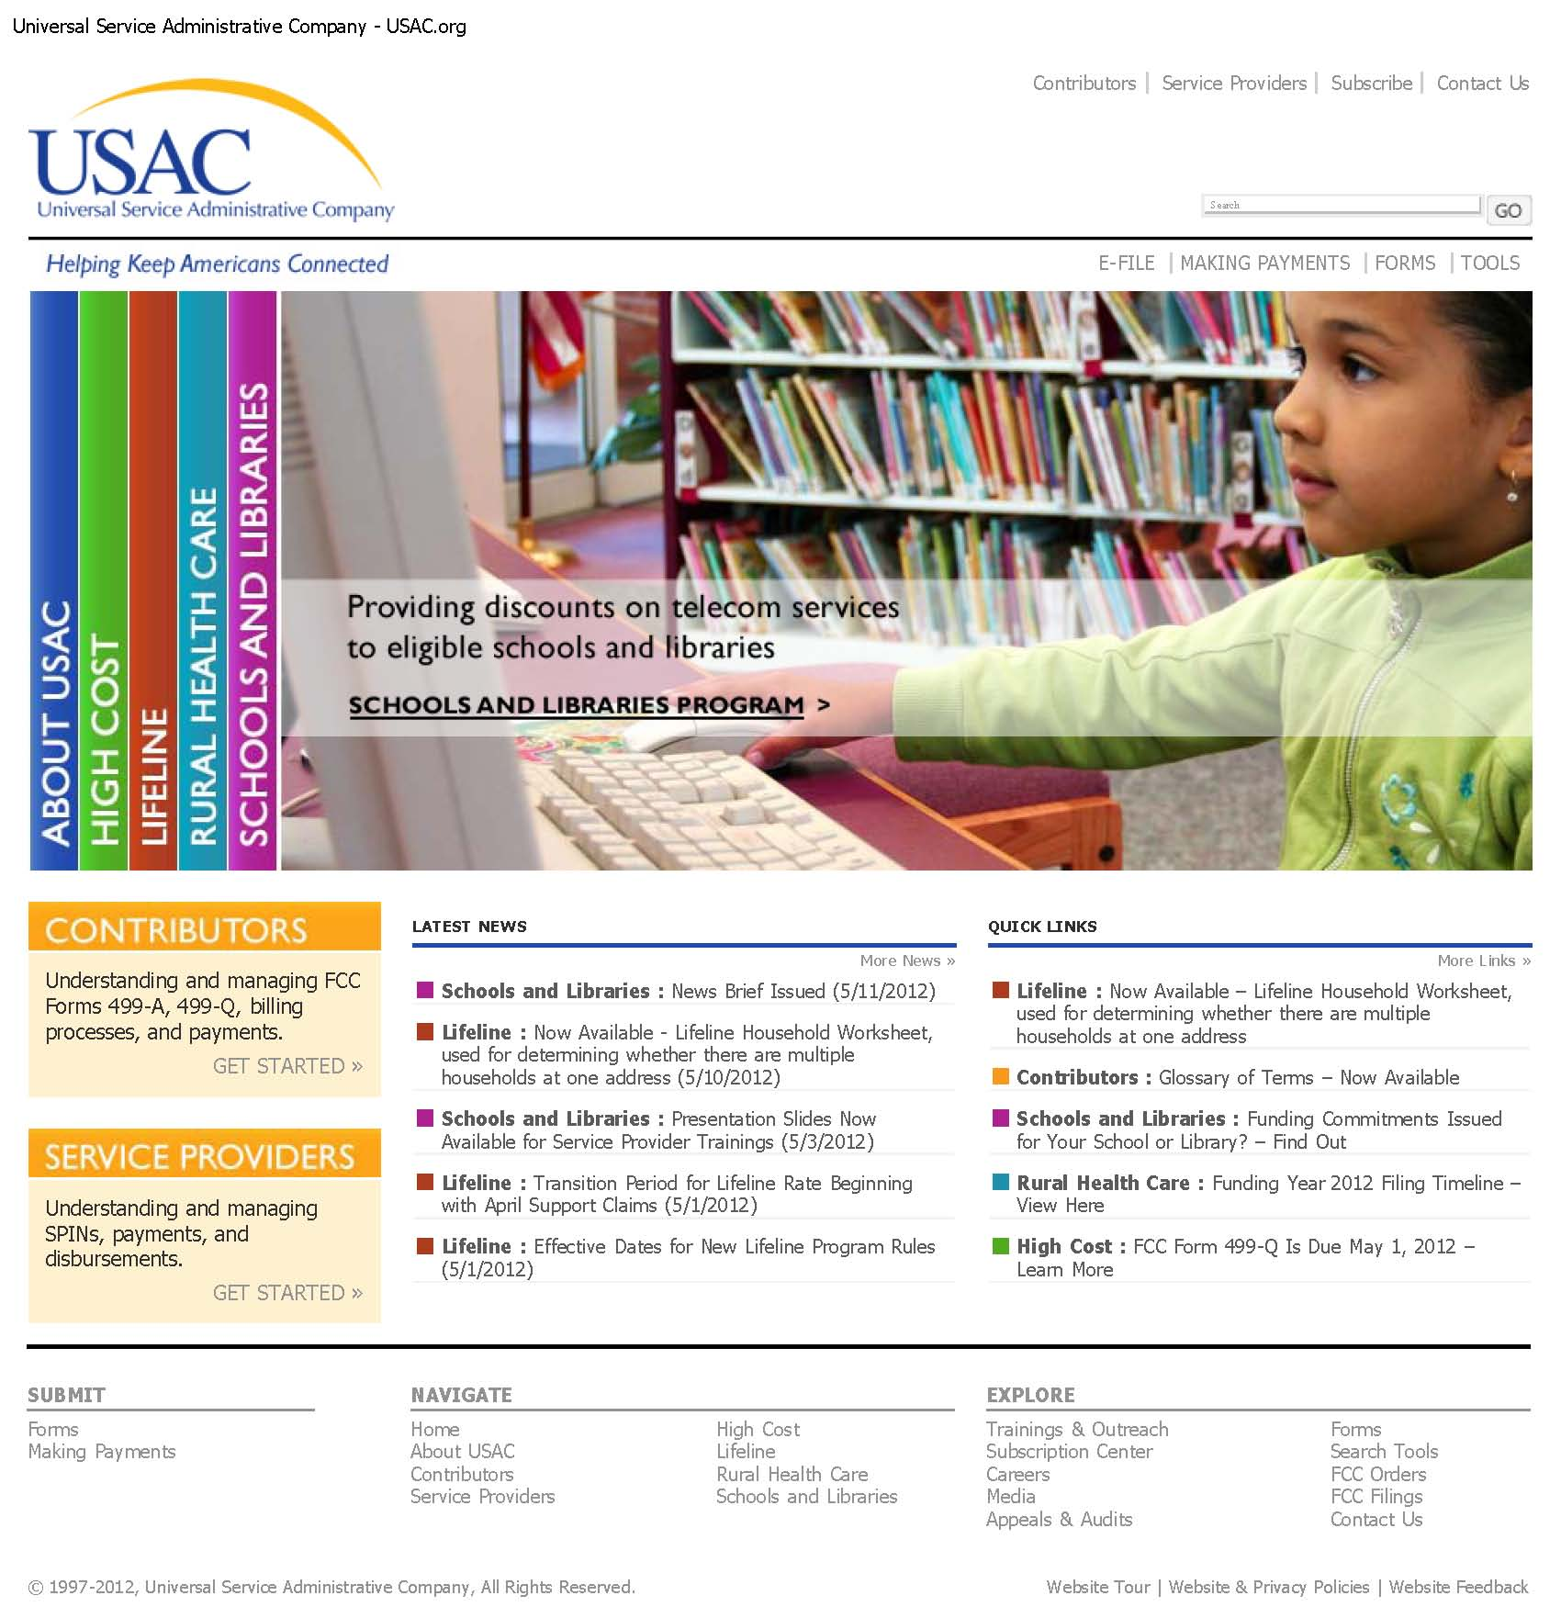

Slide 103
Dallas ISD E-Rate Compliance Vendor Training
    Dallas ISD Awarded E-Rate Vendor Responsibilities:
    E-Rate Vendors Must Certify to Dallas ISD that Vendor Personnel Involved in Dallas ISD Matters will make Best Efforts to Attend USAC-Sponsored Training Workshops
    http://www.usac.org/about/about/outreach/default.aspx

Slide 105
Dallas ISD E-Rate Compliance Vendor Training
    Dallas ISD Awarded E-Rate Vendor Responsibilities:
    E-Rate Vendors Must Certify to Dallas ISD that Vendor Personnel Involved in Dallas ISD Matters Subscribe and Timely Review School and Libraries News Brief.
      Tips, reminders, and general program information for both applicants and service providers.
      http://www.usac.org/about/tools/publications/subscription-center.aspx

Slide 107
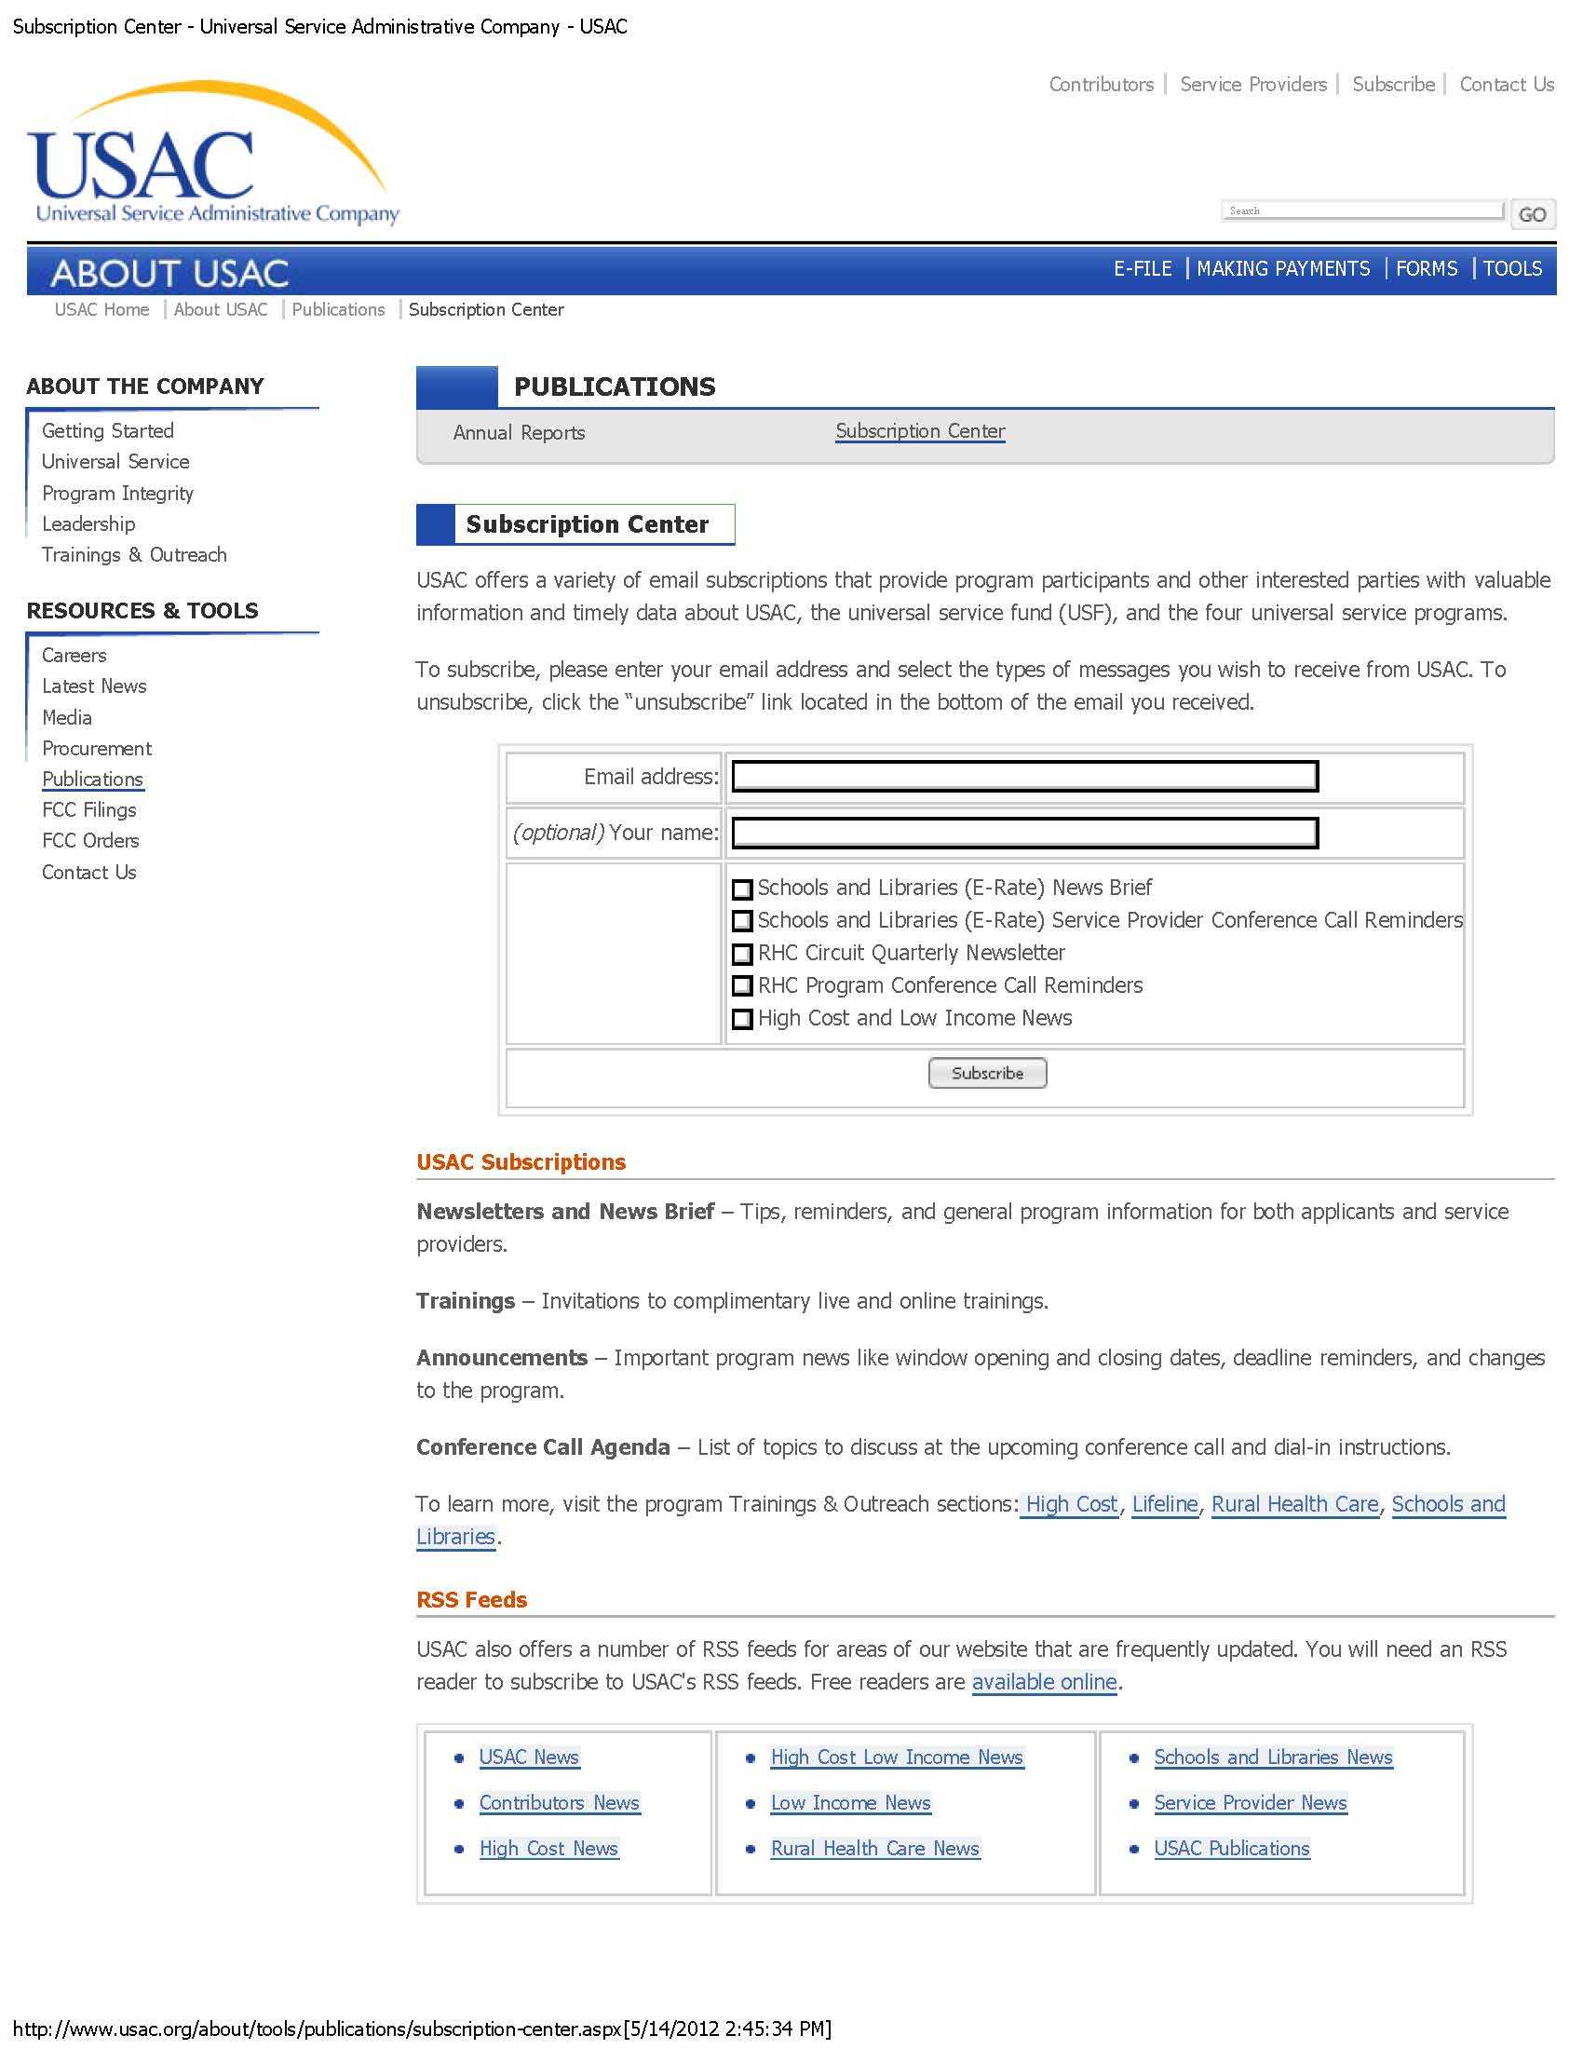
gkerbow@dallasisd.org
Gary Kerbow
√

Slide 108
Dallas ISD E-Rate Compliance Vendor Training
    Dallas ISD Awarded E-Rate Vendor Responsibilities:
    Provide Documentation of Attendance at Webinar and Subscription to School News Briefs Newsletter:
      USAC will provide a list of registrants at each webinar;
      Vendors to document attendance at webinar on provided form;
      Vendors to document evident of subscription to School News Briefs Newsletter.
        Form on the following slide is provided for this purpose.

Slide 109
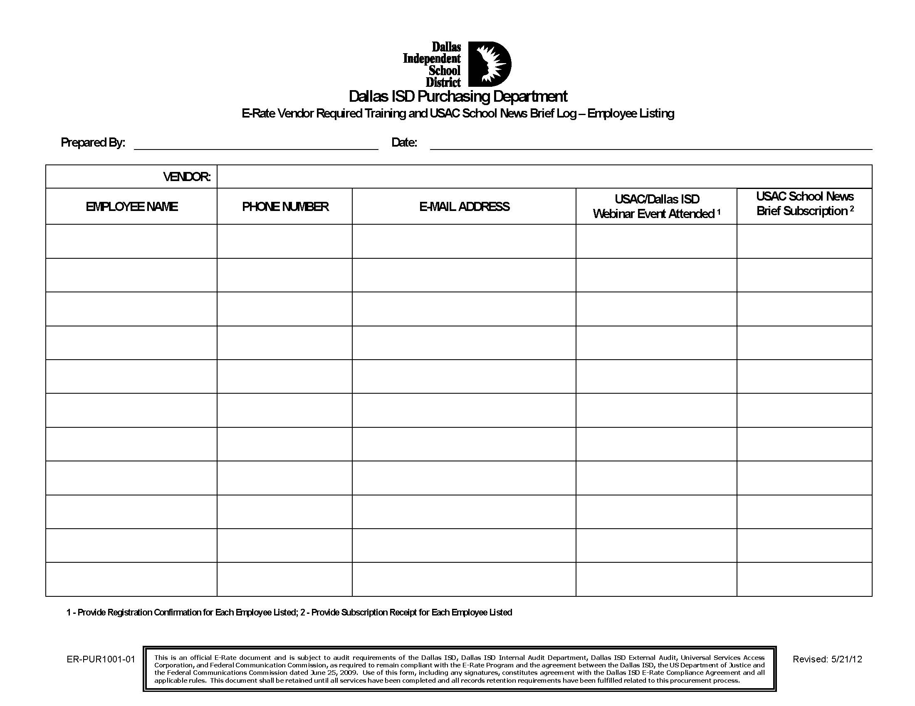

Slide 110
Dallas ISD E-Rate Compliance Vendor Training
    Dallas ISD E-Rate Vendor Responsibilities:
    In Addition to Program Review, Training Attendance and News Brief Subscription, Dallas ISD E-Rate Vendors Must:
      Agree to accept Dallas ISD E-Rate compliance language;
      Accept Dallas ISD E-Rate contract;
      Amend existing contracts to include E-Rate compliance language;
      Refrain from offering any thing of value to any Dallas ISD Employee;

Slide 111
Dallas ISD E-Rate Compliance Vendor Training
    Dallas ISD E-Rate Vendor Responsibilities (continued):
    In Addition to Program Review, Training Attendance and News Brief Subscription, Dallas ISD E-Rate Vendors Must:
      Label equipment purchased under E-Rate Program;
      Not prepare response in conjunction with any competing vendor;
      Refrain from Contacting any employee or Board member during the performance of a contract except as provided for in Dallas ISD Policy CH (LOCAL);
      Certify that there are no hidden terms, side agreements or payments, or undisclosed arrangements or conflicts of interests inconsistent with applicable laws, policies and program rules;

Slide 112
Dallas ISD E-Rate Compliance Vendor Training
    Dallas ISD E-Rate Vendor Responsibilities (continued):
    Dallas ISD E-Rate compliance language:
“Federal E-Rate Requirements and District Compliance Plan.
Every contractor or vendor furnishing goods and services selected to participate in the District’s E-Rate program will be required to sign a contract with the District that includes the following provisions. Any contractor or vendor selected with an existing contract with the District will be required to agree to an amendment containing the same provisions.
The Contractor expressly acknowledges:
That the E-Rate Program is a federal program and that compliance with the E-Rate Program Rules and Requirements, including the obligations to comply with state and local procurement laws, applicable federal laws (e.g. the Commission’s rules and orders requiring a “fair and open” competitive bidding process free from conflicts of interest and inappropriate gift giving) and the instructions, notices, and certifications in the E-Rate Program application forms is a condition of receiving Universal Service Funds payments and of participation in the E-Rate Program;
That USAC is obligated to recover funds disbursed in violation of E-Rate Program Rules and Requirements. See Federal-State Joint Board on Universal Service, Changes to the Board of Directors for the National Exchange Carrier Association, Inc., Schools and Libraries Universal Service Support Mechanism, Order on Reconsideration and Fourth Report and Order, CC Docket Nos. 96-45, 97-21, 02-6, 19 FCC Rcd 15252 (2004); Schools and Libraries Universal Service Support Mechanism, CC Docket No. 02-6, Fifth Report and Order, 19 FCC Rcd 15808 (21204);
That a vendor’s violation of E-Rate Program Rules and Requirements, including the requirements for a fair and open competitive bidding process, and the District’s E-Rate Compliance Policy, which incorporates the E-Rate Regulation, may be grounds for rescission of vendor contracts or even debarment depending on the severity of the violation and repetitive nature of the misconduct.
That a vendor who violates any of these provisions may have a pending bid or proposal rejected, be excluded, or debarred from receiving future contracts and/or have an existing contract canceled.

Slide 113
Dallas ISD E-Rate Compliance Vendor Training
    Dallas ISD E-Rate Vendor Responsibilities (continued):
    Dallas ISD E-Rate compliance language:
“That a vendor refrains from contacting individual members of the Board regarding any aspect of the vendor’s E-rate business, whether current or anticipated. Communications with the Board, if required, will be in writing addressed to all members of the board.
That the vendor complies with all state and local laws and District policies regarding conflict of interest and gifts of things of value, including the FCC’s rules and requirements regarding “fair and open competition.” The vendor completed all affidavits and questionnaires required by the District relating to conflict of interest and gifts in
a complete and truthful manner.
That the vendor will be required to submit each FCC Form 474 to Dallas ISD for review and approval before the Vendor submits the FCC Form 474 to USAC for payment.
The vendor certifies to the District that within 60 calendar days of the beginning of the contract term:
The vendor’s personnel handling Dallas ISD E-Rate Program matters have reviewed the rules and requirements governing the E-Rate Program;
The vendor’s personnel handling Dallas ISD E-Rate Program matters have reviewed training materials specified by USAC, including the information identified for service providers on the schools and libraries section of USAC’s website, http://www.usac.org/sl, and the information in the Schools and Libraries Reference Area of the website;
The vendor’s personnel handling Dallas ISD E-Rate Program matters will make best efforts to attend USAC-sponsored training workshops;
The vendor’s personnel handling Dallas ISD E-Rate Program matters will subscribe to and timely review the weekly Schools and Libraries Newsbrief at http://www.usac.org/sl/tools/news-briefs/Default.aspx.
The vendor certifies and warrants that it has complied in all respects with the requirement that the competitive bidding process for E-Rate goods and services was “fair and open” and consistent with the rules and requirements of the FCC.

Slide 114
Dallas ISD E-Rate Compliance Vendor Training
    Dallas ISD E-Rate Vendor Responsibilities (continued):
    Dallas ISD E-Rate compliance language:
“The vendor acknowledges that for a period of one year from June 25, 2009, all Applicable Dallas ISD Personnel shall be prohibited from accepting any gifts, meals, entertainment, or any other thing of value (except for items of little intrinsic value, such as greeting cards, key chains and pens) from any outside entity that provides or seeks to provide goods or services pursuant to the E-Rate Program. Thereafter Applicable Dallas ISD Personnel may only accept such gifts, items or other things of value to the extent consistent with applicable state, local and federal law, including E-Rate Program Rules and Requirements (e.g. the rules requiring “fair and open” competitive bidding process), the Dallas ISD ERCP and other school district policies. Violation of these rules by a vendor may result in termination of contracts and other sanctions.
The vendor certifies that the district has not directly or indirectly solicited or accepted any gift, gratuity, favor, entertainment, loan, or any other thing of value from the vendor participating in or seeking to participate in the schools and libraries universal service program.
The vendor certifies that, as a provider of eligible services, it shall not charge District a price above the lowest corresponding price or support services, unless the Federal Communications Commission, with respect to interstate services or the state commission with respect to intrastate services, finds that the lowest corresponding price is not compensatory. Promotional rates offered by a service provider for a period of more than 90 days must be included among the comparable rates upon which the lowest corresponding price is determined.
Vendor and District shall retain all documents related to the application for, receipt, and delivery of discounted telecommunications and other supported services for at least 5 years after the last day of service delivered in a particular Funding Year. Any other document that demonstrates compliance with the statutory or regulatory requirements for the schools and libraries mechanism shall be retained as well.
Vendor agrees that any physical product delivered (i.e. network electronics, servers, switches, etc.) be delivered with a separate label (in addition to the District Fixed Asset tag) that will be the responsibility of the vendor to affix.
Vendor agrees that the label affixed to all physical E-Rate products shall clearly identify each component as having been procured with E-Rate funds, and have appropriate notifications to users. Likewise, this label will carry an identifying E-Rate serial number.

Slide 115
Dallas ISD E-Rate Compliance Vendor Training
    Dallas ISD E-Rate Vendor Responsibilities (continued):
    Dallas ISD E-Rate compliance language:
“Vendor agrees that upon completion of labeling all physical E-Rate products, vendor will be responsible for documenting all hard goods installed under the project, including location, E-Rate serial number, model number, etc.
Vendor certifies that the prices in any bid or response shall have been arrived at independently, without, for the purpose of restricting competition, any consultation, communication, or agreement with any other bidder, responder or competitor relating to those prices, the intention to submit a bid or response, or the methods or factors used to calculate the prices offered.
Vendor certifies that the prices in any bid or response were not knowingly disclosed by the bidder or responder, directly or indirectly, to any other bidder, responder or competitor before bid opening (in the case of a sealed bid solicitation) or contract award (in the case of a negotiated solicitation) unless otherwise required by law.
Any questions from prospective vendors shall be directed to the Director of Purchasing for response, if any is required.
Vendor certifies that there are no hidden terms, side agreements or payments, other undisclosed arrangements, or conflicts of interest that are inconsistent with general and state law, District policies, and the policies and requirements of the E-Rate Program.
Vendor certifies that it was not involved in the preparation or certification of the entity's Form 470.
Vendor certifies that it did not play any role in the development or writing of any portion of the specifications for the procurement. Any individual or entity who assists the District in any manner, directly or indirectly, in the development of any portion of a design specification shall not be permitted to participate in bid or any proposal or participate in any contract that relates in any way to the specifications with which the individual or entity assisted.
A current E-rate vendor may assist in the development, preparation or drafting of a design specification but that vendor may not participate in any response submitted to the District or any contract that relates in any way to the specifications with which the individual or entity assisted.

Slide 116
Dallas ISD E-Rate Compliance Vendor Training
    Dallas ISD E-Rate Vendor Responsibilities (continued):
    Dallas ISD E-Rate compliance language:
“Vendor certifies that it has read and agrees to comply with the E-Rate Program Manual (Attached as Exhibit H).
Vendor agrees to make the certifications regarding training and gift policies as contained in the E-Rate Compliance Agreement, and E-Rate Program Manual.
No attempt has been made by the vendor to induce any other individual or entity to submit or not to submit an offer for the purpose of restricting competition.
Vendor certifies that there has been no contact between any District employee and any employee, agent, or representative of the vendor before, during and after the pendency of
an E-Rate procurement concerning the procurement.
Vendor is required to update a Conflict of Interest Questionnaire, (Form “CIQ”) attached as Exhibit A to the E-Rate Program Manual, with the District not later than September 1 of each year in which a covered transaction is pending and by the seventh business day after the date of an event that would make a statement in the questionnaire incomplete or inaccurate.
Vendor certifies that a “Family Conflict of Interest Questionnaire”, attached as Exhibit B to the E-Rate Program Manual, must be completed for the sale or purchase of property, goods, or services. The due date is the seventh business day after the date that the individual or entity begins contracts discussions or negotiations with the District or submits to the District an application, response to a request for proposals or bids, correspondence, or other writing related to a potential agreement with the District.
Vendor certifies that if it becomes aware of new facts or change of facts that would make a completed "Conflict of Interest Questionnaire" inaccurate, the vendor shall file an amended questionnaire(s) within seven (7) days of the date the individual or entity first learned of the new facts or changes in facts.
Vendor certifies that it is required to file a Conflict of Interest Questionnaire with the District if a relationship exists between the vendor’s company and an officer of the District. The questionnaire is due no later than the seventh business day after the date that the person begins contract discussions or negotiations or submits to the entity an application, response to a request for proposal or bid, correspondence, or other writing related to a potential agreement.
Vendor certifies and agrees that vendor and prospective vendors, including their agents and representatives, are prohibited from giving any gift, meal, entertainment or any other item of value to any District employee participating in any way in E-Rate procurement. This prohibition extends to the members of the employee's immediate family, including spouse (or partner), children, parents, and siblings of the employee.

Slide 117
Dallas ISD E-Rate Compliance Vendor Training
    Dallas ISD E-Rate Vendor Responsibilities (continued):
    Dallas ISD E-Rate contract:
      Developed in January 2012;
      Contains all required elements of the Compliance Agreement;
      Contains, as an Exhibit, Dallas ISD E-Rate Program Manual;
      Contains Dallas ISD Standard Terms and Conditions;
      Is included in ALL Dallas ISD E-Rate procurement documents.

Slide 118
Dallas ISD E-Rate Compliance Vendor Training
    Dallas ISD E-Rate Vendor Responsibilities (continued):
    Amend existing contracts to include E-Rate compliance language:
      Amend to include Compliance Language as ordered by the FCC;
      Required to make a “Good Faith Effort” for amending existing contracts;
      Reviewed by special outside E-Rate counsel.

Slide 119
Dallas ISD E-Rate Compliance Vendor Training
    Dallas ISD E-Rate Vendor Responsibilities (continued):
    Refrain from offering “any thing of value” to any Dallas ISD Employee:
      Dallas ISD adopted “No-Gift Policy” to ease this requirement;
      Offers of anything of value must be reported to FCC and USAC;
      Dallas ISD E-Rate Eligible Employees must sign No-Gift Compliance Agreement;
      Vendors to execute “No-Gift Pledge” beginning next year.

Slide 120
Dallas ISD E-Rate Compliance Vendor Training
    Dallas ISD E-Rate Vendor Responsibilities (continued):
    Label equipment purchased under E-Rate Program:
      “1.307 The procurement documents will include a requirement that any physical product delivered (i.e. network electronics, servers, switches, etc.) be delivered with a separate label (in addition to the District Fixed Asset tag) that will be the responsibility of the vendor to affix. This label will clearly identify each component as having been procured with E-Rate funds, and have appropriate notifications to users. Likewise, this label will carry an identifying E-Rate serial number. Upon completion of the project, the vendor will be responsible for documenting all hard goods installed under the project, including location, E-Rate serial number, model number, etc.”

Slide 121
Dallas ISD E-Rate Compliance Vendor Training
    Dallas ISD E-Rate Vendor Responsibilities (continued):
    Label equipment purchased under E-Rate Program:
      “1.307 The procurement documents will include a requirement that any physical product delivered (i.e. network electronics, servers, switches, etc.) be delivered with a separate label (in addition to the District Fixed Asset tag) that will be the responsibility of the vendor to affix. This label will clearly identify each component as having been procured with E-Rate funds, and have appropriate notifications to users. Likewise, this label will carry an identifying E-Rate serial number. Upon completion of the project, the vendor will be responsible for documenting all hard goods installed under the project, including location, E-Rate serial number, model number, etc.”

Slide 122
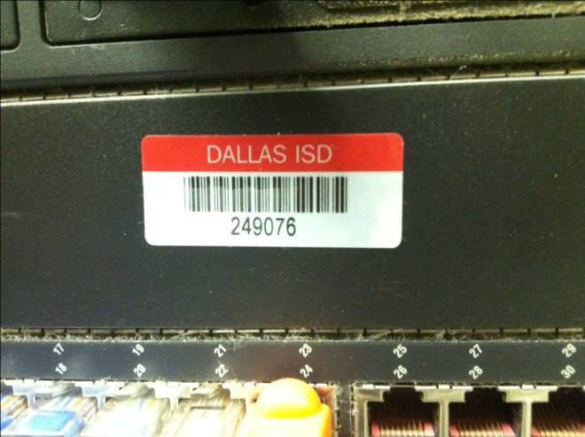
Dallas ISD E-Rate Compliance Vendor Training
    Dallas ISD E-Rate Vendor Responsibilities (continued):
    Label equipment purchased under E-Rate Program:
        Dallas ISD Asset Tag

Slide 123
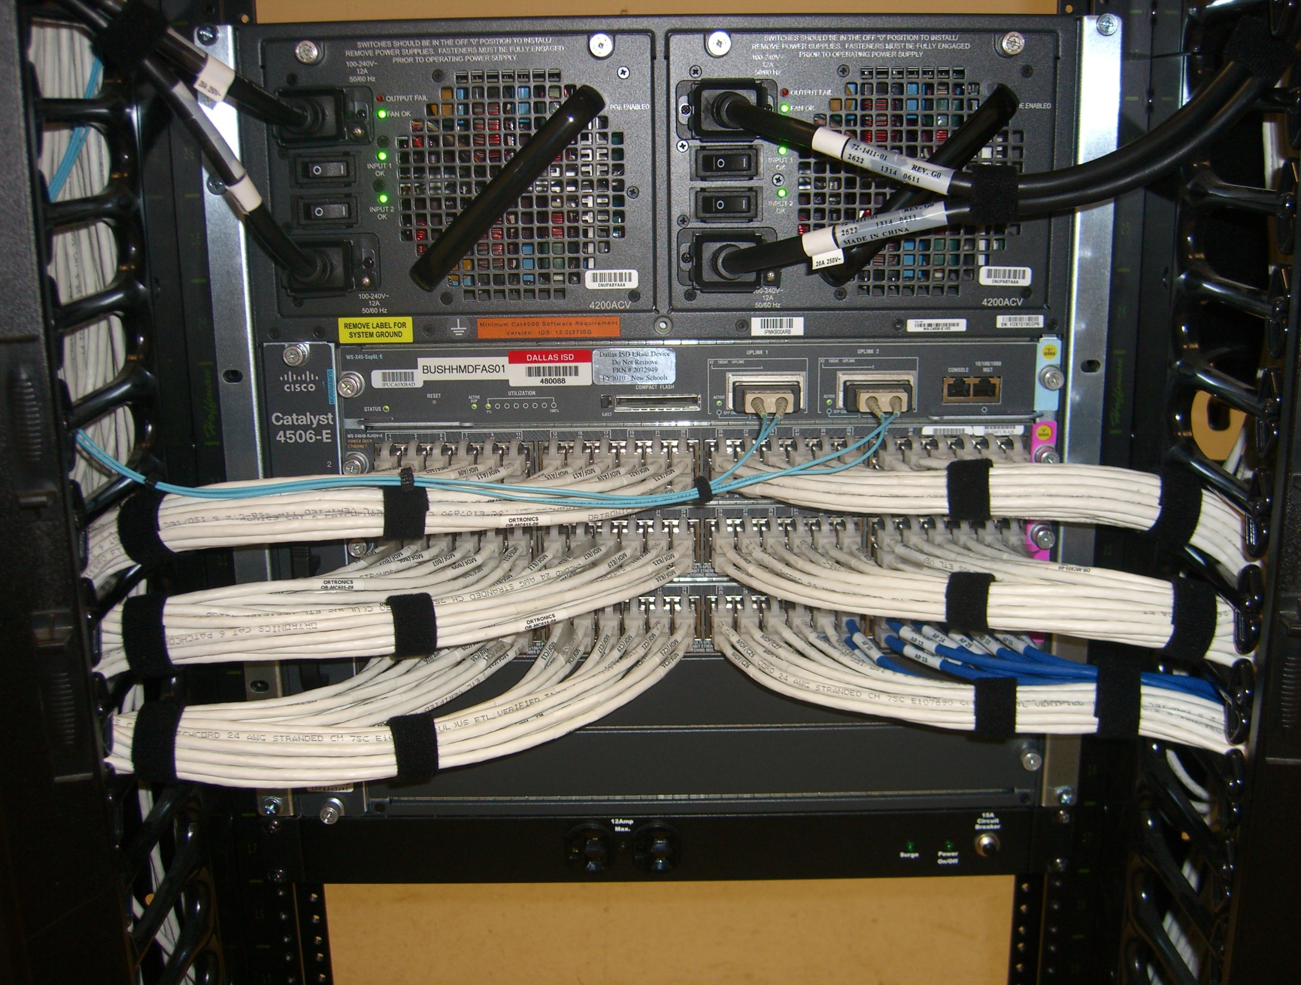

Slide 124

Dallas ISD E-Rate Compliance Vendor Training
    Dallas ISD E-Rate Vendor Responsibilities (continued):
    Label equipment purchased under E-Rate Program:
        Dallas ISD E-Rate Asset Tag

Slide 125

Dallas ISD E-Rate Compliance Vendor Training
    Dallas ISD E-Rate Vendor Responsibilities (continued):
    Label equipment purchased under E-Rate Program:
        Dallas ISD E-Rate Asset Tag

Slide 126
Dallas ISD E-Rate Compliance Vendor Training
    Dallas ISD E-Rate Vendor Responsibilities (continued):
    Not prepare response in conjunction with any competing vendor:
      This is standard procurement protocol to prohibit collusion, but this provision was included in the Compliance Agreement as a direct result of the behavior of vendors which led to Dallas ISD’s suspension from participating in the E-Rate program.

Slide 127
Dallas ISD E-Rate Compliance Vendor Training
    Dallas ISD E-Rate Vendor Responsibilities (continued):
    Refrain from Contacting any employee or Board member during the performance of a contract except as provided for in Dallas ISD Policy CH (LOCAL):
      1.502 Prospective vendors (including their employees, agents, or representatives or anyone acting on their behalf) shall refrain from communicating directly or indirectly with individual members of the Board of Trustees before, during and after the pendency of an E-Rate procurement concerning the procurement.

Slide 128
Dallas ISD E-Rate Compliance Vendor Training
    Dallas ISD E-Rate Vendor Responsibilities (continued):
    Additional Communications Requirements from Vendors:
      1.501 Before, during and after the pendency of any E-Rate procurement, any questions from prospective vendors (including their employees, agents, or representatives or anyone acting on their behalf) shall be directed to the Director of Purchasing for response, if any is required. Except as provided above, there shall be no contact between any District employee and any employee, agent or representative of a prospective vendor before, during and after the pendency of an E-Rate procurement concerning the procurement.

Slide 129
Dallas ISD E-Rate Compliance Vendor Training
    Dallas ISD E-Rate Vendor Responsibilities (continued):
    Additional Communications Requirements from Vendors:
      1.501 Before, during and after the pendency of any E-Rate procurement, any questions from prospective vendors (including their employees, agents, or representatives or anyone acting on their behalf) shall be directed to the Director of Purchasing for response, if any is required. Except as provided above, there shall be no contact between any District employee and any employee, agent or representative of a prospective vendor before, during and after the pendency of an E-Rate procurement concerning the procurement.

Slide 130
Dallas ISD E-Rate Compliance Vendor Training
    Dallas ISD E-Rate Vendor Responsibilities (continued):
    Certify that there are no hidden terms, side agreements or payments, or undisclosed arrangements or conflicts of interests inconsistent with applicable laws, policies and program rules:
      Documented by inclusion of required Conflict of Interest Response Form;
      Documented by inclusion of Disclosure of Family Interest Form;
      1.604 Failure to fill out and timely return any required conflict of interest questionnaire or form may be grounds for disqualification of a vendor from further consideration in the pending procurement.

Slide 131
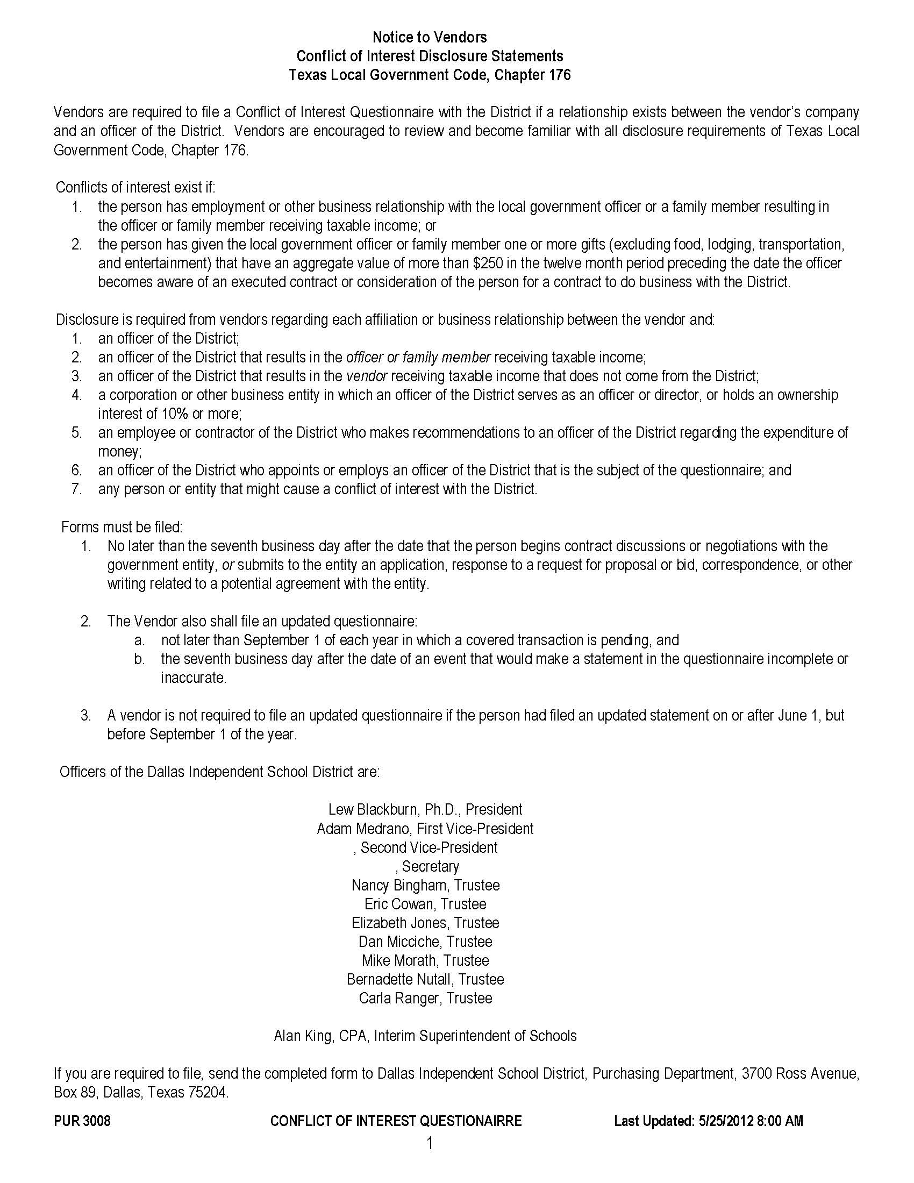

Slide 132
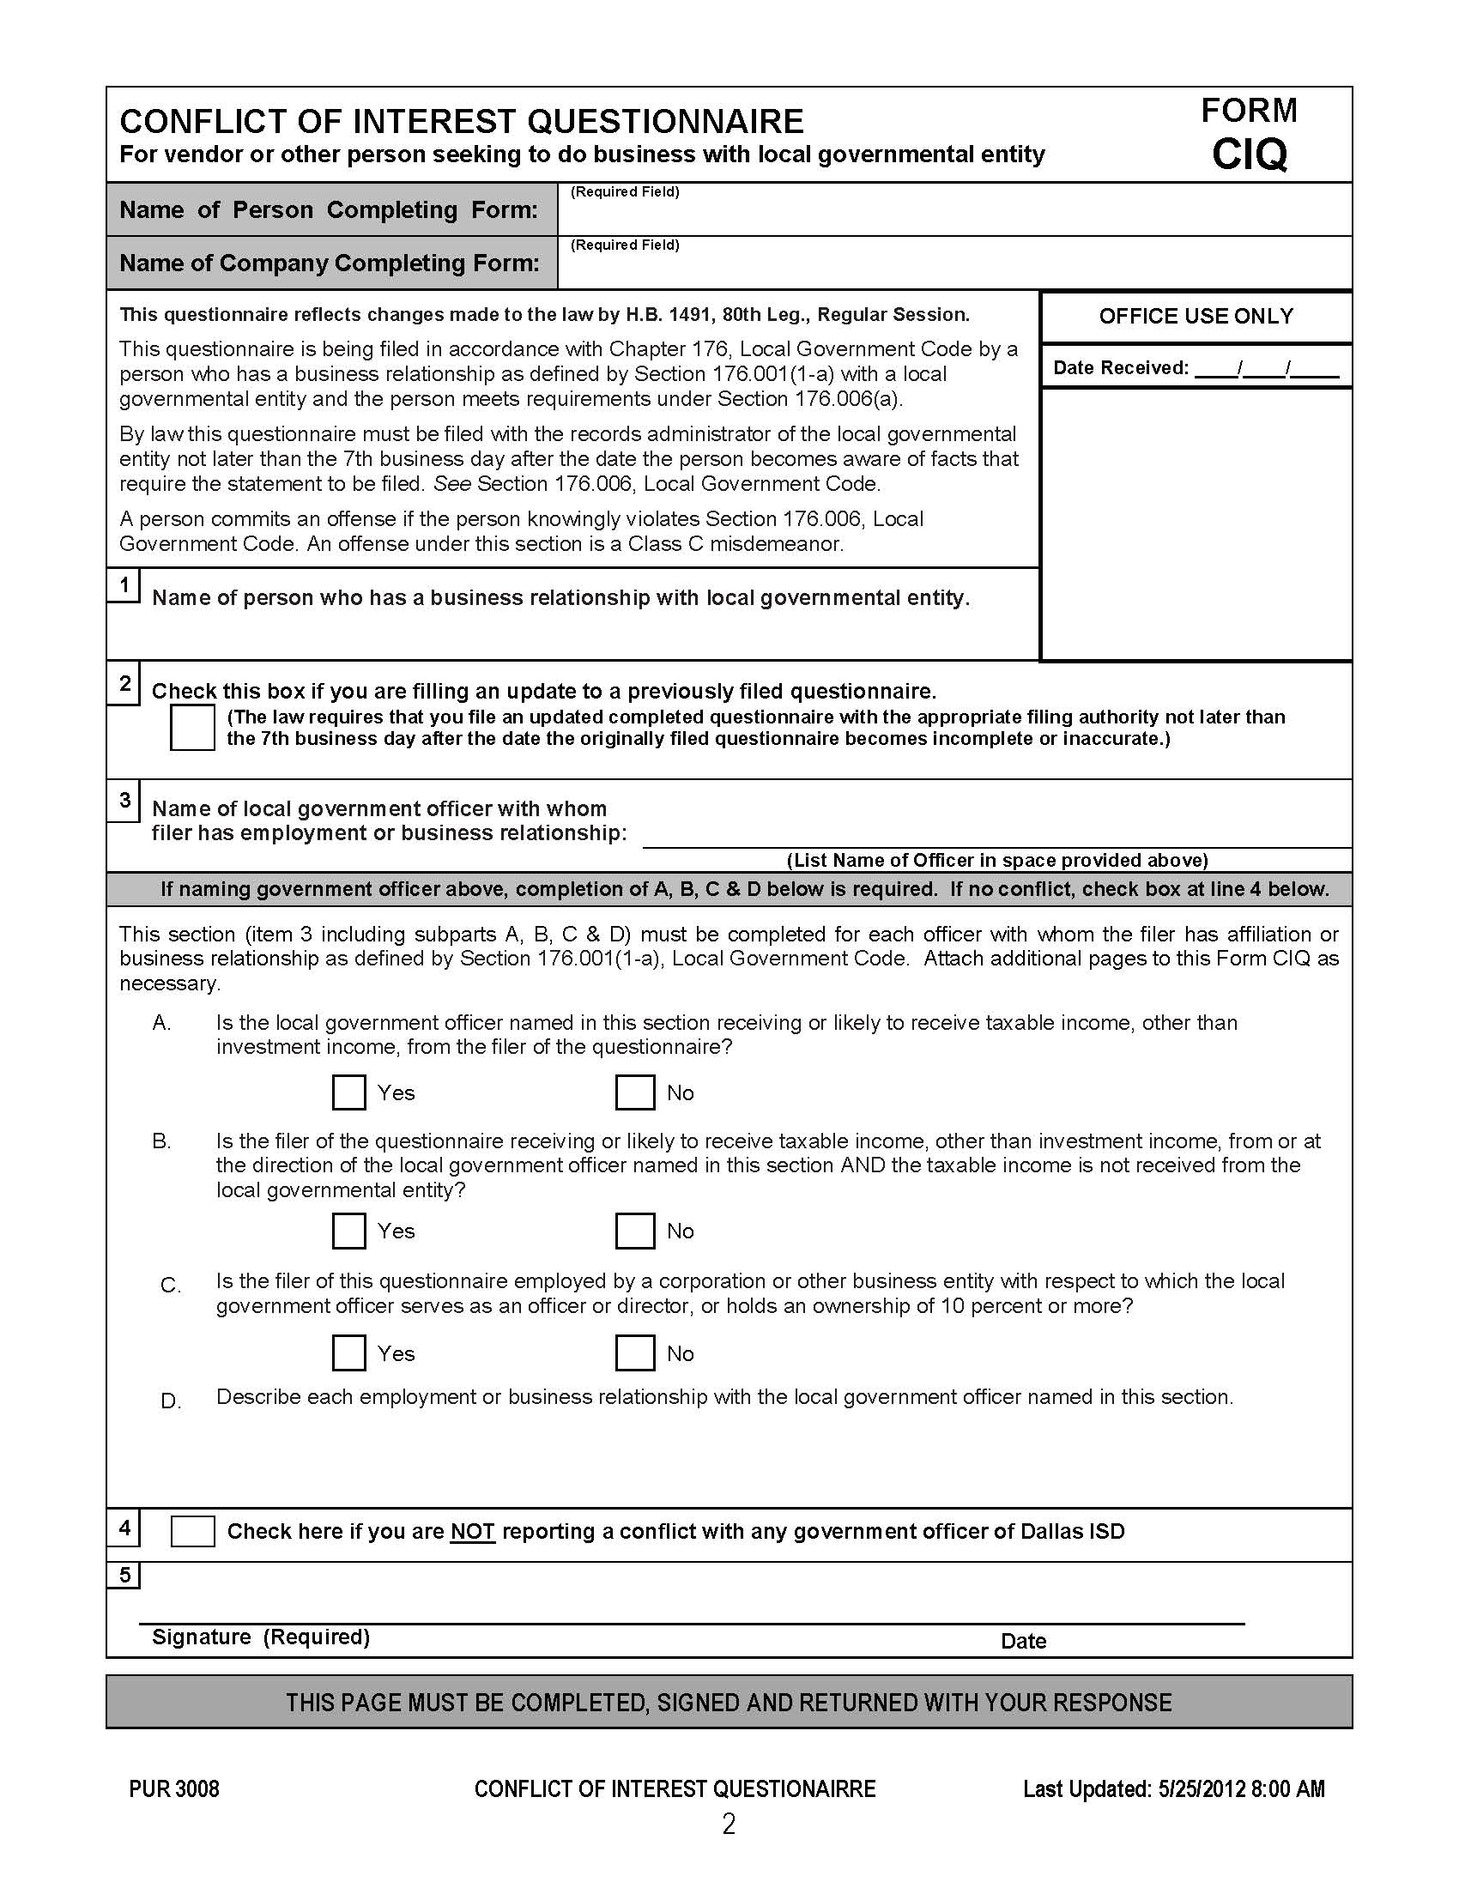

Slide 133
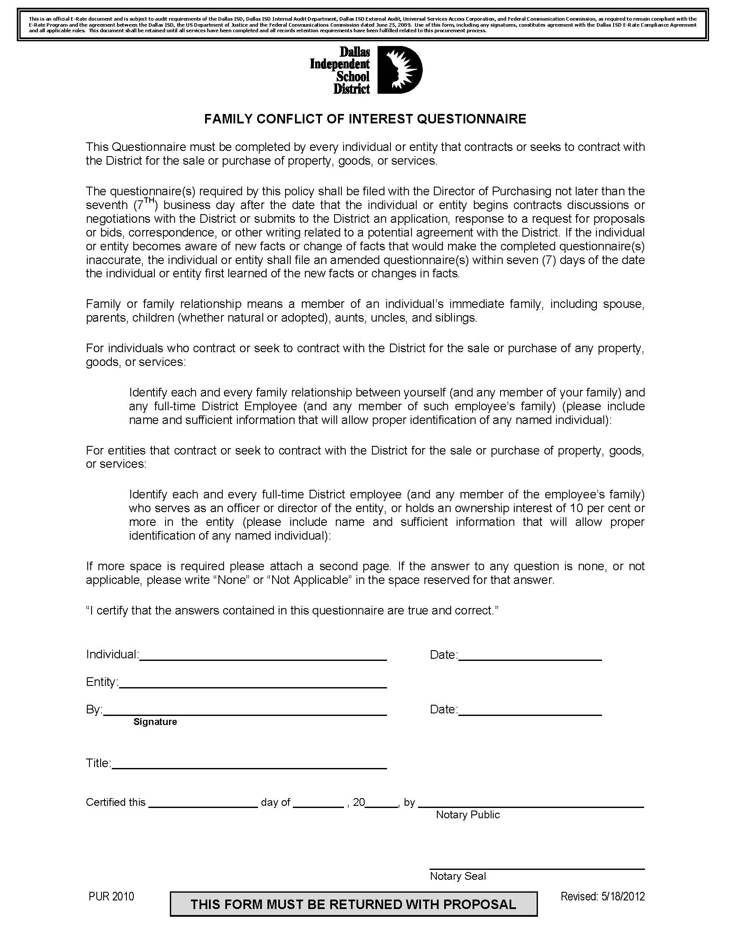

Slide 134
Dallas ISD E-Rate Compliance Vendor Training
    Additional Practices and Procedures:
    E-Rate Markings;
    No Gift Pledge Forms;
    Campaign Contribution Reporting Form;
    E-Rate Library of Resources.

Slide 135
Dallas ISD E-Rate Compliance Vendor Training
    Additional Practices and Procedures:
    E-Rate Markings;
      All E-Rate Related forms, documents or communiqués will be marked with the following language:
“This is an official E-Rate document and is subject to audit requirements of the Dallas ISD, Dallas ISD Internal Audit Department, Dallas ISD External Audit, Universal Services Access Corporation, and Federal Communication Commission, as required to remain compliant with the E-Rate Program and the agreement between the Dallas ISD, the US Department of Justice and the Federal Communications Commission dated June 25, 2009. Use of this form, including any signatures, constitutes agreement with the Dallas ISD E-Rate Compliance Agreement and all applicable rules. This document shall be retained until all services have been completed and all records retention requirements have been fulfilled related to this procurement process.”

Slide 136
Dallas ISD E-Rate Compliance Vendor Training
    Additional Practices and Procedures:
    No Gift Pledge Forms:
      Not a requirement of the compliance agreement, but takes an extra step to emphasize the ‘No Gift’ policy observed by the District.
        Vendor No Gift Pledge Form;
        Evaluation Committee Member No Gift Pledge Form.

Slide 137
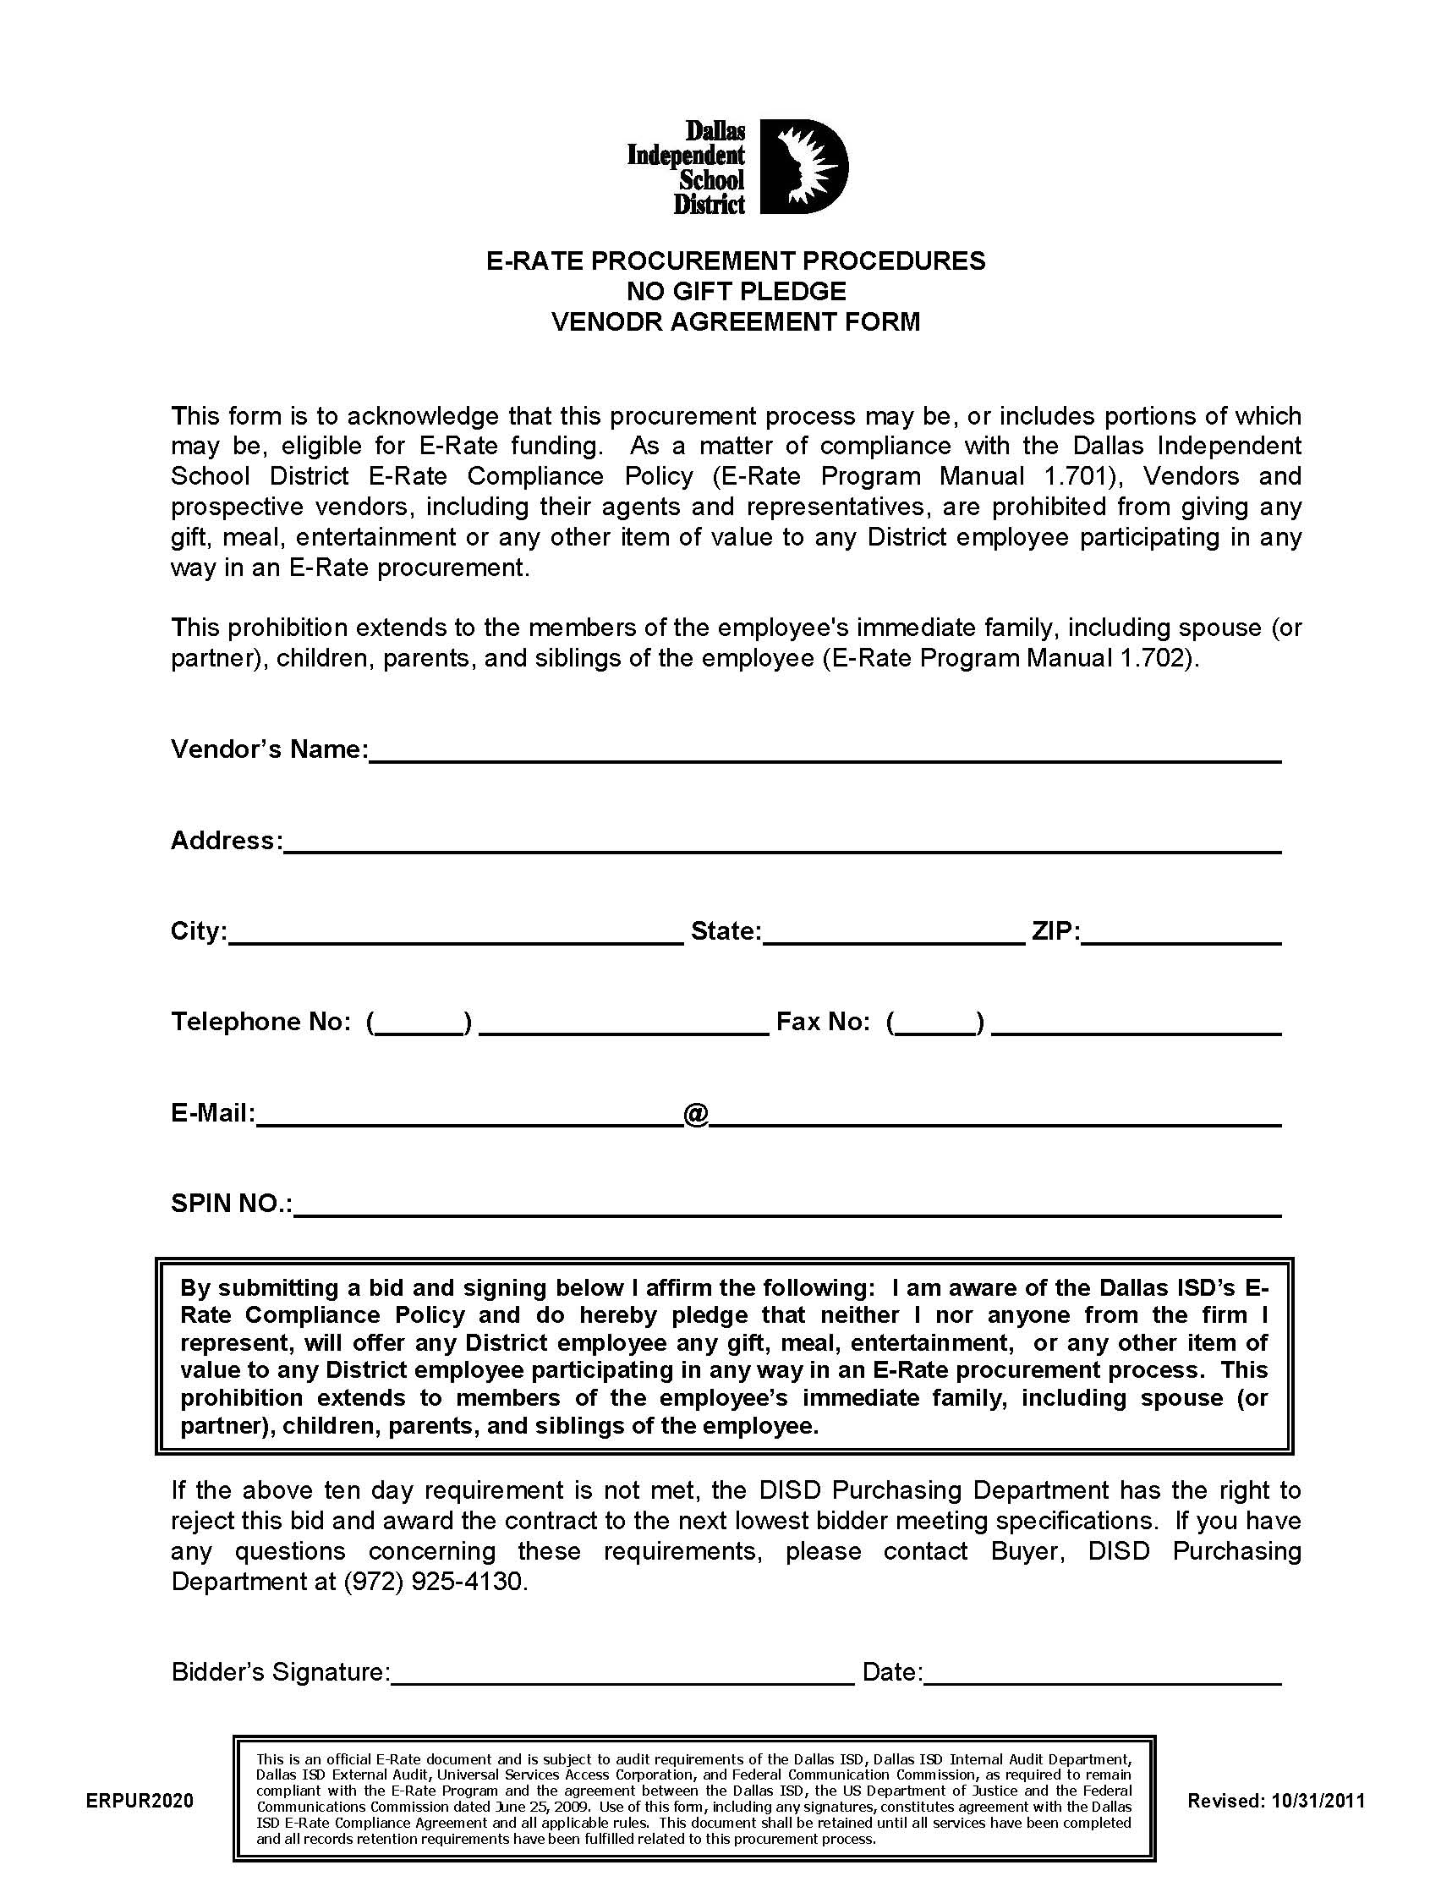

Slide 138
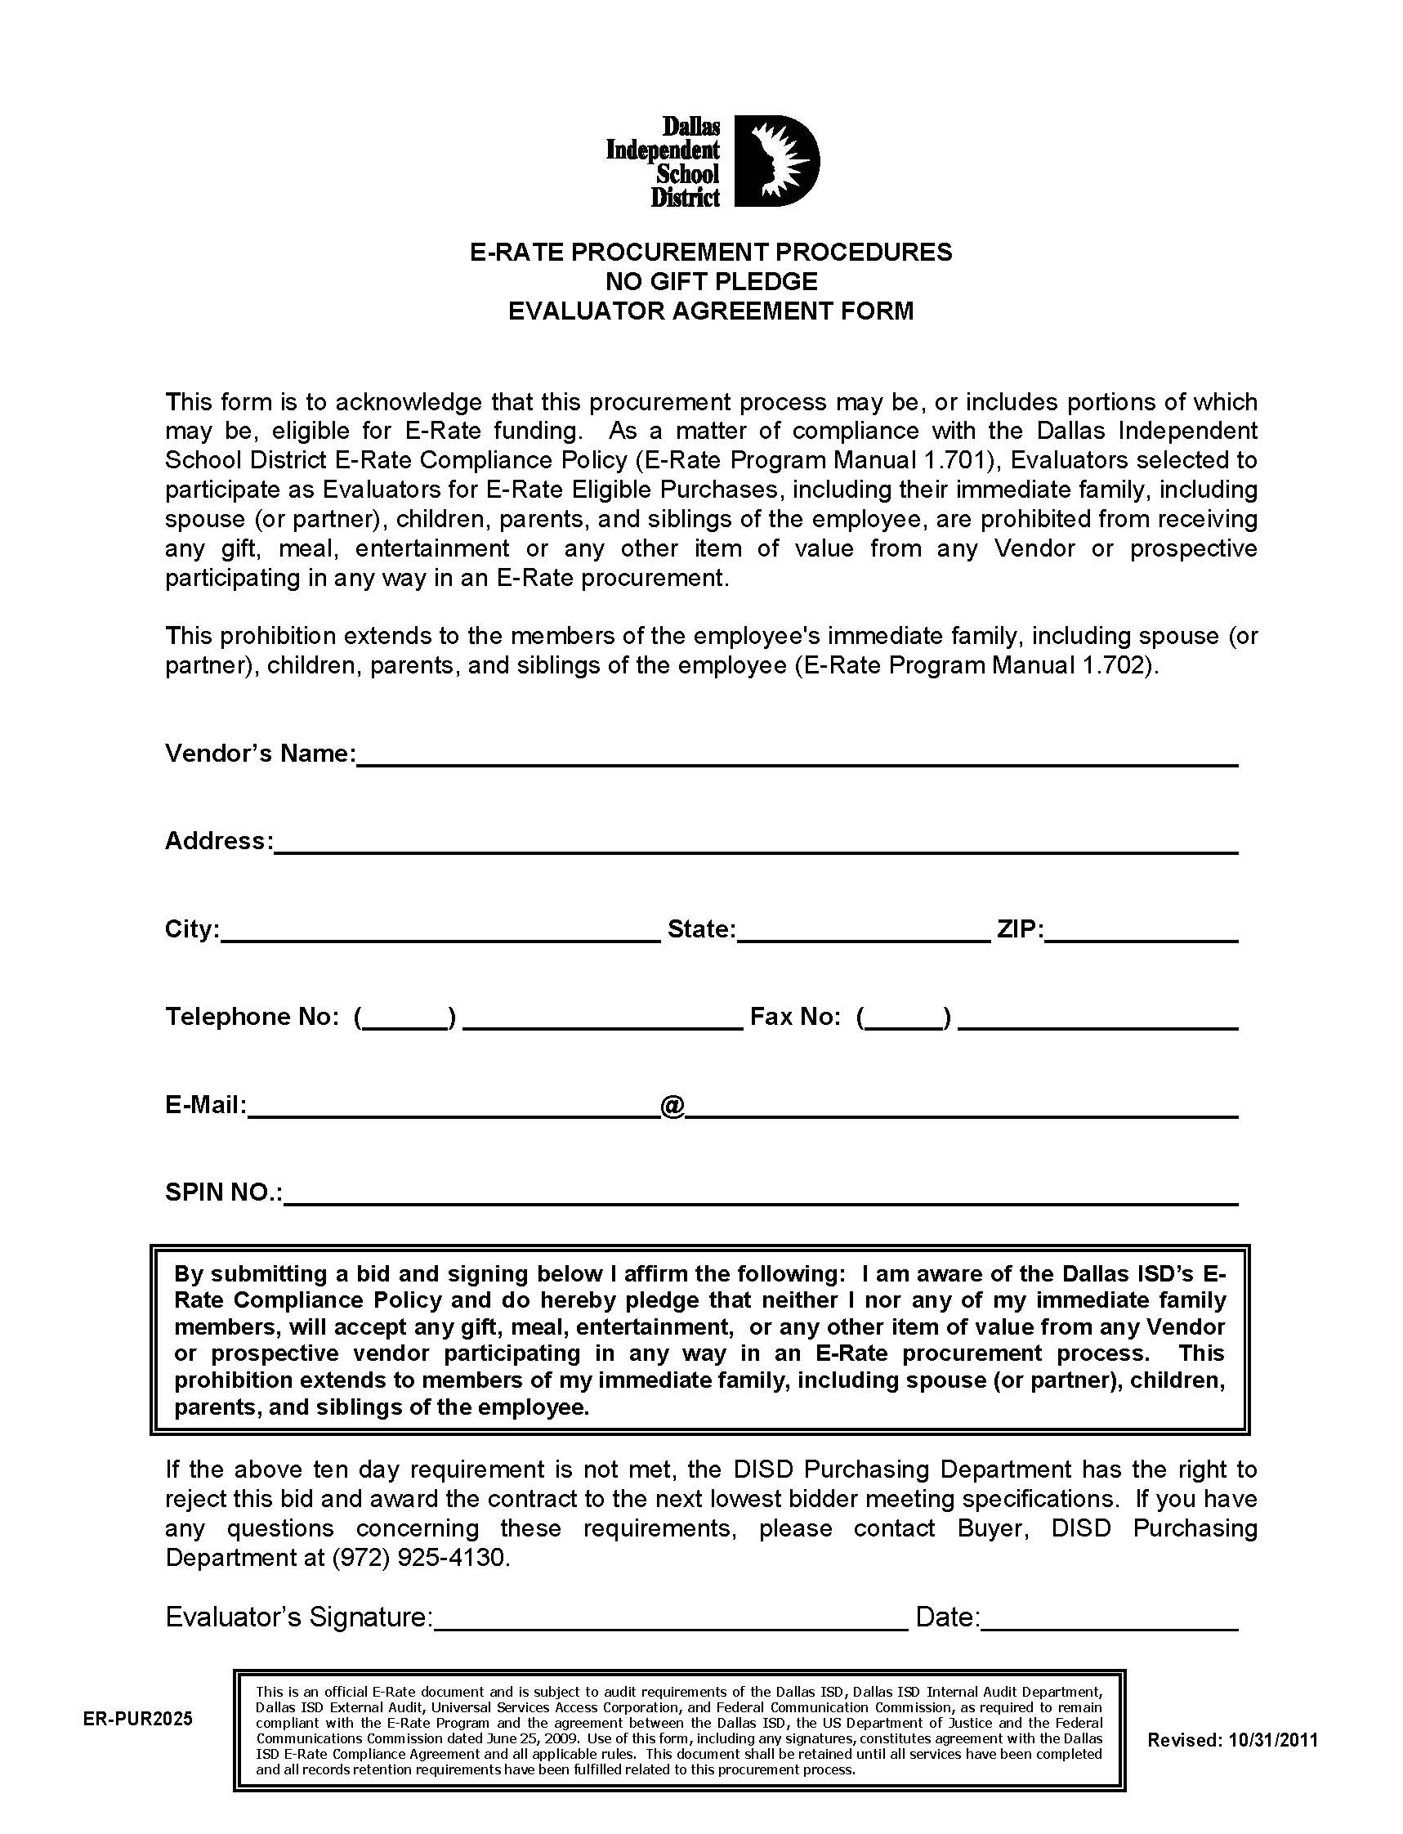

Slide 139
Dallas ISD E-Rate Compliance Vendor Training
    Additional Practices and Procedures:
    Campaign Contribution Reporting Form:
      Not a requirement of the compliance agreement, but takes an extra step to emphasize the no tolerance policy observed by the District for E-Rate related purchases.

Slide 140
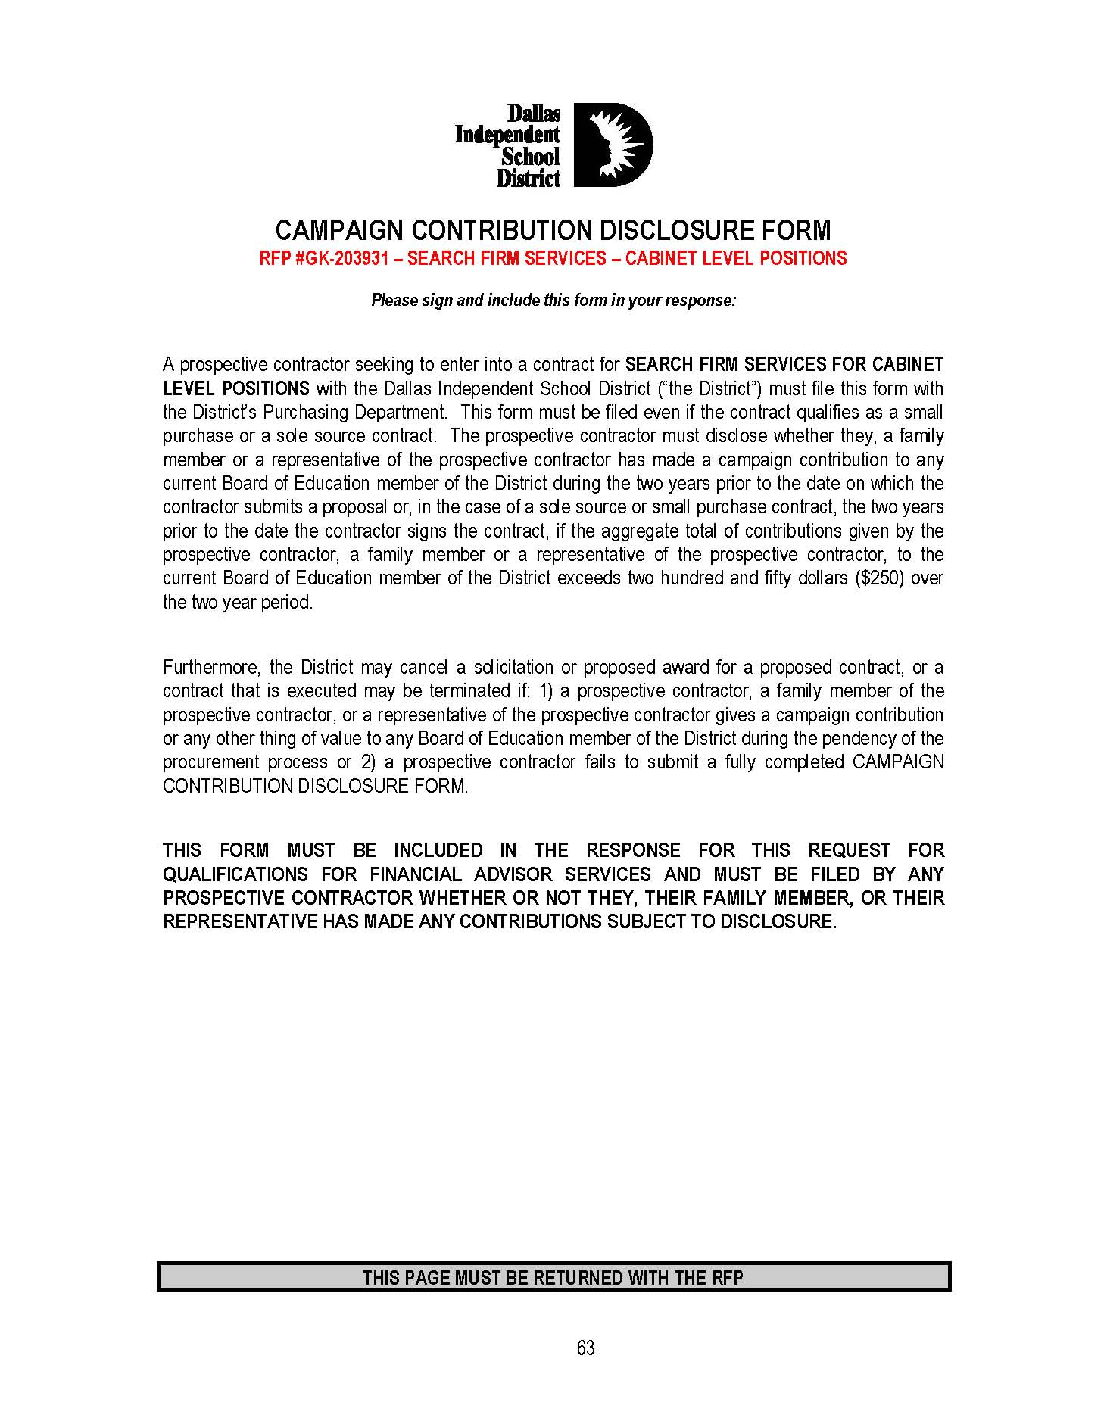

Slide 141
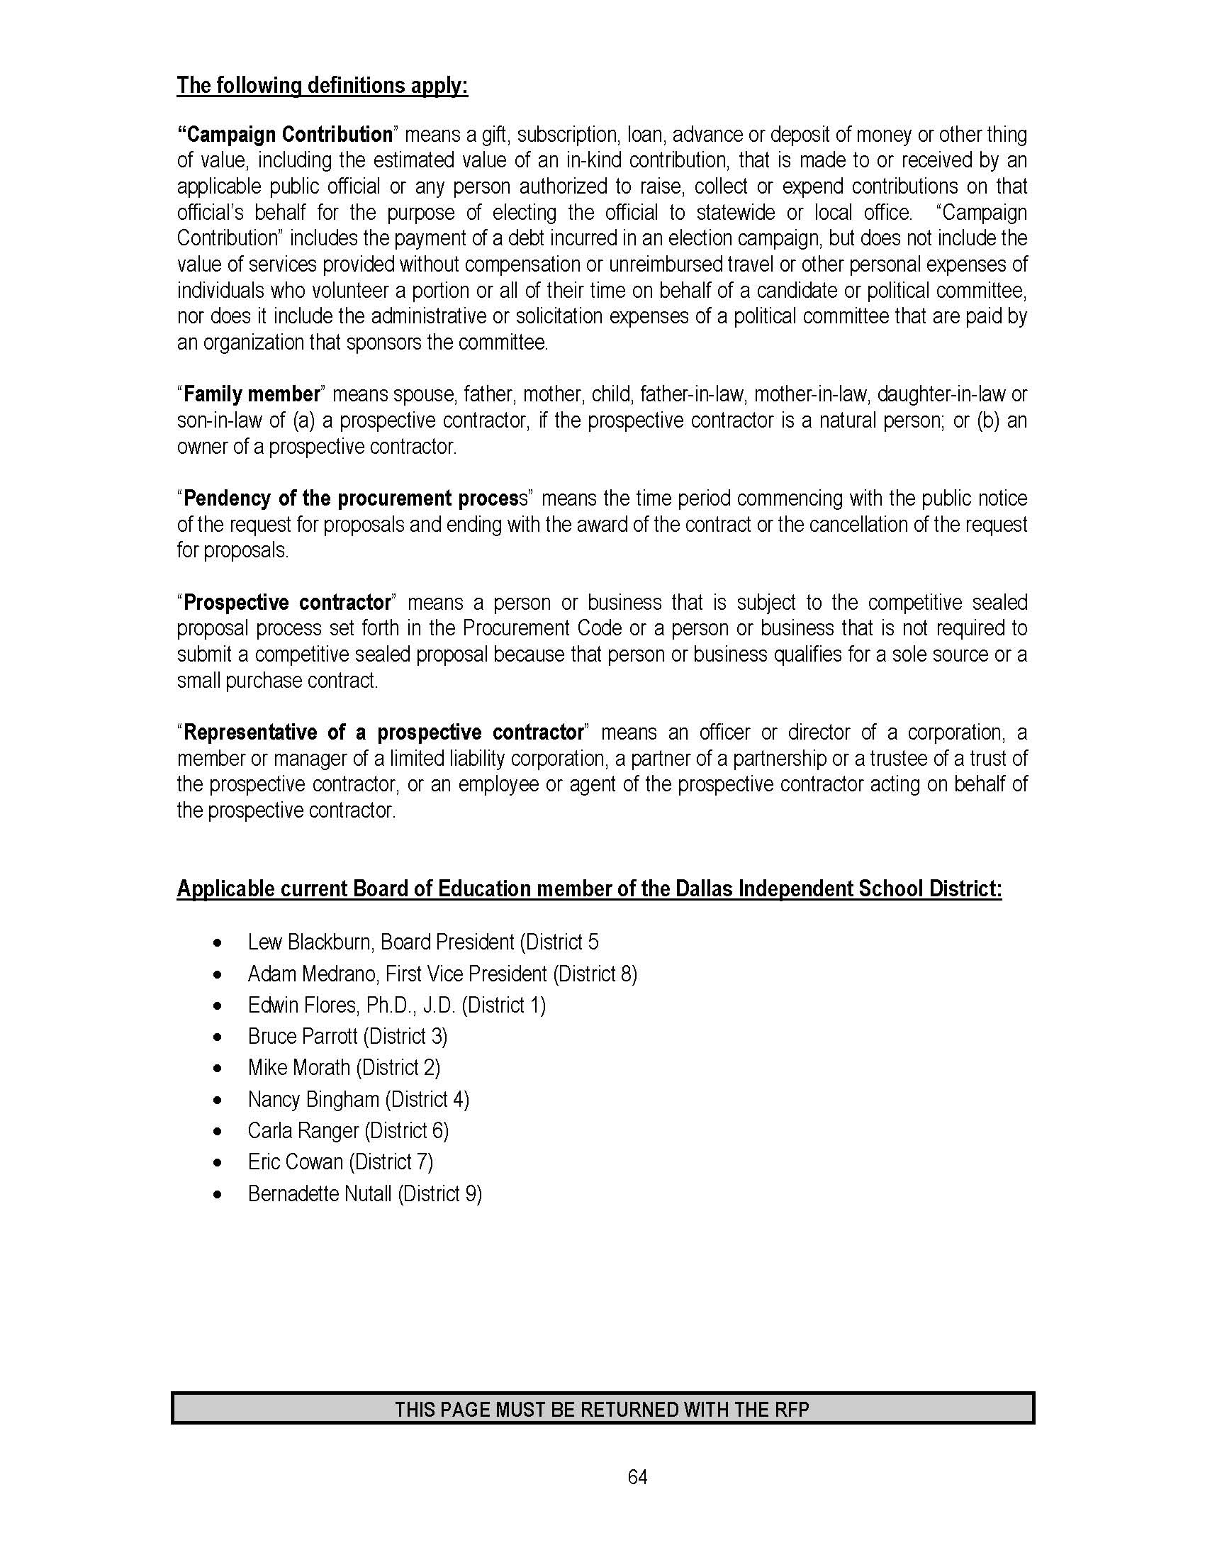

Slide 142
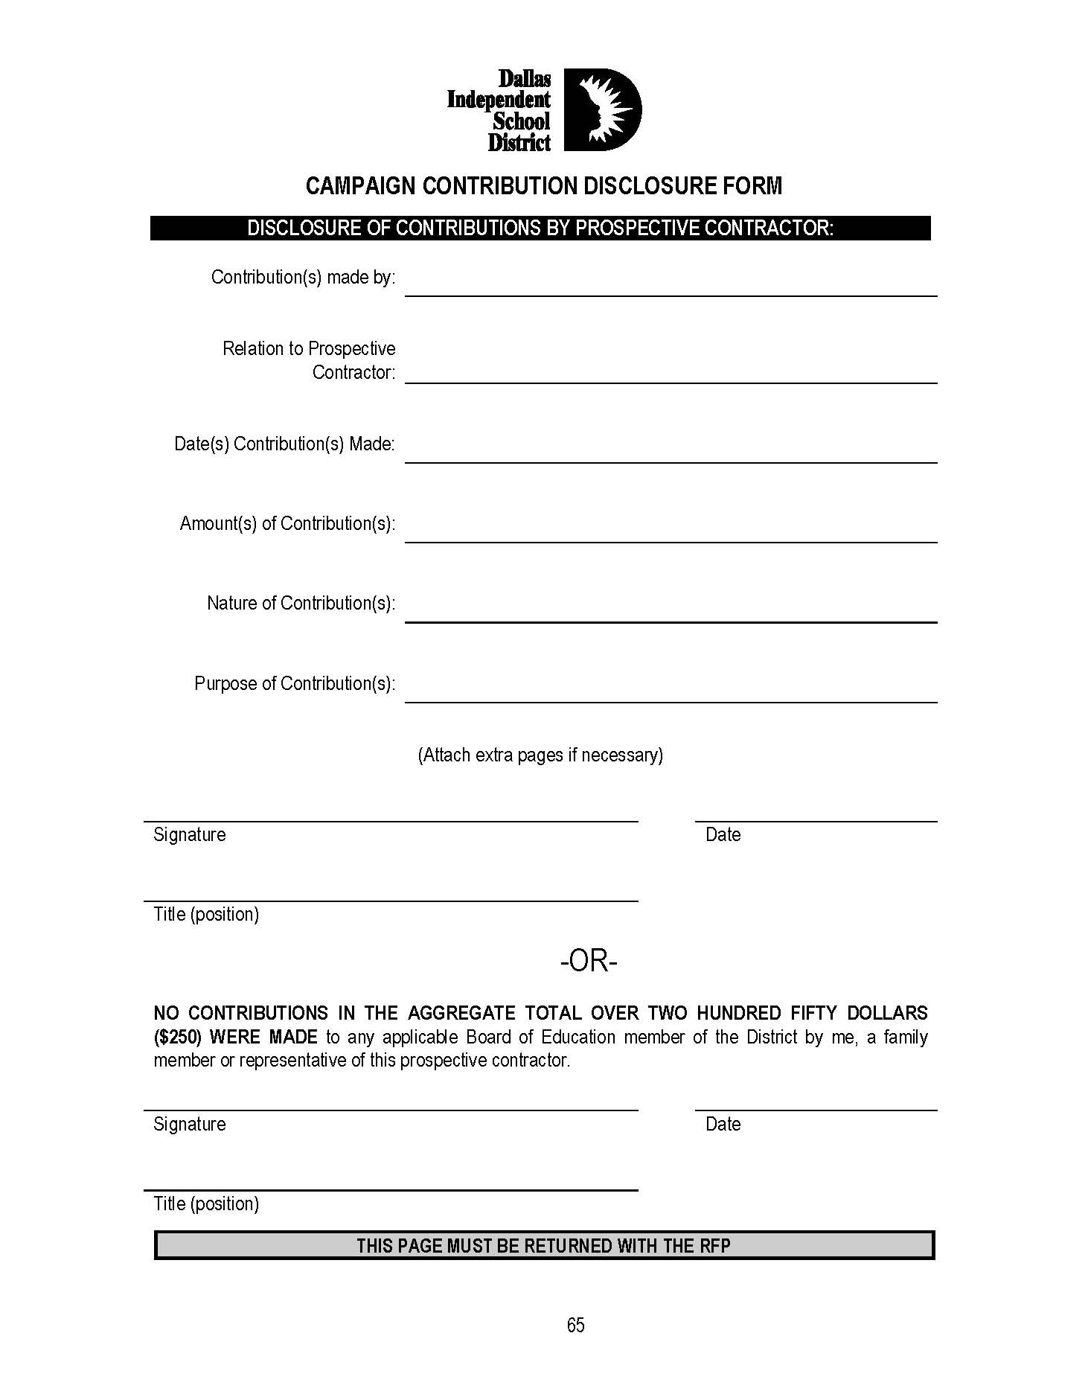

Slide 143
Dallas ISD E-Rate Compliance Vendor Training
    Additional Practices and Procedures:
    E-Rate Library of Resources:
      Available Online – www.dallasisd.org
      Scroll to bottom to select link entitled
          E-Rate Whistleblower Hotline
      Select to available access E-Rate Resources

Slide 144
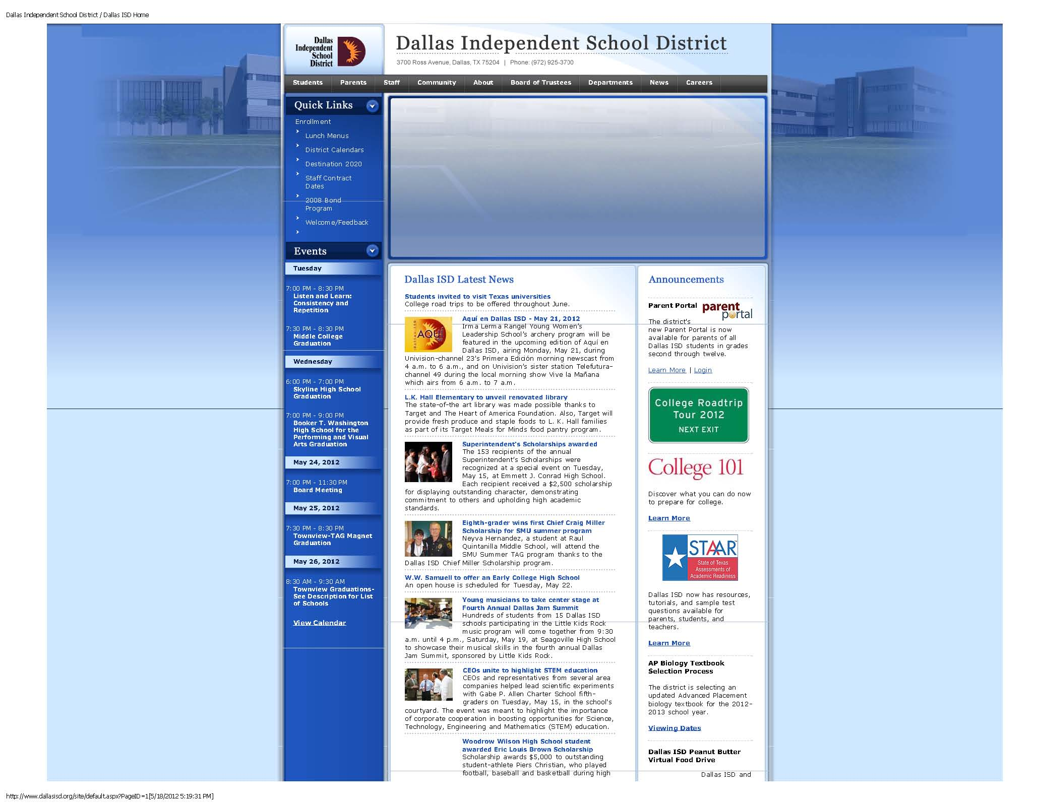

Slide 145
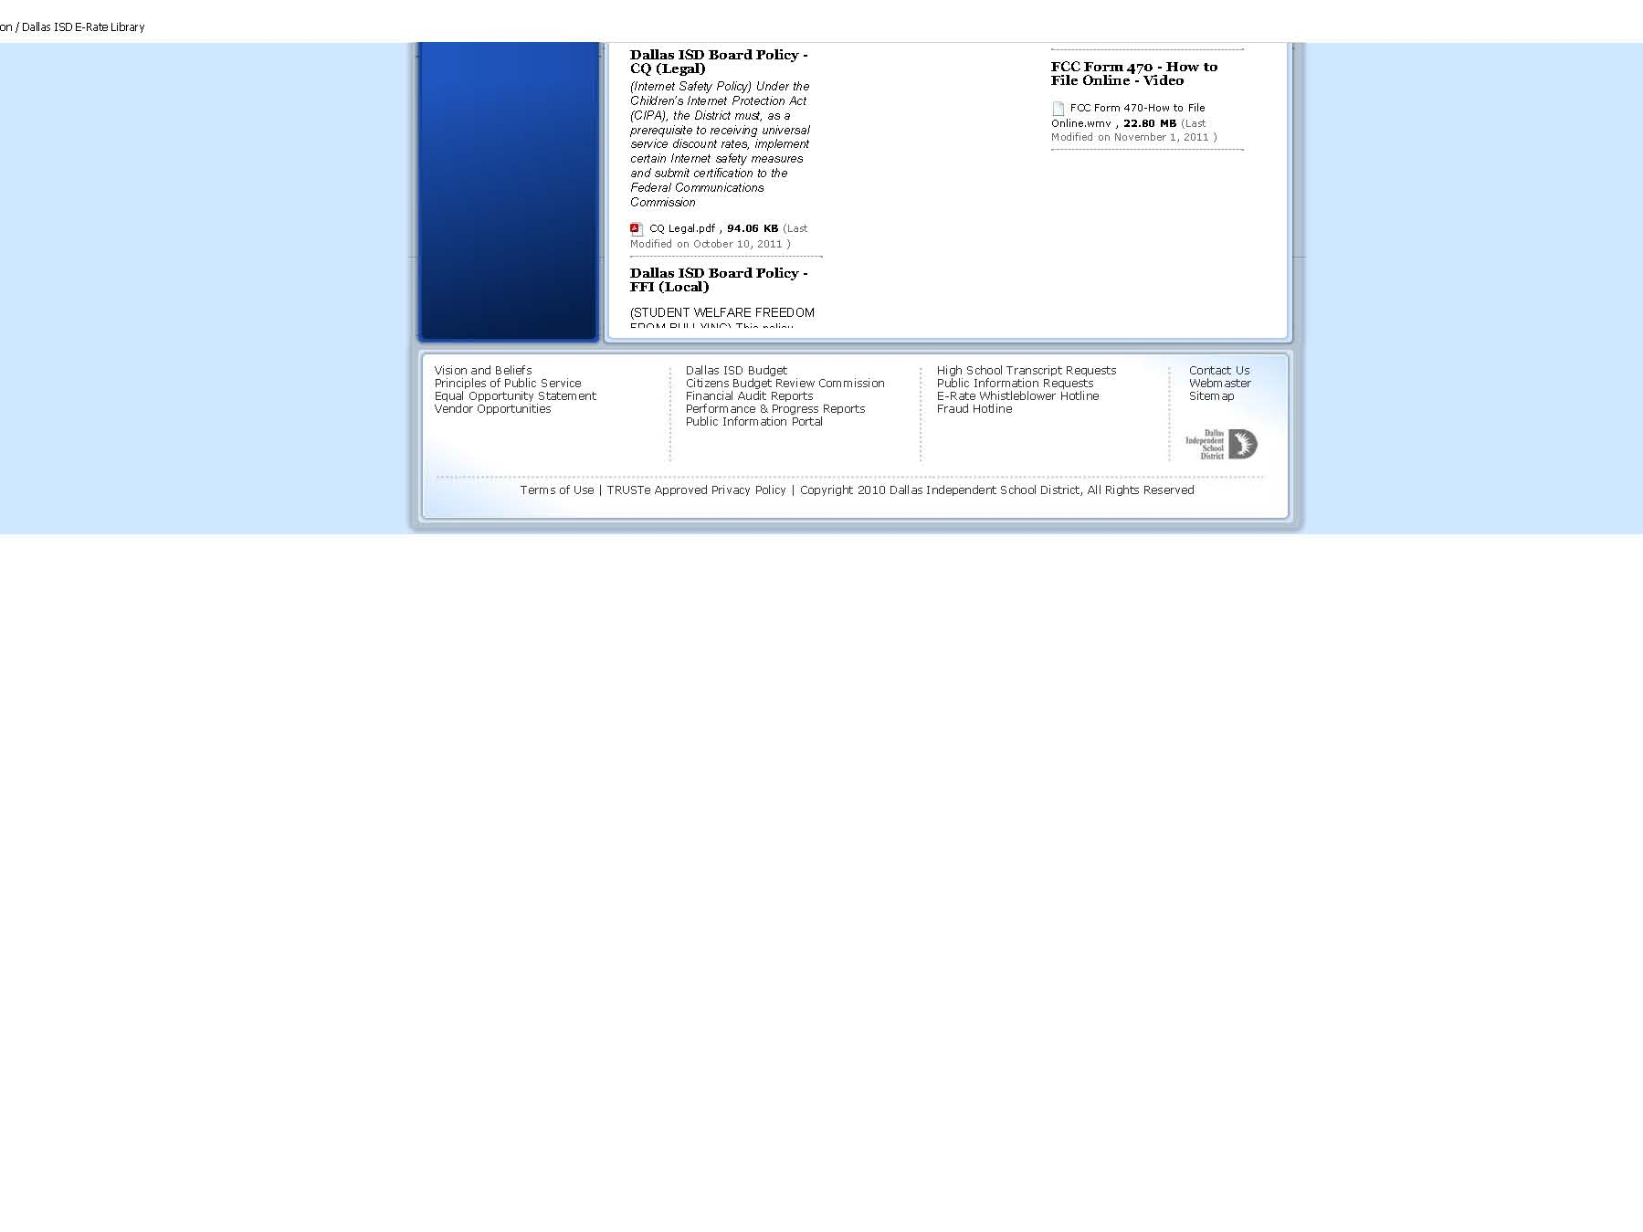

Slide 146
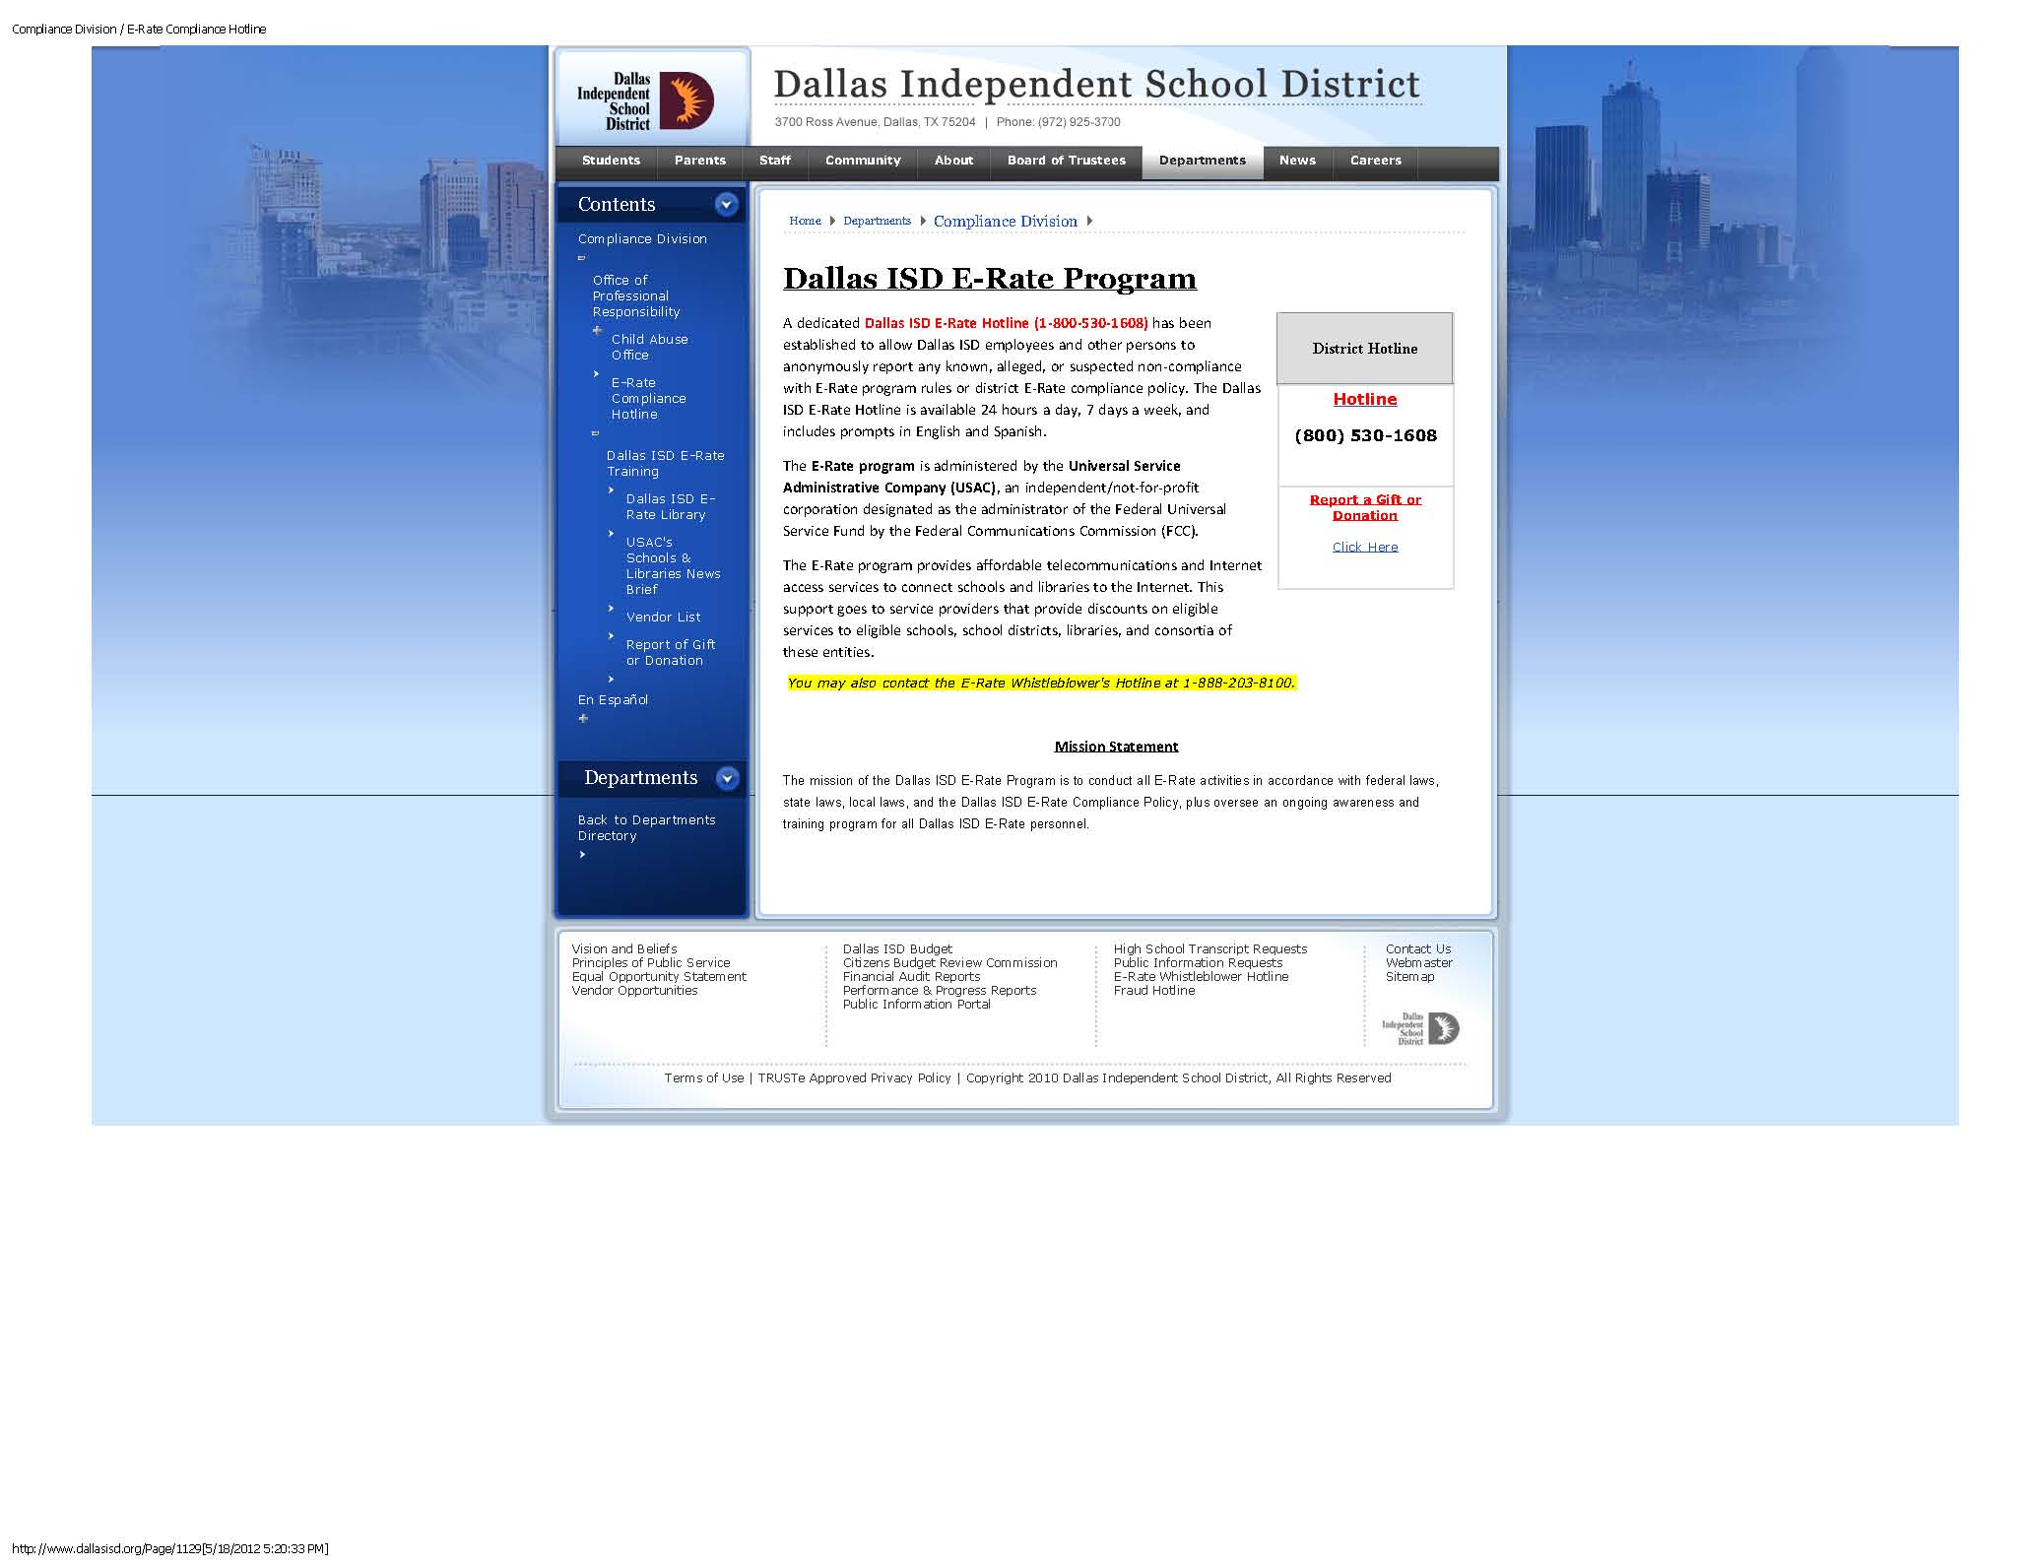

Slide 147
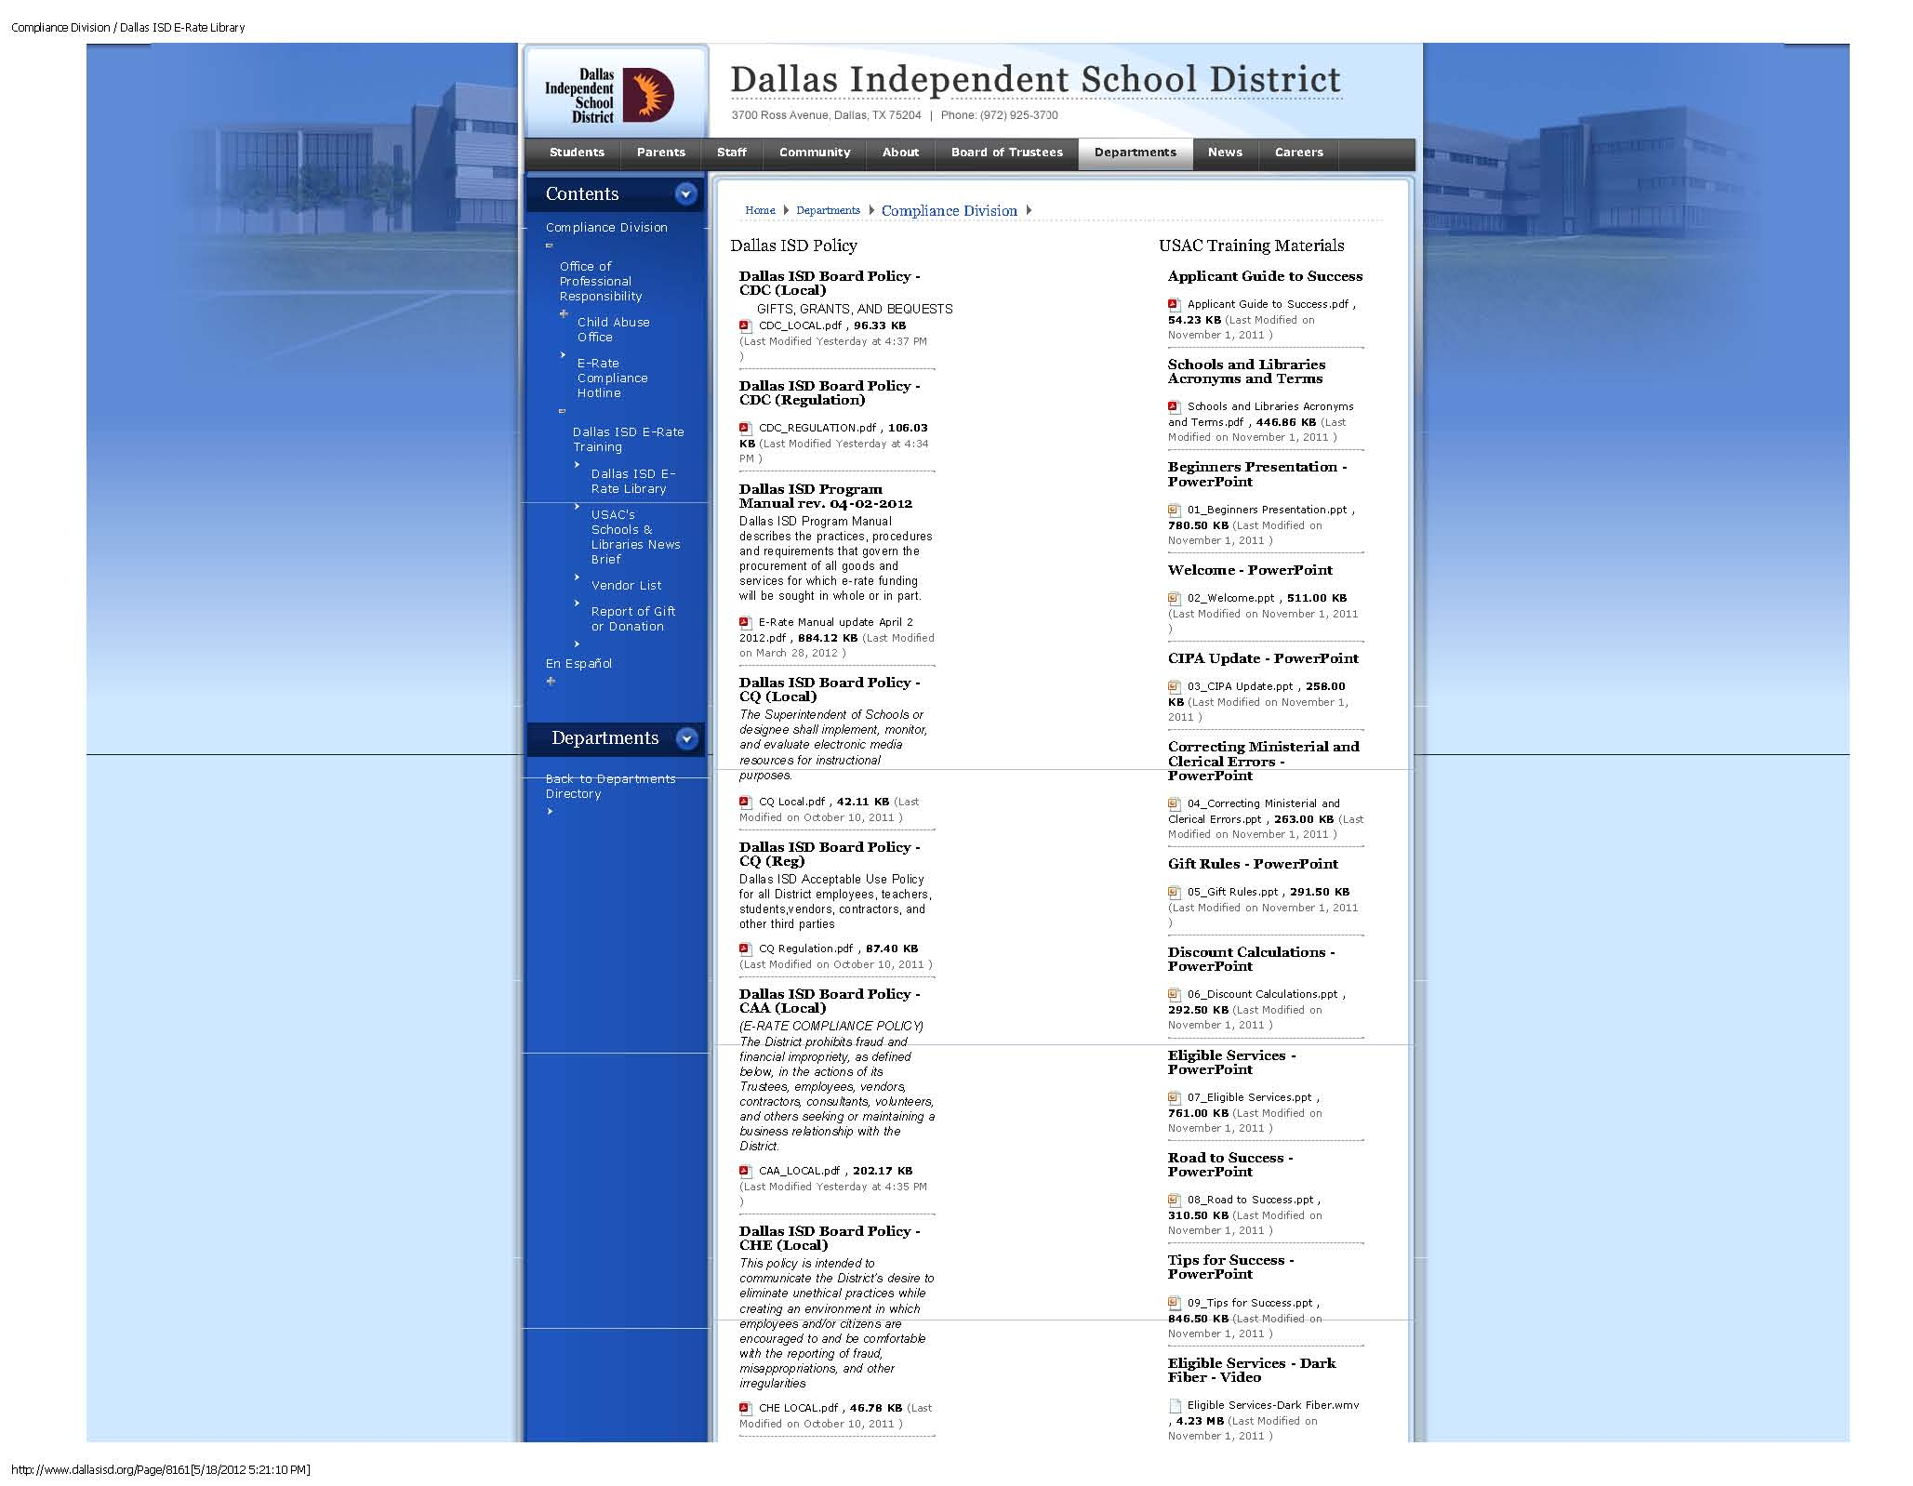

Slide 148
Dallas ISD E-Rate Compliance Vendor Training
    Summary:
    Dallas ISD Has Compliance Agreement with the FCC and USAC in Conjunction with the E-Rate Program;
    To continue in program, Dallas ISD must meet its compliance agreement;
    Vendors have a role in assisting Dallas ISD in becoming compliant by following several vital things:
      Agree to compliance language and E-Rate contract;
      Avoid any side deals, or pre-determined agreements;
      Communicate only as allowed in Procurement documents;
      Attend required training;
      Subscribe and regularly read the USAC New Brief.

Slide 149
Dallas ISD E-Rate Compliance Vendor Training
    Summary:
    Thank you for your attendance at today’s webinar.
    Attendance at today’s training event meets all requirements for Vendor Training as required in the Dallas ISD Compliance Agreement.
    Thanks to USAC for making this training event possible.
      John Noran
      Suzie Casal
    This webinar is be recorded and will be available for future viewing;
    Turn it back over to USAC.

Slide 150
Dallas ISD E-Rate Compliance Vendor Training
Q&A
Date Created: 04-05-12

