Slide 1
The E-rate Program
Myths and Misconceptions Debunked
Fall 2012 Applicant Trainings

Slide 2
Myths and Misconceptions
Overview
Technology planning misconceptions
Eligible services myths
FCC Forms 470 and 471 misconceptions
Competitive bidding and contracts misconceptions
PIA myths and misconceptions
FCC Form 486 and Invoicing misconceptions
Post-commitment misconceptions

Slide 3
Myths and Misconceptions Debunked
Technology Planning Misconceptions

Slide 4
Technology Planning Misconceptions
Technology Plan Timing
Misconception: I need to draft my tech plan each funding year before I file my FCC Form 470 for all services
Fact: Tech plans are no longer required for Priority One (Telecom and Internet Access) but are still required for Priority Two (Internal Connections and Basic Maintenance)
Fact: Tech plans can be approved for more than one year, so your services may still be covered by your approved plan
Fact: If P2 services are all included in a current tech plan, and the plan covers at least part of the upcoming funding year, then a new draft tech plan is not needed prior to posting an FCC Form 470

Slide 5
Technology Planning Misconceptions
Technology Plan Timing
Misconception: Technology plan approvals are always due July 1st
  Not necessarily. Applicants requesting Priority 2 services must have an approved plan that covers at least part of the upcoming funding year prior to the start of service or the filing of the FCC Form 486, whichever comes first
  If P2 services starting after July 1 are not covered by an existing tech plan, the new tech plan must be approved before the start of service or the filing of the FCC Form 486, whichever comes first

Slide 6
Myths and Misconceptions Debunked
Eligible Services Myths

Slide 7
Eligible Services Myths
Internet Access – Off-campus Use
Myth: I can provide Internet access to my students and staff at home (for educational purposes – of course)
Not true. Off-campus Internet access is not an E-rate eligible service
The FCC’s “Learning on the Go” is a pilot program, which allowed up to $10M to support interactive off-premise (home) wireless device connectivity for the 20 schools and libraries chosen to participate
  Pilot program is not accepting any new applicants

Slide 8
Eligible Services Myths
Understanding the Two-in-Five Rule
Myth: If a school in my district or branch in my system uses a year under the Two-in-Five Rule, it counts for the district/system as a whole
Wrong. The Two-in-Five Rule applies to the entities listed on the Block 4 worksheet cited on the Internal Connections funding request (i.e., the individual schools, libraries, and/or non-instructional facilities listed on the worksheet). Entities can use two years within any five-year period, looking back and looking forward from that year
If the entity is a NIF, then the schools or libraries on the Block 4 worksheet have used a year under Two-in-Five

Slide 9
Eligible Services Myths
Understanding the Two-in-Five Rule (continued)
Myth: I received a commitment for Internal Connections, but I will get this year back if I don’t invoice for any equipment.
Partially correct but missing a crucial step: USAC considers you to have used a year of Two-in-Five if you have an Internal Connections commitment
When no disbursements have been made on Internal Connections funding requests, you can get a year back if (and only if) you file an FCC Form 500 to cancel the unused FRN

Slide 10
Eligible Services Myths
Understanding the Two-in-Five Rule (continued)
Myth: I can receive discounts on a PBX this year and switches for each of the following two years because they are different types of Internal Connections
Not true. The Two-in-Five Rule applies regardless of the type of Internal Connections services received
If the first-year PBX and the second-year switch requests are funded, USAC would deny the third-year request for violating the Two-in-Five Rule

Slide 11
Eligible Services Myths
Service Provider Identification Numbers
Myth: USAC issued a SPIN to my service provider, so the service provider is certified by USAC and all their services are eligible for discounts
False. The Service Provider Identification Number (SPIN) is a unique number assigned by USAC for identification and tracking purposes only
USAC does not provide blanket approvals for a service provider’s offerings, but reviews requests based on that year’s Eligible Services List and other factors

Slide 12
Myths and Misconceptions Debunked
FCC Forms 470 and 471 Misconceptions

Slide 13
FCC Forms 470 and 471 Misconceptions
FCC Form 470 Timing
Myth: I should wait for the FCC Form 471 filing window to open before filing my FCC Form 470
False. You can file the FCC Form 470 for a funding year as soon as that funding year becomes available online
  Generally this occurs about a year before the start of the funding year (e.g., FY2013 starts July 1, 2013, and the FY2013 FCC Form 470 became available online in July 2012)

Slide 14
FCC Forms 470 and 471 Misconceptions
Filing Multiple Forms
Misconception: I need to file an FCC Form 470 every year.
YES… If you intend to purchase services under a tariffed or month-to-month basis, you must post a new FCC Form 470 each year *However*
NO…If you have purchased services under a multi-year contract or a contract with voluntary extensions, you do not have to file a new FCC Form 470 for the life of the contract.
Remember: You MUST file an FCC Form 471 every year – even if you have a multi-year contract

Slide 15
FCC Forms 470 and 471 Misconceptions
Filing Multiple Forms
Misconception: I can apply for P1 and P2 services on one FCC Form 471
We recommend that you don’t. If P1 and P2 services are combined on the same FCC Form 471, USAC cannot issue commitments on the P1 services until a funding decision can be made on the P2 services
However, you don’t have to file P1 services from different providers on separate FCC Forms 471 – you can put them all on the same form, just on separate FRNs (same for P2)

Slide 16
FCC Forms 470 and 471 Misconceptions
Discount Calculations
  Misconceptions: All my students or patrons at my entity are impoverished so I can claim a 90% discount level, and I’m rural because I can see cows from my office window
  Wrong and wrong.
    Use National School Lunch Program numbers or an alternate discount mechanism to determine your discount, and retain your documentation
    Use the urban/rural status to determine your status
    Use the discount matrix to determine your discount

Slide 17
FCC Forms 470 and 471 Misconceptions
Transitional Errors
  Misconception: I’m new to E-rate and don’t understand the forms, so I can just copy information from the FCC Forms 470 and 471 my entity filed last year that USAC approved.
  Don’t do this without making sure the information is accurate. Copying information from a past year’s forms could result in inaccurate or dated information.
  Eligible services, entities, costs, discount levels, and other data entered on program forms should be carefully reviewed each funding year.

Slide 18
FCC Forms 470 and 471 Misconceptions
Transitional Errors (PINs)
  Misconception: I’m new to E-rate and I don’t have a PIN, so I’ll call the Client Service Bureau and request one; or I’ll just use the PIN from my former boss’s PIN mailer.
Wrong. PINs cannot be requested. An authorized person who does not have a PIN must file an FCC Form 470, 471, or 486 on paper – or file online and submit a paper certification page – before USAC can issue a PIN to that authorized person.
  Even more wrong. PINs are considered equivalent to a handwritten signature and are specific both to an authorized person and to a Billed Entity. Don’t use them interchangeably between authorized persons or Billed Entities.

Slide 19
Myths and Misconceptions Debunked
Competitive Bidding and Contracts Misconceptions

Slide 20
Competitive Bidding and Contracts Misconceptions
State Master Contracts
Myth: My state posted an FCC Form 470 and signed contracts with three service providers as a result. I can just pick any one of the three to complete my FCC Form 471.
Wrong. You must conduct a bid evaluation for all three service providers able to provide services under these contracts (a “mini-bid”) and choose the most cost-effective solution.
However, you don’t need to post an FCC Form 470 just to conduct this mini-bid.

Slide 21
Competitive Bidding and Contracts Misconceptions
Choosing a Service Provider
Myth: There is only one service provider who serves my region, so I can just claim sole source and not bother with a competitive bidding process.
Wrong. The 28-day waiting period, competitive bidding, and other applicable rules must always be followed

Slide 22
Myths and Misconceptions Debunked
PIA Myths and Misconceptions

Slide 23
PIA Myths and Misconceptions
PIA Correspondence
Myth: I put my Billed Entity Number on everything I sent to PIA during review – that should be enough for them to figure out who I am and match my documents with my application
Wrong: The more identifying information you provide, the better:
  FCC Form 471 application number(s)
  Funding Request Numbers
  Item 21 attachment number(s)
  Contact information, especially phone and email
We may have trouble identifying individual pages if they get separated

Slide 24
PIA Myths and Misconceptions
PIA Correspondence
Myth: PIA asked me for documentation, so I’ll keep working on it and tell my reviewer when I’m ready to send it
Wrong: Don’t hope that PIA can read your mind - communicate with your PIA reviewer
PIA asks for the information within 15 days – be sure to request an extension if you need it by notifying your PIA Reviewer and receiving a confirmation

Slide 25
PIA Myths and Misconceptions
Item 21 Attachments
Myth: The Item 21 is not really due until PIA asks for it.
False. Beginning with FY2011, Item 21 attachments must be filed by the deadline
  FRNs without timely filed Item 21 attachments will not be funded

Slide 26
PIA Myths and Misconceptions
Funding Commitment Decision Letters (FCDL)
Misconception: My FCDL states that my FRN is ‘As Yet Unfunded.’ Since it hasn’t been denied, where is my funding?
“As Yet Unfunded” indicate that your FRN is approved for funding when funding becomes available, which has not yet occurred for your discount level.

Slide 27
PIA Myths and Misconceptions
FCC Form 471 Application Status
Misconception: The application status tool shows that my Form 471 has 16 different statuses.
Look again. The first gray grid on the application status display lists each of the FCC Forms 471 you filed and its status. The second gray grid on the display is a “key,” which explains what each status means.

Slide 28
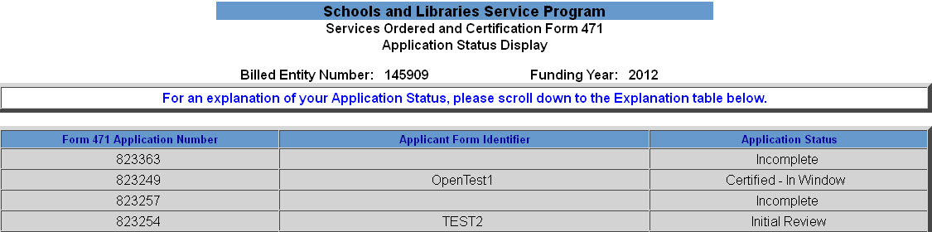
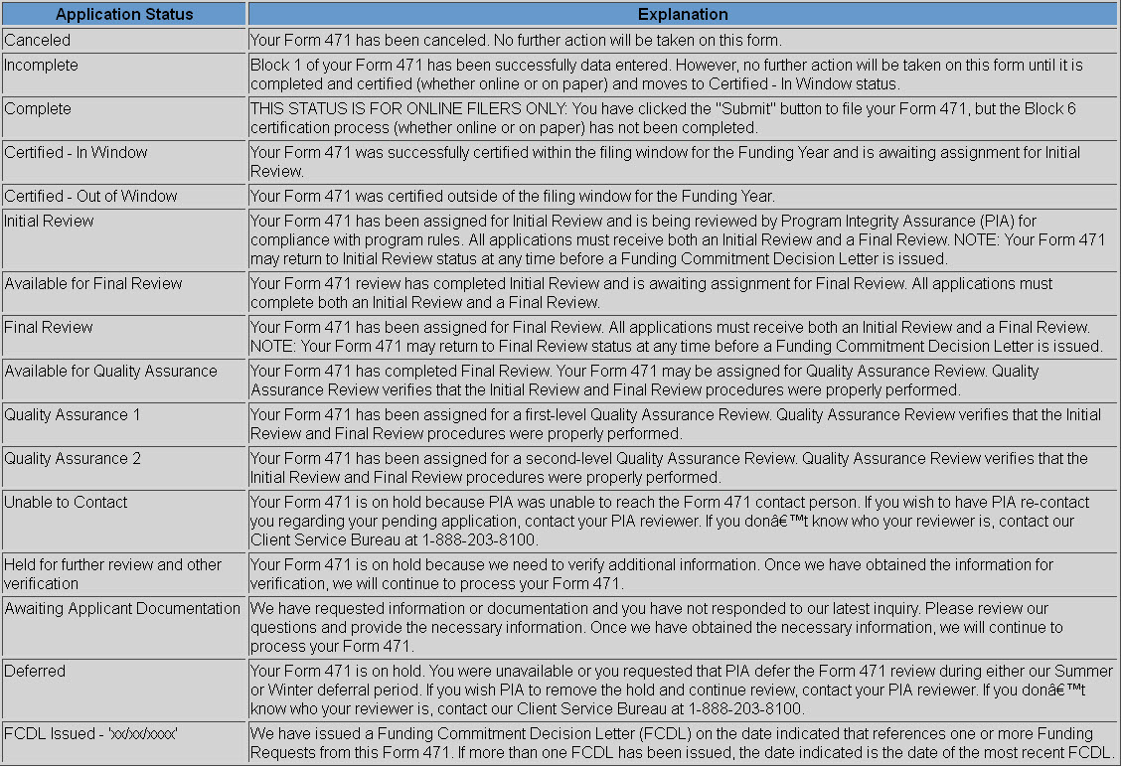
PIA Myths and Misconceptions

Slide 29
Myths and Misconceptions Debunked
FCC Form 486 & Invoicing Misconceptions

Slide 30
FCC Form 486 & Invoicing Misconceptions
Requirements Before Invoicing USAC
Misconception: I received my FCDL, so my grant check is in the mail as well
Wrong: E-rate is not a grant program
After USAC issues an FCDL, services must start, applicants must file an FCC Form 486, and service providers must file an FCC Form 473
Applicants must then either pay for services in full and file an FCC Form 472 (BEAR) or ask the service provider to provide discounted bills

Slide 31
FCC Form 486 & Invoicing Misconceptions
Certifying CIPA Compliance on FCC Form 486
  Misconception: I filter all my computers and wrote an Internet safety policy, therefore I am CIPA compliant
  Not quite – there are other components to CIPA, for example:
    Public hearing or meeting about the Internet safety policy for which reasonable public notice was provided
    SCHOOLS – You should have already amended your Internet safety policy to provide for the education of minors about appropriate online behavior
  Be sure to review the CIPA guidance on the USAC website

Slide 32
FCC Form 486 & Invoicing Misconceptions
Understanding Invoicing Reductions and Denials
Misconception: Once my BEAR has been denied I will have to appeal the decision to get my funding
No, if you correct the problem identified on the BEAR Notification Letter, you can simply resubmit the BEAR Form.
If you don’t understand why your BEAR Form was denied or reduced, submit a question or call the Client Service Bureau.

Slide 33
Myths and Misconceptions Debunked
Post-Commitment Misconceptions

Slide 34
Post-Commitment Misconceptions
FCC Form 500
Misconception: When I have unused funds from my commitment, I should leave the money where it is in case I need it later for something else
No, unused commitment funds cannot be transferred to other years or FRNs
PLEASE file an FCC Form 500 to return any unused funds to USAC so that they can be used for other commitments

Slide 35
Post-Commitment Misconceptions
Document Retention
Misconception: I must keep hard copies of all my documentation
Applicants and service providers are required to keep documentation (hard copies or electronic) for a period of at least five (5) years from last date of service
If you have a multi-year contract, keep copies of relevant documents (including the contract) for five years after the last date of service delivery covered by that contract

Slide 36
Post-Commitment Misconceptions
Operational SPIN Change Reminders
Misconception: I found a new service provider who is cheaper, so I did a SPIN change. Now USAC and I both spend less, so everybody wins.
You can’t do a SPIN change just to get a cheaper price – there must be a legitimate reason to change providers (e.g., breach of contract, unable to perform)
Moreover, the new service provider must have received the next highest point value in the original bid evaluation (unless only one or no bids were received)

Slide 37
Post-Commitment Misconceptions
Extensions
Misconception: I need to extend my contract, service delivery deadline and invoice deadline, so I’ll just file an FCC Form 500 for all three.
33 ^{1/3} percent correct (best case scenario)
  If you can extend your contract (*hint: read your contract*) and you do so, filing an FCC Form 500 reports the new expiration date to USAC
  You must, however, file separate extension requests for the other two deadlines, totaling three submissions to USAC

Slide 38
Post-Commitment Misconceptions
Appeals
Misconception: I just had my FCC appeal approved, so where is my check? Are you out of money for that funding year?
First, read the remand order carefully – USAC may have been directed to do additional work before taking an action
Second, you are responsible for following the remainder of the application process, e.g., timely filing an FCC Form 486 and 472
Third, if the appeal is old, verify the contact information USAC has on file by calling CSB
*Note: You can still receive funding for an older funding year

Slide 39
Post-Commitment Misconceptions
Appeals
Misconception: I was audited; I don’t agree with the audit findings, so I plan to appeal them.
Audit findings are not appealable, because no determination (e.g., a necessity to recover funds) has been made by USAC
If USAC issues a COMAD or RIDF letter following an audit, that is the appealable event

Slide 40
Questions?

