Slide 1
The E-rate Program
Eligible Services
Fall 2012 Applicant Trainings

Slide 2
Eligible Services
Overview
Eligible Services List (ESL) Order
  Format changes for Priority One services
  Reduced burdens for the FCC Form 470
Priority One (P1)
Priority Two (P2)
Miscellaneous
Dark fiber
Equipment transfers, disposals, and trade-ins

Slide 3
Eligible Services
Eligible Services List (ESL) Order

Slide 4
Eligible Services List Order
Overview
No changes to overall eligibility of products and services
Format changes to the ESL
  Background: Some regulatory and procedural information are relocated to Special Eligibility Conditions
  Priority One services are consolidated into one list
  New information about service category selection for Priority One services on FCC Form 470

Slide 5
Eligible Services List Order
FY 2012 ESL - Consolidated List of P1 Services
Priority One services are no longer separated by regulatory category (Telecommunications Services, Telecommunications, and Internet Access)
  Consolidation is to make ESL more user-friendly
    There are no changes to FCC rules and requirements
  Consolidated list includes services that can be requested as Telecom Services or Internet Access on the FCC Form 471 (e.g., voice mail, interconnected VoIP, fiber) depending on the type of service provider

Slide 6
Eligible Services List Order
ESL Order – Other highlights
FCC Form 470 Guidance
  Sufficient for applicants to check off one Priority One service category (Telecom Services or Internet Access)
    Description of the services requested or RFP must contain enough detail for service providers to identify services and formulate bids (no change from current requirement)
    Service providers should review entire Priority One section

Slide 7
Eligible Services List Order
ESL Order – Other highlights
FCC Form 471 Guidance
  Applicants must continue to select the correct category of service on the FCC Form 471 for regulatory purposes such as:
    Telecom Services must be provided by eligible telecom carriers
    Requests for Internet Access must be CIPA compliant
  Once an applicant has selected a vendor, they may consult with the vendor to determine which service category to check in Block 5 of the FCC Form 471

Slide 8
Eligible Services List Order
ESL Order – Other highlights
Additional streamlining for FY 2013
  Removes citations and regulatory language
  Moves information about certain regulatory requirements to Special Eligibility Conditions
  Makes minor corrections to ESL (from para. 10 of Order)

Slide 9
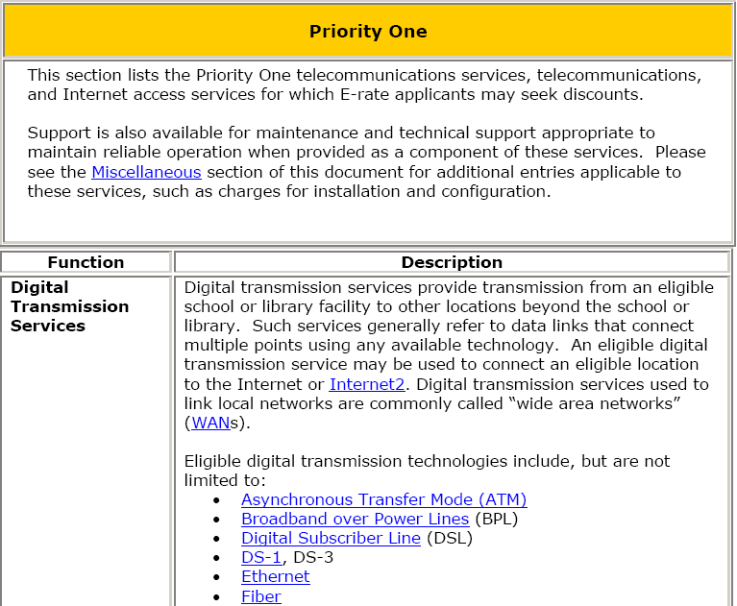
Eligible Services List Order
ESL Screenshot

Slide 10
Eligible Services
Priority One

Slide 11
Priority One
Telecommunications Services
Digital Transmission Services
  Digital Subscriber Line (DSL)
  Primary Rate Interface (PRI)
  T-1, T-3
  Satellite service

Slide 12
Priority One
Not Eligible as Telecom Services
Broadcast “Blast” messaging
Monitoring services for 911, E911 or alarm telephone lines
Services to ineligible locations
End-user devices
  Cell phones, tablet devices, netbooks and computers

Slide 13
Priority One
Internet Access (IA)
Support for IA includes charges to access the Internet and costs for the conduit to the Internet
Other eligible Internet Access services include:
  E-mail service
  Wireless Internet access
  Interconnected VoIP
  Web hosting

Slide 14
Priority One
Not Eligible as Internet Access
Costs for Internet content
  Subscription services such as monthly charges for on-line magazine subscriptions
Internet2 membership dues
Website creation fees
Web-based curriculum software
Software, services or systems used to create or edit Internet content

Slide 15
Eligible Services
Priority Two

Slide 16
Priority Two
Internal Connections
Support for equipment and cabling onsite that transport info to classrooms or public rooms of a library
Subject to the Two-in-Five Rule
  Entities can only receive funding every two out of five years

Slide 17
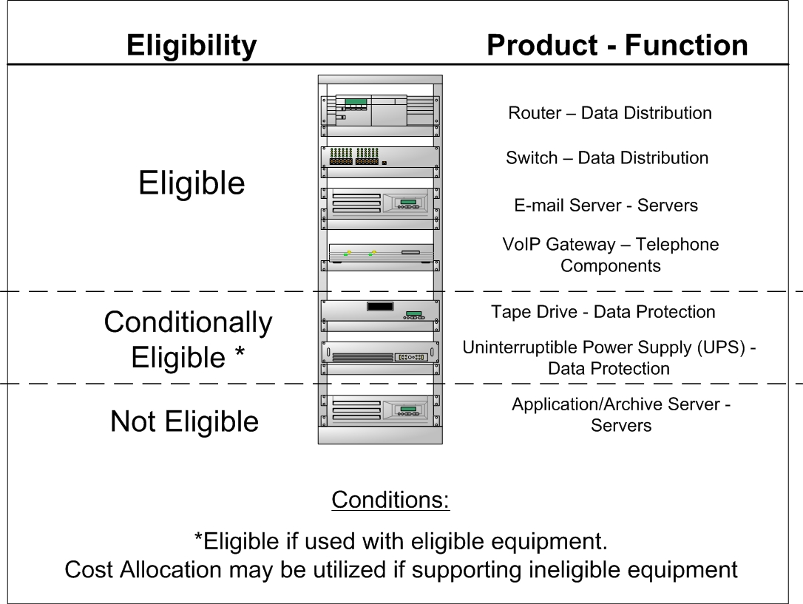
Priority Two
Internal Connections

Slide 18
Priority Two
Basic Maintenance of Internal Connections (BMIC)
Support for basic maintenance of eligible internal connections
Such as:
  Repair and upkeep of hardware
  Wire and cable maintenance
  Basic tech support
  Configuration changes

Slide 19
Priority Two
Basic Maintenance of Internal Connections
Agreements or contracts must state the eligible components covered, make, model, and location
Service must be delivered between July 1-June 30
Two-in-Five Rule does not apply to BMIC

Slide 20
Priority Two
BMIC Updated Guidance
Standard manufacturer warranties of no more than three years remain eligible
  If there is a cost associated with the warranty, then the warranty is not eligible
Support for BMIC is limited to actual work performed under the contract

Slide 21
Priority Two
BMIC Updated Guidance
Applicants may make estimates based on:
  Hours per year of maintenance
  History of needed repairs and upkeep and
  Age of eligible internal connections
Applicants using the factors listed above must submit a bona fide request
It is not reasonable to estimate an amount that would cover the full cost of every piece of eligible equipment

Slide 22
Priority Two
BMIC Updated Guidance
Flat rate contracts may be eligible however, applicants may only invoice for services actually delivered/work performed
Exceptions that will not require demonstration that work was performed are:
  Software upgrades and patches
  Bug fixes and security patches and
  Online and telephone based technical support

Slide 23
Eligible Services
Miscellaneous

Slide 24
Miscellaneous
Miscellaneous Charges
Miscellaneous charges can apply to all service categories and are funded in the same category of the service they are supporting
Training is eligible when included as part of the contract and performed coincidently with the installation of the new service/product or in a reasonable time thereafter
  Training for end-users or professional development is not eligible

Slide 25
Miscellaneous
Miscellaneous Charges
Taxes, surcharges and other similar reasonable charges are eligible for discount. This includes but is not limited to :
  Universal service fund
  Excise Tax
  911
  Local Number Portability and
  Telephone relay service

Slide 26
Miscellaneous
Miscellaneous Charges
Other charges that are not eligible include but are not limited to:
  Universal service administration fee
  Interest or finance charges
  Late payment fees and
  Termination fees

Slide 27
Eligible Services
Dark Fiber

Slide 28
Dark Fiber
Leased Dark Fiber as Priority One
Leased dark fiber added as Telecommunications starting with the FY2011 Eligible Services List
Allows for the lease of dark fiber as a Priority One service, from any entity
On the FCC Form 470, file for either Telecom or Internet Access (per the ESL Order)
On the FCC Form 471, select the Telecom box if the dark fiber is provided by a telecom carrier
  In all other cases, select the Internet Access box

Slide 29
Dark Fiber
Leased Dark Fiber as Priority One
Dark fiber must be lit immediately
Does not allow for unneeded capacity or the warehousing of dark fiber for future use
Maintenance costs of dark fiber and installation costs to hook up the dark fiber are eligible
  This includes charges for installation within the property line
Modulating electronics for leased dark fiber are not eligible

Slide 30
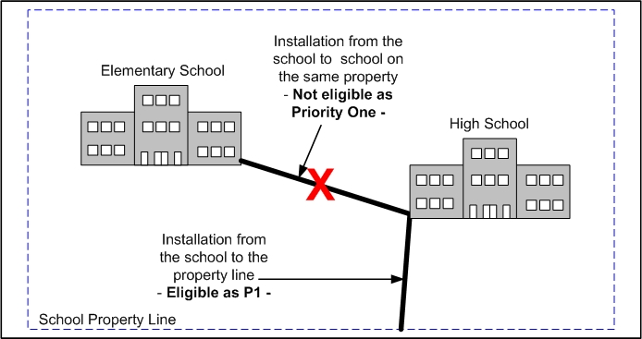
Dark Fiber
Leased Dark Fiber as Priority One
Installation costs to hook up the dark fiber are eligible from the eligible entity to the property line

Slide 31
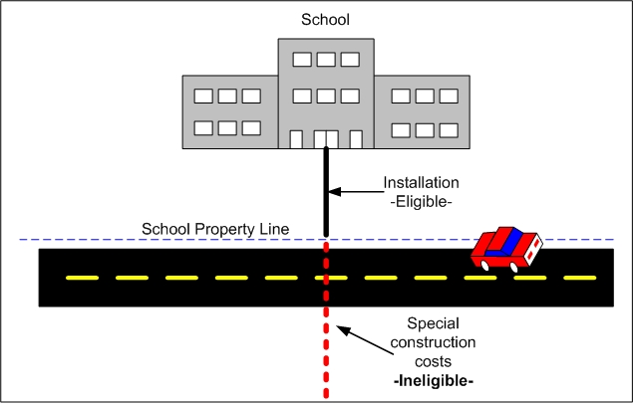
Dark Fiber
Dark Fiber as Priority One
Special construction charges to build out connections from applicants’ facilities to an off-premise fiber network are not eligible

Slide 32
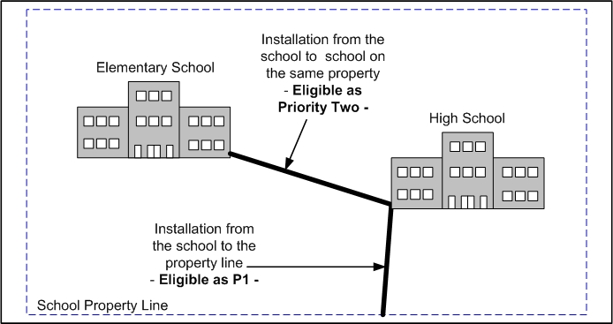
Dark Fiber
Dark Fiber as Priority Two
Installation and fiber costs between two eligible buildings, not crossing a public right-of-way, are considered Internal Connections

Slide 33
Eligible Services
Equipment Transfers, Disposal and Trade-in

Slide 34
Equipment Transfers
Equipment Transfer Rules
In general, equipment may not be transferred for money or any other thing of value
A no-cost transfer may occur three years or more after the purchase of the equipment to other eligible entities
No equipment transfer may occur prior to three years from the date of purchase, unless the eligible entity is permanently or temporarily closing

Slide 35
Equipment Transfers
Equipment Transfers Less Than Three Years
Notify USAC
Both the closing entity and the recipient must retain records of the transaction
  The recipient must also be an E-rate eligible entity
  Include the reason for the transfer
Records must be kept for five years after the date of the transfer

Slide 36
Disposal of Equipment Rules
Disposal of Equipment Rules
As of January 3, 2011, applicants can dispose of obsolete equipment, but no sooner than five years after the date the equipment is installed
Resale for payment or other consideration is allowable no sooner than five years after the equipment is installed
Resale or disposal is prohibited before the five years have passed

Slide 37
Trade-ins and Exchanges
Trade-ins and Exchanges
Trade-ins of equipment can be permitted if the E-rate funded equipment to be traded in has been installed for five years
  This limitation does not apply for equipment not funded through E-rate

Slide 38
Questions?

Slide 39
Thank you!

