Slide 1
E-rate Program
State of E-rate
May 10, 2012 - Atlanta I May 15, 2012 – Los Angeles

Slide 2
State of E-rate
Topics
FY2012 Demand Estimate
FY2012 Priority 1
FY2012 Priority 2
Audits
HATS

Slide 3
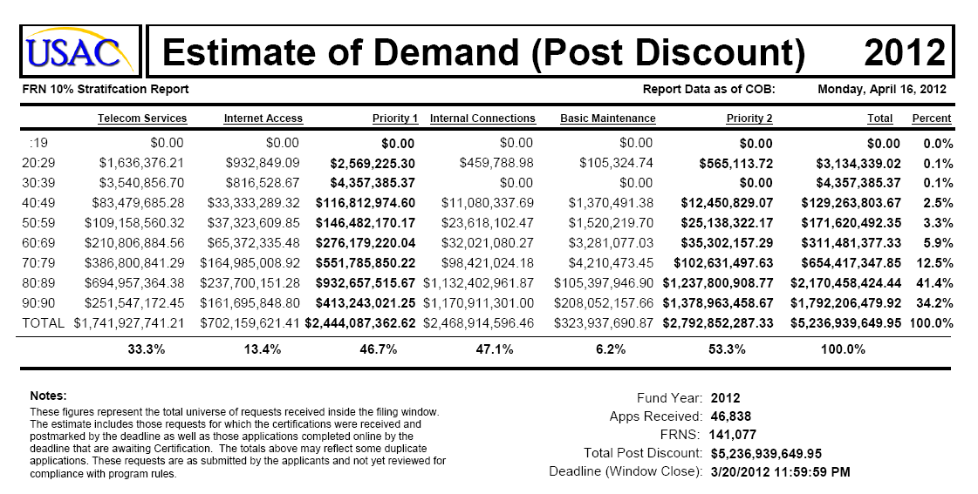
State of E-rate
FY2012 Demand Estimate

Slide 4
State of E-rate
FY2012 Priority 1 from 20% - 90%
April 20 Demand Estimate sent to FCC
April 23 USAC Board approved funding All P1s
April 25 request sent to FCC to fund all P1s
USAC Review Procedures approved by FCC
First FY2012 funding wave target - end of May
$2.176 billion needed to fund all P1s

Slide 5
State of E-rate
FY 2012 Priority 2
FY2012 P2s at 90% will require FCC to roll over funds
FCC makes decision on rollover in 2nd quarter 2012
If enough funds are available, will fund 90%
If required funds are not available, FCC rules direct USAC to prorate
Decision regarding FY2012 P2 at 90% is months away

Slide 6
State of E-rate
Payment Quality Assurance (PQA)
Not an audit
Easier
Faster
Less work
Less expensive
PQA will always contact the applicant for information, and may need the service provider’s assistance for billing information

Slide 7
State of E-rate
Beneficiary/Contributor Compliance Audit Program (BCAP)
An audit
Necessary to ensure compliance with FCC rules & orders
Less complex than previous audits
Ongoing, starting 3rd Qtr 2011
  No end, no rounds
If applicant selected for audit, service provider will be notified

Slide 8
State of E-rate
Beneficiary/Contributor Compliance Audit Program (BCAP)
Steps for Service Providers to minimize audit findings and assist applicants
  Retain documents and information, such as contracts, service agreements, customer bills, maintenance logs, installation and delivery dates, and invoices
  Provide sufficient detail on customer bills
    Include Funding Request Number (FRN), specific details of the items purchased (e.g., serial numbers, quantity, product descriptions, product delivery information)
    Indicate total amount due ("Pre-Discount Amount") less amounts paid by or to be paid by USAC

Slide 9
State of E-rate
Beneficiary/Contributor Compliance Audit Program (BCAP)
  Provide sufficient detail on bills (cont.)
    Indicate payment terms of the net amount of the bill
    Separate eligible items from ineligible items
    Generate separate bills for eligible and ineligible items to reduce risk of including an ineligible item on BEAR/SPI
Complete BEAR/SPI using one line per customer bill
Reimburse applicants within 20 days of receipt of funds from USAC (BEAR payments)

Slide 10
State of E-rate
HATS (Helping Applicants To Succeed)
In 2012 USAC will have 1,000 HATS contacts
Answer complex questions
Provide deadline reminders
Help new applicants, including new contact people
Etc.

Slide 11
Questions?

