Slide 1
E-Rate Program
Revised FCC Forms 470 and 471
Fall 2010 Service Provider Trainings

Slide 2
Overview
Revised FCC Forms 470 and 471 for FY2011
Form timelines
General format changes
Changes common to both forms
Form 470
  Deleted fields
  Additions and changes
Form 471
  Additions and changes

Slide 3
Target Window Timeline
Target timeline for FY2011 FCC Form 471 filing window
Current FY2011 Form 470 became available July 1, 2010
  Applicants can file a Form 470 now and cite it on an FY2011 Form 471
FY2011 Form 471 window target opening mid-December with the revised Form 471 (current version can no longer be used)
When the revised version of Form 470 becomes available, applicants can file a Form 470 using the revised version and cite it on an FY2011 Form 471
Form 471 window target closing end of February

Slide 4
Filing a Form 470
“Current” and “revised” FY2011 Form 470
You are STRONGLY encouraged to:
  File AND certify (online or on paper) the current Form 470 before the revised Form 470 becomes available
  OR
  File AND certify (online or on paper) the revised Form 470 after it becomes available

Slide 5
Filing a Form 470
“Current” and “revised” FY2011 Form 470
If you file the current Form 470 online, you must certify it online or on paper before the revised Form 470 is posted
  Client Service Bureau (CSB) will ask you for corrections if your certification does not match your online filing (i.e., if you don’t print your certification using Certify Complete)
If you file the current Form 470 on paper, you must postmark it before the revised Form 470 goes live on the USAC website
  Otherwise, CSB will preserve your postmark date but you will be required to re-submit on the revised Form 470

Slide 6
Form 471 Submissions – FY2009

Slide 7
Form 471 Submissions – FY2010

Slide 8
General Format Changes
Formatting changes to paper forms
Grey boxes (one character per box) removed
Extra lines separating most fields removed
Larger font where possible
Checkboxes outlined
More easily read

Slide 9
General Format Changes
Online formats remain the same
Apply Online page
Form filing options
  Interview or expert
  Continue incomplete
  Item 21 (Form 471)
Certification options
  Certify online or on paper
NOTE: Training site will be updated after Apply Online page

Slide 10
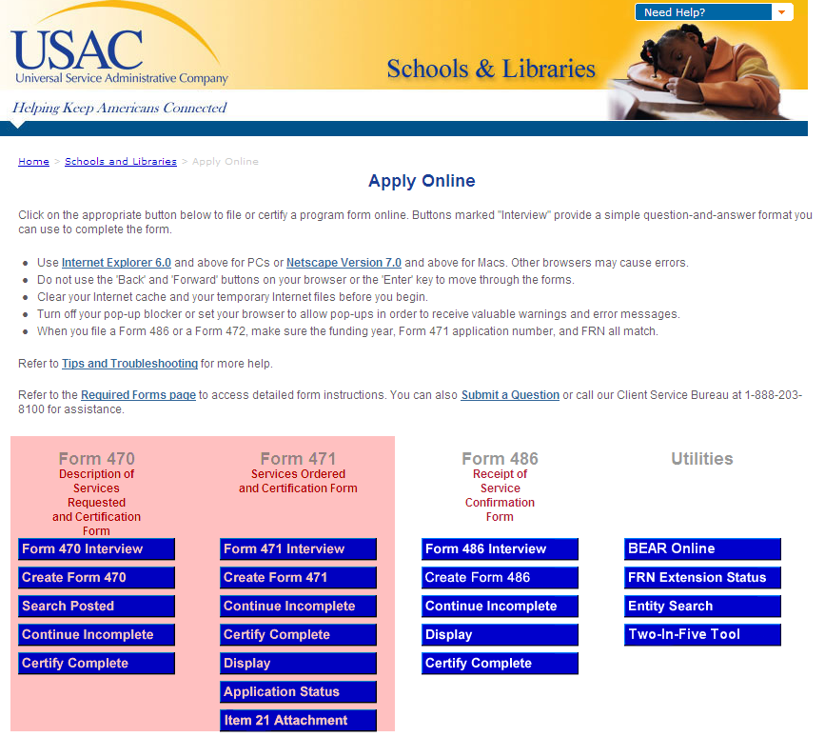
Apply Online Page

Slide 11
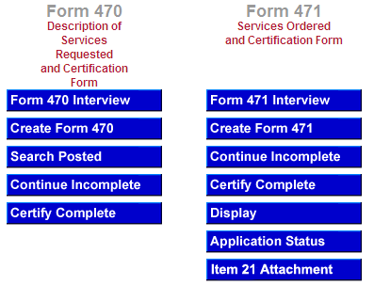
Apply Online Page - Detail

Slide 12
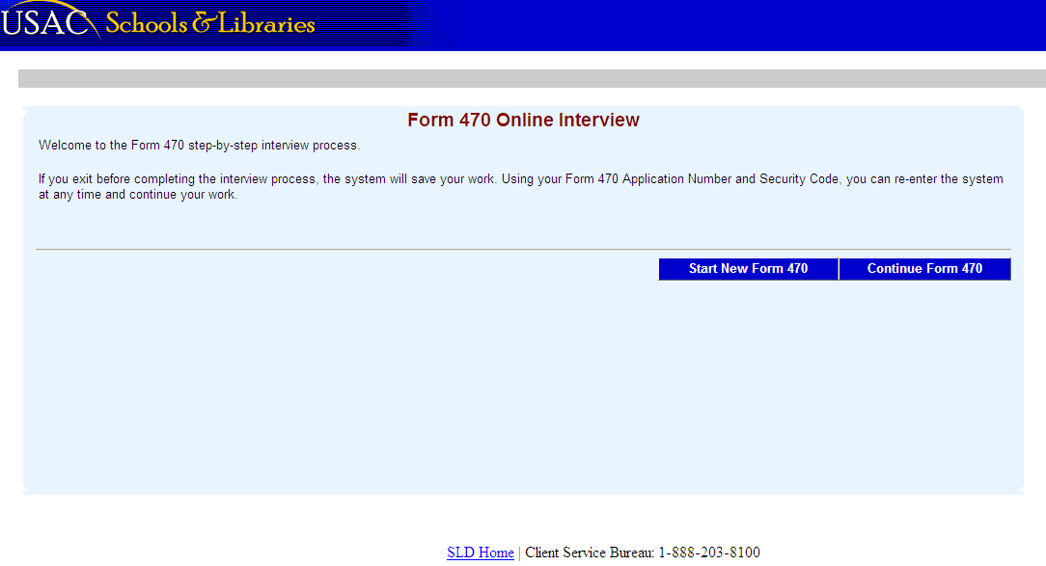
Interview Example (Form 470)

Slide 13
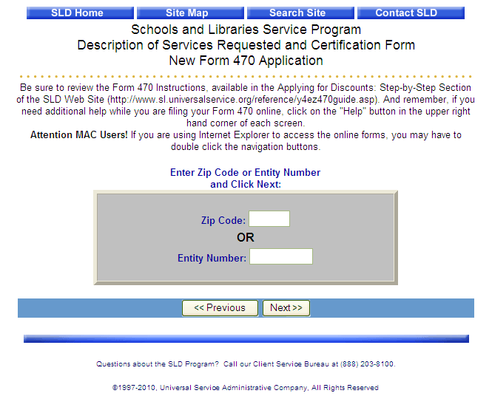
Expert Example (Form 470)

Slide 14
Revised FCC Forms 470 and 471
Changes Common to Both Forms

Slide 15
Changes Common to Both Forms
Eligible Entities/Type of Application (Additions in red)
Individual school
School district
Library
Consortium
Statewide application for (two-letter state code) _____
  All public schools in state
  All non-public schools in state
  All libraries in state

Slide 16
Changes Common to Both Forms
Recipient(s) of Services (check all that apply)
  Public
  Private
  Charter
  Tribal
  Head Start
  State Agency
You must check at least one option
You may check multiple options

Slide 17
Changes Common to Both Forms
Consultant Information
Applicant will now identify a consultant that is assisting the applicant with the application process
Client Service Bureau can quickly assign a consultant registration number (CRN)
  Each consulting firm has a CRN
  If the firm has multiple employees, the individual employee who assisted with the form is also identified
  In the last block, a checkbox has been added to indicate if the consultant is also the authorized person

Slide 18
Changes Common to Both Forms
Consultant Information Fields
Consultant Registration Number
Name (of consulting firm or sole proprietor)
Name of employee
Street address/City/State/Zip
Telephone number with extension
Fax number
Email address

Slide 19
Changes Common to Both Forms
Technology plan certification
I certify that, if required by Commission rules, all of the individual schools and libraries receiving services under this form are covered by technology plans that do or will cover all 12 months of the funding year, and that have been or will be approved by a state or other authorized body, or an SLD-certified technology plan approver, prior to the commencement of service OR
I certify that no technology plan is required by Commission rules.

Slide 20
Changes Common to Both Forms
Educational purposes certification
I certify that the services the applicant purchases at discounts provided by 47 U.S.C. § 254 will be used primarily for educational purposes and will not be sold, resold, or transferred in consideration for money or any other thing of value, except as permitted by the Commission’s rules at 47 C.F.R. §§ 54.500, 54.513.

Slide 21
Changes Common to Both Forms
Email addresses
All email addresses featured on these forms must now be entered twice
  Both e-mail address entries will be compared
  If they don’t match, both fields will be cleared and the applicant must try again
  This process helps to guarantee the accuracy of this important information

Slide 22
Revised FCC Forms 470 and 471
Form 470

Slide 23
Form 470 - Overview
Changes to Form 470
Block 1: Applicant Address and Information
  Eligible entities that will receive services / Recipient(s) of services added (slides 15 and 16)
  Number of eligible entities moved from Block 4
  Consultant information added (slide 18)
Block 2: Summary Description of Needs or Services
  Tariffed/month-to-month, contracted services (multi-year, voluntary extensions), contracts signed before July 19, 1997 deleted
  SPI/BEAR/no preference checkboxes deleted

Slide 24
Form 470 - Overview
Changes to Form 470
Block 3: Technology Resources deleted
  Basic telephone service deleted
  Necessary resources deleted
Block 4: Recipients of Service
  Statewide recipients of services moved to Block 1
  Telephone numbers and prefixes for multiple eligible entities deleted
  Ineligible participating entities deleted

Slide 25
Form 470 - Overview
Changes to Form 470 (continued)
Block 5: Certifications and Signature
  Some certification language changed
  Consultant as authorized person checkbox added (slide 17)

Slide 26
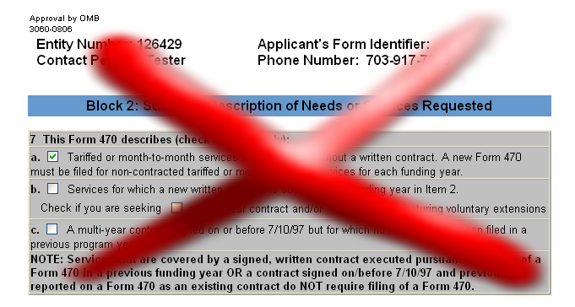
Form 470 – Deleted Fields
T/MTM or contract information (Current Items 7a – 7c)

Slide 27
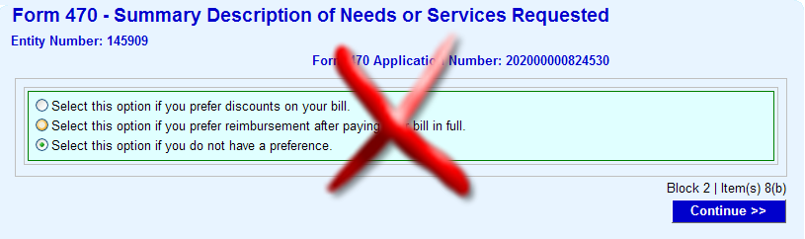
Form 470 – Deleted Fields
SPI/BEAR/No preference (Current Items 8b, 9b, 10b, and 11b)

Slide 28
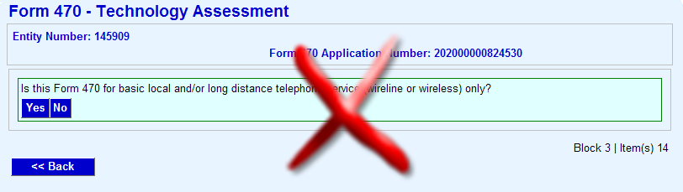
Form 470 – Deleted Fields
Basic Telephone Service (Current Item 14)

Slide 29
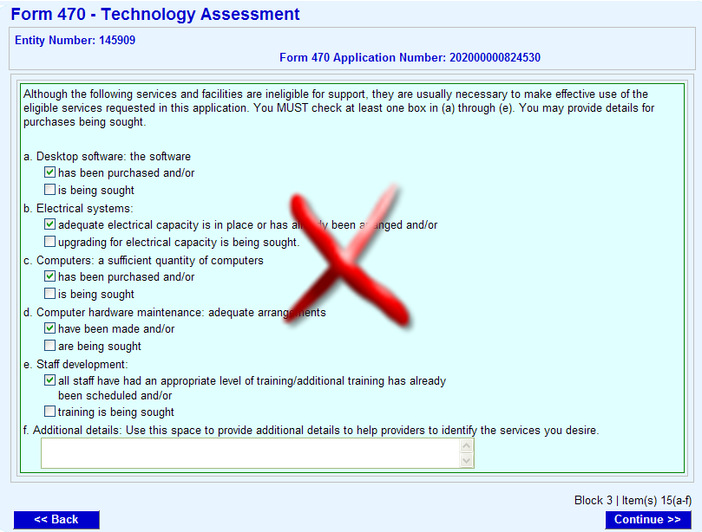
Form 470 – Deleted Fields
Necessary Resources (Current Items 15a-15f)

Slide 30
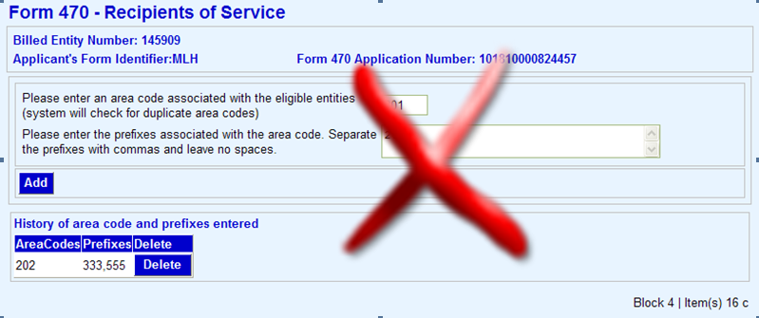
Form 470 – Deleted Fields
Phone numbers and prefixes (Current Item 16c)

Slide 31
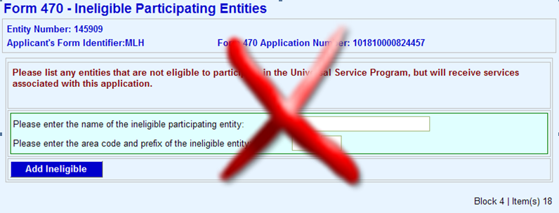
Form 470 – Deleted Fields
Ineligible participating entities (Current Item 18)

Slide 32
Form 470 – Certifications
Block 4 - Changes to certification pages
Item 17 – Technology plan certification (slide 19)
Items 18 and 19 – Current Item 21 has been split into two separate certifications
  The text contained in the two certifications remains the same as on the original combined certification
Item 20 – Educational purposes certification (slide 20)
Item 21 – The following sentence has been added:
  I certify that I have considered what financial resources should be available to cover these costs.

Slide 33
Form 470 – Certifications
Block 4 - Changes to certification pages
Item 22 – I certify that I am authorized to procure eligible services for the eligible entity(ies)…
Signature page
Item 27b – Checkbox for consultant as authorized person (slide 17)

Slide 34
Revised Forms 470 and 471
Form 471

Slide 35
Form 471 - Overview
Changes to Form 471
Block 1: Billed Entity Address and Information
  FCC Registration Number added
  Type of application and Recipient(s) of services added (slides 15 and 16)
  Consultant information added (slides 17 and 18)
Block 2: Impact of Services Ordered
  Collection of broadband services data added
Block 3: [reserved]

Slide 36
Form 471 - Overview
Changes to Form 471 (continued)
Block 4: Discount Calculation Worksheet
  Libraries must now provide urban/rural and student count information on the worksheet
  Certain entity-level data added or requested in a different format
Block 6: Certifications and Signature
  Some certification language changed
  Consultant as authorized person checkbox added (slide 17)

Slide 37
Form 471
Changes to Form 471
Block 1: Billed Entity Address and Identifications
  Item 3b – FCC Registration Number (FCC RN) added
    Persons and entities doing business with the FCC must obtain an FCC RN and supply it when doing business with the FCC (Form 471 Block 1 entities only)
    If you do not already have an FCC RN, you can visit https://fjallfoss.fcc.gov/coresWeb/publicHome.do
  Items 5a and 5b – Type of application/Recipient(s) of service added (slides 15 and 16)
  Item 6g – Consultant information added (slide 18)

Slide 38
Form 471
Changes to Form 471
Block 2: Impact of Services Ordered
  BEFORE ORDER column removed
“AFTER ORDER” columns to complete:
  Individual schools and school districts complete the “Schools” column
  Libraries and library consortia complete the “Libraries” column
  Consortia complete one or both as appropriate depending on the consortium members

Slide 39
Form 471
Block 2: Impact of Services Ordered – Items 7a through 7g
Number of students (schools) or patrons (libraries)
Number of (class)rooms with telephone service
Number of drops (direct Internet connections)
Number of (class)rooms with Internet access
Number of computers or other devices with Internet access
Number of dial-up (<56K) Internet connections
Direct broadband services (next slide)

Slide 40



Form 471
Block 2: Impact of Services Ordered – Item 7g
Direct broadband services: Number of buildings served at the following speeds:
  __ < 200 kbps __ 10 – 25 mbps
  __ 200 kbps – 1.5 mbps __ 25 – 50 mbps
  __ 1.5 – 3 mbps __ 50 – 100 mbps
  __ 3 – 10 mbps __ > 100 mbps

Slide 41
Form 471
Block 3: [Reserved]
Block 3 is marked “reserved” to maintain the numbering of subsequent blocks

Slide 42
Form 471
Block 4: Discount Calculation Worksheet
Basic structure of worksheet remains the same
Schools and libraries must provide urban/rural status, student counts, and certain specific information
  Total number of students
  Number of students eligible for National School Lunch Program (NSLP)
  New construction
  Administrative entity or non-instructional facility (NIF)
  Alternative discount mechanism

Slide 43
Form 471
Block 4: Discount Calculation Worksheet (continued)
Schools must also include the following information if applicable (more than one may apply):
  Pre-kindergarten
  Head Start
  Adult Education
  Juvenile Justice
  Educational Service Agency (ESA)
  Dormitory

Slide 44
Form 471
Block 4: Discount Calculation Worksheet (continued)
School districts and library systems must create one worksheet listing all eligible entities in order to calculate the shared discount for the district or system
  This allows USAC to verify the calculation for
    New school or library construction when the student population is not known
    Eligible discount for non-instructional facilities (NIFs) such as administration buildings
  This worksheet will not affect Two-in-Five status unless it is cited in Item 22 of a funding request

Slide 45
Form 471
Block 5: Discount Funding Request(s)
No changes

Slide 46
Form 471 – Certifications
Block 6: Certifications and Signature
Item 26 – Technology plan certification (slide 19)
Item 27 – I certify that (if applicable) I posted my Form
470 and (if applicable) made any related RFP available for at least 28 days…
Item 29 – Educational purposes certification (slide 20)
Signature page
Checkbox for consultant as authorized person (slide 17)

Slide 47
Revised Forms 470 and 471
Questions?

