Slide 1
E-rate Program
Eligible Services
Fall 2010 Service Provider Trainings

Slide 2
Eligible Services for FY 2011
Overview
  Priority One
    Telecommunication Services, Telecommunications and Internet Access (IA)
  Priority Two
    Internal Connections (IC) and Basic Maintenance of IC (BMIC)
What’s New
  Dark Fiber
Services Updates
  Web Hosting
  Wireless Internet Access
  Ineligibles
  BMIC

Slide 3
Eligible Services
Overview

Slide 4
Overview
Priority One – Telecommunications Services
Support for telecom services
Examples:
  Local and Long Distance service
  Cellular Service
    Text messaging
  Ethernet

Slide 5
Overview
Priority One – Telecommunications Services
Other examples of eligible telecom services
  T-1, T-3
  DSL
  PRI
  Satellite service
  Interconnected Voice over Internet Protocol (VoIP)
  Taxes and fees
  Installation and configuration

Slide 6
Overview
Priority One – Telecommunications Services
Some examples of services NOT eligible:
  Broadcast “Blast” messaging
  Monitoring services for 911, E911 or alarm telephone lines
  Services to ineligible locations
  End-user devices

Slide 7
Overview
Priority One - Telecommunications
Telecommunications Services and Telecommunications are now two categories on the Eligible Services List (ESL)
  Telecommunications Services can only be provided by an eligible telecommunications carrier
  Telecommunications can be provided by non-telecommunications carriers via fiber in whole or in part

Slide 8
Overview
Priority One – Internet Access
Support for Internet Access includes the Internet Service Provider (ISP) fees and the conduit to the Internet
Examples also include:
  E-mail Service
  Wireless Internet Access
  Web Hosting
  VoIP

Slide 9
Overview
Priority One – Internet Access
Some examples of services NOT eligible:
  Costs for Internet Content
    Subscription services such as monthly charges for on-line magazine subscriptions
  Internet2 membership dues
  Web site creation fees
  Software, services, or systems used to create or edit Internet content

Slide 10
Overview
Priority Two – Internal Connections
Support for equipment and cabling on-site that transport information to classrooms or public rooms of a library
Does NOT include end-user components such as computers
Subject to the Two-in-Five Rule
  Entities can only receive funding every two out of five years

Slide 11
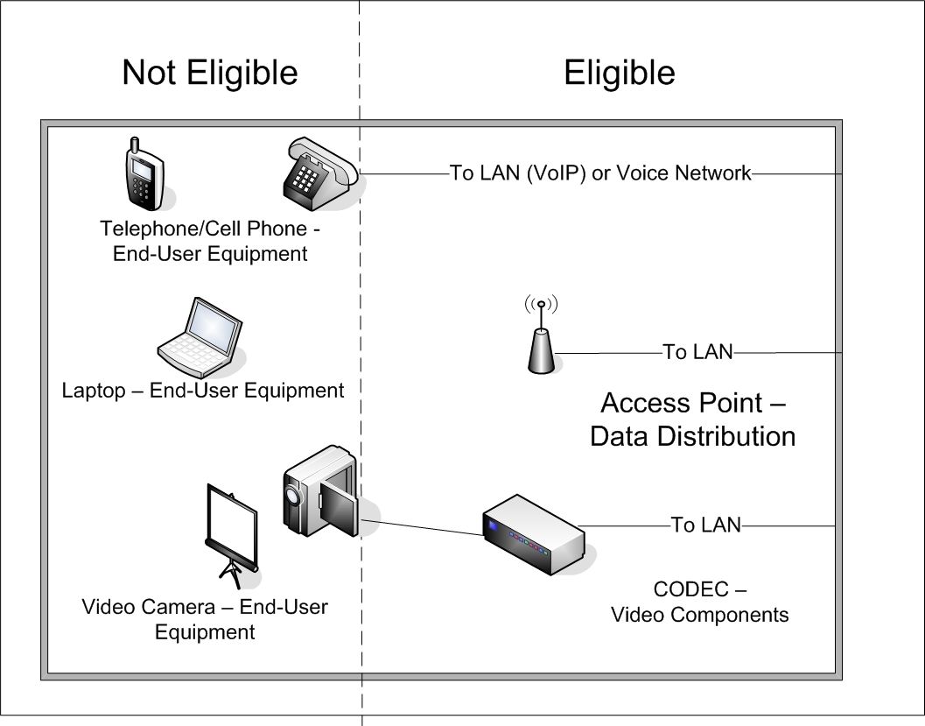
Overview
Priority Two -Internal Connections

Slide 12
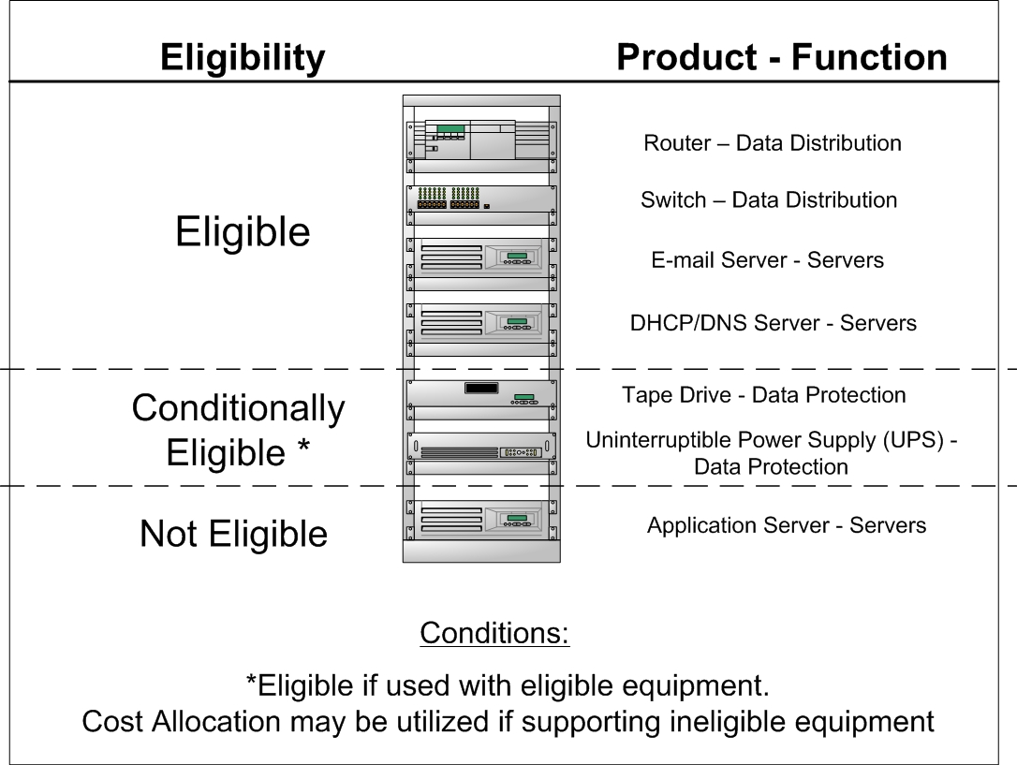
Overview
Priority Two -Internal Connections

Slide 13
Overview
Priority Two – Basic Maintenance of Internal Connections
Support for basic maintenance of eligible internal connections
Examples:
  Repair and upkeep of eligible hardware
  Wire and cable maintenance
  Basic technical support
  Configuration changes

Slide 14
Overview
Priority Two – Basic Maintenance of Internal Connections
Agreements or contracts must state the eligible components covered, make, model and location
Service must be delivered within the July 1st to June 30th timeframe
Two-in-Five Rule does not apply to BMIC

Slide 15
Eligible Services
What’s New

Slide 16
What’s New
Leased Dark Fiber for FY 2011
Leased Dark Fiber included as Telecommunications on the FY2011 Eligible Services List
Support for the lease of fiber, whether lit or dark, as a priority one service, from any entity
On the FCC Form 471, applicants should select the Telecom box if the leased fiber is provided by a telecom carrier
In all other cases, the applicant should select the Internet Access box

Slide 17
What’s New
Leased Dark Fiber for FY 2011
Dark fiber must be lit immediately
Does NOT allow for unneeded capacity or warehouse dark fiber for future use
Maintenance costs of dark fiber and installation costs to hook up the dark fiber are eligible
  This includes charges for installation within the property line
Modulating electronics for leased dark fiber are not eligible

Slide 18
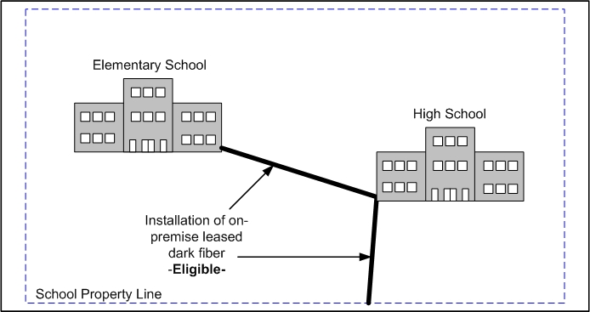
What’s New
Leased Dark Fiber Installation Diagram
Installation costs to hook up the dark fiber is eligible including charges within the property line

Slide 19
What’s New
Leased Dark Fiber for FY 2011
Special Construction charges to build out connections from applicants’ facilities to an off-premise fiber network are NOT eligible
Some examples of ineligible special construction charges include:
  Design and engineering costs
  Project management costs
  Digging trenches
  Laying fiber

Slide 20
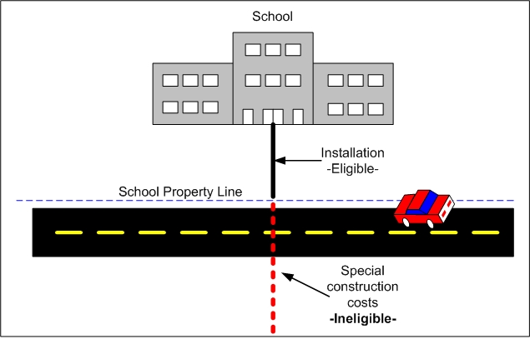
What’s New
Leased Dark Fiber Installation Diagram
Special Construction charges to build out connections from applicants’ facilities to an off-premise fiber network are NOT eligible

Slide 21
Eligible Services
Services Updates

Slide 22
Services Updates
Web Hosting
Web hosting change:
  Blogging and discussion boards are now eligible
Status quo:
  Remains eligible for discount as Internet access
  Web features including content created by third party vendors, databases for grades, student attendance files, or other reports are NOT eligible
  These ineligible web features must be cost allocated

Slide 23
Services Updates
Wireless Internet Access Applications
Wireless IA Applications update:
  Wireless service dedicated to an ineligible service or group of services will be deemed entirely ineligible
    For example, cellular service for the GPS tracking for a bus is entirely ineligible
  Bundled services will require cost allocation
    For example, a voice plan for the bus driver and a data plan for GPS tracking must be cost allocated to remove the data plan
    USAC will conduct outreach to applicants if no reasonable cost allocations were provided

Slide 24
Services Updates
Other Ineligibles
Separately priced firewalls in Priority One are not eligible
  Bundled firewalls included with Internet access service is eligible
  Firewalls are eligible as Internal Connections
Intrusion Detection/Intrusion Prevention Devices are not eligible
Anti-Spam and Anti-Virus Software are not eligible
On-line backup solutions are not eligible
Scheduling services are not eligible

Slide 25
Services Updates
Basic Maintenance of Internal Connections Clarifications
Unbundled warranties are NOT eligible
Unbundled warranties allow for broken equipment to be fixed or if it is beyond repair, replaced
Unbundled warranties are considered a type of retainer and not as an actual maintenance service
This does not apply to a manufacturer’s warranty of no more than three years that is included in the price of the equipment OR
If the retainer is tied to actual service performed

Slide 26
Services Updates
Basic Maintenance of Internal Connections
Applicants may make estimates based on:
  Hours per year of maintenance
  History of needed repairs and upkeep
  Current life of eligible internal connections
Basic maintenance will be paid on the actual work performed and hours used only

Slide 27
Eligible Services
Questions?

