Slide 1
Authorizations & User Management in RHC Connect
Third-Party Authorizations and Letters of Agency/Letters of Exemption
January 21, 2026

Slide 2

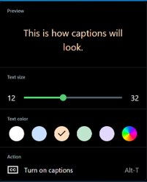


Housekeeping – Closed Captioning (CC)
Attendees control their own captioning.
You control the caption font size and color.
Toggle CC off and on at your preference.
Captions ON
Captions OFF

Slide 3
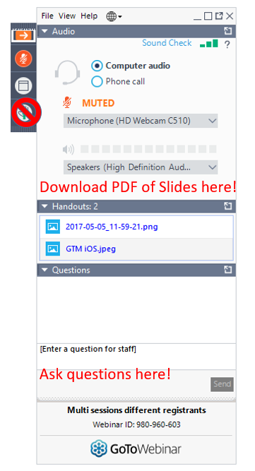
Housekeeping
Use the “Audio” section of your control panel to select an audio source and connect to sound
  Turn on your computer’s speakers, or
  Use the call-in instructions in your confirmation email
All participants are on mute
Submit questions at any time using the “Questions” box
Slides attached to GoToWebinar Panel and will be posted with the recording to the Webinars webpage

Slide 4


Meet Our Team
Blythe Albert
Ecatarina Grant
Advisor of Program Management | RHC Outreach
Manager of Communications | RHC Outreach

Slide 5
Agenda
Introduction - Authorizations
Submitting Third-Party Authorizations (TPA) in RHC Connect
  FCC Form 460 and FCC Form 460 Revision
  Consultant Groups
  Primary and Secondary Account Holders
Submitting Letters of Agency (LOA) and Letters of Exemption (LOE) in RHC Connect
Best Practices and Resources

Slide 6
Glossary
Acronym | Definition
FCC | Federal Communications Commission
HCF | Healthcare Connect Fund
FY | Funding Year
HCP | Health Care Provider (your site)
HCP Number | Number associated with your site or consortium
PAH | Primary Account Holder
TPA | Third-Party Authorization
LOA | Letter of Agency
LOE | Letter of Exemption

Slide 7
Introduction - Authorizations
Authorizations & User Management in RHC Connect

Slide 8
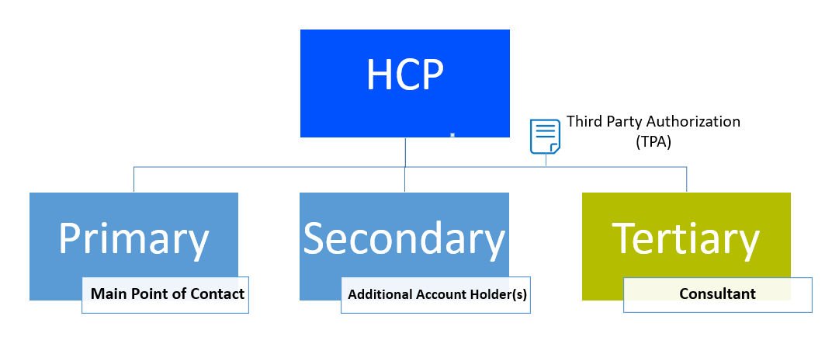
Types of Account Holders
Primary Account Holder (PAH)
  Must work for the legal entity of the HCP
  Responsible for the accuracy of information submitted to USAC
  Can only be one individual
  Mandatory for every HCP
  Responsible for keeping all account holder information current
Secondary Account Holder
  Must work for the legal entity of the HCP
  Responsible for the accuracy of information submitted to USAC
  Can have multiple secondary account holders
Tertiary Account Holder
  Must have a valid Third-Party Authorization (TPA)
  TPAs are uploaded to the FCC Form 460 upon submission or on their own in RHC Connect

Slide 9
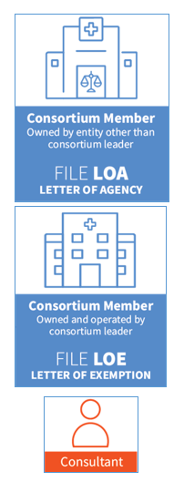
Authorizations
Letter of Agency (LOA) - Provides written authorization for the Project Coordinator to act on behalf of each participating health care provider (HCP) within the consortium.
  This is mandatory for HCP member sites not owned and operated by the Consortium Leader.
Letter of Exemption (LOE) - Provides written authorization to the Project Coordinator to file forms for sites that are owned and operated by the Consortium Leader.
Third Party Authorization (TPA) - Provides written authorization for a third party/consultant to complete and submit forms on behalf of an HCP.

Slide 10
RHC Connect - Updates
Authorizations & User Management in RHC Connect

Slide 11
RHC Connect - TPA and User Management
Do not submit third-party authorizations (TPAs) in My Portal or through the RHC Customer Service Center.
Submit all TPAs and manage Consultant Groups using the following online resources:
  Third-Party Authorization webpage
  RHC Connect User Guide - TPA
The decommissioning of My Portal has been pushed back to the middle of calendar year (CY) 2026.
  TPAs will not be migrated to RHC Connect.
  Continue to track your TPAs expiration date(s) in RHC Connect as email reminders will not be sent.
  The RHC outreach team will continue to provide information about important deadlines and the decommissioning of My Portal.

Slide 12
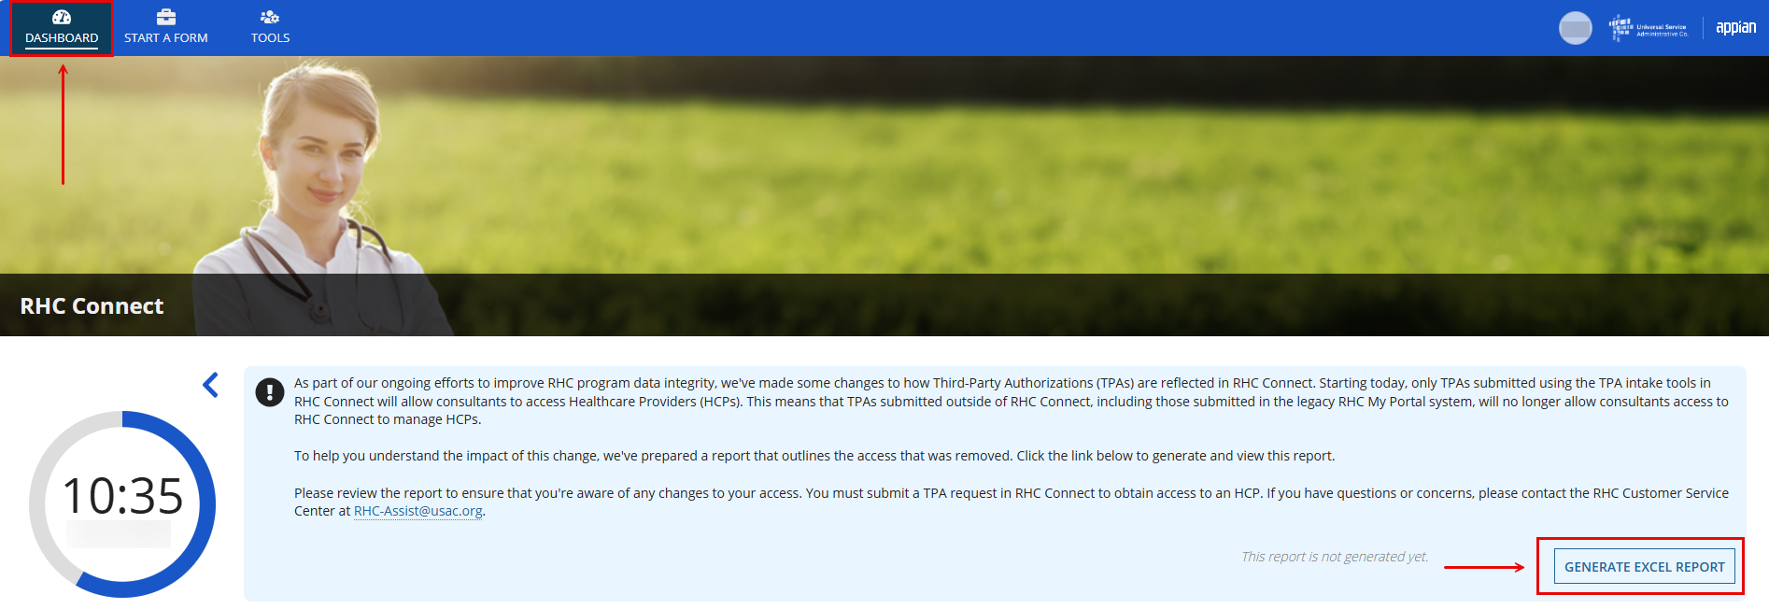
TPA REPORT
Excel download is available on the RHC Dashboard.
Includes information about all HCPs consultants have access to and those that have not yet moved to RHC Connect..

Slide 13
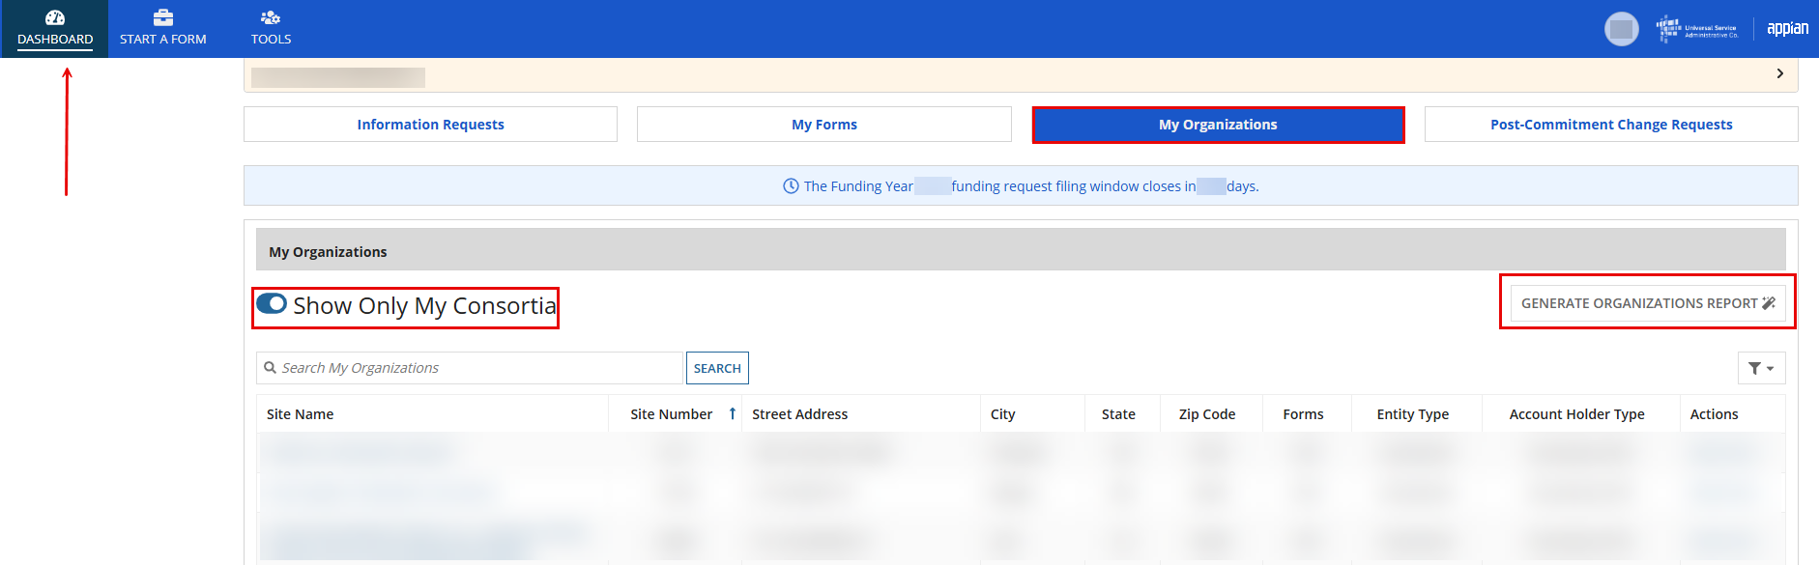
Organizations Report
Excel download is available on the My Organizations tab.
Includes information about all HCPs consultants have access to.

Slide 14
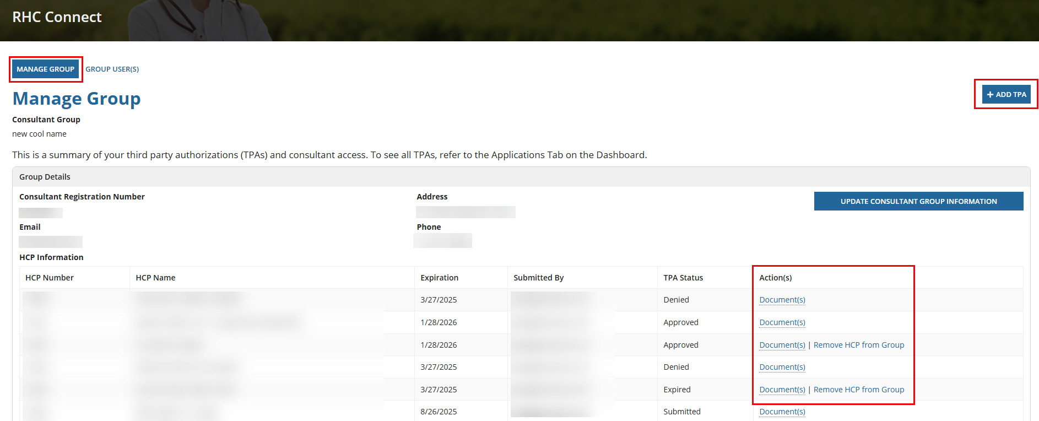
TPA Information
For complete information, do not use the TPA page under the My Forms tab.
Navigate to Tools-> Manage Consultant Groups -> Manage Group

Slide 15
Submitting TPAs in RHC Connect -
FCC Form 460 or FCC Form 460 Revision
Authorizations & User Management in RHC Connect

Slide 16
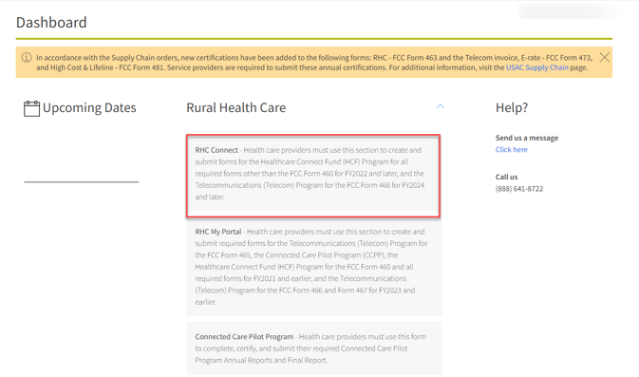
My Portal Landing Page
Log into My Portal and click RHC Connect.

Slide 17
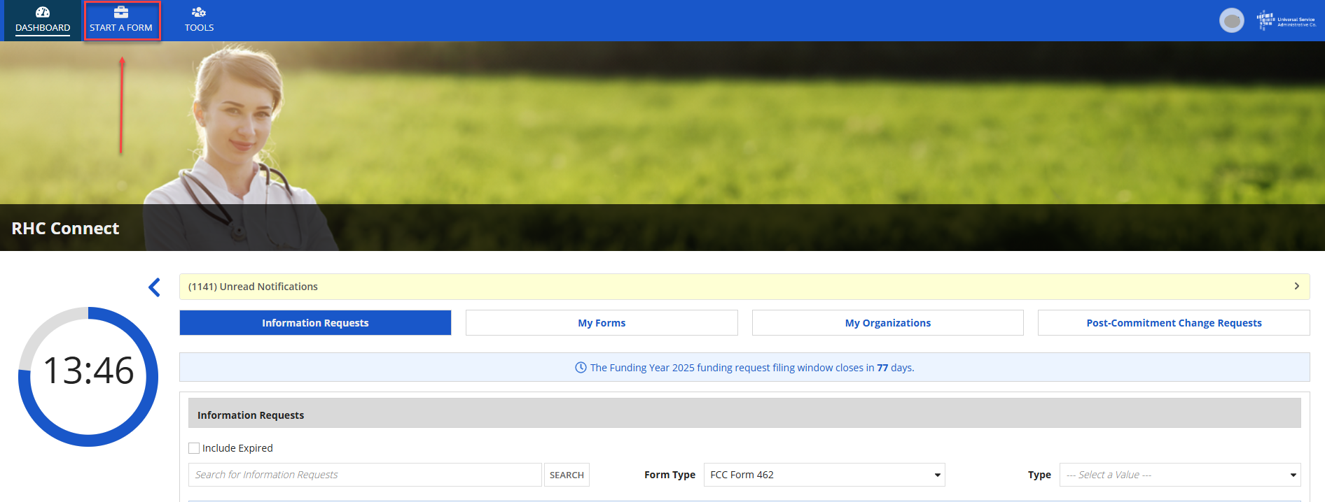
Start a Form
On the Dashboard, click Start a Form.

Slide 18
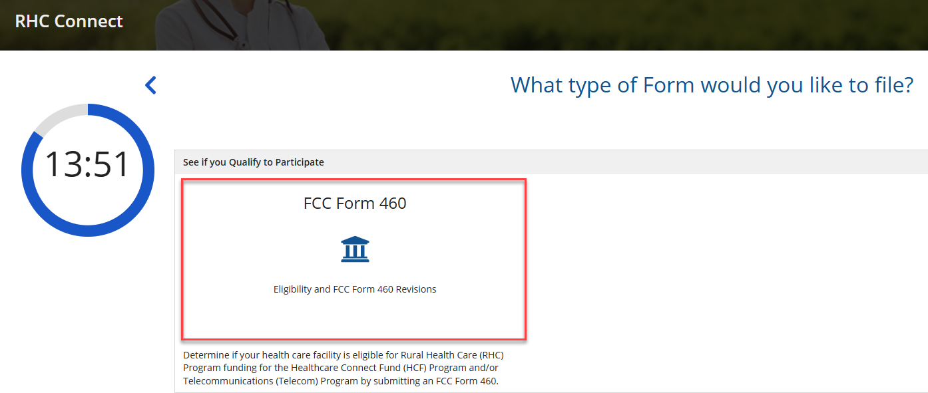
FCC Form 460
Click FCC Form 460 then click Next (bottom right on the screen).

Slide 19
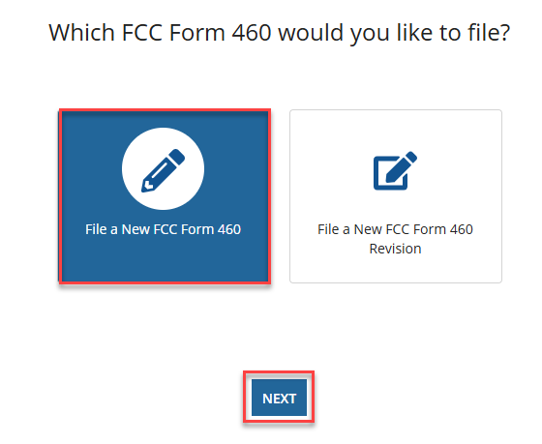
FCC Form 460
Click File a New FCC Form 460. Then click Next.
Same process for File a New FCC Form 460 Revision.

Slide 20
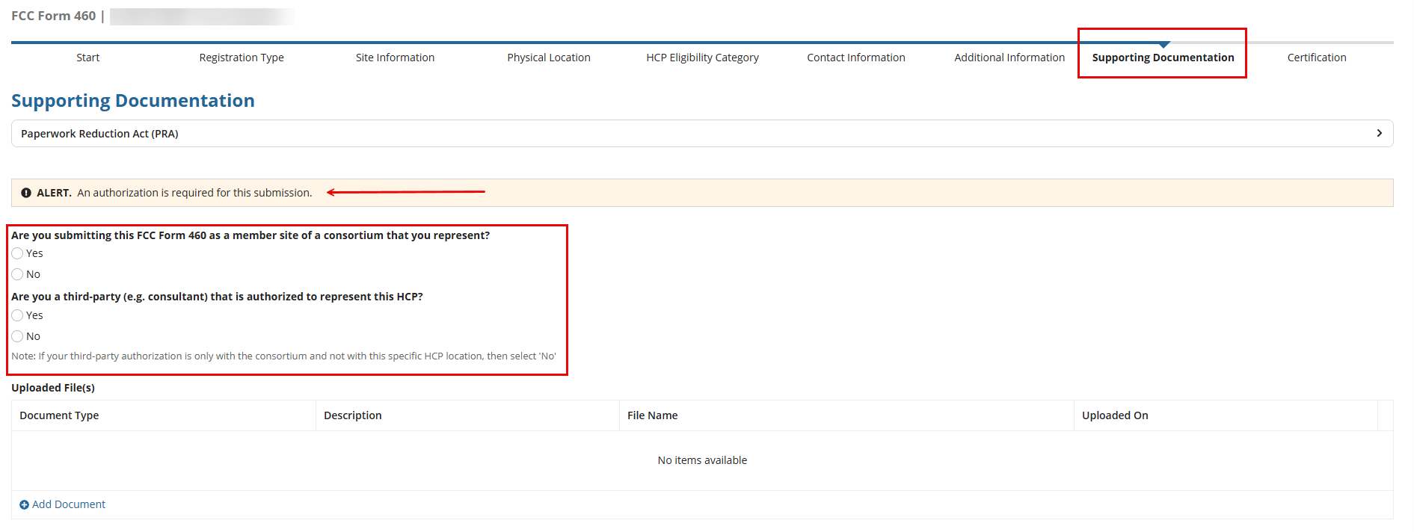
FCC Form 460 – Supporting Documentation
Follow all steps for submitting an FCC Form 460.
On the Supporting Documentation tab, answer the questions and upload the TPA or LOA as applicable.

Slide 21
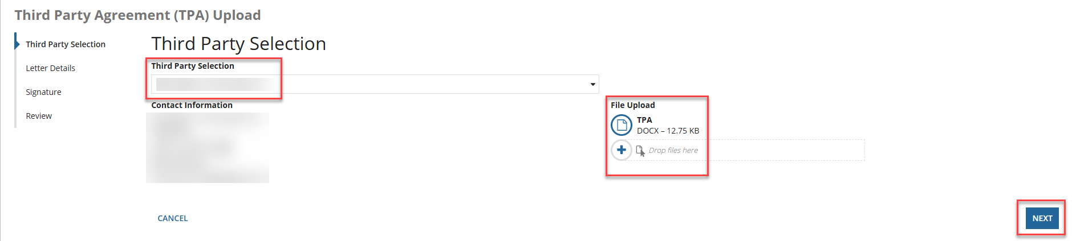
TPA Upload – Third Party Selection
Information is prepopulated based on information about consultant group in the system.
Third-parties are required to upload the TPA document.
Click upload under File Upload, then click Next.

Slide 22
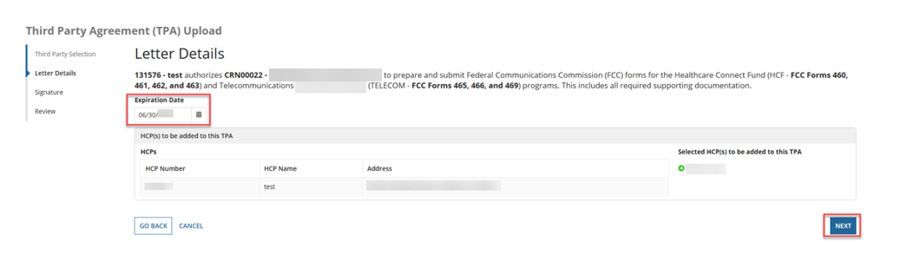
TPA Upload – Letter Details
Enter the Expiration Date.
Information for the HCP will be prepopulated.
Click Next.

Slide 23
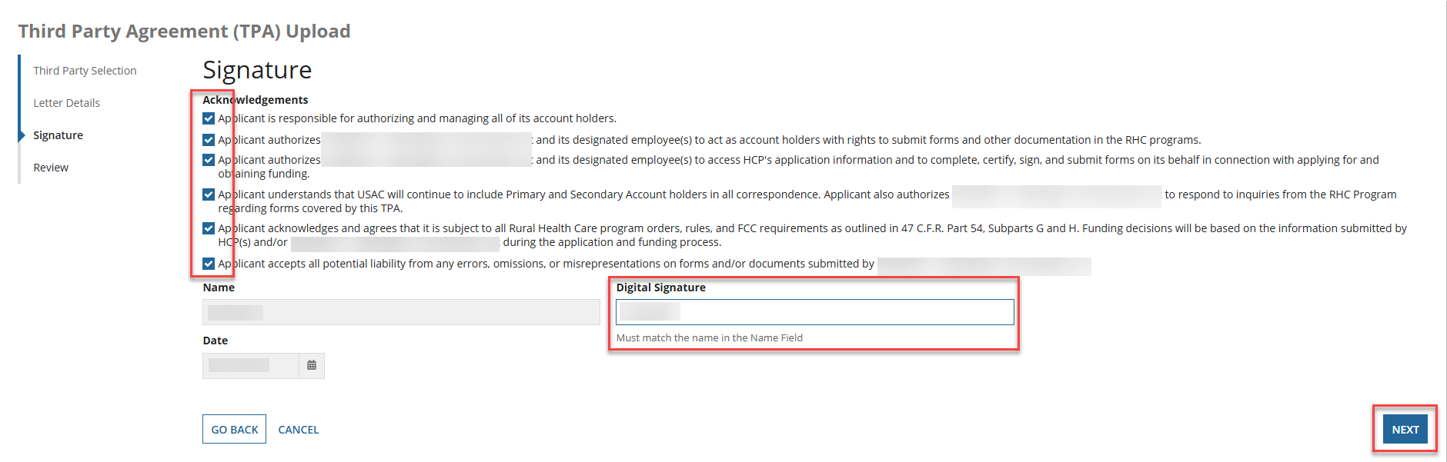
TPA Upload - Signature
Click all the Acknowledgements and type your full name as it appears in RHC Connect in the Digital Signature field.
Then click Next.

Slide 24
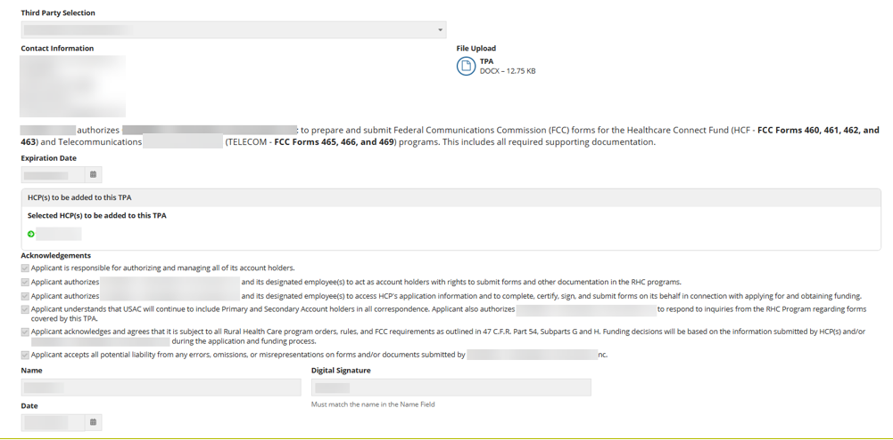
Review
Review the information, then click Submit.

Slide 25
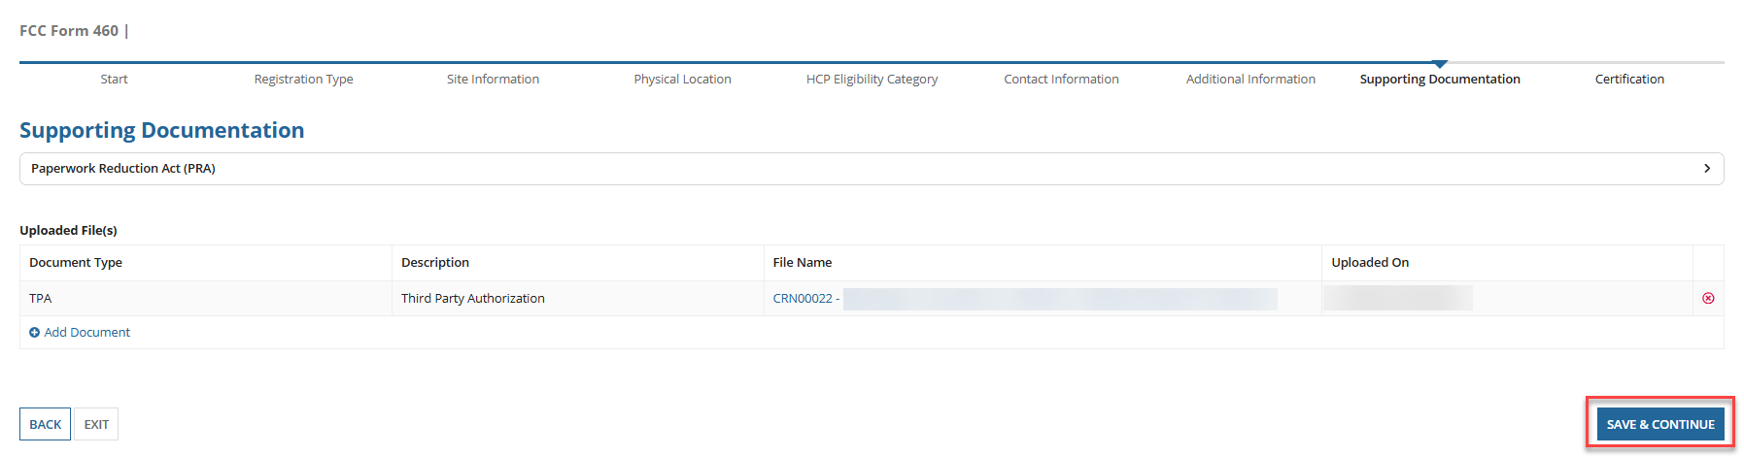
Submit FCC Form 460
Continue with steps to submit the FCC Form 460.

Slide 26
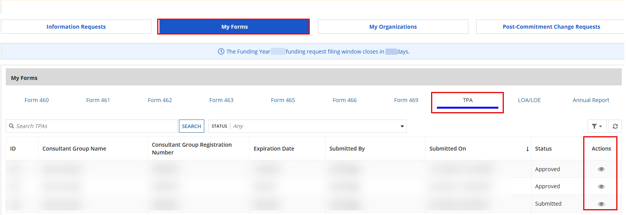
My Forms Tab
To view TPAs, navigate to the My Forms tab on the Dashboard and click on the TPA hyperlink.
Click on the “eye” icon under the Action(s) column.

Slide 27
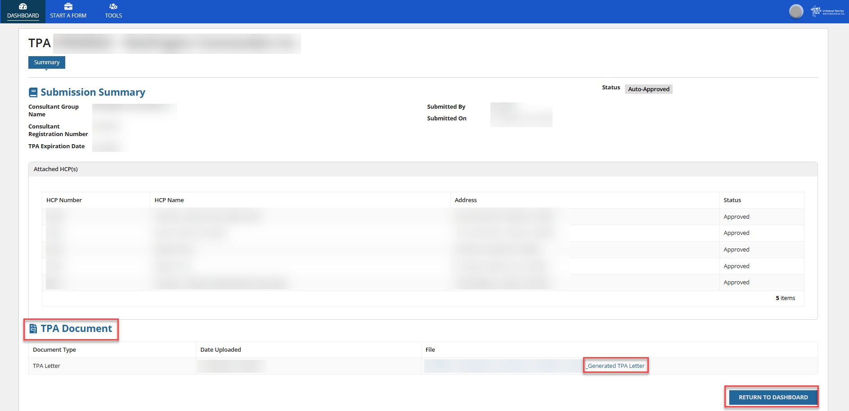
TPA – Summary Screen
To view the system generated TPA, click the hyperlink under the TPA Document section.
If you uploaded a TPA, it would also appear in the TPA Document section.
To return to the Dashboard, click Return to Dashboard.

Slide 29
Submitting TPAs in RHC Connect -
Consultant Groups
Authorizations & User Management in RHC Connect

Slide 30
My Portal Landing Page
Log into My Portal and click RHC Connect.

Slide 31

RHC Connect Dashboard
On the Dashboard, click Tools.

Slide 32
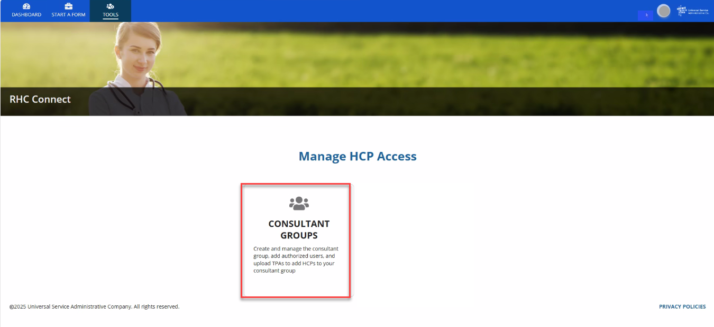
Manage HCP Access
Click Consultant Groups.

Slide 33
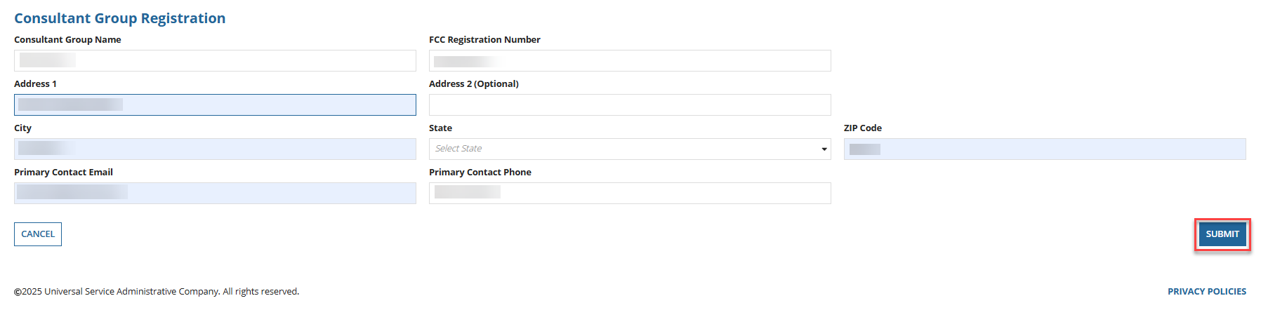
Consultant Group Registration
Enter information about the consultant group in the fields, then click Submit.

Slide 34
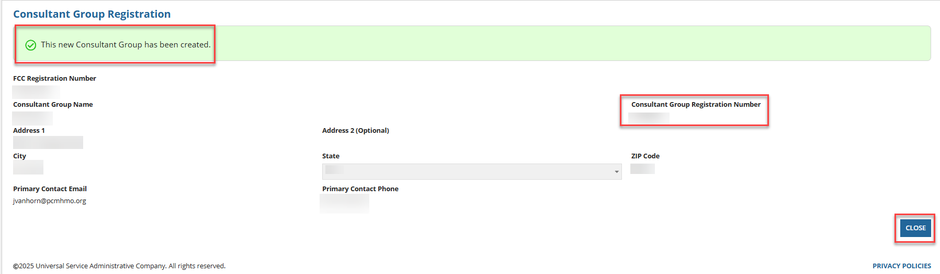
Consultant Group Registration - Confirmation
Each consultant group is assigned a Consultant Group Registration Number.
Click Close to continue.

Slide 35
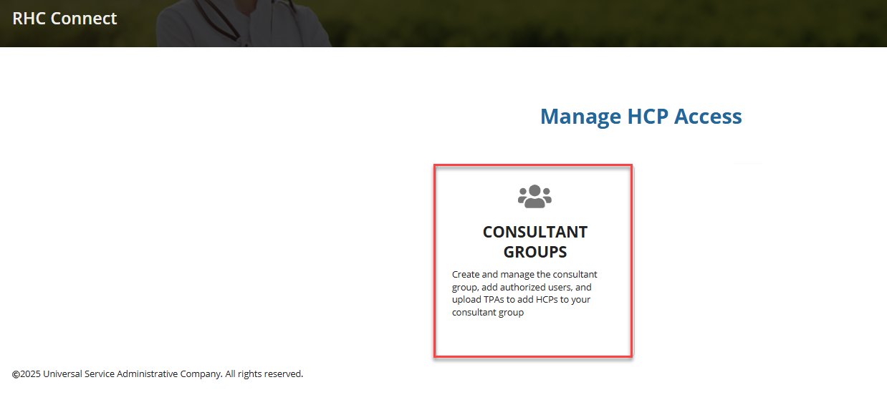
Manage HCP Access
Click Consultant Groups.

Slide 36
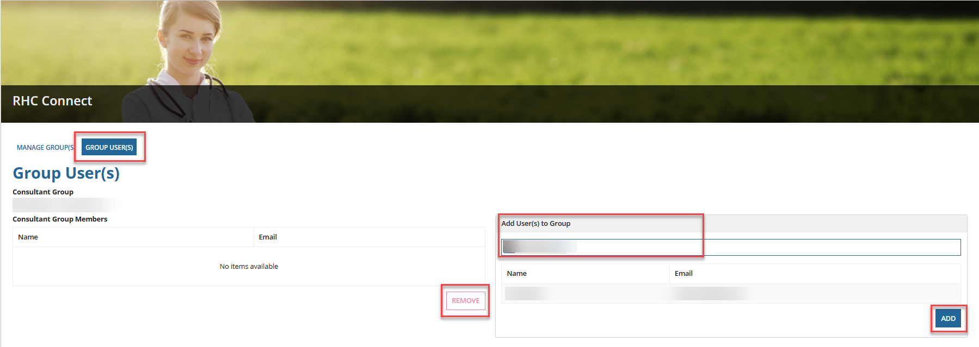
Group Users – Adding Users
Click Group Users and enter user information in the Add User(s) to the Group field.
Added user must have created their user profile using Multi-Factor Authentication.
To remove users, select the user and click Remove.

Slide 37
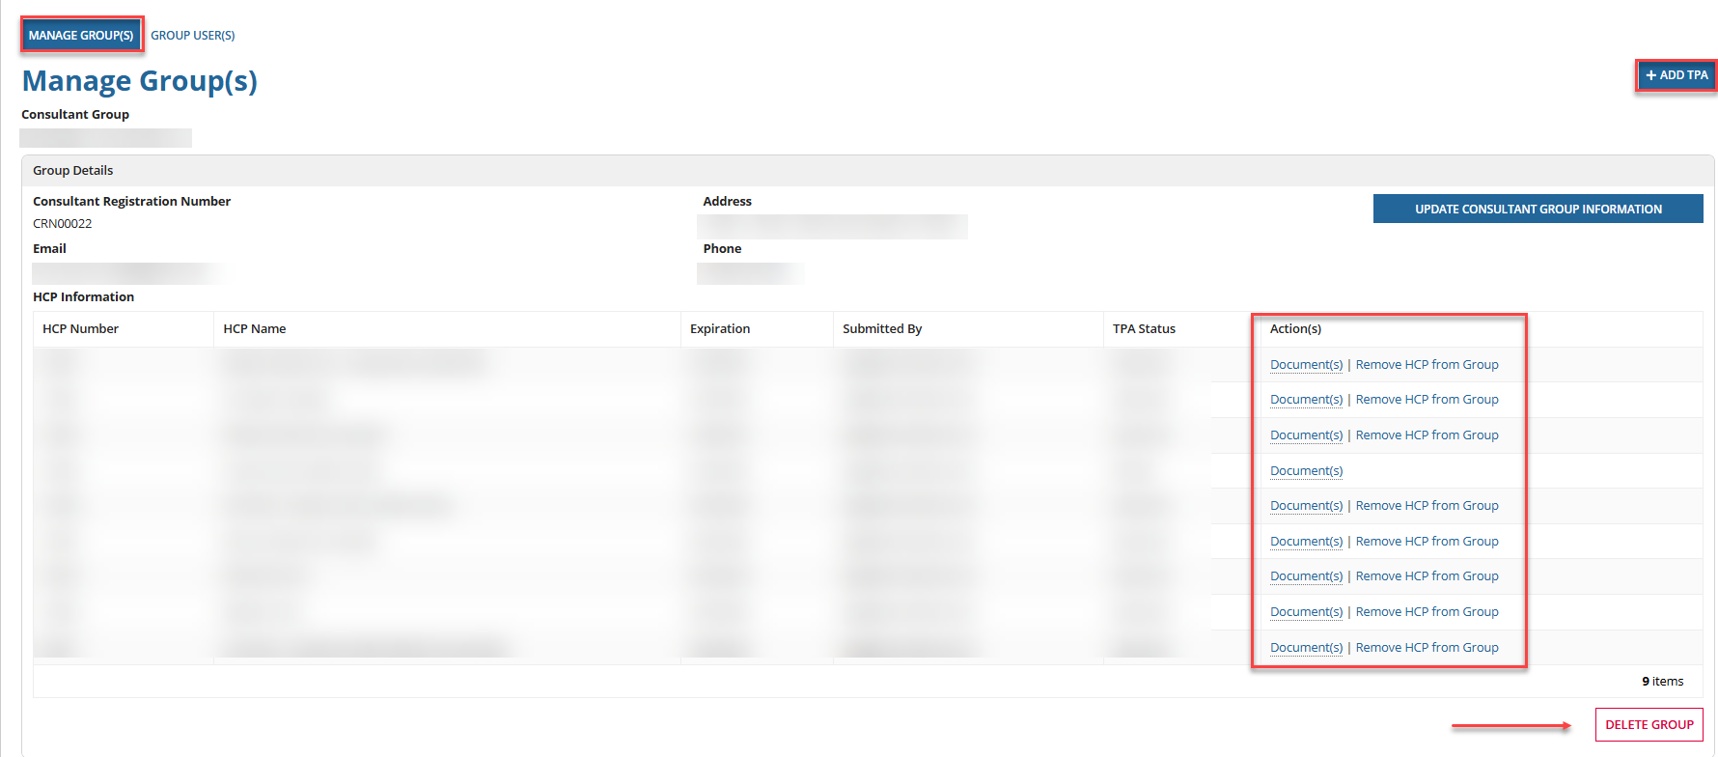
Manage Groups Tab
All HCPs will be displayed.
To view a document or remove an HCP from the group, click the hyperlinks under the Action(s) column.
To delete the consultant group, click Delete Group.
To add a TPA, click +Add TPA.

Slide 38
TPA Upload – Third Party Selection
Information is prepopulated based on information about consultant group in the system.
Third-parties are required to upload the TPA document.
Click upload under File Upload, then click Next.

Slide 39
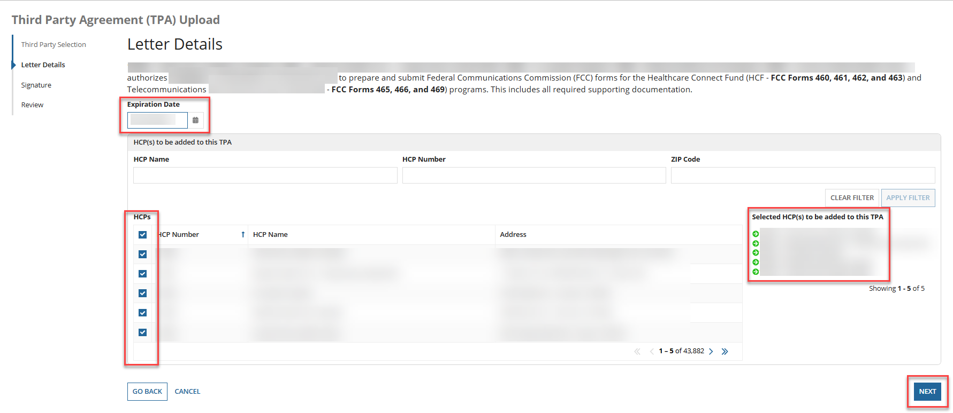
TPA Upload - Letter Details
Enter the Expiration Date, then select HCPs using the filters.
Selected HCPs will appear on the right under Selected HCP(s) to be added to this TPA.
Click Next.

Slide 40
TPA Upload - Signature
Click all the Acknowledgements and type your full name as it appears in RHC Connect in the Digital Signature field.
Then click Next.

Slide 41
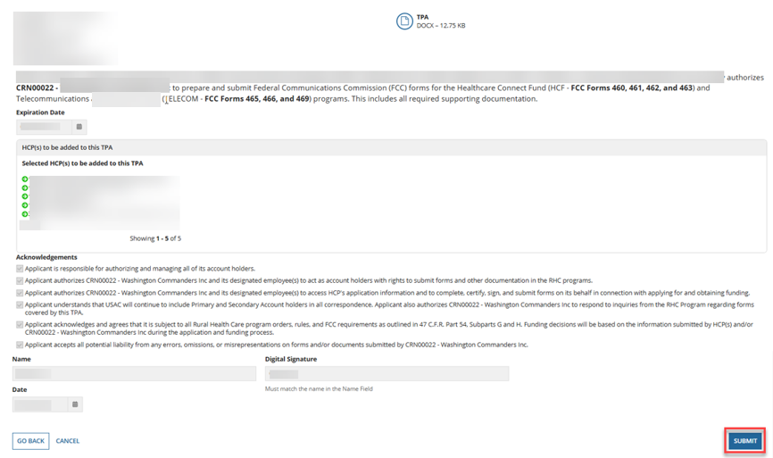
Review
Review the information, then click Submit.

Slide 42
My Forms Tab
To view TPAs, navigate to the My Forms tab on the Dashboard and click on the TPA hyperlink.
Click on the “eye” icon under the Action(s) column.

Slide 43
TPA – Summary Screen
To view the system generated TPA, click the hyperlink under the TPA Document section.
Uploaded TPA, it will also appear in the TPA Document section.
To return to the Dashboard, click Return to Dashboard.

Slide 44
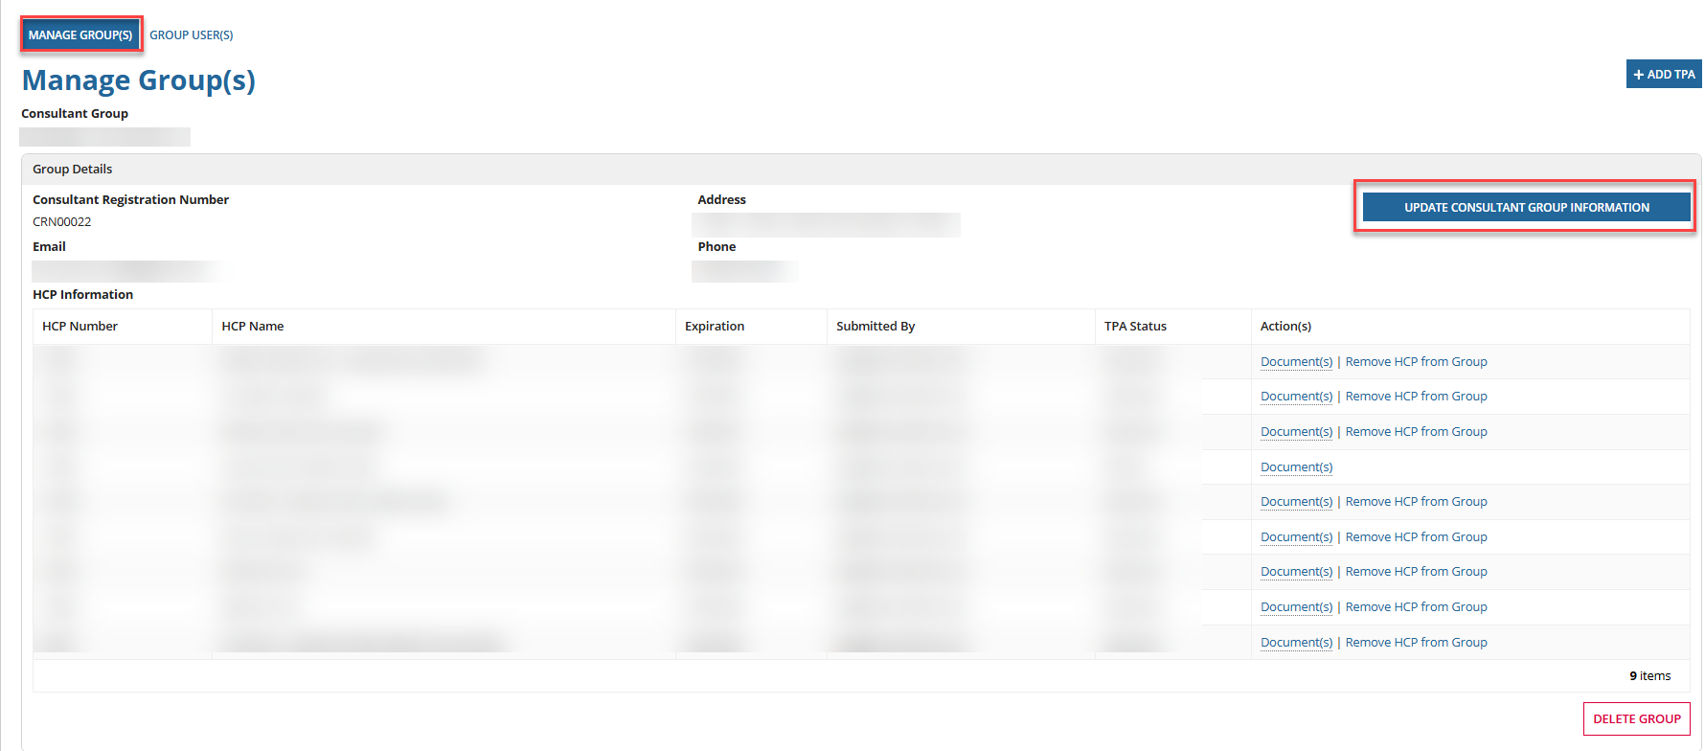
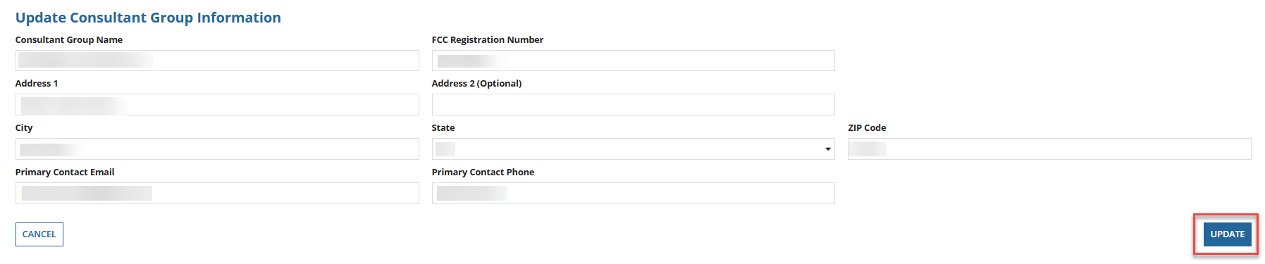
Update Consultant Group Information
Go to the Manage Group(s) section and click Update Consultant Group Information.
Edit the information, then click Update.

Slide 45
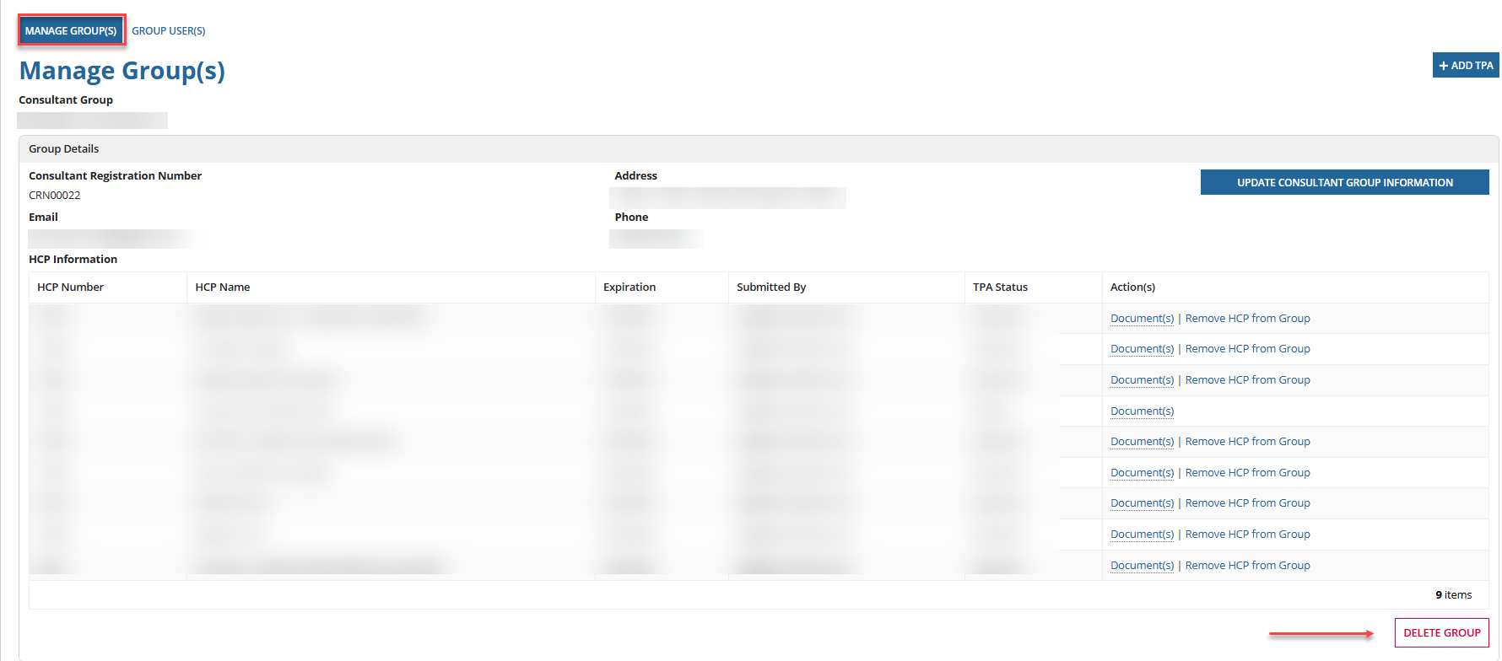
Delete Consultant Group
To delete a consultant group, click Delete Group.

Slide 47
Submitting TPAs in RHC Connect -
Primary & Secondary Account Holders
Authorizations & User Management in RHC Connect

Slide 48
My Portal Landing Page
Log into My Portal and click RHC Connect.

Slide 49
RHC Connect Dashboard
On the Dashboard, click Tools.

Slide 50
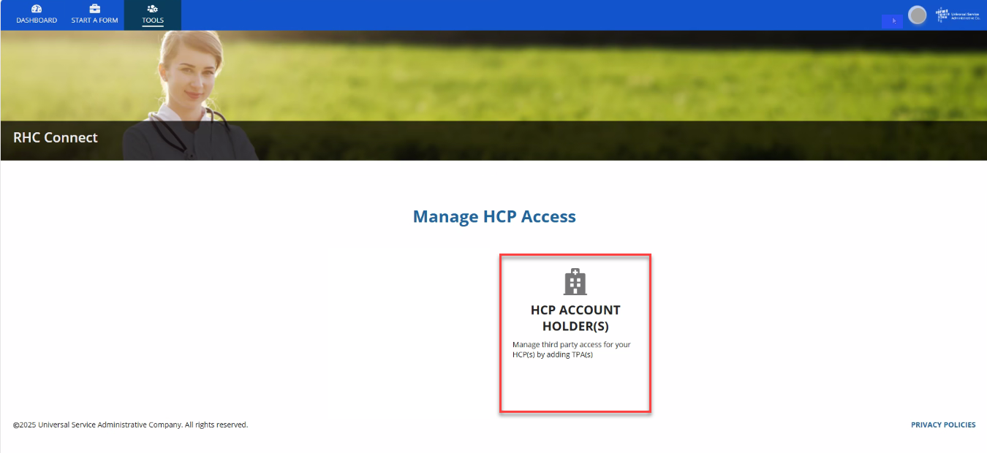
Manage HCP Access
Click HCP Account Holder(s).

Slide 51
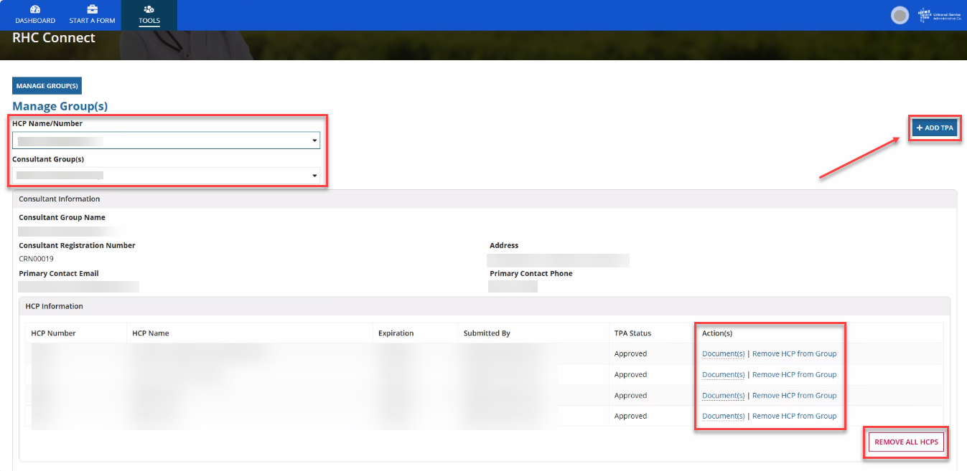
Manage Groups
Select the HCP(s) from the dropdown menu.
Select the Consultant Group from the dropdown menu.
To remove an HCP, click the hyperlink under the Action(s) column.
Click Remove All HCPs to remove all HCPs.
Click Add TPA.

Slide 52
TPA Upload – Third Party Selection
Select the consultant group from the Third-Party Selection dropdown menu.
Information about the consultant group will prepopulate.
Uploading the TPA document is optional for the Primary and Secondary Account Holders.
Add the document, then click Next.

Slide 53
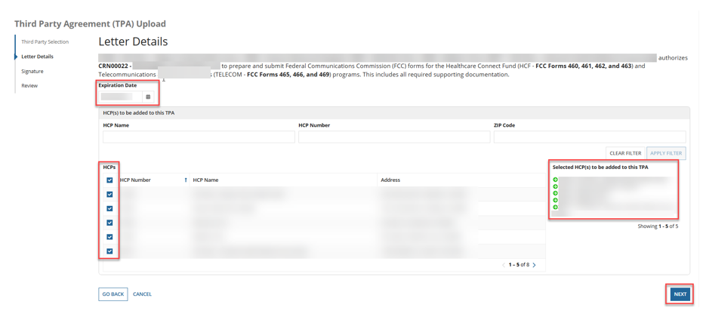
TPA Upload – Letter Details
Select the Expiration Date using the dropdown calendar.
To add HCPs to the TPA, click the box beside each HCP or click the box next to HCP Number to select all.
The selected HCPs will appear under Selected HCP(s), then click Next.

Slide 54
TPA Upload - Signature
Click all the Acknowledgements and type your full name as it appears in RHC Connect in the Digital Signature field.
Then click Next.

Slide 55
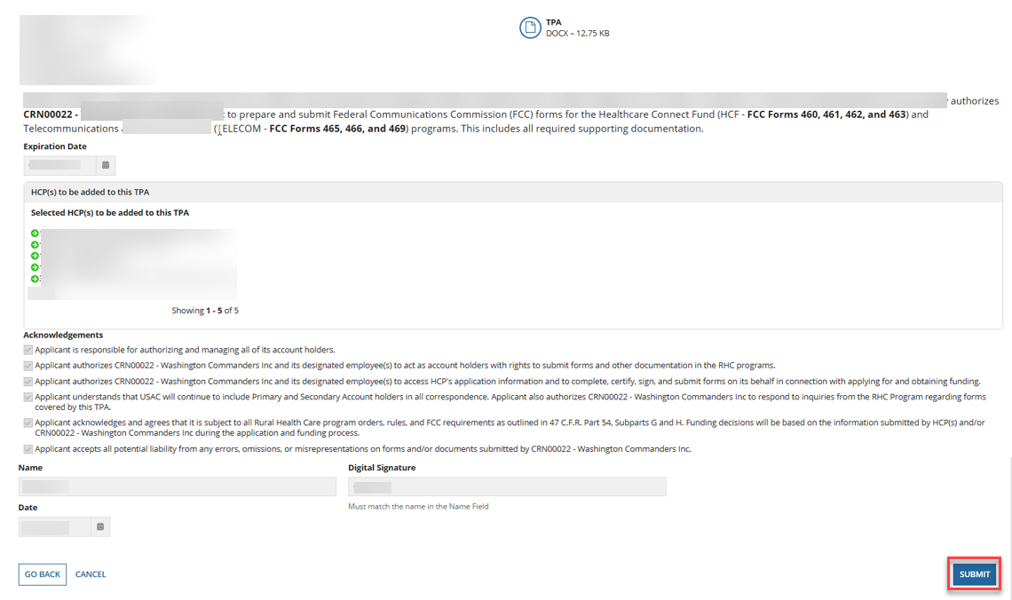
Review
Review the information, then click Submit.

Slide 56
My Forms Tab
To view TPAs, navigate to the My Forms tab on the Dashboard and click on the TPA hyperlink.
Click on the “eye” icon under the Action(s) column.

Slide 57
TPA – Summary Screen
To view the system generated TPA, click the hyperlink under the TPA Document section.
If you uploaded a TPA, it would also appear in the TPA Document section.
To return to the Dashboard, click Return to Dashboard.

Slide 58
Questions?
58

Slide 59
Submitting LOAs and LOEs in RHC Connect
Authorizations & User Management in RHC Connect

Slide 60
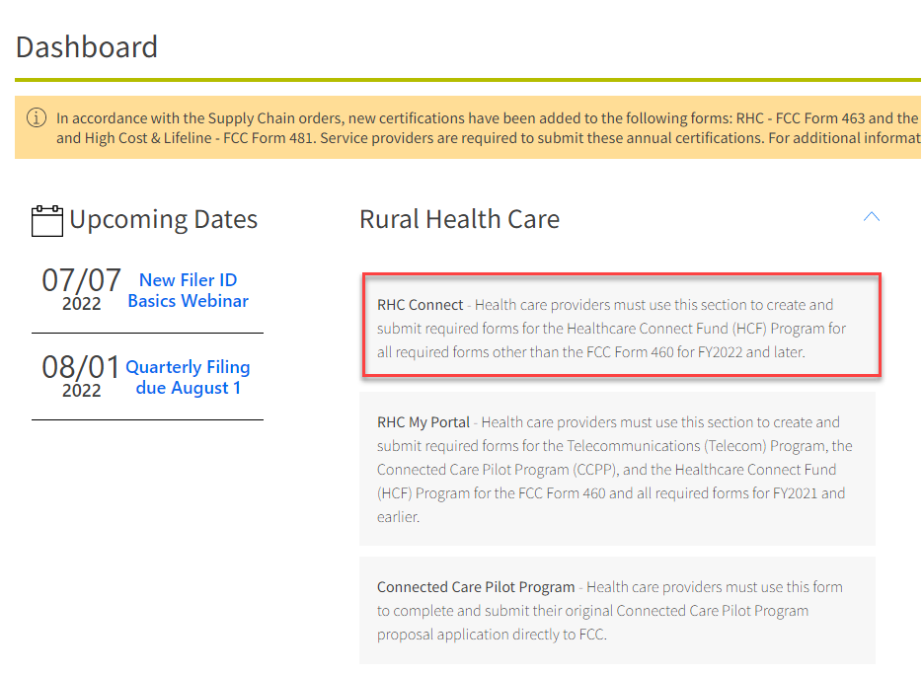
My Portal Landing Page
Log into My Portal and click on RHC Connect.

Slide 61
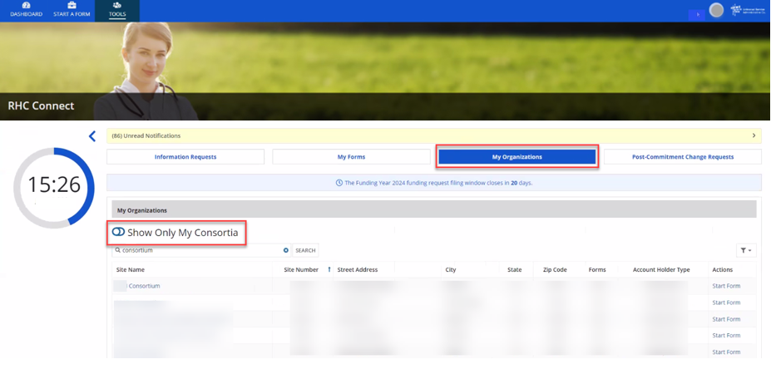
RHC Connect Dashboard
Click My Organizations tab.
All consortia are displayed when toggle beside Show Only My Consortia is closed.

Slide 62
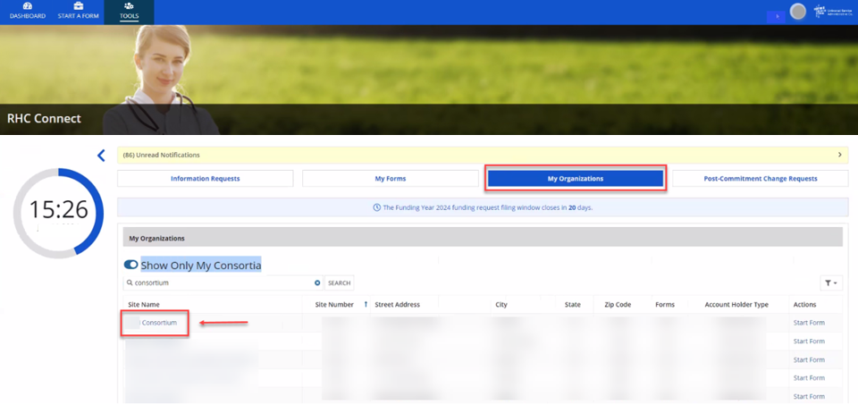
RHC Connect Dashboard (continued)
Open the toggle beside Show Only My Consortia to display your consortia.
Click hyperlink for consortium the LOA is for.

Slide 63
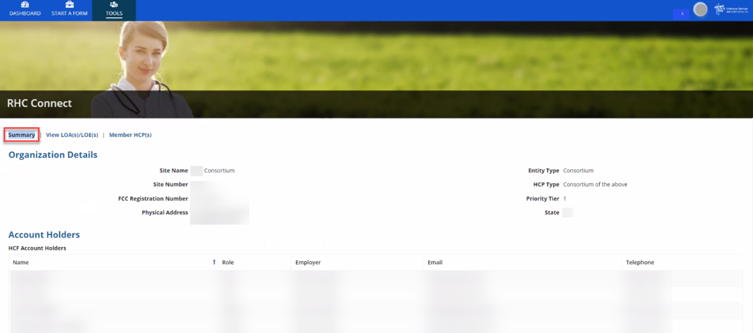
Summary Screen
Information is displayed about the Consortium Leader and all Account Holders.

Slide 64
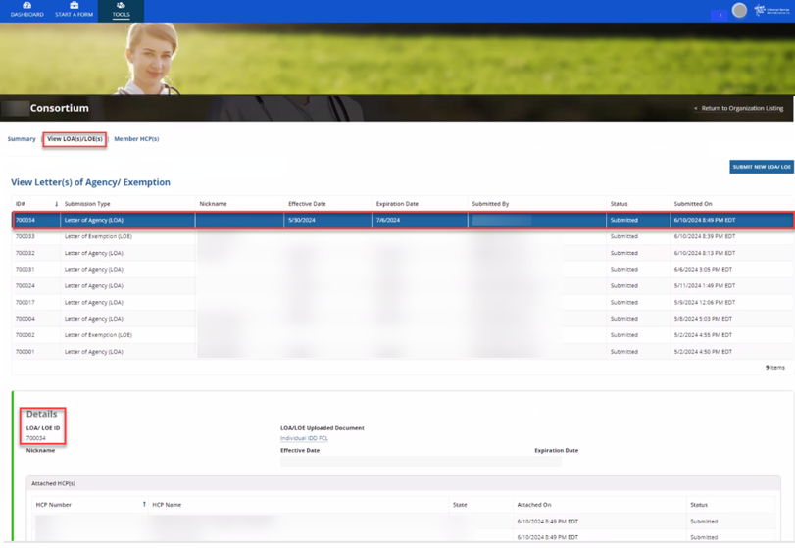
View LOA(s)/LOE(s) Screen
All LOA(s) and LOE(s) for the consortium are displayed.
Click on an existing LOA or LOE to view the Details.

Slide 65
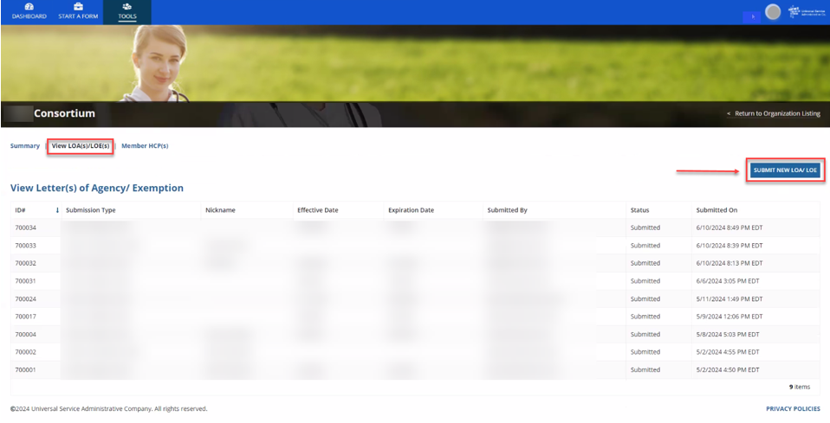
View LOA(s)/LOE(s) Screen (continued)
Click Submit New LOA/LOE.

Slide 66
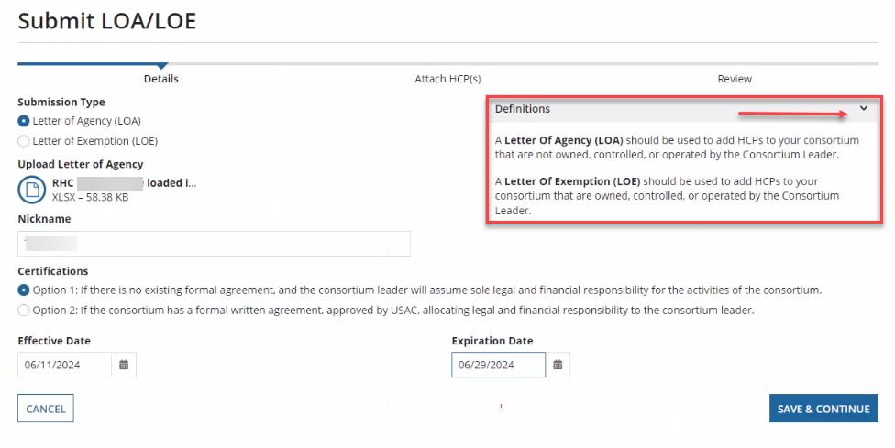
Submit LOA/LOE - Details
Click the arrow beside Definitions to view a description of Letter of Agency (LOA) and Letter of Exemption (LOE).

Slide 67
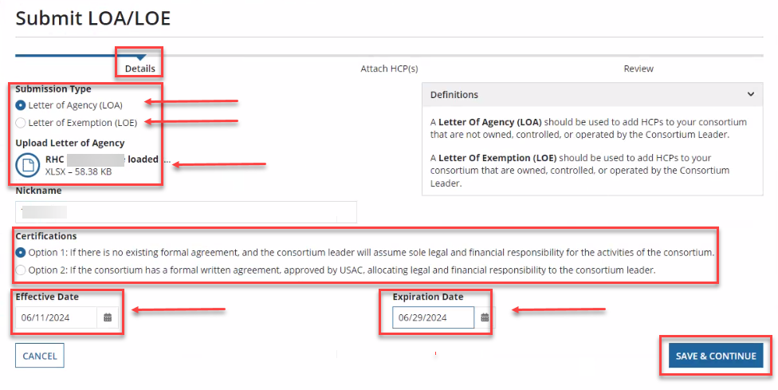
Submit LOA/LOE – Details (continued)
Click correct radio button under Submission Type and upload document.
Enter a nickname and select Option 1 or Option 2 under Certifications.
Select the Effective Date and the Expiration Date from the dropdown calendar, then click Save & Continue.

Slide 68
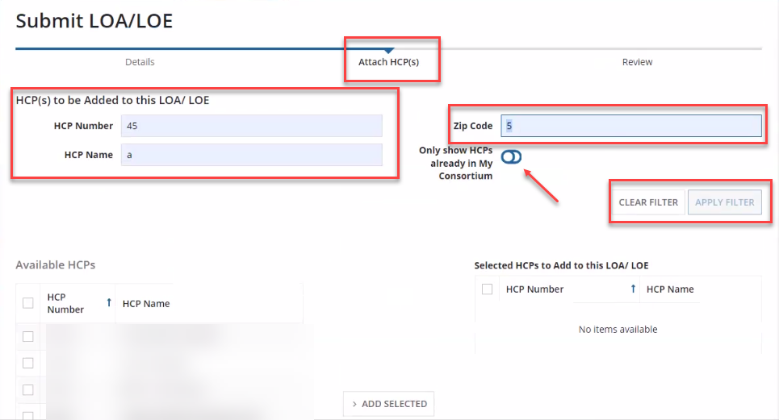
Attach HCP(s)
Search by HCP Number, HCP Name or Zip Code, then click Apply Filter.
Open the toggle to show sites already in the consortium.

Slide 69
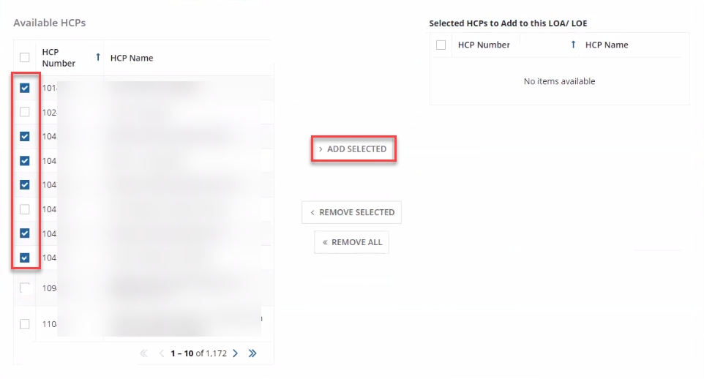
Attach HCPs (continued)
Select the HCPs to attach, then click Add Selected.

Slide 70
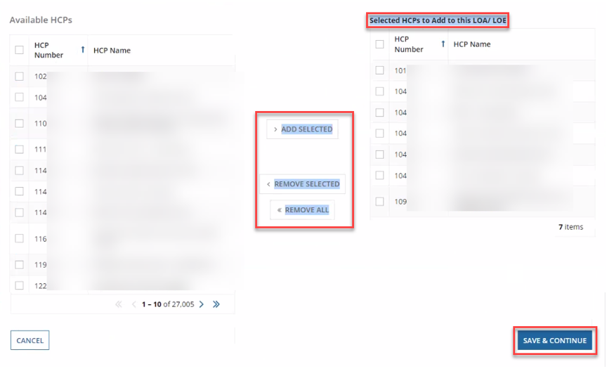
Attach HCPs (continued)
Selected HCPs will move to column on the right.
Click Remove Selected or Remove All if the HCP(s) was selected incorrectly.
Once all HCPs are added, click Save & Continue.

Slide 71
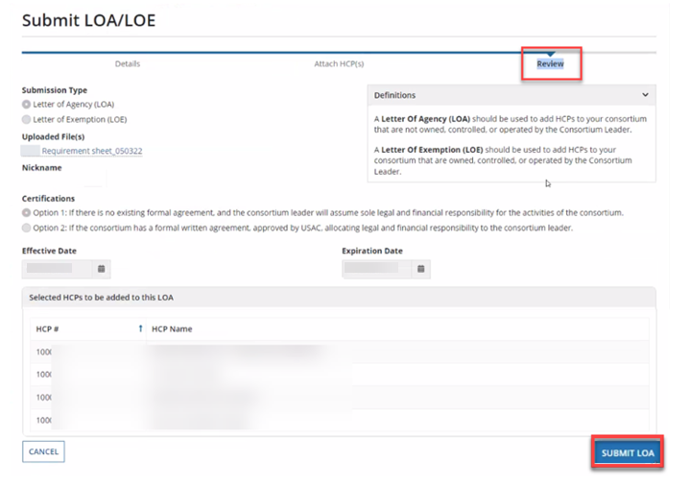
Review
Review information, then click Submit LOA.

Slide 72
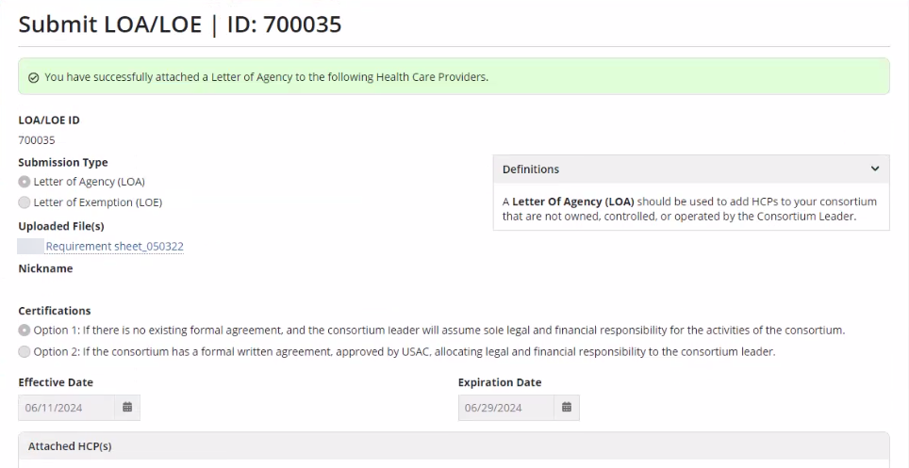
After Submitting
Message in green banner confirms LOA was successfully submitted.

Slide 73
Best Practices and Resources
Authorizations & User Management in RHC Connect

Slide 74
Best Practices
Keep all authorizations up to date.
The PAH is responsible for keeping authorizations current.
If the PAH is leaving the organization, submit an FCC Form 460 revision to update contact information for the new PAH prior to leaving.
Be sure all uploaded documents are complete and include all required information.
  Use online templates.
USAC cannot make any changes on your behalf.

Slide 75
Online Resources
Authorizations webpage
Consultants & Third Parties webpage
Third Party Authorization webpage
RHC Connect User Guide – Third-Party Authorization
Letter of Agency webpage
Sample LOA
Letter of Exemption webpage
RHC Connect LOA/LOE Submission User Guide
Webinars webpage - Consortium Best Practices webinars

Slide 76
Upcoming Trainings
Please join the RHC Outreach team for the following webinars:
Consortium Best Practices Webinar:
  When: Wednesday, January 28, 2026, from 2-3 p.m. ET - Register
HCF Program Office Hours Webinar:
  When: Wednesday, February 4, 2026, from 2-3 p.m. ET - Register
Telecom Program Office Hours Webinar:
  When: Wednesday, February 11, 2026, from 2-3 p.m. ET - Register
For a list of upcoming webinars, check the RHC Upcoming Dates webpage for dates and details.

Slide 77


RHC Program Customer Service Center
Email: RHC-Assist@usac.org
Include in your email:
  HCP Number
  FRN Number
Phone: (800) 453-1546
  Hours are 8 a.m. – 8 p.m. ET
  Monday- Friday

Slide 78
The RHC Customer Service Center
The RHC Customer Service Center CAN | The RHC Customer Service Center CANNOT
Answer general questions regarding both programs | Determine eligibility of a specific site or service before an official form submission
Provide account holder information for an HCP | Review a form or document for accuracy before an official submission
Provide clarity regarding FCC Report and Order 19-78 and other FCC orders | Contact a service provider or other account holder on someone else’s behalf
Provide helpful resources and best practices for forms | Provide documents that are not already accessible in My Portal and RHC Connect
Assist with My Portal and RHC Connect | Transfer a call to a specific form reviewer

Slide 79
Questions?
79

Slide 80


